Slide 1
CSE 546 Final Project
Solving reinforcement algorithms on environments under uncertainty
Team 22: Antarpreet Kaur, Kanupriya Pandey, Veda Sai Rochishna Eli
05/07/2023

Slide 2
Project Overview
The project explores performance of multiple popular algorithms on Gym or Gymnasium environments under uncertainty.
The gymnasium discrete space environments are deterministic implying that an agent's actions have consistent effects on the environment's state. The project augments the gymnasium environments with stochastic factors such as aerodynamic disturbances, such as wind noise and random engine failures.
The objective of introduction of noise is the environments is to incorporate a degree of unpredictability into the agent's decision-making algorithm, thereby rendering the environment more demanding and less deterministic.

Slide 3
Project Overview
The project gymnasium environment modified by adding noise are Cat Pole v1 environment which is part of the classic control environments, and Lunar Lander v2 which is part of the Box2d environments.
The algorithms evaluated are Deep Q-Learning Network (DQN), Double Deep Q-Learning Network (DDQN), Advantage Actor Critic (A2C), and Asynchronous Advantage Actor Critic (A3C).

Slide 4
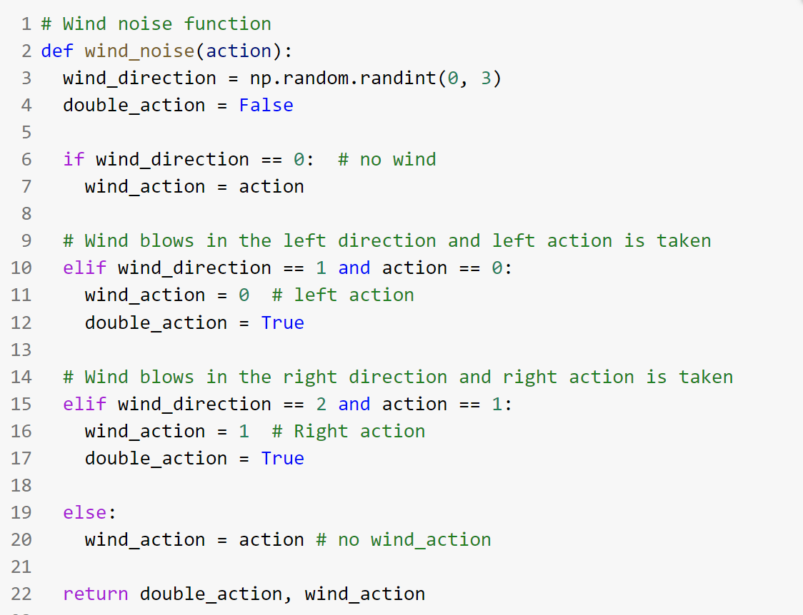
Implementation – Cart Pole Environment
Wind effects are applied to the Cart Pole environment to emulate real-world scenario and add uncertainty to the environment.
At every step wind can blow in a random direction of left or right enabling the cartpole to move a step based on the wind direction.

Slide 5
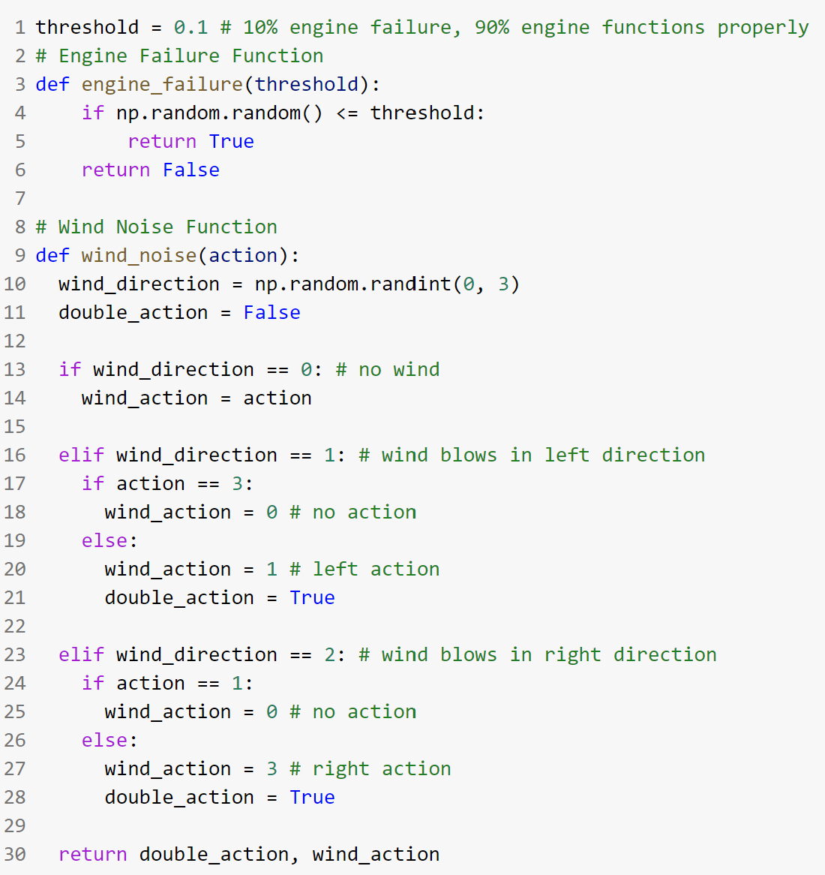
Implementation – Lunar Lander Environment
Lunar lander is a more complex environment which enables more customization for adding uncertainty in the environment.
Engine failure and wind effects generated by effects such as solar winds or random particles in the space are applied to the Lunar Lander environment to emulate real-world scenario and add uncertainty to the environment.

Slide 6
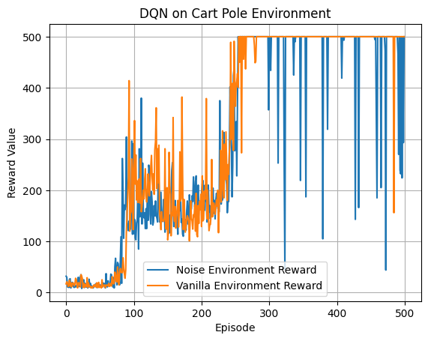
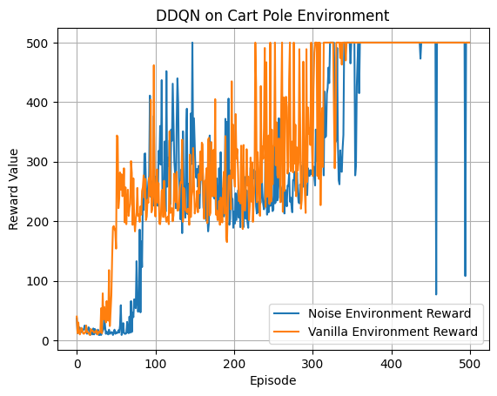
Results - Cart Pole vanilla vs noise environment rewards

Slide 7
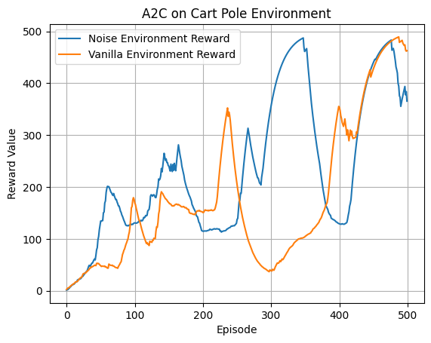
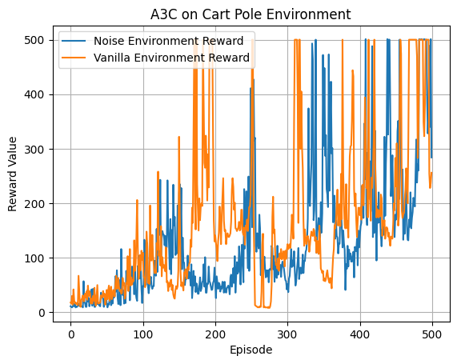
Results - Cart Pole vanilla vs noise environment rewards

Slide 8
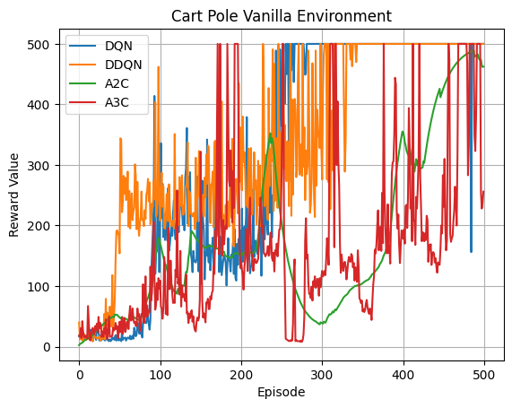
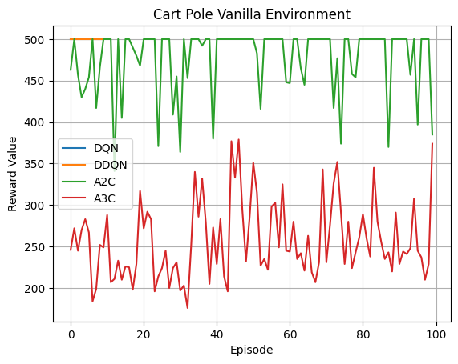
Results - Cart Pole vanilla environment summary

Slide 9
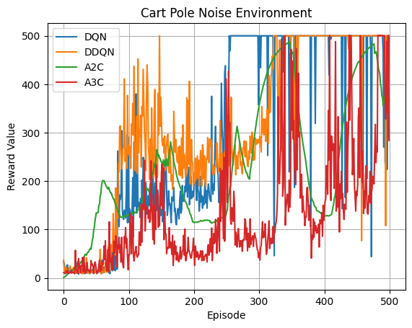
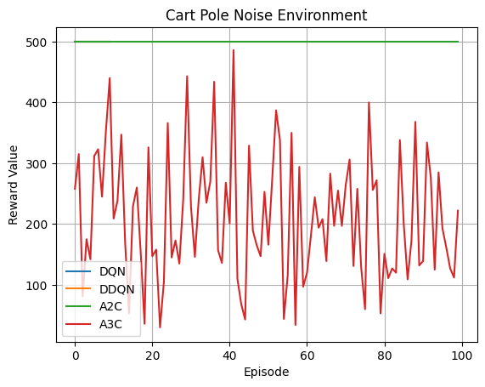
Results - Cart Pole noise environment summary

Slide 10
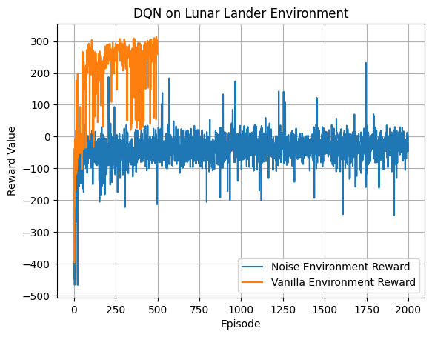
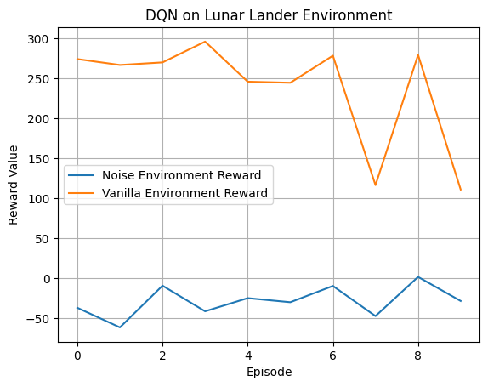
Results – Lunar Lander vanilla vs noise environment rewards

Slide 11
Summary
The algorithms Deep Q-Learning Network, Double Deep Q-Learning Network, Advantage Actor Critic, and Asynchronous Advantage Actor Critic all performed well on Cart Pole environment.
The stochasticity added to the Cart Pole environment was small enough and allowed the agent based on DQN, DDQN, A2C and A3C to successfully converge and learn an optimal policy.
The lunar lander environment had a higher degree of uncertainty introduced into the environment with random engine failure and aerodynamic disturbance through wind noise. Thus, the agent following DQN algorithm failed to converge or learn the optimal policy in the modified Lunar Lander environment.

Slide 12
Team Contribution
Team Member | Project Contribution | Contribution %
Kanupriya Pandey | DQN Algorithm DDQN Algorithm | 100%
 | Noise in Environment | 33%
Veda Sai Rochishna Eli | A2C Algorithm | 100%
 | Noise in Environment | 33%
Antarpreet Kaur | A3C Algorithm | 100%
 | Noise in Environment | 33%

Slide 13
Thank you

