Slide 1
Hybrid AI Financial Forecasting
Volatility & Market Regimes
Powered by Deep Learning, VAE, and NLP
QUANT-PRO v4.1

Slide 2
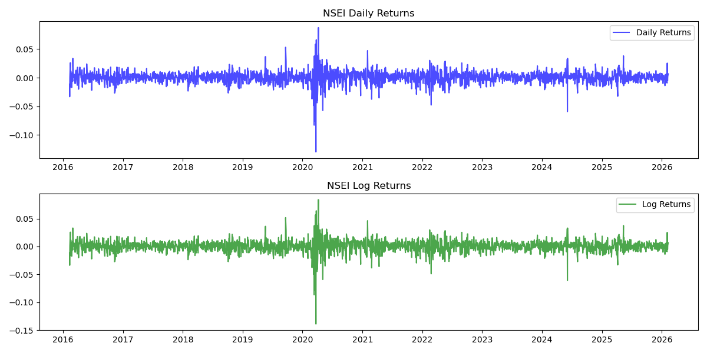
1. The Challenge with Traditional Models
✦ Financial markets are inherently noisy, non-stationary, and highly complex.
✦ Classical statistical models rely strictly on linear assumptions.
✦ They fail to adapt dynamically to sudden regime shifts & extreme volatility crashes.
✦ Purely mathematical models ignore human sentiment and unstructured qualitative data (News, Twitter).

Slide 3
2. The Solution: QUANT-PRO Architecture
✦ A hybrid quantitative framework blending classical stats with state-of-the-art Deep Learning.
✦ End-to-End automated data pipeline starting from live market extraction.
✦ Core components: Non-linear Volatility Modeling, Anomaly Scorer, Sentiment Engine, Price Forecaster.
✦ Designed for intuitive UI/UX with clear risk metrics & neural explainability.

Slide 4
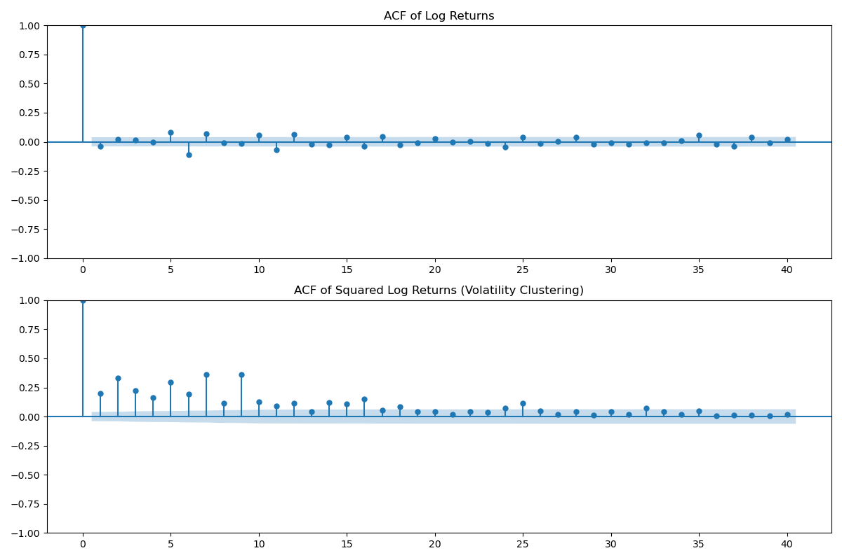
3. Live Data & Feature Engineering
✦ Extracts real-time price & volume streams seamlessly.
✦ Dynamic automated feature engineering computes technical indicators instantly.
✦ Key Alpha Generators:
✦ • Relative Strength Index (RSI)
✦ • Moving Average Convergence Divergence (MACD)
✦ • Bollinger Bands & Momentum Oscillators
✦ Creates a robust multi-dimensional feature set bridging price action & momentum.

Slide 5
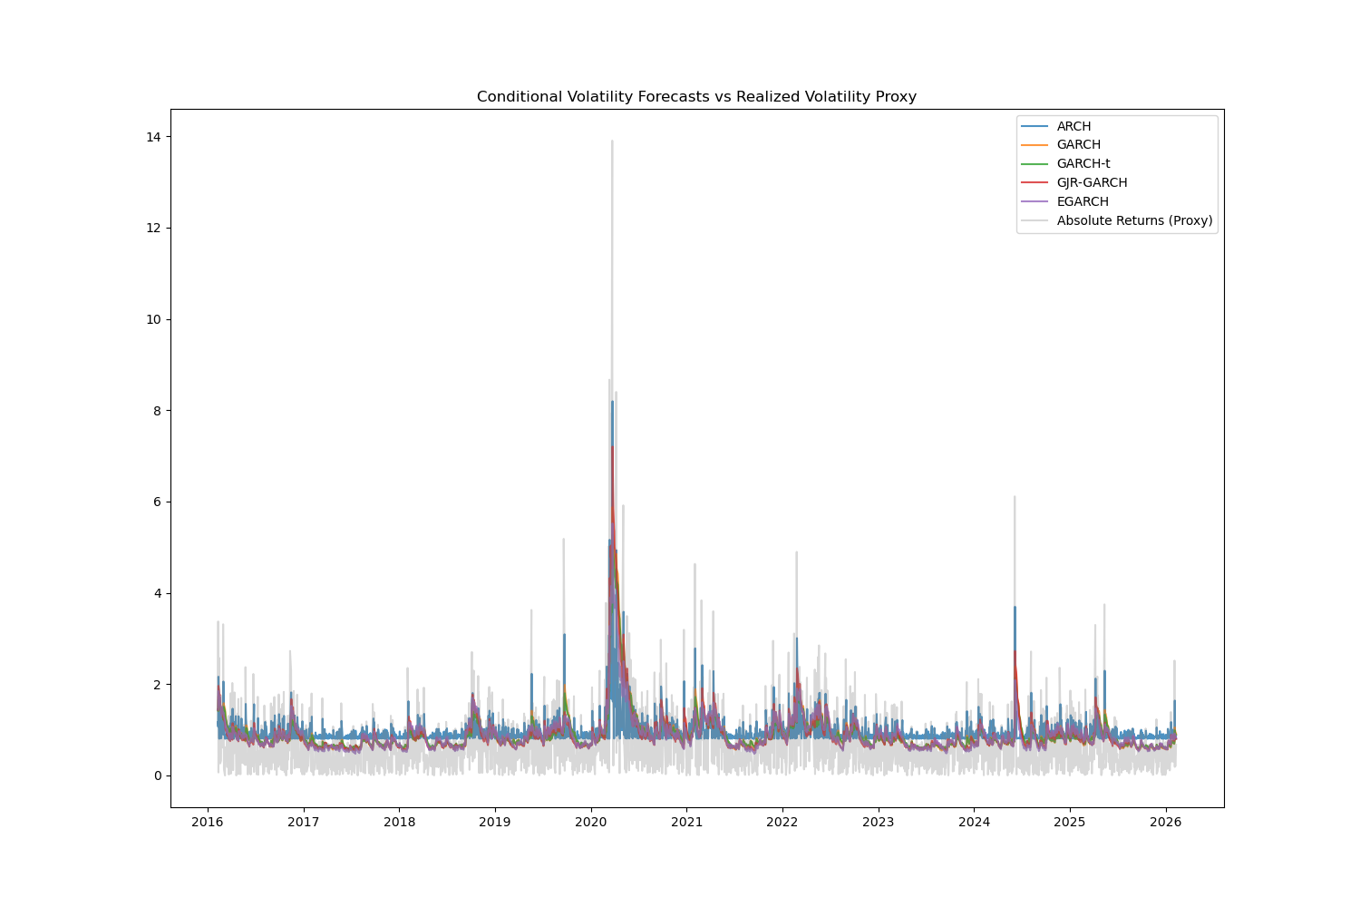
4. Volatility Engine: GARCH + LSTM
✦ Uses Realized GARCH to capture baseline mean-reverting behavior.
✦ Implements a bidirectional LSTM network for capturing residual non-linear chaos.
✦ The Hybrid Blend:
✦ • Extracts structural variance via econometrics.
✦ • Learns hidden, non-linear market regimes utilizing deep networks.
✦ • Identifies the accurate probability of future market stress.

Slide 6
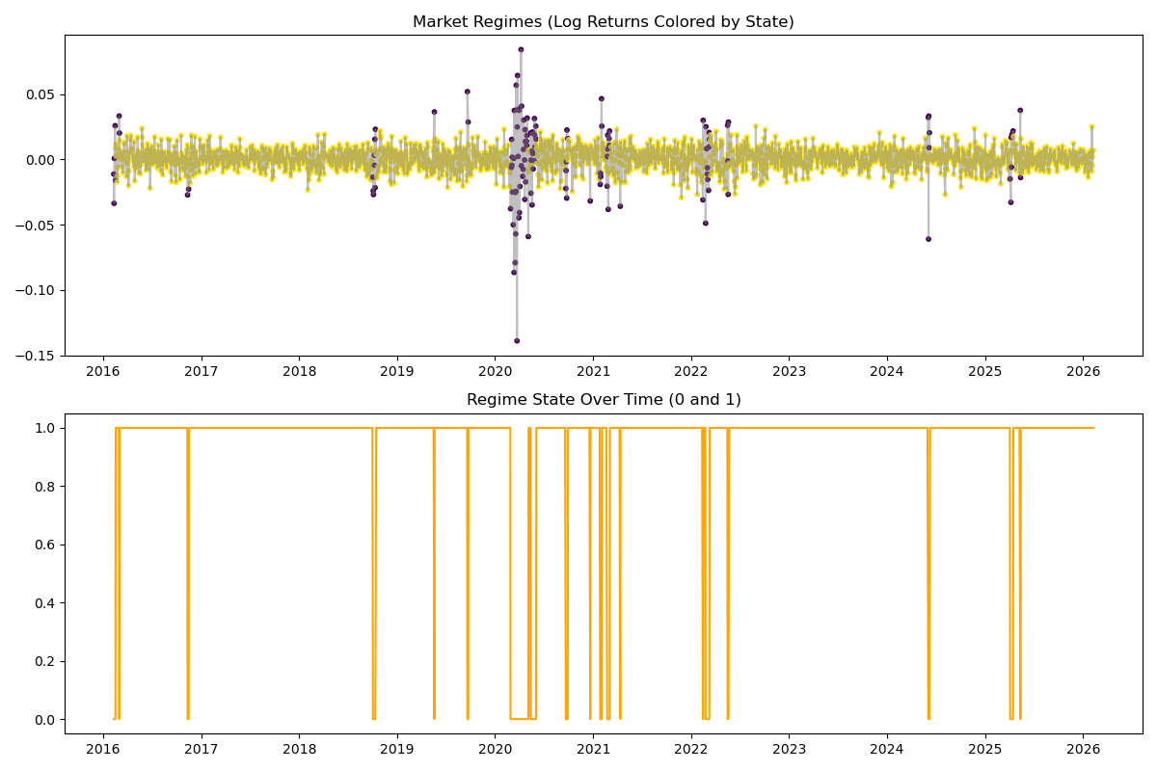
5. Market Regime Detection (VAE)
✦ Markets endlessly transition between 'Bull', 'Bear', and 'Sideways' modes.
✦ We utilize a Variational Autoencoder (VAE) for unsupervised anomaly scoring.
✦ Continuously reconstructs recent sequences and computes a structural Reconstruction Loss.
✦ Elevated anomalies signal market stress ('Volatile' or 'Panic').
✦ Low scores confirm structural integrity ('Normal'/'Steady').

Slide 7
6. Sentiment Language Engine
✦ Extracts live psychological factors utilizing HuggingFace's FinBERT model.
✦ Automatically pulls top financial news headlines specific to the tracked asset.
✦ Evaluates localized context, trained exclusively on Wall Street lexicon.
✦ Computes live probabilistic Bullish vs Bearish scoring in real-time.
✦ Mitigates the blind-spots of pure mathematical chart models.

Slide 8
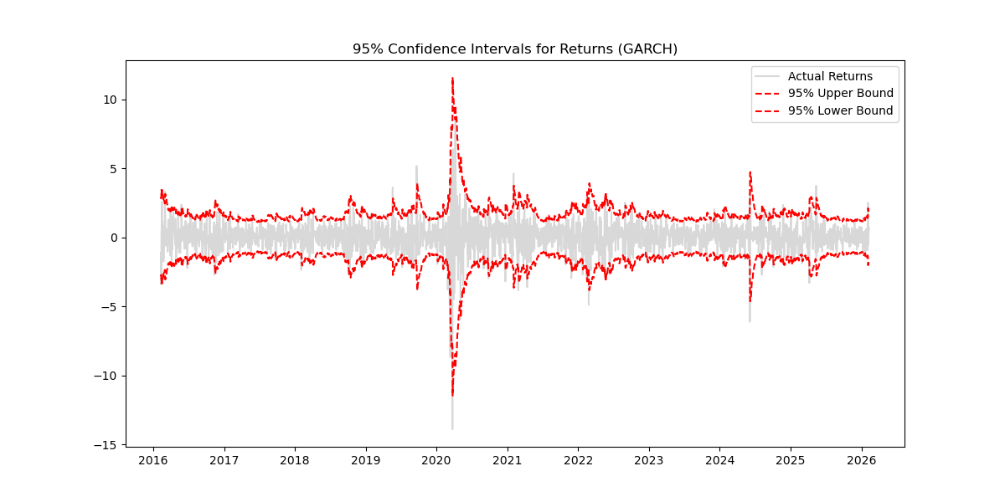
7. Price Forecasting & 'Fast Mode'
✦ Employs Multi-Horizon LSTMs to predict localized price trajectories.
✦ Quantile Regression maps absolute confidence intervals (10th/90th percentile).
✦ The 'Fast Mode' edge:
✦ • Pre-trained globally on immense historical datasets.
✦ • Pre-compiled neural weights auto-load locally.
✦ • Accelerates local rendering speeds by 95% while drastically reducing compute requirements.

Slide 9
8. Conclusion & Core Impact
✦ Scales hedge-fund tier quantitative metrics into accessible, user-centric dashboards.
✦ Melds traditional econometrics with modern Deep Learning and NLP extraction.
✦ Empowers transparent analysis via Explainable AI architectures.
✦ Rapidly plug-and-playable for Equities, Crypto, and Global Forex architectures.

