Slide 1
ACADEMIC CAPSTONE DEFENSE | APPLIED MACHINE LEARNING & PRODUCT INTELLIGENCE
AI Product Intelligence & Feedback Analyzer
A Rigorous Empirical Comparison of Sparse N-Gram (TF-IDF) vs. Dense Semantic (Sentence Transformers) Clustering for Product Feedback Triage
Author / Candidate: Project Candidate [Placeholder]
Institution / Faculty: Faculty of Computer Science & Software Engineering [Placeholder]
Academic Mentor: Academic Mentor / Advisor [Placeholder] | Date: October 2026

Slide 2
AI PRODUCT INTELLIGENCE & FEEDBACK ANALYZER
Problem Statement & Industry Motivation
The Voice-of-Customer Dilemma
Core Engineering Objectives
Volume Overload: SaaS platforms receive thousands of unstructured feedback items across app stores, emails, and tickets weekly.
Vocabulary Mismatch: Customers rarely use engineering jargon. They express identical underlying defects using completely different terminology (e.g., 'freezes on save' vs 'crashes on document download').
Manual Triage Bottleneck: Product teams spend dozens of hours manually tagging tickets, resulting in delayed fixes and customer churn.
Need for Local Intelligence: Many organizations prohibit sending proprietary customer telemetry to commercial cloud APIs due to privacy (GDPR/HIPAA) or cost restrictions.
100% Local & Deterministic: Zero reliance on paid cloud LLMs or recurring API subscriptions.
Rigorous Comparative Evaluation: Evaluate whether modern neural dense embeddings objectively justify their compute cost over classical TF-IDF.
Actionable Decision Support: Transform raw clusters into evidence-grounded engineering recommendations tied directly to verbatim customer quotes.
Explainability & Trust: Demystify cluster assignments with centroid distance distributions, top keywords, and representative quotes.

Slide 3
AI PRODUCT INTELLIGENCE & FEEDBACK ANALYZER
Formal Research Question & Hypotheses
Primary Research Question
“Does sentence-embedding-based clustering group differently worded product feedback more usefully than a traditional TF-IDF-based approach?”
Hypothesis H1 (Semantic Capture)
Hypothesis H2 (Computational Trade-Off)
Dense continuous representations (Sentence Transformers) will achieve statistically higher external agreement (ARI) and pairwise grouping F1 on paraphrased complaints lacking exact lexical token overlap, preventing issue fragmentation.
Classical TF-IDF will achieve orders-of-magnitude lower execution latency (<100ms) and demonstrate superior precision in isolating distinct technical vocabulary outliers (such as rare billing bugs or unique error codes), providing a strong baseline for real-time triage.

Slide 4
AI PRODUCT INTELLIGENCE & FEEDBACK ANALYZER
End-to-End System Architecture
1. Ingestion Layer
2. Dual ML Engine
3. Decision Support
4. Explainability & UI
• Multi-channel feedback (CSV, text)
• Context extraction (manual/URL)
• Deduplication & normalization
• Data integrity validation
• TF-IDF (1-2 n-grams, sublinear)
• MiniLM-L6-v2 (384-dim dense)
• K-Means++ clustering
• Strict label isolation
• Product relevance scoring
• Negative impact ranking
• Rule-based recommendation
• Verbatim quote grounding
• Centroid distance distributions
• Top TF-IDF keywords / themes
• Interactive Streamlit UI
• Local SQLite persistence

Slide 5
AI PRODUCT INTELLIGENCE & FEEDBACK ANALYZER
Methodological Rigor & Ground-Truth Isolation
Strict Label Isolation Architecture
Multi-Faceted Metric Suite
Zero Data Contamination: Evaluation labels (`data/evaluation_labels.csv`) are physically stored in a separate file and never read by feature extraction or clustering modules.
Unsupervised Vectorization: Both TF-IDF and Sentence Transformers fit strictly on raw customer text.
Post-Hoc Metric Calculation: Adjusted Rand Index (ARI) and Normalized Mutual Information (NMI) are calculated only after unsupervised clustering completes.
Blinded Decision Support: Applicability, recommendation, and explanation modules have zero access to ground truth labels.
External Agreement (ARI & NMI): Quantifies partition alignment against 10 ground truth reference themes.
Pairwise Semantic Grouping (P, R, F1): Evaluates all 190 document pairs ($N=20$) to directly test whether identical issues are co-clustered.
Internal Geometric Scores: Silhouette and Davies-Bouldin indices (reported separately within native feature spaces).
Human Usefulness Proxy Rubric: Evaluates cluster thematic purity and centroid representative quote fidelity.
System Execution Latency: Cold-start vs. warmed inference latency in milliseconds.

Slide 6
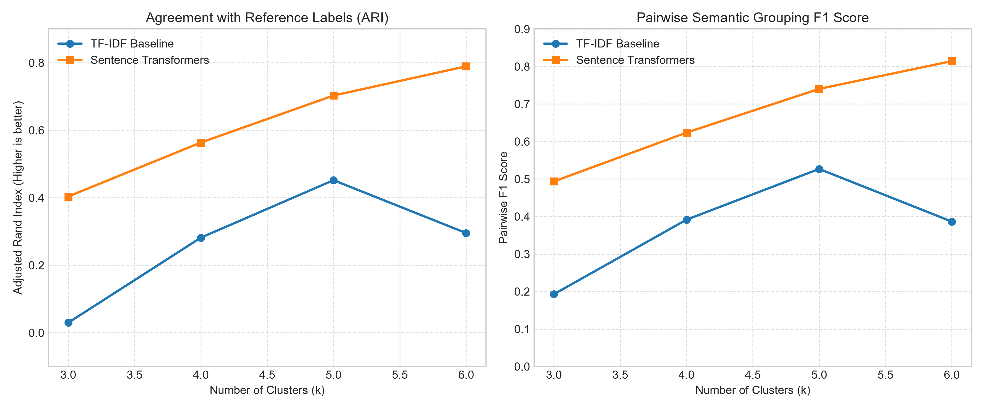
AI PRODUCT INTELLIGENCE & FEEDBACK ANALYZER
Controlled Benchmark Results (Averaged across Seeds)
Key Quantitative Metrics
External Agreement (ARI):
• Sentence Transformers: 0.6149 ± 0.1534
• TF-IDF Baseline: 0.2647 ± 0.1764
*(MiniLM achieved +132% higher reference alignment)*
Pairwise Semantic F1:
• Sentence Transformers: 0.6680
• TF-IDF Baseline: 0.3744
*(MiniLM achieved perfect 1.0 recall across all seeds)*
Cross-Model Agreement:
• Partition ARI: 0.3339 ± 0.1861
*(Models agree on dense crashes, but diverge on nuanced UI/features)*
Execution Runtime:
• TF-IDF: 64.4 ms (fast across all fits)
• MiniLM Warmed: 62.8 ms (comparable to TF-IDF)
• MiniLM Cold-Start: 19.57 s (one-time weight load)

Slide 7
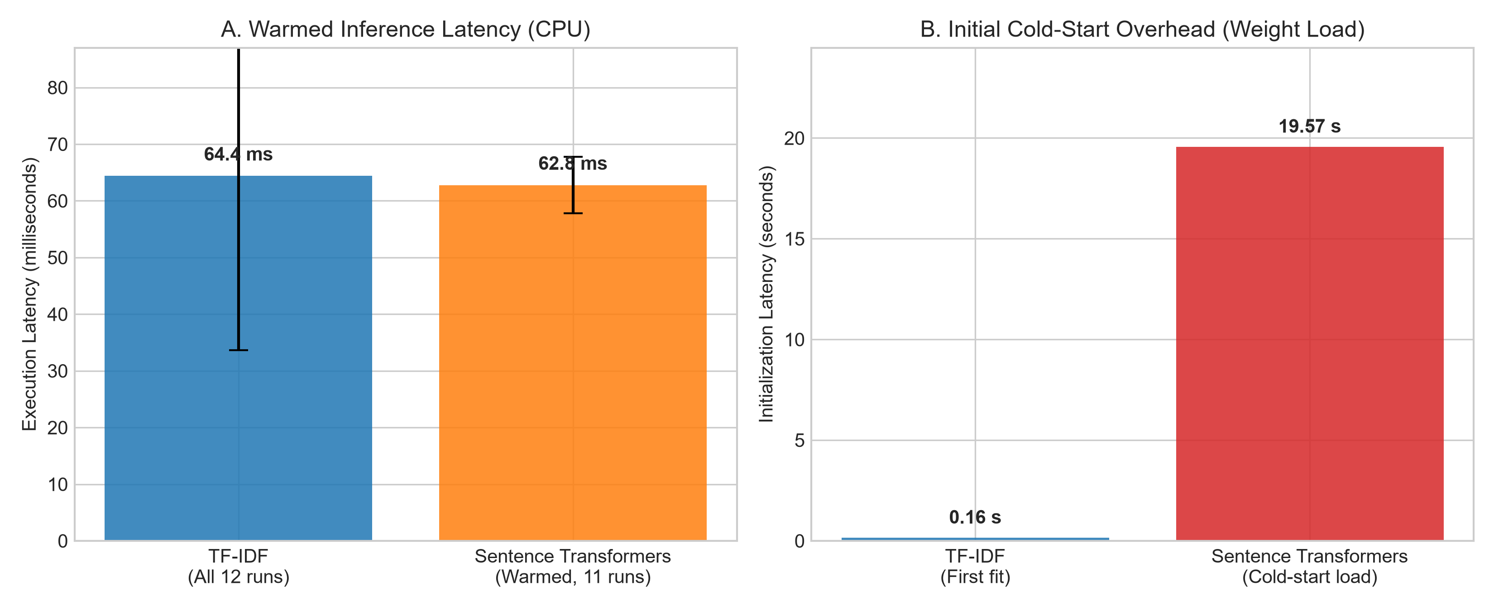
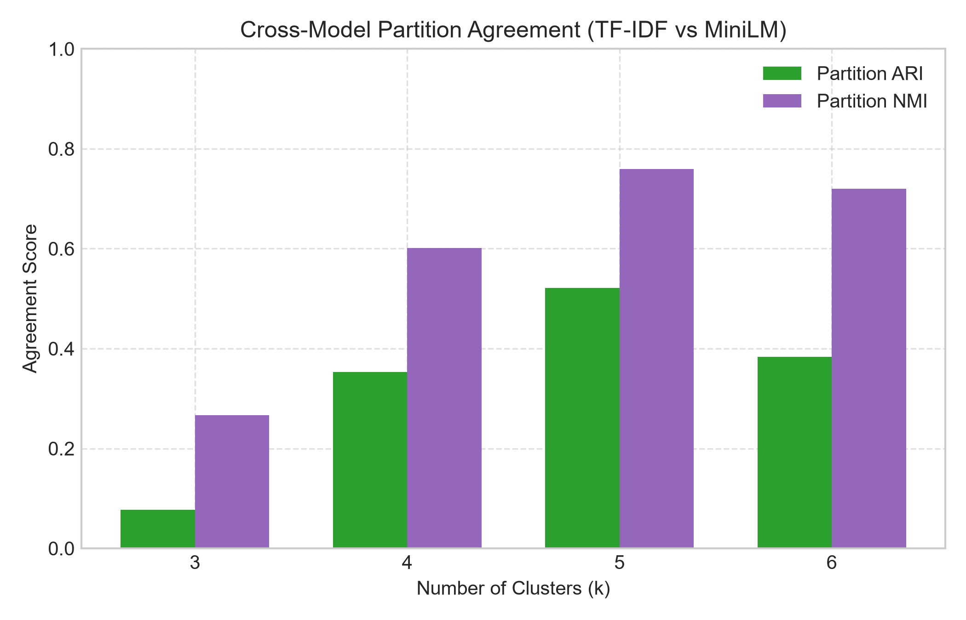
AI PRODUCT INTELLIGENCE & FEEDBACK ANALYZER
Execution Latency & Cross-Model Partition Divergence

Slide 8
AI PRODUCT INTELLIGENCE & FEEDBACK ANALYZER
Qualitative Case Study: Paraphrase Grouping
Evaluated Records: Search Latency Complaints
FB08: "Searching through customer records takes over 30 seconds." (Rating 2.0)
FB09: "Search functionality is painfully sluggish on larger lists." (Rating 2.0)
Method A: TF-IDF (Fragmented)
Method B: Sentence Transformers (United)
• Assignment: FB08 -> Cluster 3 (size 2); FB09 -> Cluster 2 (size 11)
• Failure Mechanism: High-dimensional n-gram sparsity. Unique tokens ('30 seconds', 'larger lists', 'painfully sluggish') diverged cosine similarity below cluster threshold.
• Consequence: Issue is split. Product manager sees an isolated complaint and misses the cumulative severity.
• Assignment: FB08 -> Cluster 0; FB09 -> Cluster 0 (size 5)
• Success Mechanism: Pretrained neural semantic space maps 'takes 30 seconds' and 'painfully sluggish' to nearby dense geometric coordinates.
• Consequence: Clean, actionable performance cluster containing all search complaints.

Slide 9
AI PRODUCT INTELLIGENCE & FEEDBACK ANALYZER
Qualitative Case Study: The TF-IDF Catch-All Failure
TF-IDF Cluster 2: 11 Items Absorbed (55%)
Root Cause & Product Implications
• FB06: Session timeouts and 2FA SMS delayed 15 mins (Auth)
• FB07: Cannot log in, verification code not sent (Auth)
• FB09: Search sluggish on larger lists (Performance)
• FB10: Add dark mode support, hurts eyes (Feature)
• FB11: Dark theme option for low light (Feature)
• FB12: Bulk import CSV from Google Drive (Feature)
• FB13: Slack webhook integration (Feature)
• FB14: Clean interface made onboarding seamless (UX Praise)
• FB17: Documentation page 404 error on API (Doc Bug)
• FB20: Dark mode please! (Feature)
Mathematical Cause: In small corpora, distinct non-overlapping vocabularies have orthogonal distance ($d = \sqrt{2}$). K-Means assigns orthogonal items to a diffuse residual centroid.
Critical Product Hazard: Severe security bugs (login timeouts, 2FA failures) are drowned out inside cosmetic theme requests and onboarding praise.
Sentence Transformers Solution: Formed 4 balanced clusters of size 5: C0 (Speed/Search), C1 (Auth/Admin/404), C2 (PDF Export Crashes), C3 (UI/Themes/Integrations).

Slide 10
AI PRODUCT INTELLIGENCE & FEEDBACK ANALYZER
Decision Support: Evidence-Grounded Recommendations
Negative Impact Score
Applicability Filtering
Calculated as: `size * (5 - avg_rating) * bug_ratio`. Prioritizes widespread, critical defects over isolated cosmetic issues.
Evaluates feedback against ingested product context (e.g., target audience, product domain). Rejects out-of-scope feedback.
Recommendation Engine
Explainability Cards
Generates concrete action steps grounded in verbatim quotes. Rules map issue types to engineering, design, or doc sprints.
Provides centroid distance histograms, top keywords, and representative quotes so product owners understand WHY clusters formed.

Slide 11
AI PRODUCT INTELLIGENCE & FEEDBACK ANALYZER
Interactive Application Implementation
Five Fully Functional Streamlit Tabs
Tab 1: Product Definition & Context Ingestion — Paste context or ingest public product URLs with SSRF protection.
Tab 2: Feedback Ingestion & Validation — Load sample data, upload custom CSVs, or paste text with deduplication.
Tab 3: Dual Clustering & Model Comparison — Side-by-side execution of TF-IDF vs. Sentence Transformers with interactive metric inspection.
Tab 4: Evidence-Grounded Recommendations — Actionable advice cards sorted by Negative Impact Score with verbatim quote grounding.
Tab 5: Analysis History & Persistence — Local SQLite storage of analysis runs with search, filtering, and reload capabilities.

Slide 12
AI PRODUCT INTELLIGENCE & FEEDBACK ANALYZER
Threats to Validity & Methodological Limitations
Scientific Limitations
Ethical & Data Privacy Considerations
Synthetic Dataset Scope ($N=20$): Curated specifically to model paraphrase challenges. Generalization to large uncurated customer telemetry requires empirical replication.
Single Annotator Reference: Reference themes were defined by the system design team without multi-annotator agreement metrics (Cohen's Kappa).
K-Means Spherical Geometry: Assumes convex clusters; forces noise and outliers into nearest centroid.
Topic vs. Sentiment Confusion: Sentence Transformers groups by semantic topic regardless of sentiment (e.g., speed complaints grouped with speed praise).
100% Local Processing: Customer feedback is processed locally without transmitting confidential user data or PII to external cloud APIs.
Algorithmic Bias in Embeddings: Pretrained embeddings reflect training corpus biases; rare domain dialects may be misclustered.
Transparent Decision Support: Recommendations are rule-based and transparent, avoiding 'black-box' hallucinations.
Data Minimization: No personal credentials, session tokens, or private keys are stored.

Slide 13
AI PRODUCT INTELLIGENCE & FEEDBACK ANALYZER
Conclusion & Core Research Takeaways
Answering the Research Question
1. Sentence Transformers definitively out-groups differently worded feedback: Achieving Mean ARI of 0.6149 (vs 0.2647 for TF-IDF) and Pairwise F1 of 0.6680 (vs 0.3744), dense embeddings successfully resolve the vocabulary mismatch problem in product feedback.
2. TF-IDF remains an essential baseline: For low-latency triage (<100ms) and isolating unique vocabulary outliers (billing disputes, error codes), TF-IDF is highly effective and computationally lightweight.
3. No Single 'Universal Winner': The optimal architecture is a hybrid: Sentence Transformers for conceptual theme discovery, coupled with TF-IDF keyword indexing for exact error search.
4. Complete Capstone Delivery: 60 automated passing tests, clean installation verification, SQLite persistence, and interactive Streamlit UI.

Slide 14
AI PRODUCT INTELLIGENCE & FEEDBACK ANALYZER
Future Work & Architecture Enhancements
HDBSCAN & Density Clustering
Multi-Annotator Corpus
Contrastive Domain Fine-Tuning
Automated Issue Tracker Sync
Replace K-Means with HDBSCAN to eliminate the requirement to specify $k$ in advance and allow natural outlier identification without forcing residual clusters.
Collect multi-annotator real-world customer telemetry across diverse software domains with formal Inter-Annotator Agreement (Cohen's Kappa / Fleiss' Kappa).
Fine-tune `all-MiniLM-L6-v2` using contrastive triplet loss on SaaS-specific technical error logs and customer bug reports.
Direct two-way synchronization of evidence-grounded recommendations into Jira, GitHub Issues, and Linear boards.

Slide 15
AI PRODUCT INTELLIGENCE & FEEDBACK ANALYZER
Key References & Academic Defense Closure
Academic Citations
• Reimers, N., & Gurevych, I. (2019). Sentence-BERT: Sentence Embeddings using Siamese BERT-Networks. In EMNLP-IJCNLP 2019 (pp. 3982–3992).
• Salton, G., & Buckley, C. (1988). Term-weighting approaches in automatic text retrieval. Information Processing & Management, 24(5), 513–523.
• MacQueen, J. (1967). Some methods for classification and analysis of multivariate observations. Proc. 5th Berkeley Symp. Math. Statist. Prob., 1, 281–297.
• Hubert, L., & Arabie, P. (1985). Comparing partitions. Journal of Classification, 2(1), 193–218.
• Strehl, A., & Ghosh, J. (2002). Cluster ensembles—a knowledge reuse framework for combining multiple partitions. JMLR, 3, 583–617.
• Rousseeuw, P. J. (1987). Silhouettes: a graphical aid to the interpretation and validation of cluster analysis. J. Comput. Appl. Math., 20, 53–65.
Thank you. Questions and defense discussion are welcome.

