Slide 1
Domain Expert
DOMAIN EXPERT
Rule 1
Rule 2
Rule 3
DECISION
DATA
Rule 4
Rule 5
Rule 6

Slide 2
Domain Expert Issuing Visas
Expired passport is invalid
Passport without a free page for visa is invalid
Passport not valid 6 months after trip start date is invalid
Visas, Rejection Letter
Visa Application, Passports
Visa application with trip start date in past is invalid
Visa application without a passport is invalid
Issue a Visa if passport and visa application are valid

Slide 3
Imperative Visa Issuing System
Start
Issue Visa
yes
Visa application and passport are provided?
Is the passport expiration date in future?
Is there a free page for visa in passport?
Is passport valid 6 months after trip?
Is trip start date in future?
yes
yes
yes
yes
no
no
no
no
no
Reject Visa

Slide 4
Structure of any Rule
When a condition is true
Then an action is executed
If you program a rule based system then all you do is write the rules and you don't specify the order of rules.
But you design them in a way that the end result is how you want.
Let's see this closer

Slide 5
Rule Execution Life Cycle
Exit
None
Business Rules
How many rules could fire?
Start
More than
one
Select rule to fire
Data
Start
over
Exactly one
Rule modifies data
Fire the Rule

Slide 6
We are used with imperative programming
Writing sequence of instructions that the program follows.
Programming Drools is declarative
You describe (in small steps what you want)
You don’t specify (in order sequence) how to achieve this
SQL for example is also declarative programming
Declarative Programming

Slide 7
Rule Engine Summary
Rule Engine is like a domain expert in your system
Taking into account all the rules that exist
and applying the rules to the data
Domain expert built in imperative way has limitations
There might be a lot of branches
Hard to make changes
Drools is declarative programming
You specify what you want
You don’t specify how to achieve this step by step
Drools rule engine works in loop
Finds what rules could fire next
Picks one out and fires it
Firing the rule modifies the data

Slide 8
Rule Design Principles
Rule independency: A rule should not depend on any other specific rule. The rules should depend on the data instead.
Rule atomicity: Rules should be designed as simple as possible. Complicated rules should be split into several rules until they cannot be divided into anything smaller
Data defines the rule to fire next: While it is possible to impact the order of which rules are fired this should remain to special cases only.

Slide 9
Methods vs Rules
Rules executed by matching against any data inserted into the engine.
Rules can never be called directly.
Specific instances cannot be passed to a rule.
Depending on the matches, a rule may fire once or several times, or not at all.

Slide 10
Use DROOLS For Systems Where
It is difficult for any one person to fully understand without digging in
Each business rule defines a small component of a complex scenario
Requirements keep changing over time
Easier to make changes because no need to analyze whole tree
More people can work on rules at the same time
Decisions has to be made quickly

Slide 11
Don’t Use DROOLS If
You don’t have many rules
Rules don’t change often
You need tight control over execution flow

Slide 12
Structure of any RULE
DROOLS Rule
When a condition is true,
Then an action is executed
When
<conditions>
Then
<actions>;

Slide 13
DROOLS Rule
rule "name" attributes when Left-Hand-Side => written in MVEL or Java then Right-Hand-Side => written in Java end

Slide 14
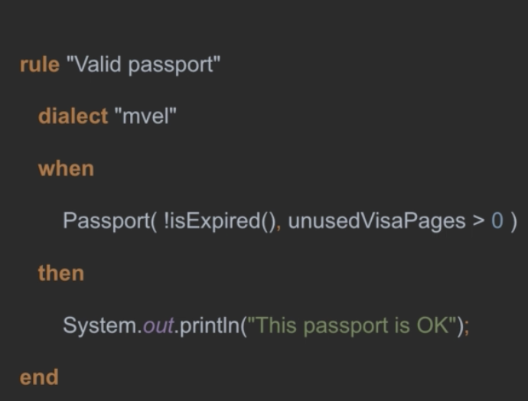
DROOLS Rule Example
Here dialect is an indicator for rule syntax notations.
Passport is our domain class which contains methods called “isExpired() and member called “unusedVisaPages”.
Here Two rules involved: isExpired() and unusedVisaPages
Each rule has been separated by , (comma) denotes is AND clause

Slide 15
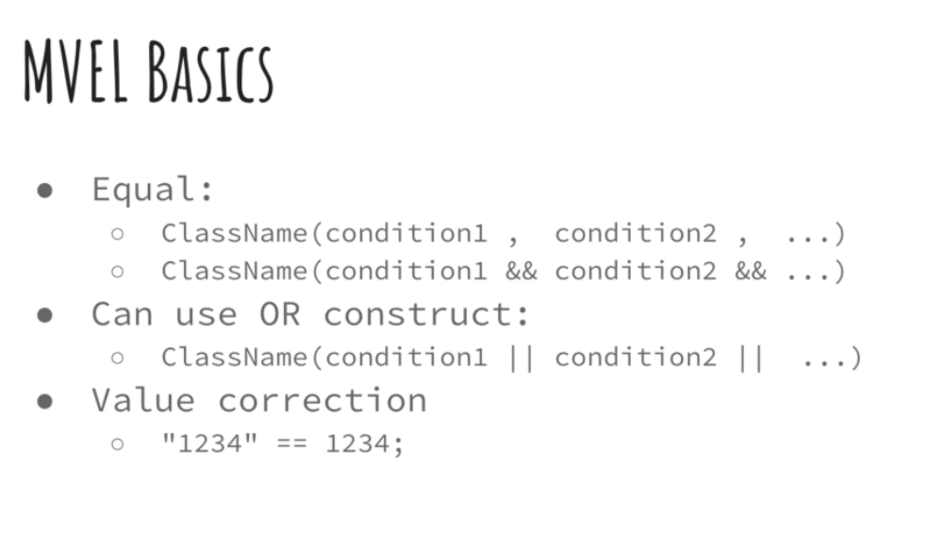

Slide 16
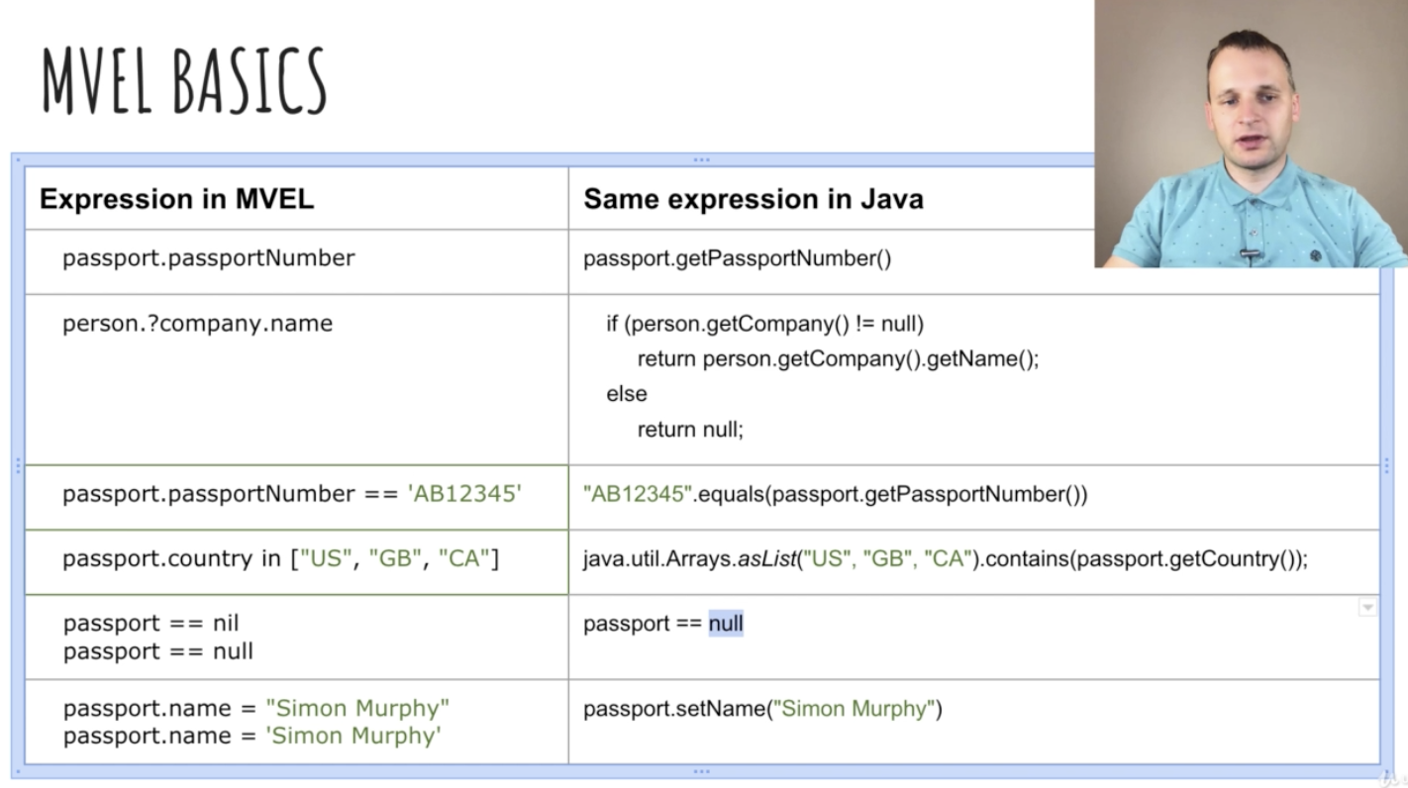

Slide 17
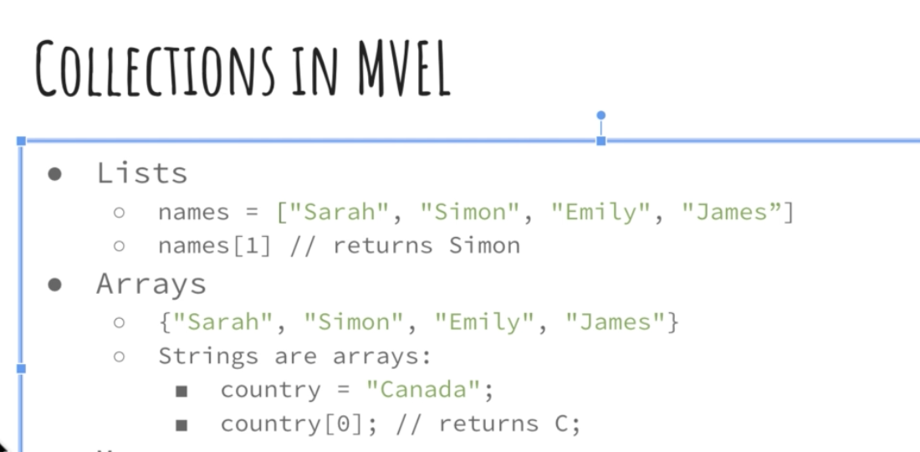
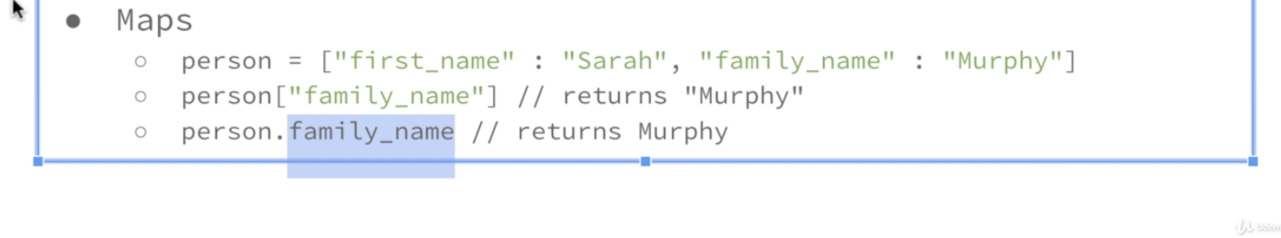

Slide 18
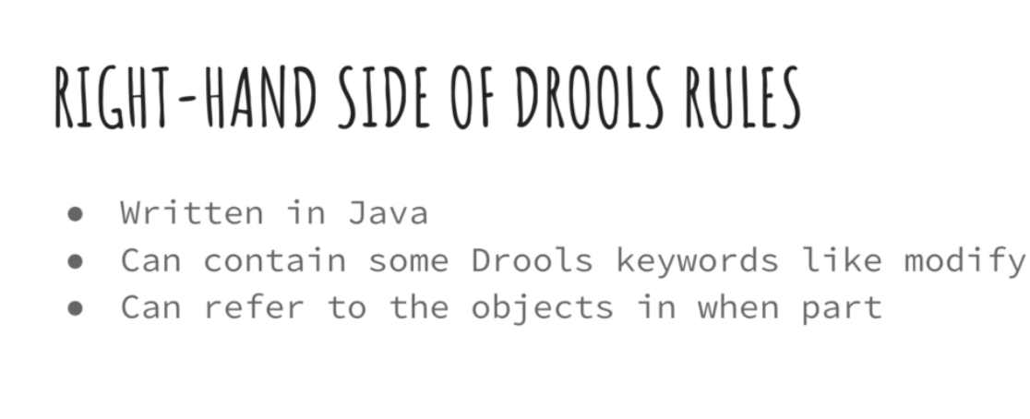

Slide 19
Summary
Drools rules have two parts:
When part called left-hand-side
Then part called right-hand-side
Rule can fire if expression on left-hand-side is true
Left-hand-side is written in MVEL syntax or in Java
Right-hand-side is written in Java

Slide 20
DROOLS Stateless Session – Common Use case
Validation:
Is this passport valid?
Is this person eligible for a Visa?
Calculation:
Compute price of travel insurance
Routing and Filtering:
Decide who in the company has to approve particular expense
Filter incoming email into folders

Slide 21
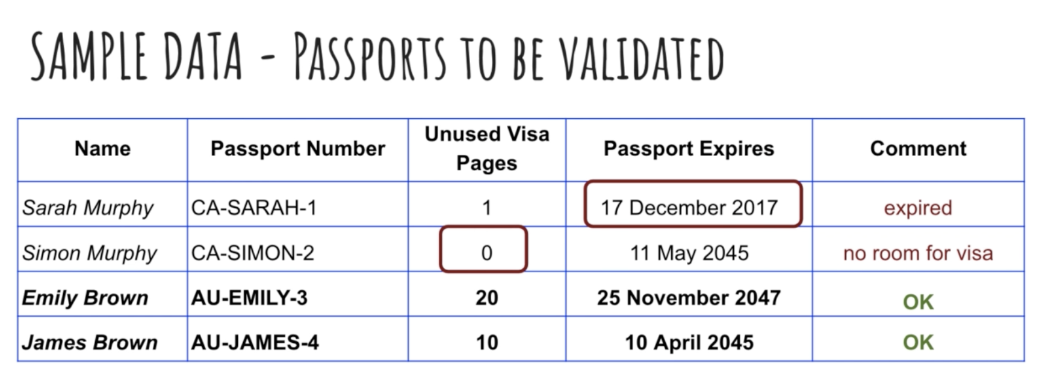
Validation - Stateless

Slide 22
Stateless Session Summary
Common use case for stateless sessions are:
Validation
Calculation
Routing and Filtering
You need to explicitly state that session is stateless.
A good practice is to write rules as short as possible
Split longer rules in smaller ones whenever you can
You can assign variables to matched objects and fields.
It is good practice to start variable name with $-sign
You can change the state of the object during session
You can not make Drools aware of changed state of an object.

Slide 23
Stateful Session Intro
If you modify an object in a stateful session then all affected rules are automatically re-checked and re-run if needed.
Stateful sessions are used a lot for:
Monitoring
Diagnostics
Logistics
Compliance

Slide 24
Stateful Session Summary
You need Stateful session if you use inference – this is one rule setting information that other rules consume
Modify keyword
Use it to make Drools aware of changes
Other rules are automatically re-run if needed
It takes an object as parameter
In the body of the modify you can call several methods of the object
Call dispose() method in the end of the Drools session to avoid memory leaks.

Slide 25
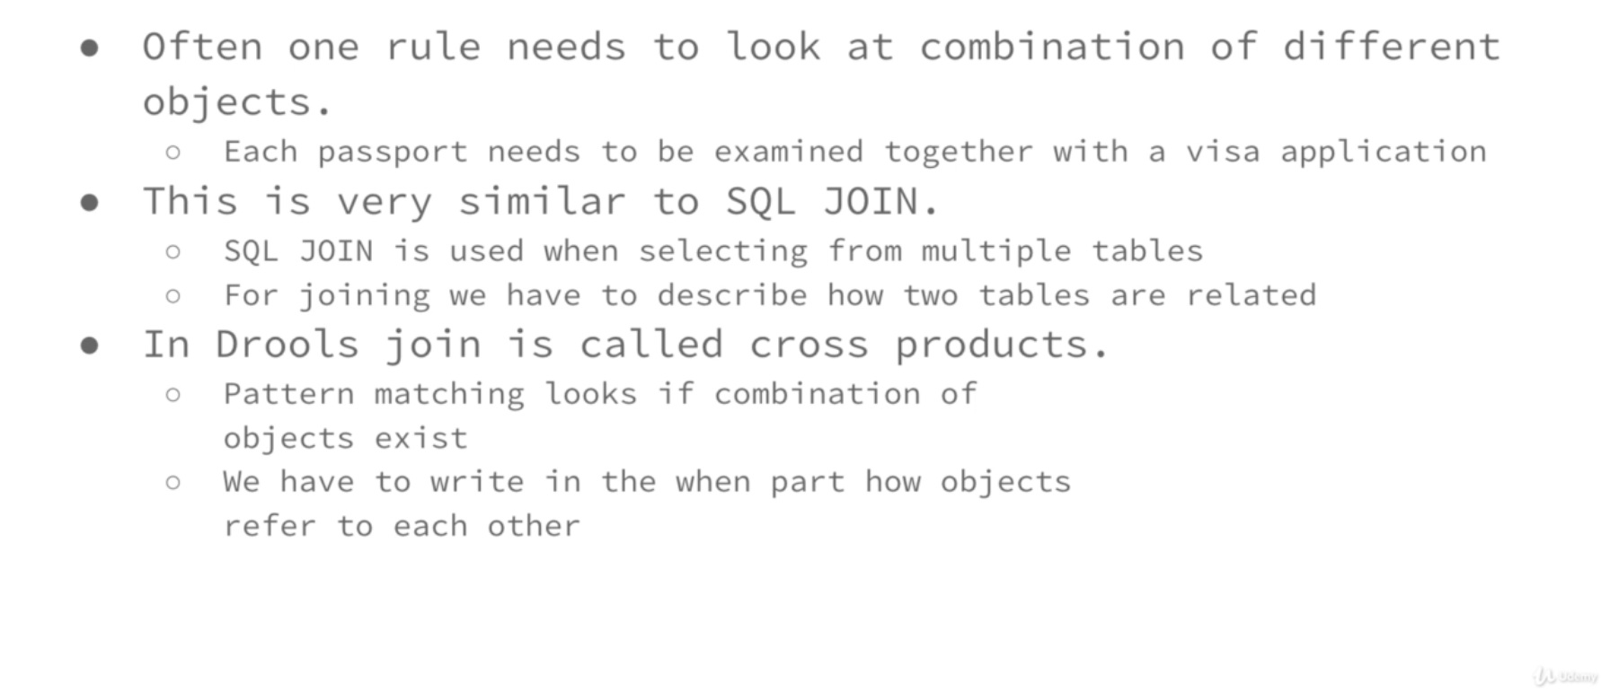
Cross Products Intro

Slide 26
Intro To Adding New Facts & Setting Execution Order
Drools rules can insert new facts into the session
So far we have dealt with validation
Inserting New Facts is another form of Interface – creating new knowledge
We are going to create a new rule that issue a visa if validation hasn’t failed
We look how and when to control execution order of the rules using either of:
Salience
Agenda-Group

Slide 27
New Facts and Execution Order Summary
You can set expiration date for any rule
You can insert new facts into session by Drools rule
You can get all facts from the session to Java code
When two or more can trigger - this is called a conflict and how drools solves it is conflict resolution
You can control order using salience and agenda groups
Rule with latest salience value is triggered first
Agenda groups are pushed into the stack by setting focus to them
Agenda groups are popped from stack by Drools
If you use salience and agenda group at same time – salience only has effect within the particular agenda group
If two or more rules belongs to same activation group then maximum one rule is run and only once.

Slide 28
Intro. Insert a Fact Logically. Check that Fact Does not exist
Insert new objects using “insertLogical()”
We know that rule can insert a fact (on the right side of rule) when expression (left hand side of the rule) is true.
If we insert the object using insertLogical() and later the same expression becomes false then the object is deleted.
Insert logical binds object existence with the truth of the when clause.
Use “not()” if you need to match that fact doesn’t exist
Don’t modify objects - insert facts about them.
No more calling setValidation(Validation.FALIED)
Reduce the number of rules needed by matching more than two objects at once.

Slide 29
Fact and Logical Summary
insertLogical()
Inserts a facts to the session
Existence of the fact is tried with truth of when-side of the rule that inserted the fact.
If expression on when side becomes false the fact is removed
Fact objects:
Like colored post-it stickers glued on actual object
Prefer them over changing actual objects
Properly override equals() and hasCode() methods of fact objects
Use Drools event listeners for debugging
DebugAgendaEventListener
RuleRuntimeEventListener
Take time to design your rules
Play with example code

Slide 30
Check A Fact Exists. Match expression for all facts
exists
Use it to check that at least one fact exists
forall – evaluates to true when
All facts that match the first pattern
Also match all the remaining patterns
Using forall to extract a fact from a group
We can extract fact with a smallest / largest value
Support family visa applications
Single Family visa application holds list of Passport objects.

Slide 31
Summary of working with Groups of Facts
If you want to check that in the session at least one fact exists – use exists.
If you want to test that a specific expression is valid for all – use forall
You can also use forall to find item with lowest / highest value from collection.

