Slide 1
SOCIAL MEDIA MARKETING
FACEBOOK PAGE:FLASH MOBILES

Slide 2
TEAM MEMBERS
KARTHIKEYAN A (18BCS094)
YUVA PRASANTH (18BCS113)
GOKULA KANNAN(18BCS123)
ARUN KUMAR(1BNCS209)

Slide 3
PROBLEM STATEMENT
Pages are places on Facebook where artists, public figures, businesses, brands, organizations and non profits can connect with their fans or customers.
If you're looking to establish a brand and promote your business to a large number of people, a Facebook Page makes the most sense.
Even some mobile shop produces cost efficiency products, the reach is still underrate because of the location.d.

Slide 4
OBJETIVES
TO MAKE MOBILE MORE PREFERABLE TO CUSTOMERS.
INCREASE THE RATE OF CUSTOMERS.
INCREASE AWARNESS ABOUT THE PRODUCT:
BRAND AWARNESS
LOCAL AWARNESS
REACH

Slide 5
PRODUCT: MOBILE BAND NAME:FLASH MOBILES DESCRIPTION:flash mobiles gives you a chance to quickly and easily find the phone you want and have it delivered to your home in no time

Slide 6
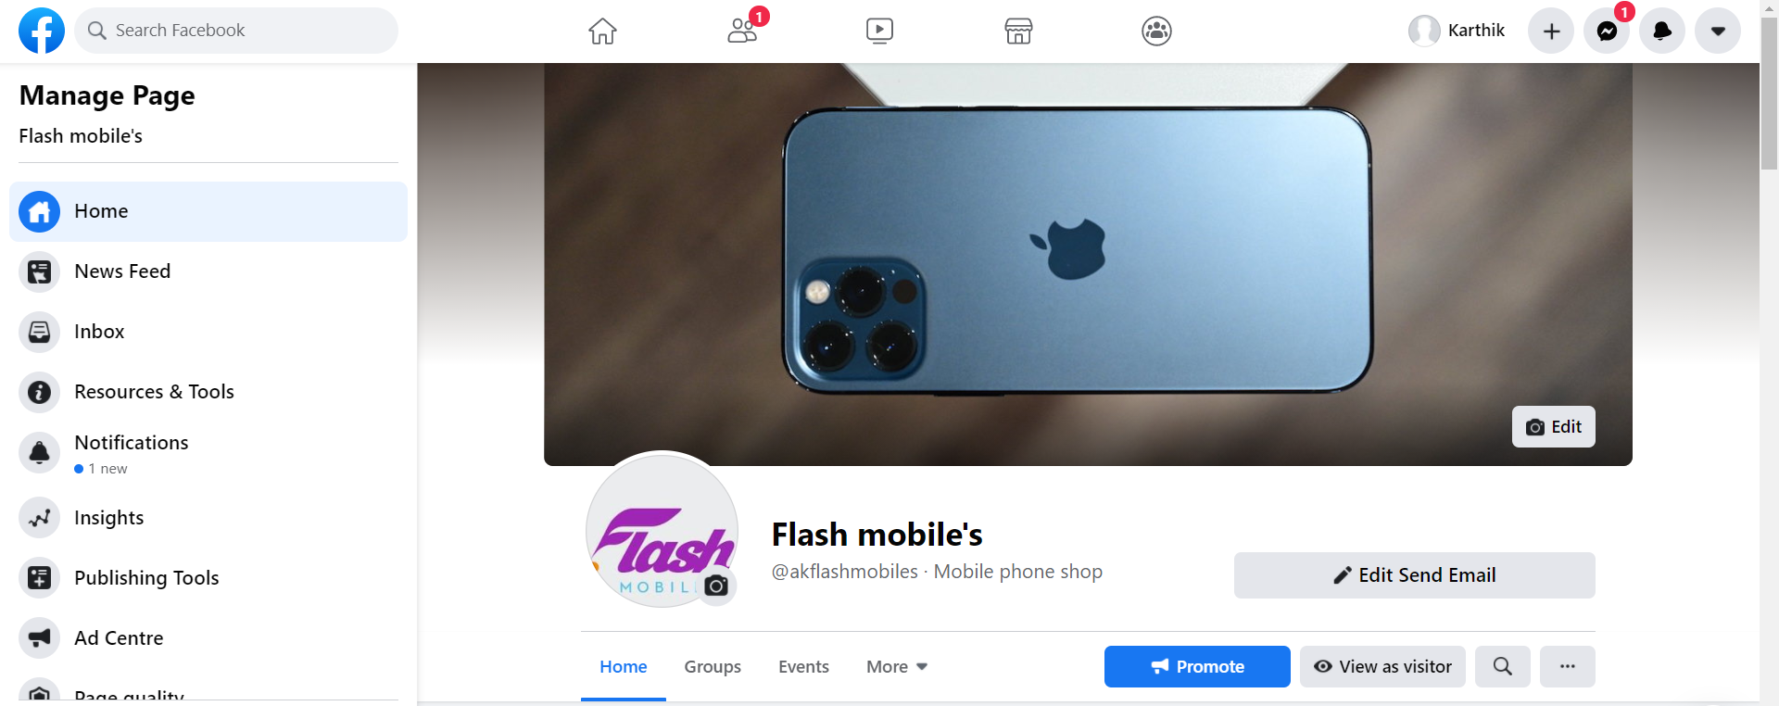
FACEBOOK PAGE

Slide 7
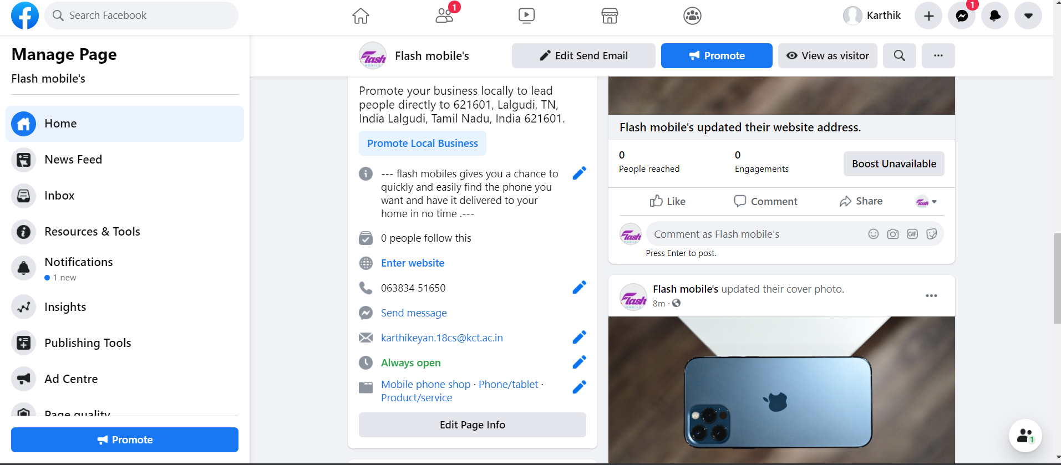
CONTACT PAGE

Slide 8
PROMOTING FACEBOOK PAGE
CREATING FACEBOOK AD
INVITE FRIENDS
SET BUDGET
UPLOAD SHORT VIDEOS
ADD HASHTAGS
POST CUSTOMER RESULT

Slide 9
THE END

