Slide 1
NEW GRACE ELECTRICAL
Electrical Engineering • Panel Boards • Cable Trays • Fabrication
Company Capability Presentation
Hosur, Tamil Nadu, India

Slide 2
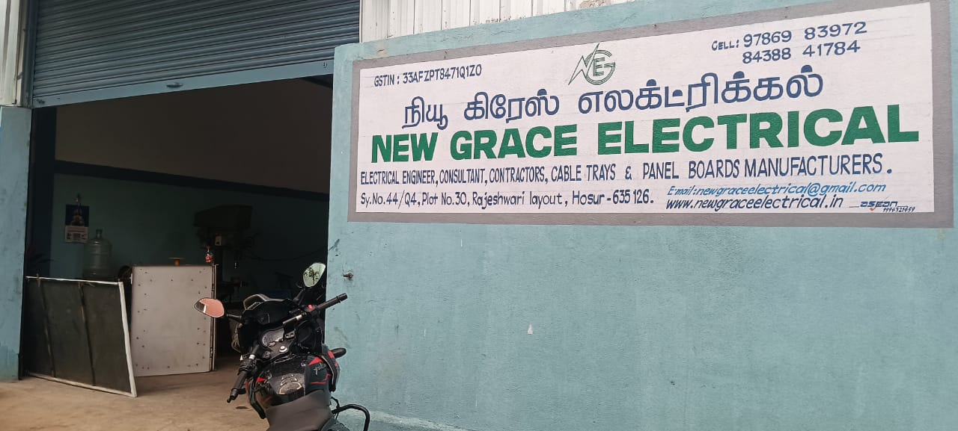
About Us
New Grace Electrical is an electrical engineering, consultancy and fabrication company based in Hosur, Tamil Nadu.
The company designs, manufactures and installs electrical panel boards, cable tray systems, and custom structural / sheet-metal fabrications for industrial clients.
Backed by an in-house fabrication shop with TIG & MIG welding, sheet-metal cutting and press-brake bending, the team delivers projects from design through site erection.
Electrical Engineers
Consultants & Contractors
Cable Tray Manufacturers
Panel Board Manufacturers
NEW GRACE ELECTRICAL
02

Slide 3
What We Do
Five integrated service lines, delivered end to end
1
Electrical Panel Boards & Switchgear
LT panels, MCC panels, distribution boards — designed, built and tested in-house.
2
Cable Tray Manufacturing
Perforated and ladder-type cable trays, galvanized for indoor and outdoor runs.
3
Structural & Sheet-Metal Fabrication
Custom enclosures, racks, trunking and structural steel work using TIG/MIG welding and press-brake bending.
4
Site Erection & Installation
Crane-assisted installation of gantries, mezzanines and grating platforms at client sites.
5
Electrical Consultancy & Contracting
Engineering design, consultancy and turnkey electrical contracting services.
NEW GRACE ELECTRICAL
03

Slide 4
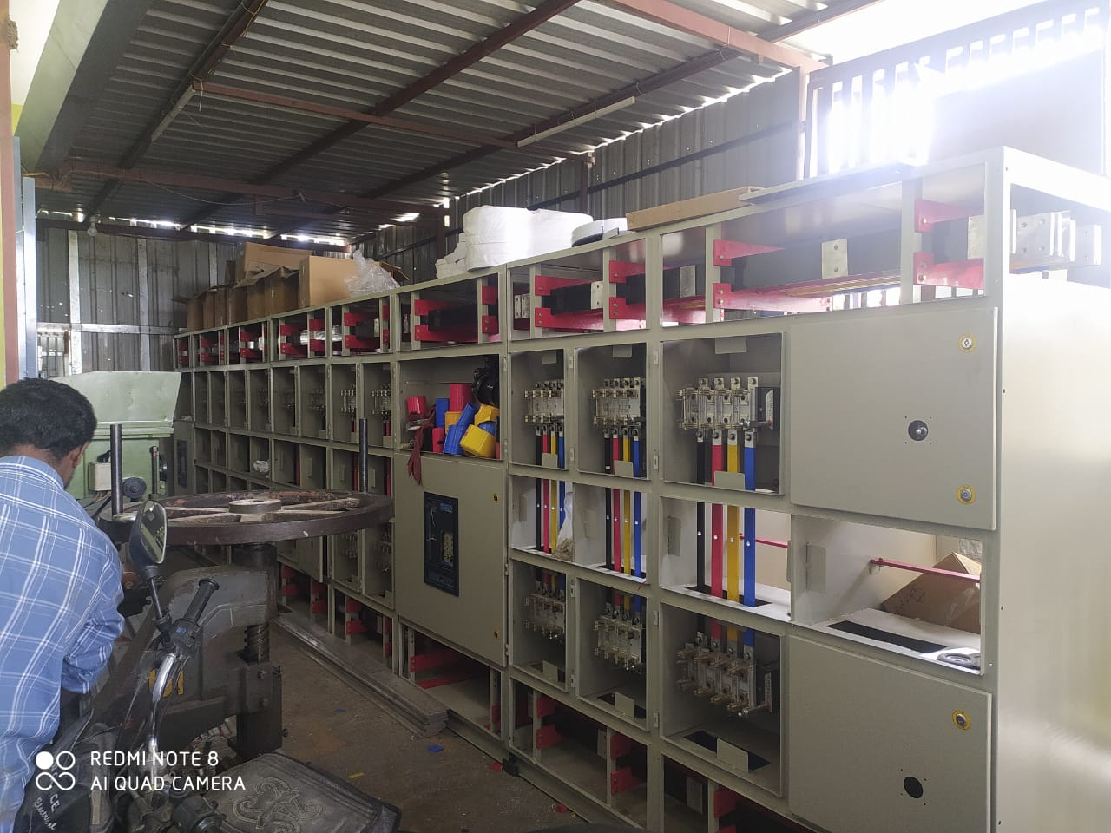
Panel Boards
& Switchgear
LT panel boards & MCC assemblies built to customer spec
Busbar fabrication, MCCB & switchgear integration
Factory testing before dispatch
Ready-to-commission enclosures with safety labeling
04

Slide 5
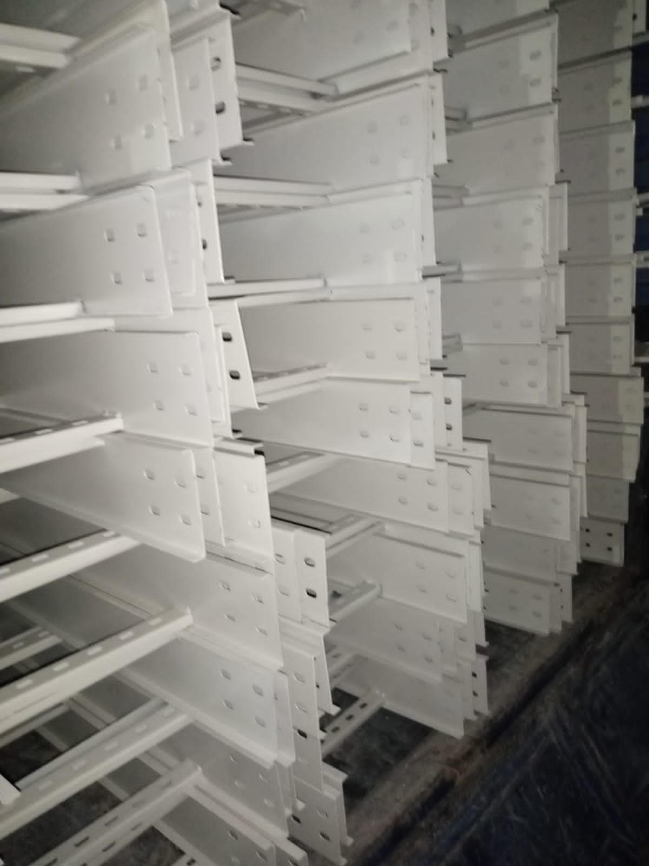
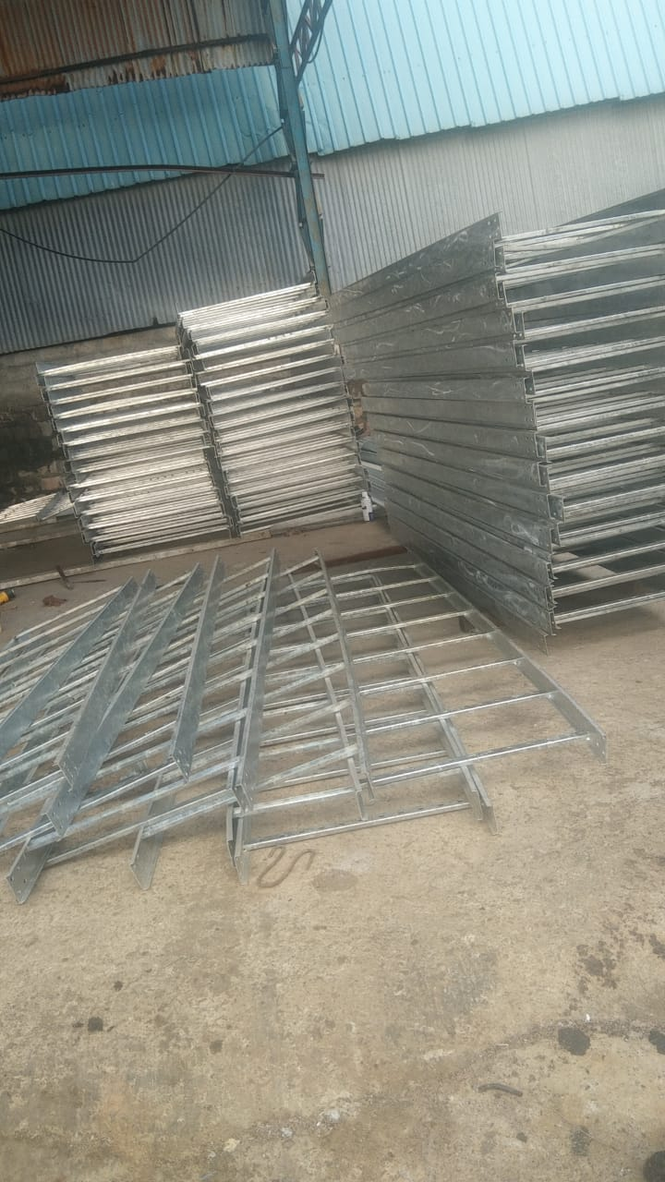
Cable Tray Manufacturing
Perforated & Ladder Type
Manufactured in-house from sheet steel and structural sections
Hot-dip galvanized finish for corrosion resistance
Indoor perforated trays and heavy-duty outdoor ladder trays
Supplied in bulk for industrial and site installation projects
NEW GRACE ELECTRICAL
05

Slide 6
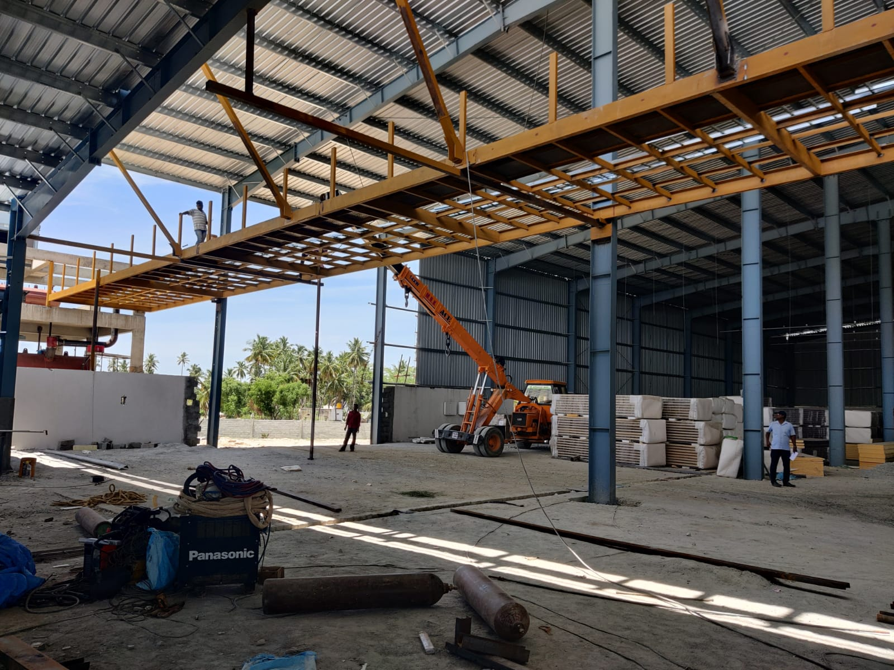
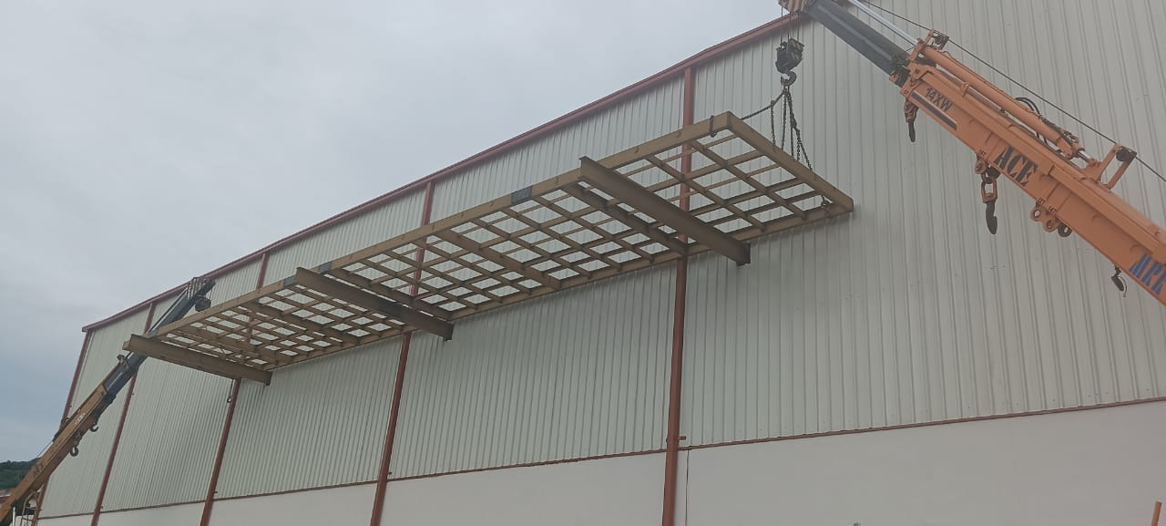
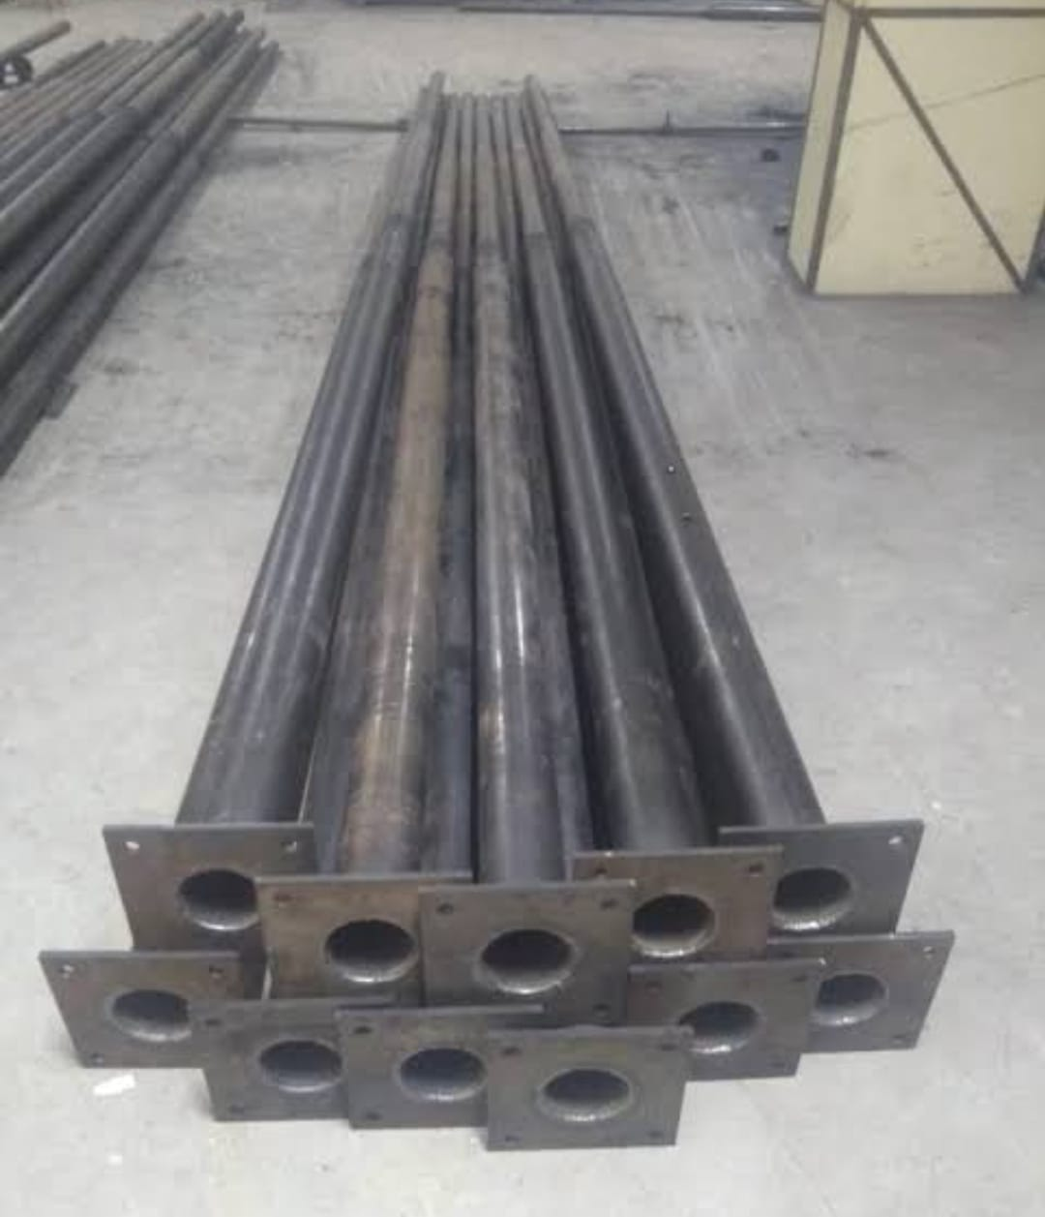
Structural Steel & Site Erection
NEW GRACE ELECTRICAL
06

Slide 7
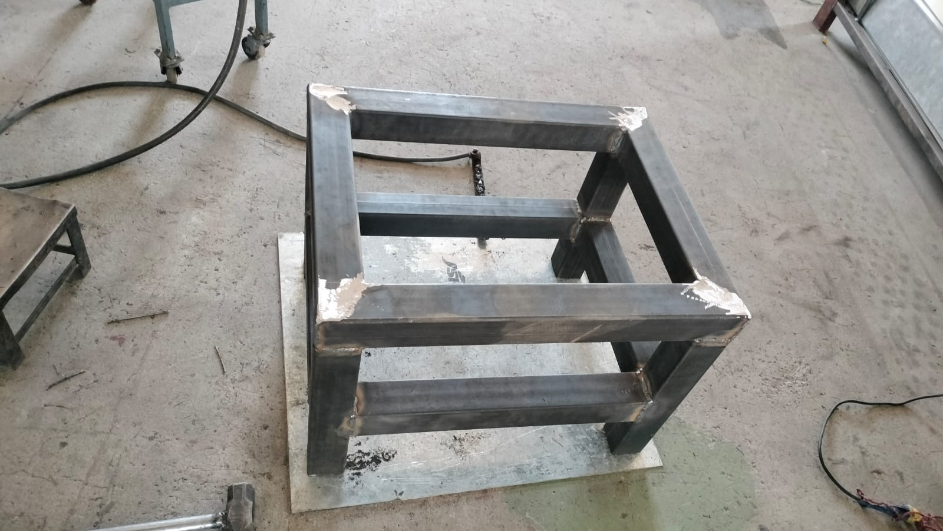
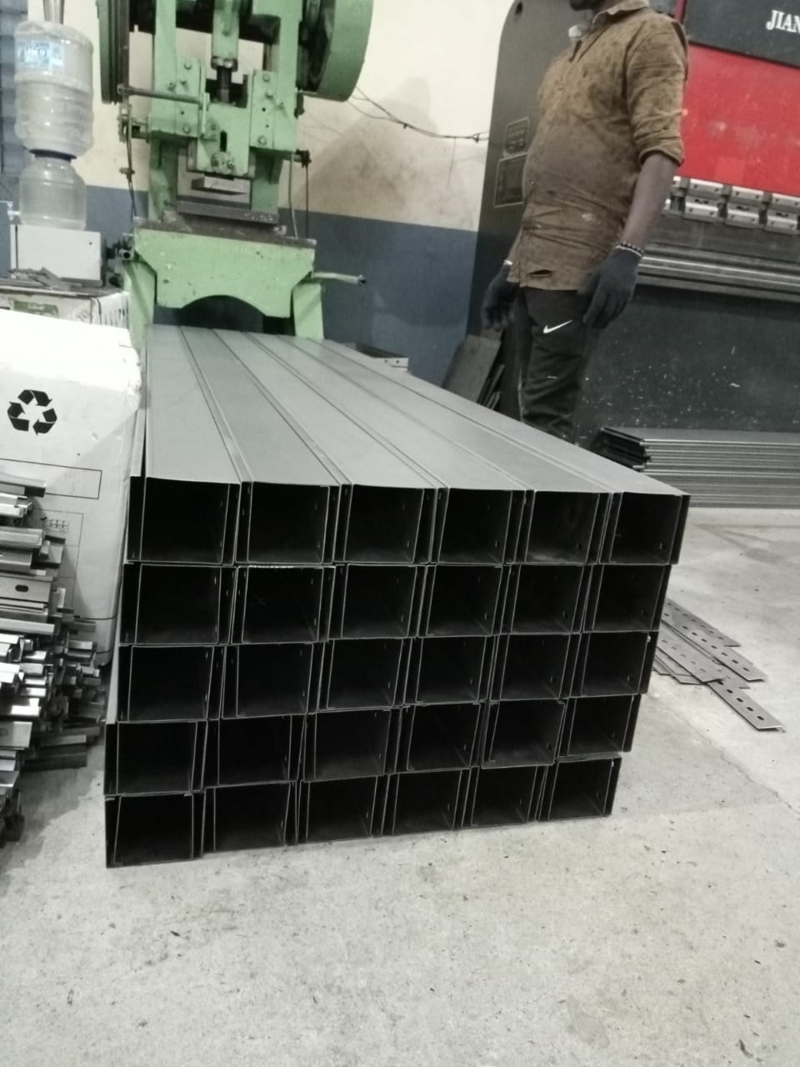
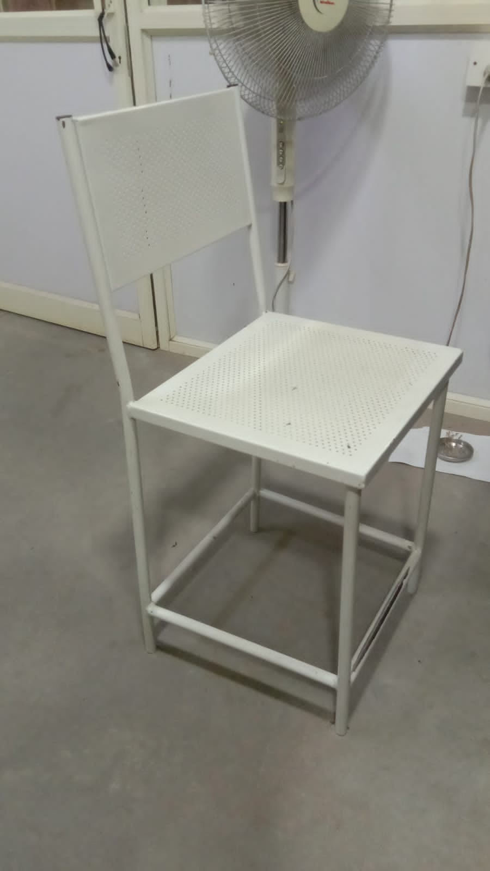
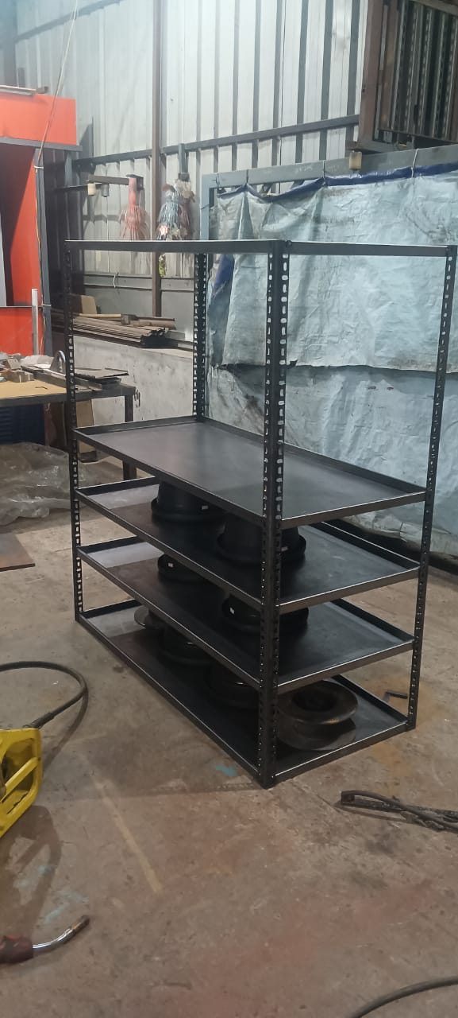
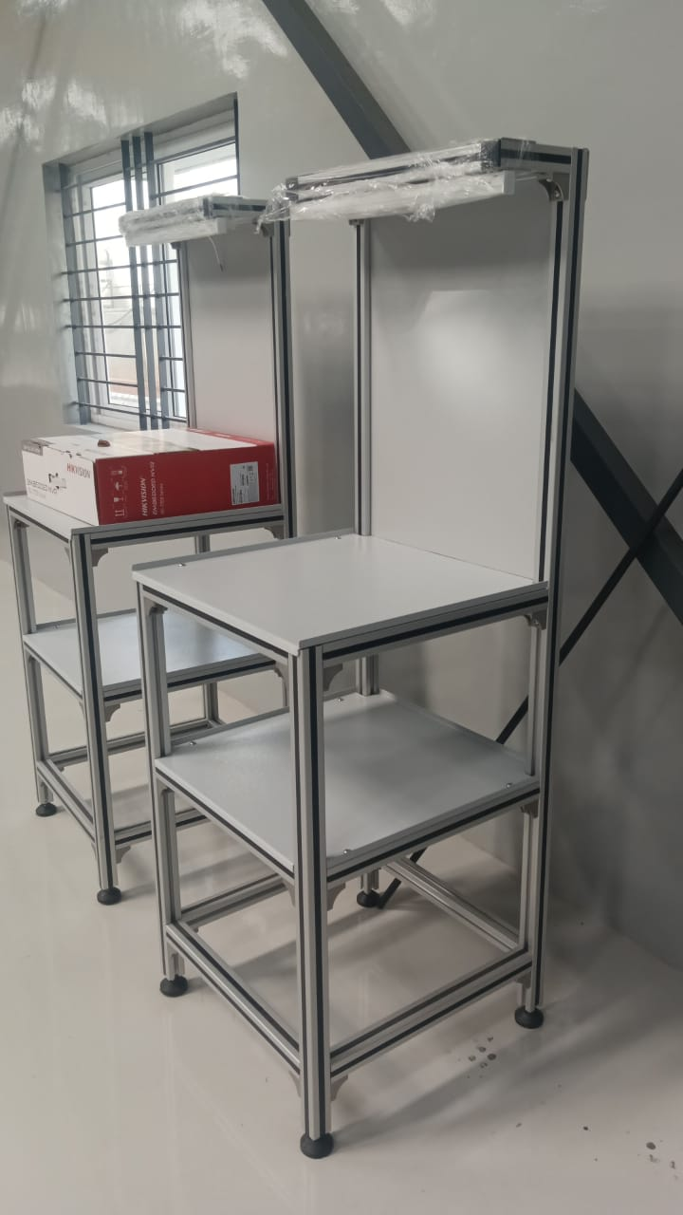
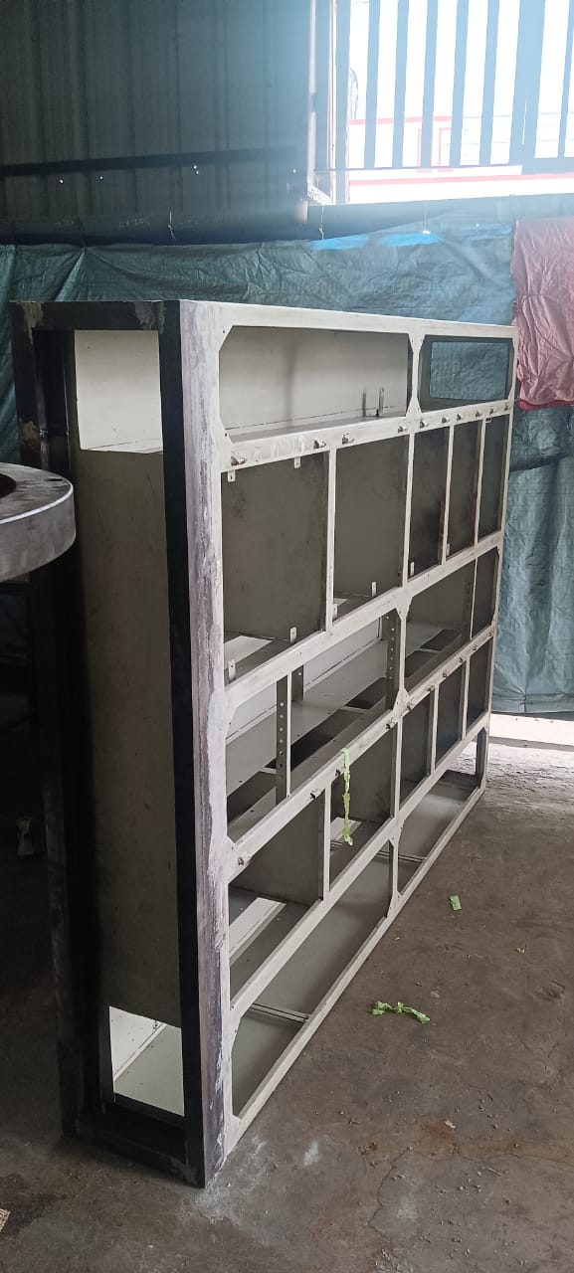
Precision Fabrication & Welding
In-house TIG & MIG welding, sheet-metal cutting and press-brake bending
NEW GRACE ELECTRICAL
07

Slide 8
Our Process
1
2
3
4
Design &
Consultancy
Cutting &
Fabrication
Assembly &
Panel Building
Site Installation
& Testing
→
→
→
Engineering review and design finalization with the client
Sheet-metal cutting, press-brake bending, TIG/MIG welding
Busbar, switchgear and panel assembly with in-house QC
Crane-assisted erection, commissioning and handover
NEW GRACE ELECTRICAL
08

Slide 9
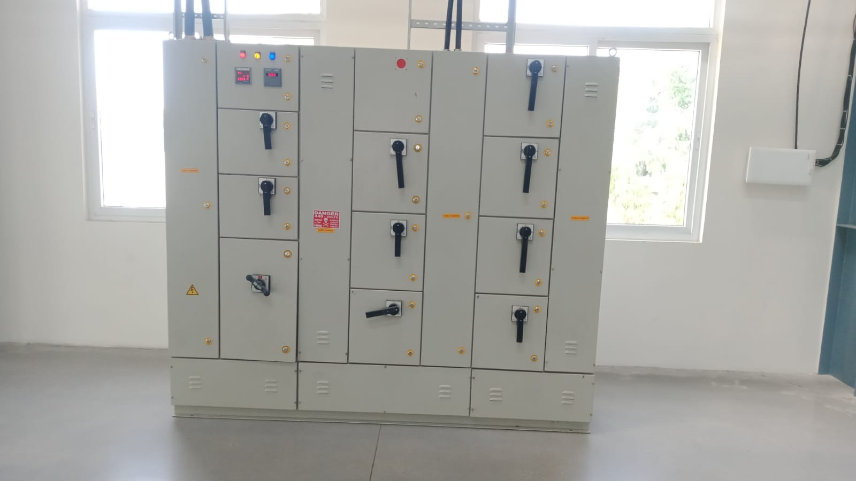
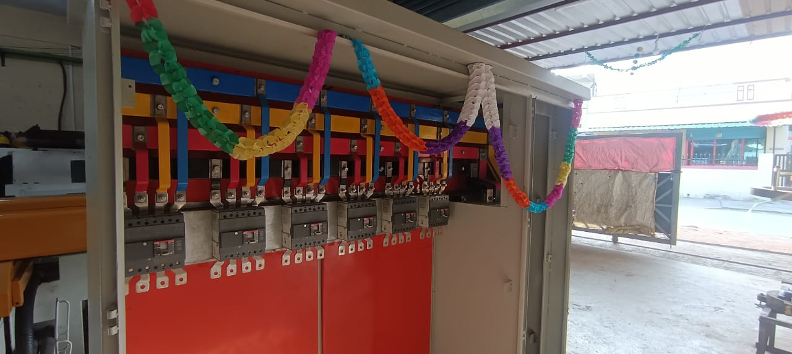
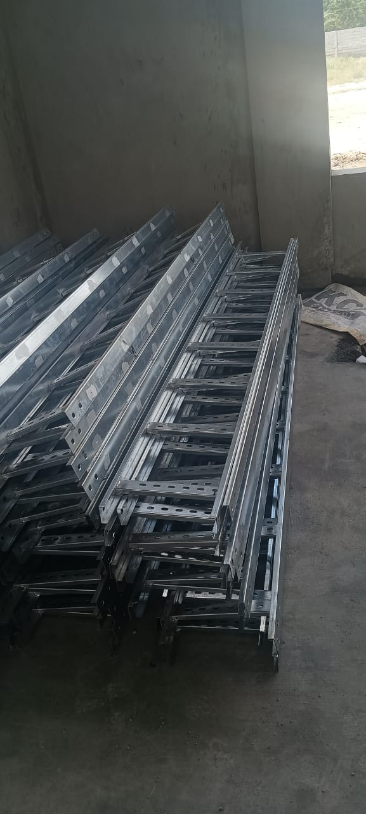
Completed Projects
Distribution panel — commissioned
Panel handover
Cable tray dispatch
NEW GRACE ELECTRICAL
09

Slide 10
Why Choose New Grace Electrical
In-House Fabrication
TIG/MIG welding, cutting and bending under one roof — full control on quality and lead time.
End-to-End Delivery
From design and consultancy through fabrication to site erection and commissioning.
Proven Site Execution
Crane-assisted installation of large structures such as gantries and mezzanine platforms.
Engineering-Led Team
Consultancy and contracting backed by qualified electrical engineers.
NEW GRACE ELECTRICAL
10

Slide 11
Let's Work Together
NEW GRACE ELECTRICAL
Electrical Engineer, Consultant, Contractors, Cable Trays & Panel Boards Manufacturers
ADDRESS
Sy.No.44/Q4, Plot No.30, Rajeshwari Layout, Hosur - 635126, Tamil Nadu
PHONE
97869 83972 / 84388 41784
EMAIL
newgraceelectrical@gmail.com
WEBSITE
www.newgraceelectrical.in
GSTIN
33AFZPT8471Q1ZO
11

