Slide 1


ST.ANNE’S COLLEGE OF ENGINEERING AND TECHNOLOGY,ANGUCHETTYPALAYAM
DEPARTMENT OF COMPUTER SCIENCE
& ENGINEERING
FINAL REVIEW
FACE MASK DETECTION AND PERSON IDENTIFICATION
BATCH-11
TEAM MEMBERS GUIDED BY,
N.KARTHIKEYAN(422117104022) Sr.A.PUNITHA JILT,
S.ARUNPANDIYAN(422117104007) ASSOCIATE PROFESSOR,
S.SANTHOSH(422117104045) ST.ANNE’S COLLEGE OF
G.P.VADALARASAN(422117104304) ENGINEERING AND

Slide 2
ABSTRACT
In this pandemic period of COVID-19 disease, more number of countries should be affected and lakhs of peoples died by this disease.
This model can be utilized for well being purpose since it is very asset effective to convey.
This project detect the face mask who wear or not and identified the person the owner of the masked face .
The datasets given in this paper, was gathered from different sources, can be utilized by different analysts for additional high level models like those of face acknowledgment, and facial part recognition measure.
The proposed approach in this paper utilizes profound learning, TensorFlow, Keras, and OpenCV to identify face veils.

Slide 3
INTRODUCTION
Affecting the health and lives of masses, COVID-19 has called for strict measures to be followed in order to prevent spread of disease.
Because crucial reason is more number of peoples affect by without wearing the mask in this pandemic period. In this type, this project is very useful.
This system is analyze the person's face that the mask wore or not. The face-eye-based multi-granularity model achieves 95 % recognition accuracy.
This technology is more relevant today because it is used to detect faces not only in static images and videos but also in real-time inspection and supervision.
They are used to facilitate self-focusing , the interaction between humans and computers, and managing image database.

Slide 4
LITERATURE SURVEY
S.NO | TITLE | DESCRIPTION | PUBLICATION DETAILS
1. | Facial mask detection using semantic segmentation | to design a binary face classifier which can detect any face present in the frame irrespective of its alignment. | Publisher : Scholarly articles Year of publication:2019
2. | COVID-19 Face mask detection with deep learning and computer vision | Use openCV to do real time face detection from a live stream via our webcam for the facemask detection data consist of with and without mask | Publisher : IEEE Year of publication:2019
3. | Face detection and recognition using openCV | Finding face recognition downside and concatenated into one feature vector that is employed to coach the system recognize among the prevailing photos with it | Publisher : IEEE Year of publication:2019

Slide 5
S.NO. | TITLE | DESCRIPTION | PUBLICATION DETAILS
4. | An automated system to limit COVID-19 using facial mask detection in smart city network | Public places are monitored with CCTV camera that who are not wearing mask in the pandemic time | Publisher : IEEE Year of publication:2020
5. | Face Detection and Segmentation Based on Improved Mask R-CNN | a face detection and segmentation method based on improved Mask R-CNN, named G-Mask, which incorporates face detection and segmentation into one framework aiming to obtain information of face. | Publisher : Research article Year of publication:2020 volume :2020 Article ID : 9242917

Slide 6
EXISTING SYSTEM
In this existing system , It is used to detect the persons that who are with mask or without mask in this pandemic period .
If the person wear the mask then it shows green light but not wore then it shows red color and alert them to wear the mask using a beep sound.
It is done with the help of deep learning algorithm, computer vision by using openCV, Tensor flow, Keras and PyTorch libraries.
It use datasets in two categories masked and unmasked faces here it split into three categories there are training dataset, test dataset and validation dataset

Slide 7
DISADVANTAGES
It not detect efficiently in all time ,sometimes it shows less efficient output.
It did not identify the person who wear the mask.
The accuracy of the project detection is less.

Slide 8
PROPOSED SYSTEM
Our project goal is to identify the person details while they wore the mask. In this system is fix in entrance of industries, companies, libraries, etc..
This technology mostly used in organization and especially monitoring the employees.
It is also used for security purpose in the industrial side or organizational side like illegal entry in the restricted area.
OpenCV DNNs have been used for face mask detection, which allows for real-time detection without much resource usage. It can also detect faces in different orientations and can also detect occluded faces with good accuracy. The proposed SSDMNV2 model performs various previous models.

Slide 9
ADVANTAGES
Reducing the spread of COVID-19 disease.
We can easily find who are follows the rules or not.
It identify the persons face transparently who wear the mask.
It give more accuracy output while compare than others.

Slide 10
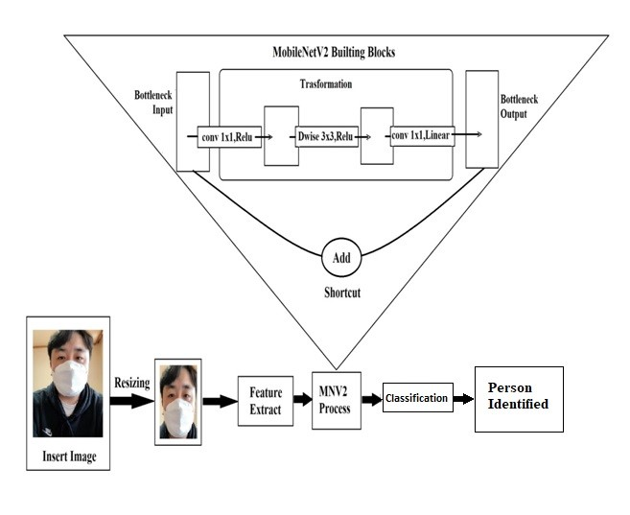
BLOCK DIAGRAM

Slide 11
IMPLEMENTATION
MODULES
Here, using three modules. They are,
Feature extraction
Face detection
Person identification
MODULES DESCRIPTION
Feature extraction
In this first module, it get the input image like masked face or unmasked face from the user. Then it crop the input image and extract the image feature using the deep learning algorithms convolution neural networks. After extract the image it goes to the second module.

Slide 12
Face Detection
In this second module the input image that is the result of feature extraction image going to recognize with the datasets to classify the image type. After classified the image it show the image type. Then it goes to the third module for the further process.
Person Identification
In third module, the detected image is compared to the database to find the real face of the masked face. After compared the faces finally it show the output of owner of the masked face image. Finally it stops their process.

Slide 13
SYSTEM REQUIREMENTS
SOFTWARE REQUIREMENT :
Language : Matlab c programming
Software : Matlab R2013a version
HARDWARE REQUIREMENT :
Processor : AMD PRO A4-3350B APU with Radeon R4 Graphics 2.00 GHz
RAM : 4.00 GB
Hard disk : 500 GB
System type : 64-bit Operating System, x64 based processor

Slide 14
ALGORITHM
Artificial Neural Network:
Artificial Neural Networks arguably works close enough to the human brain, Conceptually artificial neural networks are inspired by neural networks in the brain but the actual implementation in machine learning is way far from reality.
ANN take in multiple inputs and produce a single output.
Convolutional Neural Network :
In this planned method, the mask detection model is constructed victimization the successive API of the Keras library.
This permits us to make the new layers for our model step by step. The assorted layers used for our CNN model is represented below.

Slide 15

OUTPUT SCREENSHOTS
Upload and Run the file

Slide 16
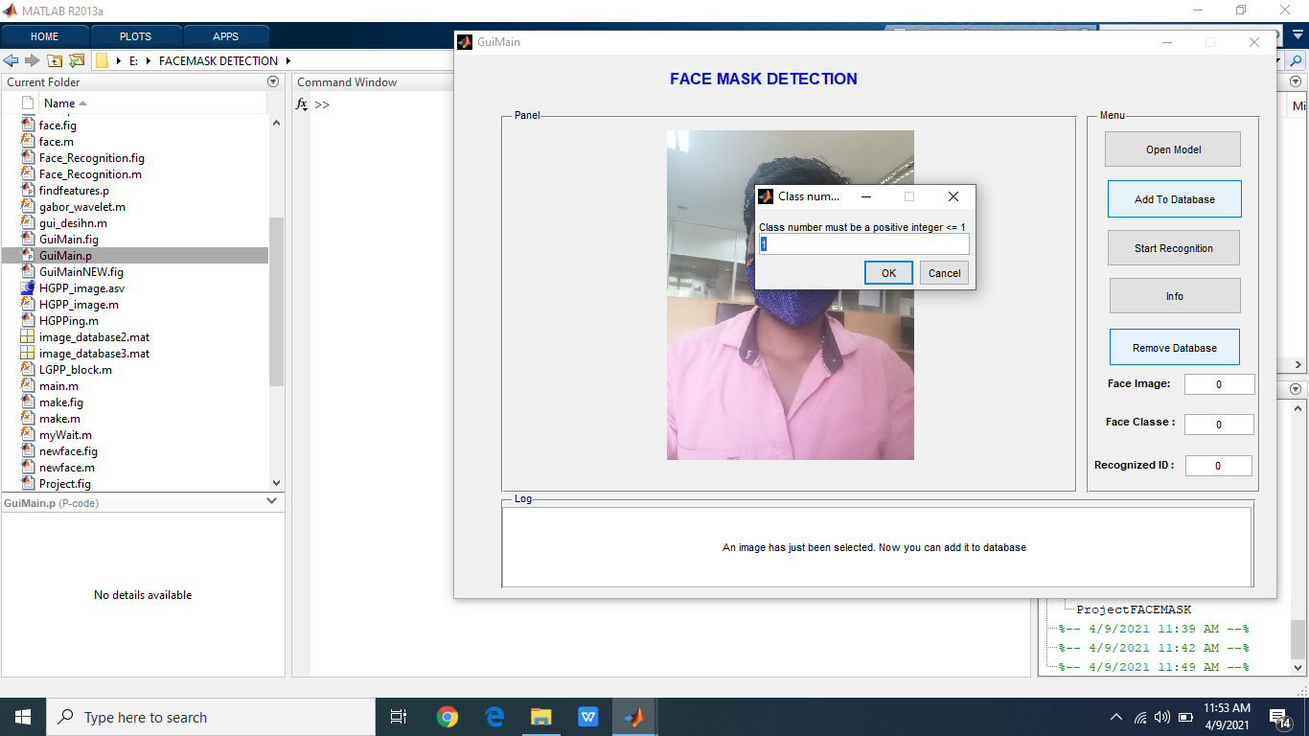
Image add to database

Slide 17
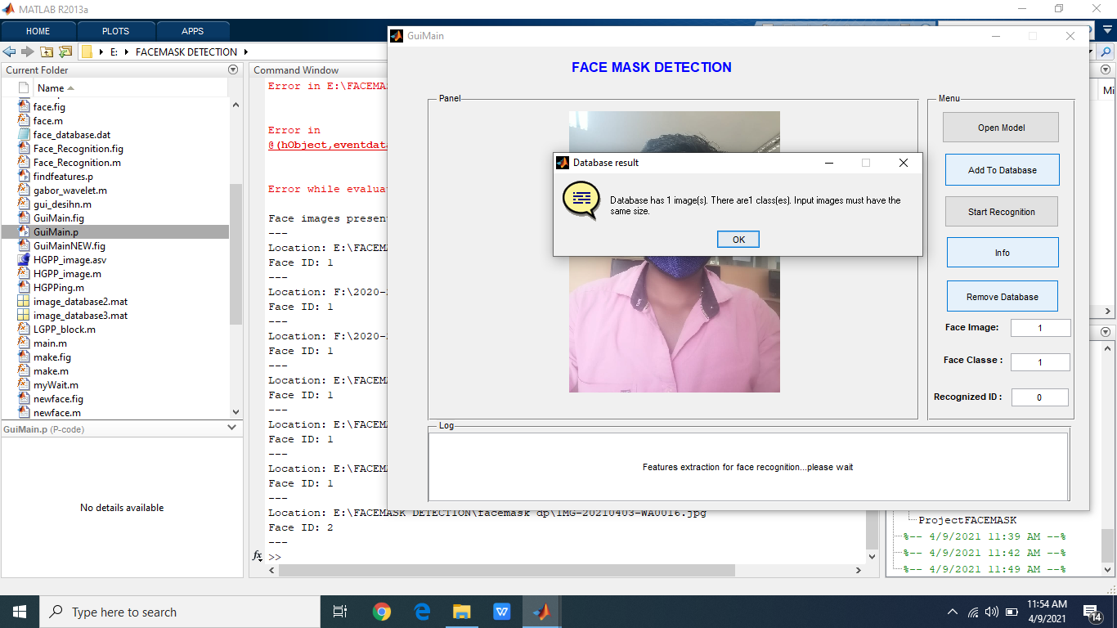
Face recognition

Slide 18
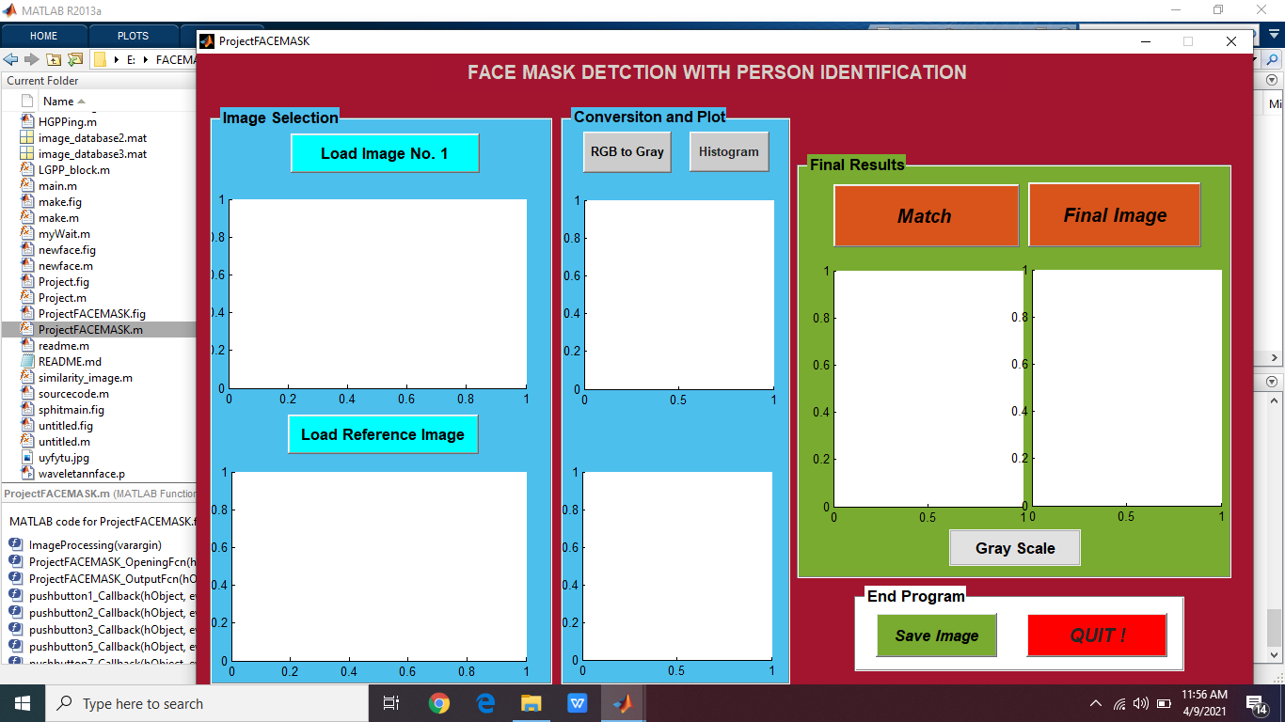
Person Identification screen

Slide 19
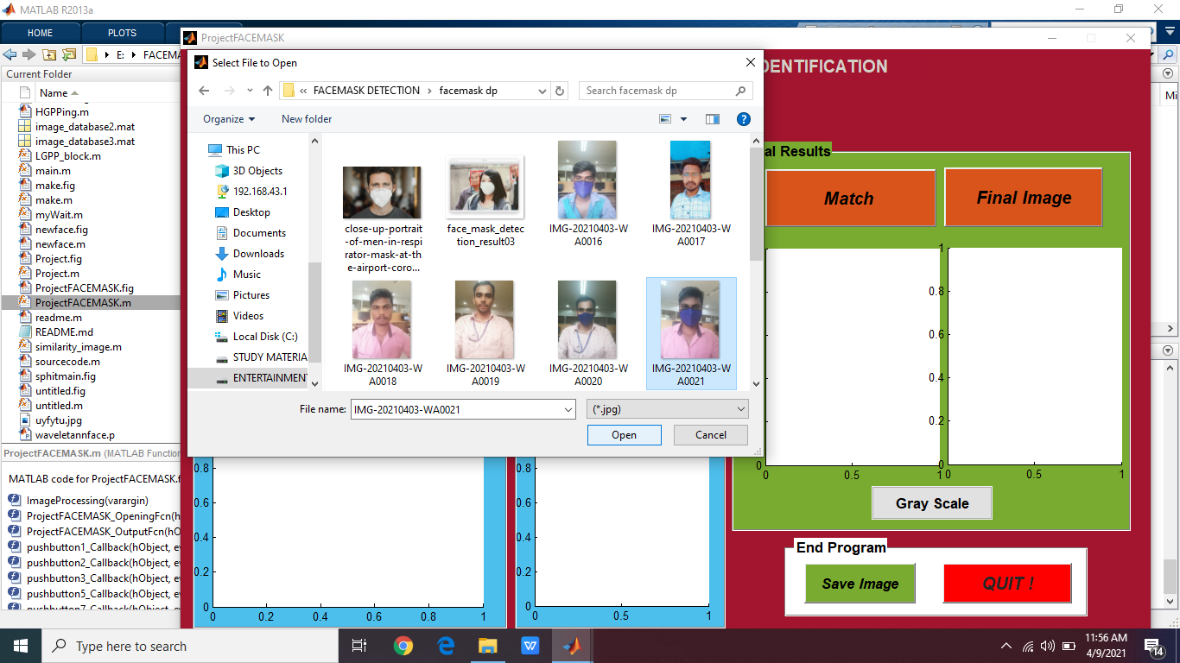
Upload input image

Slide 20
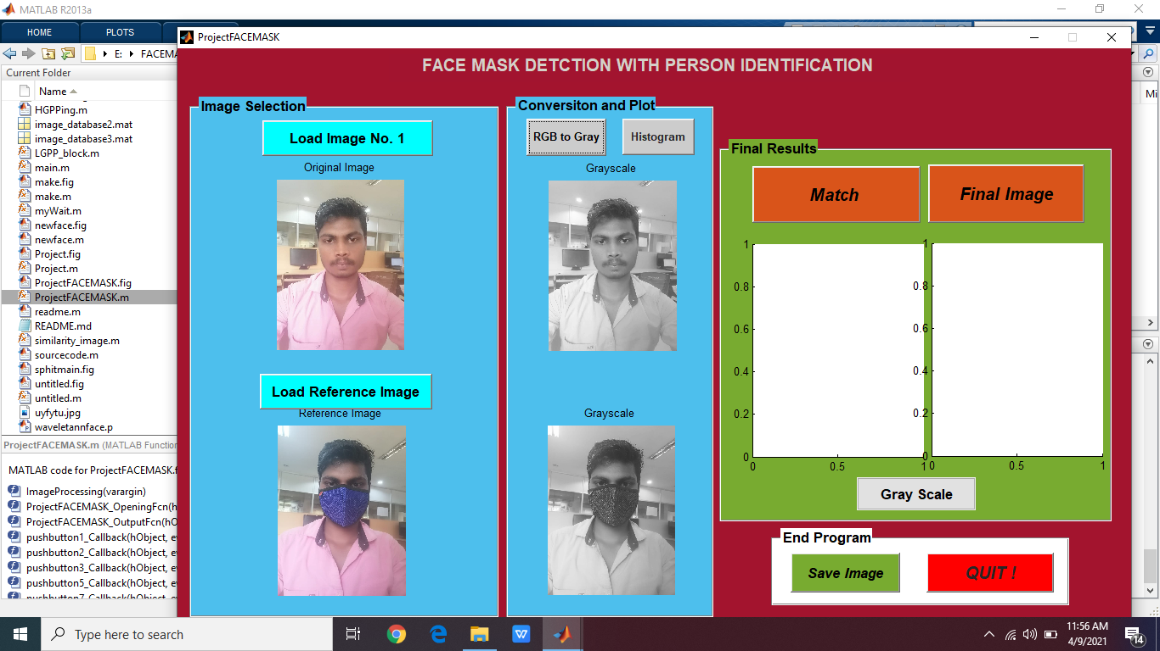
Got Grey scale image

Slide 21
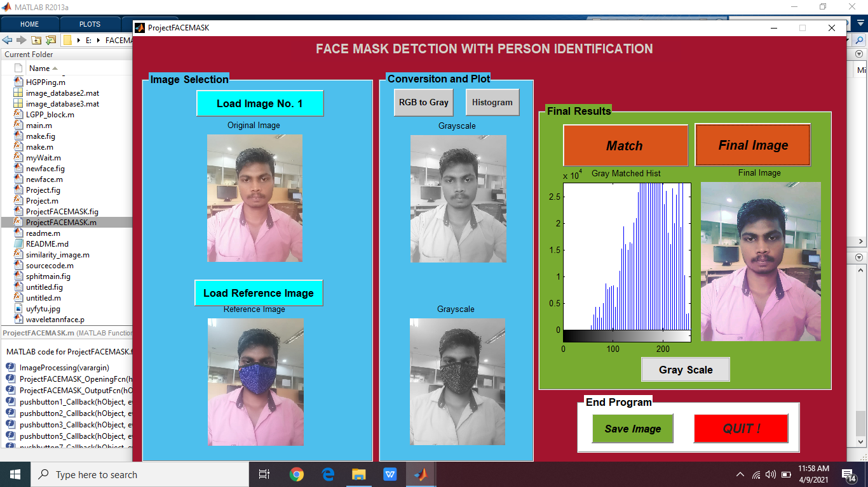
Final image

Slide 22
FUTURE ENHANCEMENT
Further this system development, we could improve the range of the public place. Because this project will helpful for small places like school, industrial organizations, exam centre and etc... And here after the future enhancement is add the people details that are the details of the person.
These features are added in this project then this project goes to be a very important thing for this society. Because this project goes to help for the college/school, companies, other places and it is very helpful to the police department also.

Slide 23
CONCLUSION
The current study used OpenCV, Pytorch and CNN to detect whether people were wearing face masks or not and identify the person face .
The models were tested with images and real-time video streams. Even though we increase the accuracy of the model, the optimization of the model is a continuous process.
This project is really helpful and make secure the people’s, environment in this pandemic period.

Slide 24
CONFERENCE / JORNAL STATUS
I applied and attended this paper in International Conference on Research and Development in Science Engineering and Technology(ICRDSET) on 5th March 2021.

Slide 25
REFERENCE :
[1] R. Girshick, J. Donahue, T. Darrell, and J. Malik, “Rich feature hierarchies for accurate object detection and semantic segmentation,” in Proceedings of the IEEE conference on computer vision and pattern recognition,2014, pp. 580–587.
[2] R. Girshick, “Fast r-cnn,” in Proceedings of the IEEE international conference on computer vision, 2015,pp. 1440–1448.
[3] S. Ren, K. He, R. Girshick, and J. Sun, “Faster r-cnn: Towards real-time object detection with region proposal networks,” in Advances in neural information processing systems, 2015, pp. 91–99.
[4] W. Liu, D. Anguelov, D. Erhan, C. Szegedy, S. Reed, C.-Y. Fu, and A. C. Berg, “Ssd: Single shot multibox detector,” in European conference on computer vision. Springer, 2016, pp. 21–37.

Slide 26
Thank you....

