Slide 1


iHackMyPlace Hackathon
Automating VBA Macro Documentation and Transformation
Done By
Karthikeyan A S
715521104022
B.E. Computer Science and Engineering
PSG Institute of Technology and Applied Research
Coimbatore - 641062

Slide 2

Problem Statement
The problem statement is to develop a solution that automates the documentation and
Understanding of legacy VBA macros used in critical processes across DFIN, facilitating their transformation into modern technologies and IT platforms. The problem statement involves developing a Macro Analysis Tool that : 1. Utilizes Gen AI or ML techniques to automate documentation process
2. Provides a interactive user interface that is easy to use
3. Generates reliable and accurate documentation

Slide 3




Proposed Solution
In the solution proposed, a react application was developed .This application enables the user to upload a macro enabled excel file.
The VBA macros are extracted using a python script .
The extracted macro is given to a pre-trained Gemini-Pro model to analyze the code.
The Gemini-Pro model is used to generate a comprehensive documentation that explains the process flow, data flow in the macro.
The Gemini-Pro model extracts the function logic from the code and describes it in a easy to understand way.
The function logic that is extracted is used to create a process flow diagram using the schemedraw tool. The documented code, functional logic and the flow diagram can be downloaded as a PDF file generated using the report lab tool.

Slide 4
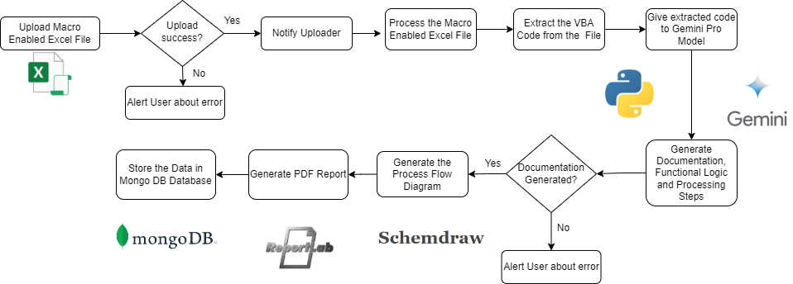
Flow Diagram

Slide 5
Benefits of the Proposed Solution
The following are the benefits of the proposed solution:
Ease of use even to new users
Comprehensive documentation and function logic extraction to simplify understanding of legacy code.
Process flow diagrams provides visualization of the function logic that simplifies understanding.
Generation of PDF reports that can be among team members to improve collaborative learning .

Slide 6
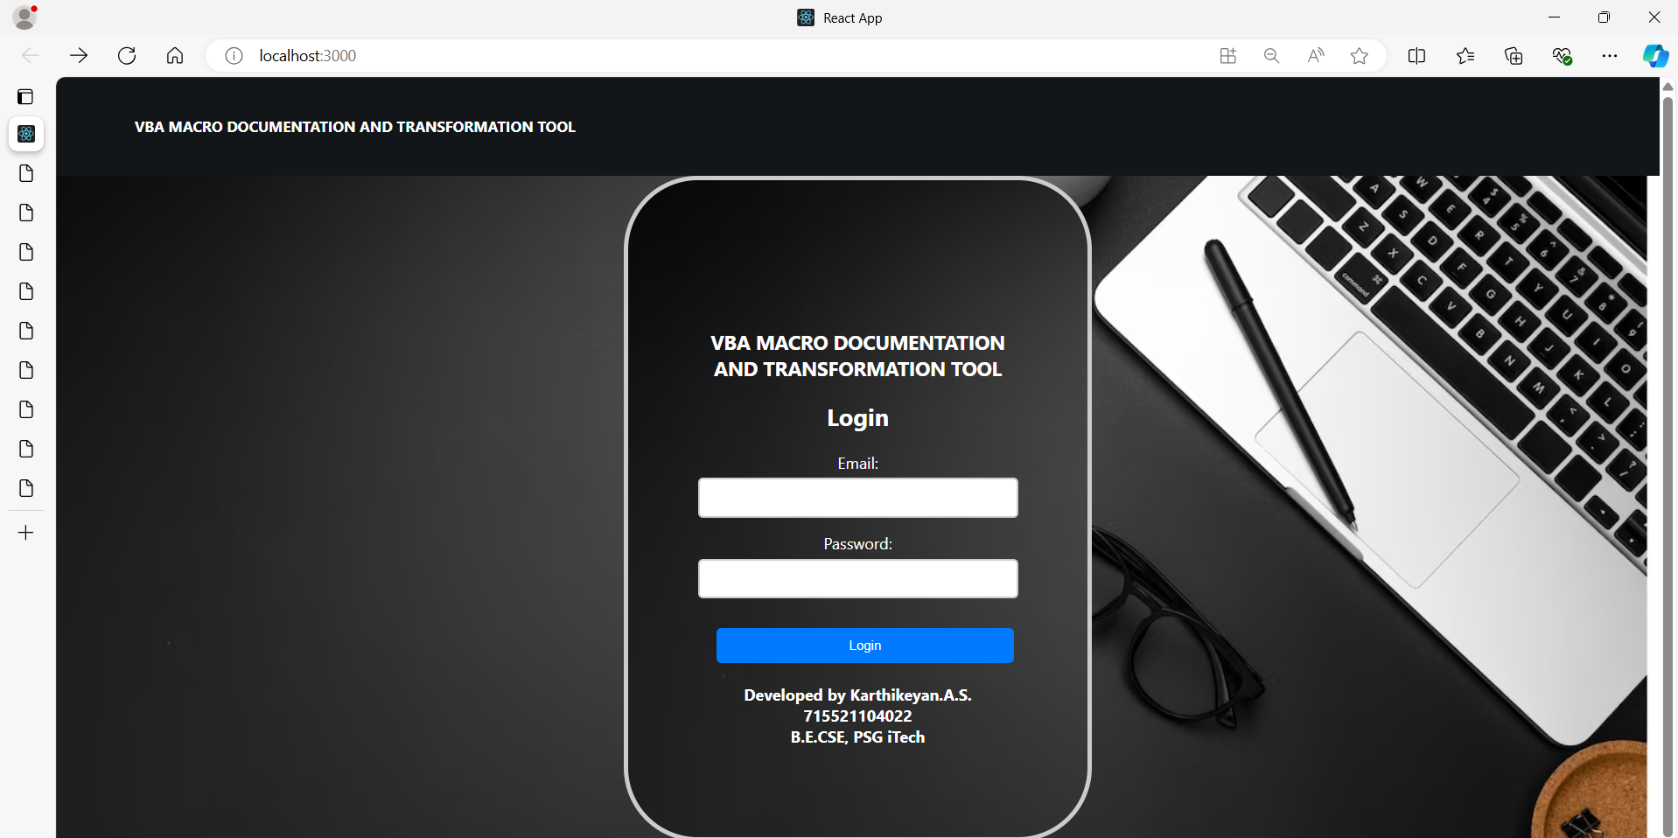
Output

Slide 7
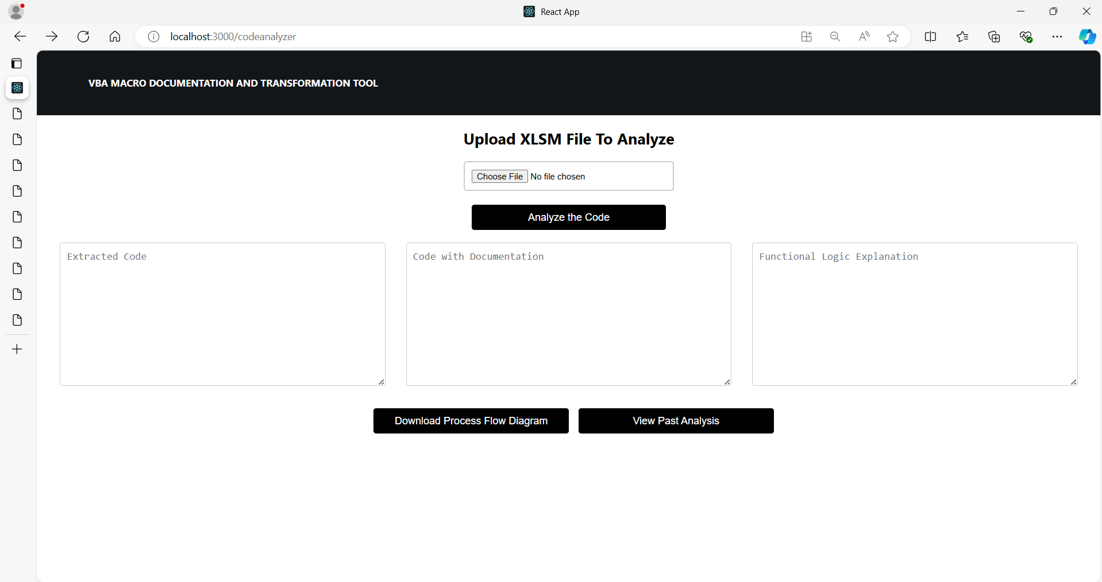
Output

Slide 8
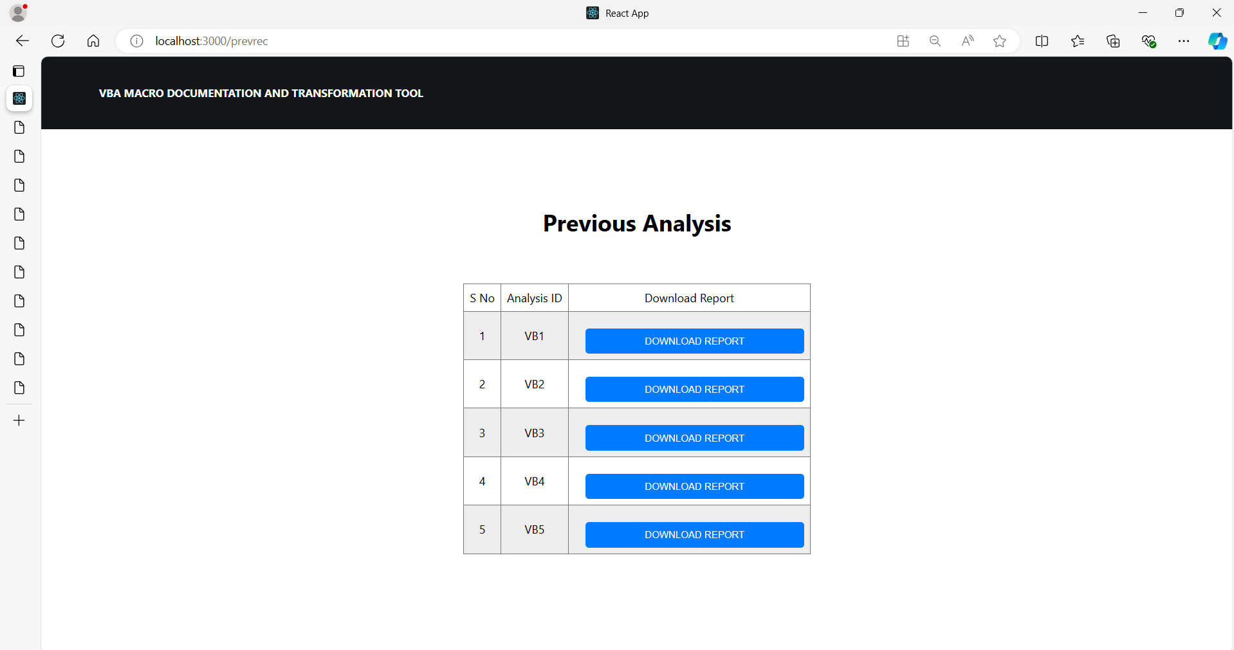
Output

Slide 9
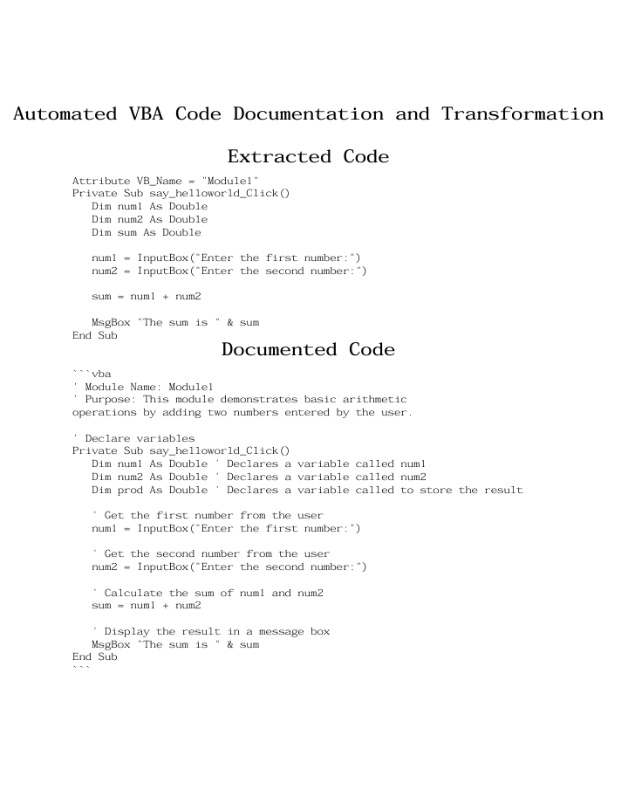
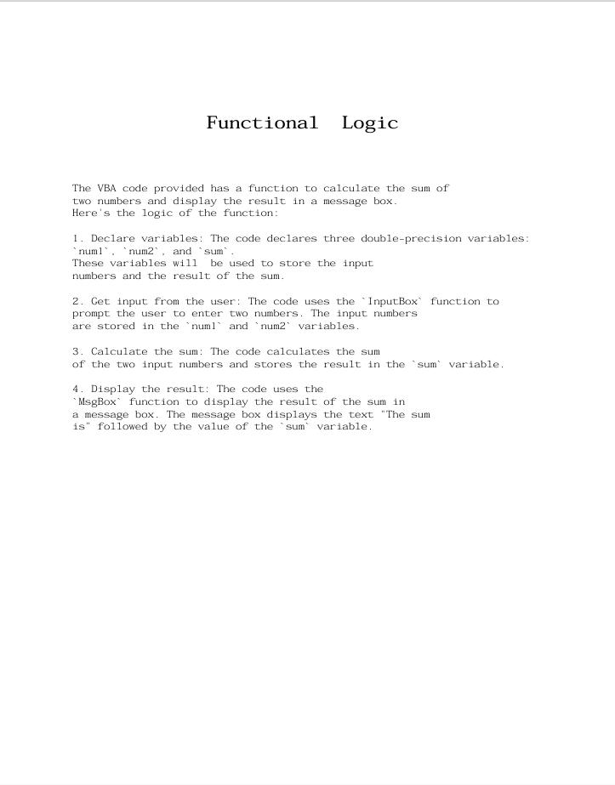
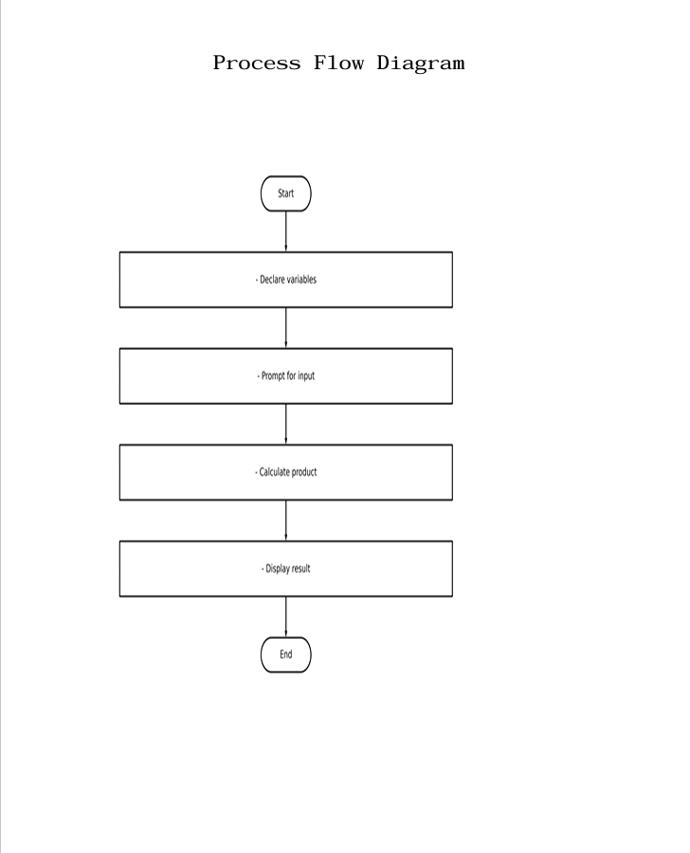
Output

Slide 10
Thankyou

