Slide 1
Karthikeyan PS
Final Project
3/21/2024 Annual Review

Slide 2
PROJECT TITLE
Random Forest Regressor
3/21/2024 Annual Review

Slide 3


AGENDA
PROBLEM STATEMENT
PROJECT OVERVIEW
WHO ARE THE END USERS?
YOUR SOLUTION AND ITS VALUE PROPOSITION
THE WOW IN YOUR SOLUTION
MODELLING
RESULTS
3/21/2024 Annual Review

Slide 4

PROBLEM STATEMENT
The objective is to develop a predictive model for Uber pickup demand using historical data. The dataset ('uber.csv') includes details like pickup date and time, hour, day of the week, and pickup counts. Initially, the data is preprocessed, converting date-time entries and extracting relevant features. Then, a RandomForestRegressor model is trained and evaluated using Mean Squared Error. Predictions are made for new data, and a scatter plot visualizes actual versus predicted pickup counts. Peak hours are identified based on the highest pickup counts. Additionally, decisions are made using a specified threshold for expected demand, enabling appropriate actions like driver allocation or promotions. The deliverables include Python code, visualizations, and documentation summarizing the approach, model performance, and actionable insights.
3/21/2024 Annual Review

Slide 5

PROJECT OVERVIEW
The project aims to develop a predictive model for Uber pickup demand using historical data. By analyzing factors such as pickup date, time, and day of the week, the model predicts the number of pickups, aiding in resource allocation and service optimization. Through data preprocessing, model training, and evaluation, insights are gained into peak hours and expected demand levels. This enables proactive decision-making, such as adjusting driver schedules or offering promotions during high-demand periods. The project encompasses data analysis, machine learning implementation, and actionable recommendations, contributing to improved efficiency and customer satisfaction in the transportation service industry.
3/21/2024 Annual Review

Slide 6

WHO ARE THE END USERS?
Operations Managers:
Dispatchers
Marketing and Promotions Teams:
Product Development Teams
Business Analysts and Strategists
Customers
3/21/2024 Annual Review

Slide 7

YOUR SOLUTION AND ITS VALUE PROPOSITION
The predictive model for Uber pickup demand offers significant value by providing actionable insights to enhance operational efficiency and customer satisfaction. By analyzing historical data such as pickup times, dates, and days of the week, the model accurately forecasts future demand for Uber pickups. This allows Uber to optimize resource allocation, ensuring an adequate number of drivers are available during peak demand periods, reducing passenger wait times, and improving service reliability. Additionally, the model enables proactive decision-making, such as targeted promotions and marketing campaigns during high-demand hours, enhancing customer engagement and retention. By leveraging the model's predictions, Uber can streamline its operations, improve the overall user experience, and maintain its competitive edge in the transportation industry.
3/21/2024 Annual Review

Slide 8

THE WOW IN YOUR SOLUTION
The wow factor in our solution lies in its ability to seamlessly integrate cutting-edge machine learning techniques with real-world transportation operations. By harnessing the power of data analytics, our predictive model empowers Uber to anticipate demand fluctuations accurately, ensuring that sufficient resources are available precisely when and where they're needed most. This not only enhances operational efficiency but also elevates the overall user experience, minimizing wait times for passengers and maximizing earnings for drivers. Moreover, our solution enables Uber to stay ahead of the curve by proactively adapting to changing market dynamics, driving innovation, and delivering exceptional service that keeps customers coming back for more. It's not just about predicting demand; it's about revolutionizing the way Uber operates, setting new standards for efficiency, reliability, and customer satisfaction in the transportation industry.
3/21/2024 Annual Review

Slide 9
MODELLING
The code uses a RandomForestRegressor model to predict Uber pickup demand. This model combines multiple decision trees to make accurate predictions based on features like the hour of the day and the day of the week. The Mean Squared Error (MSE) metric evaluates how well the model performs. If the predicted demand exceeds a certain threshold, actions such as allocating more drivers or offering promotions are taken to meet expected high demand.
3/21/2024 Annual Review

Slide 10

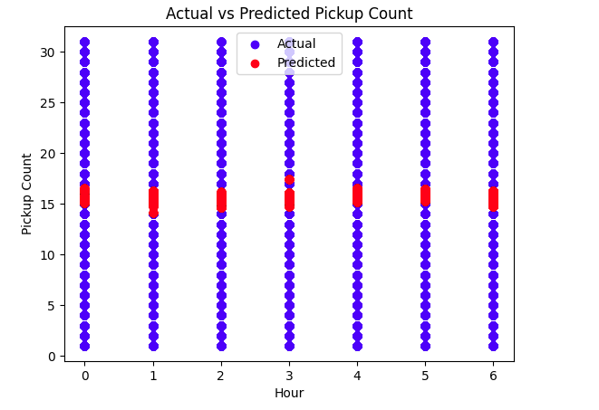


RESULTS
https://github.com/karthikeyan7325/Naan-Muthalvan
3/21/2024 Annual Review

