Slide 1

Azure DevOps
Leveraging Boards, Repos & Pipelines for
Continuous Planning & Delivery

Slide 2

Agenda
Azure DevOps Overview
Continuous Planning
Continuous Integration & Delivery
Real-time Project (Mobile App in Azure)
Q&A

Slide 3
Visual Studio Team Services is now Azure DevOps Services
Azure DevOps Services
Azure DevOps Services is a cloud service for collaborating on code development
Azure DevOps Server
Azure DevOps Server is the on-premises version of Azure DevOps Services
Notes:
Microsoft DevOps
https://mva.microsoft.com/learning-path/devops

Slide 4
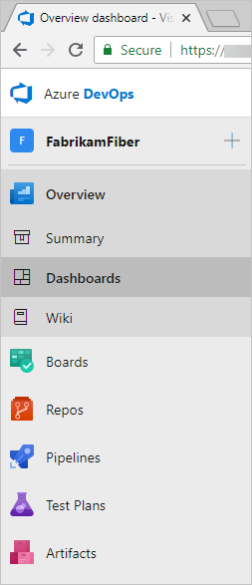





Overview of Azure DevOps Services
Highly customizable Dashboards for sharing progress & trends
Agile Boards to support Continuous Planning and tracking your work, code defects, and issues using Kanban and Scrum method
ADO Git Repositories for source control of your code
Build & Release Services to support Continuous Integration and Continuous Delivery of your apps
Many tools to Test your apps, including manual/exploratory testing thereby enabling Continuous Testing
Built-in Wiki for sharing information within your team

Slide 5
Continuous Planning
Continuous Integration & Delivery

Slide 6
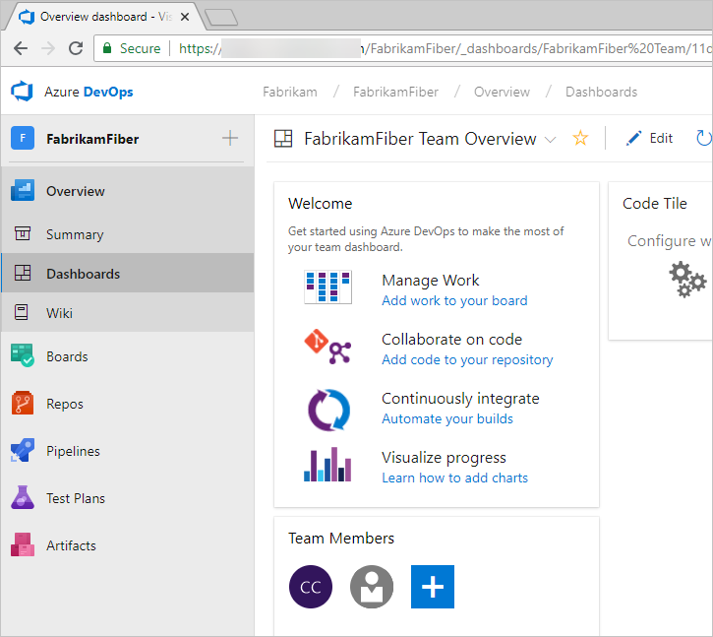
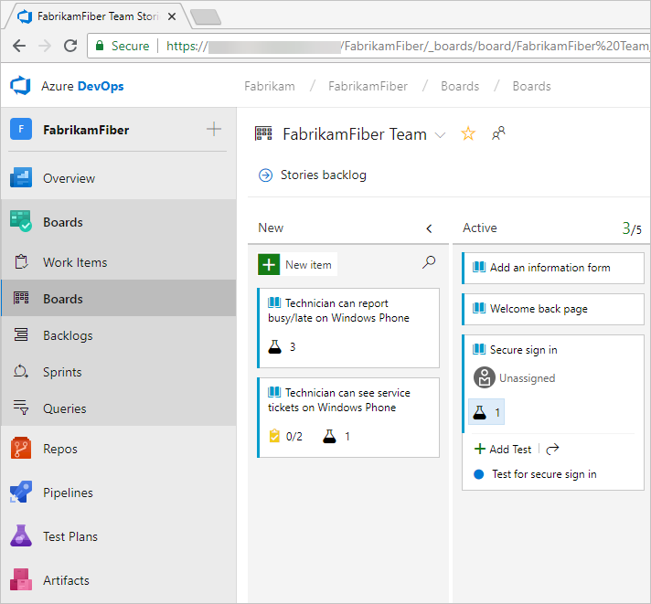
Continuous Planning: Boards & Dashboard
Dashboards
Agile Boards

Slide 7
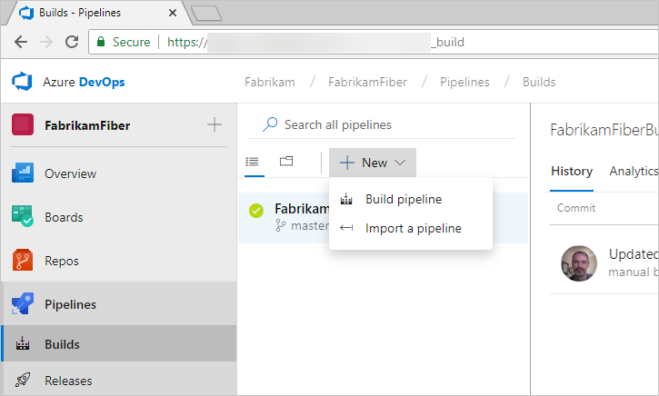
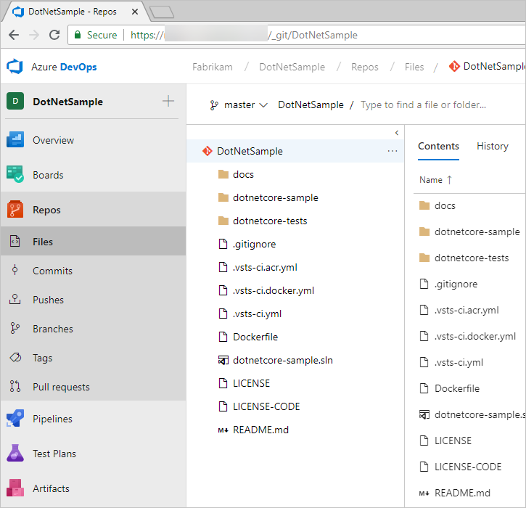
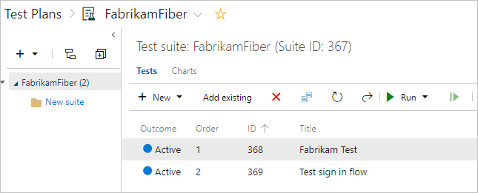
Continuous Integration: Repos, Pipeline & Testing
Source Code Management
CI-CD
Manual / Exploratory Testing

Slide 8
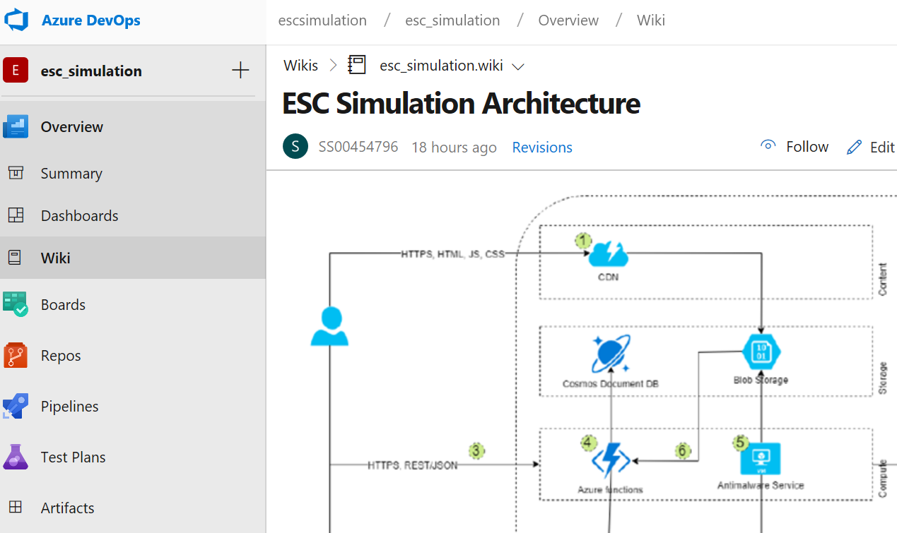
ADO - Wiki
a highly collaborative and interactive platform
Project Wiki
Team Dashboards
Discussion within work item forms
Linking of work items, commits, pull requests, and other artifacts to support traceability
Alerts and change notifications managed per user, team, project, or organization
Ability to request and manage feedback
Analytics service, analytic views, and Power BI reporting

Slide 9
Real-time Project Mobile App using Azure
Satish Sivaraman – Fullstack Architect
Chockalingam – DevOps Architect

Slide 10
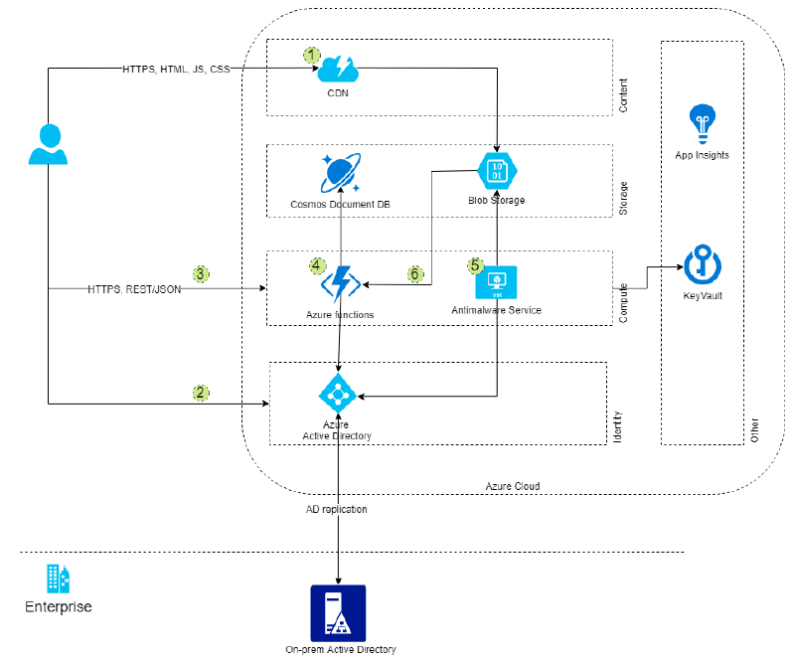

Responsive Mobile App on Azure
Notes:
Microsoft DevOps
https://mva.microsoft.com/learning-path/devops

Slide 11

Git – Single Repo with Sub-Folders
Branch
Mobile App - Development
Folders
antimalware
frontend
backend
Build Pipeline – frontend_backend-CI
Build Pipeline – antimalware-CI
Agent – Front End
Agent – API
Agent – AntiMalware
Phase 1
Phase 1
Phase 1
Nuget
VS Build
Publish
Nuget
VS Build
Publish
NPM Install
NPM Build
Publish
Release Pipeline – frontend_backend-CD_Dev
Release Pipeline – antimalware-CD_Dev
Artifact –
Frontend
Artifact –
Backend
Artifact –
Antimalware
DEV Environment
DNS_SafetyApp_Dev
Release Dashboard
Test Environment
DNS_SafetyApp_Test

Slide 12
Walkthru of Azure DevOps project

Slide 13
Q&A

Slide 14

Questions or Thoughts?
How to reach out to me?
Madan Sudarman
Cloud & DevOps – Practice Head
MS00564059@TechMahindra.com
Keep participating in Azure Meetups

