Slide 1

Visual Studio 2017 Features
Karthikeyan VK
Web Application Architect
@Karthik3030

Slide 2
Visual Studio 2017 Features
Faster & Leaner
Live Unit testing
Latest useful Shortcuts
Code Analysis
C# 7 features
Docker Integration with VS
Visual studio.com – CI
Notes:
In this session we are going to talk through creating a cloud-supported application from the ground up stating with File->New Project. We’ll see this architecture built up including shared UI with Xamarin Forms and Native UI on Android.

Slide 3
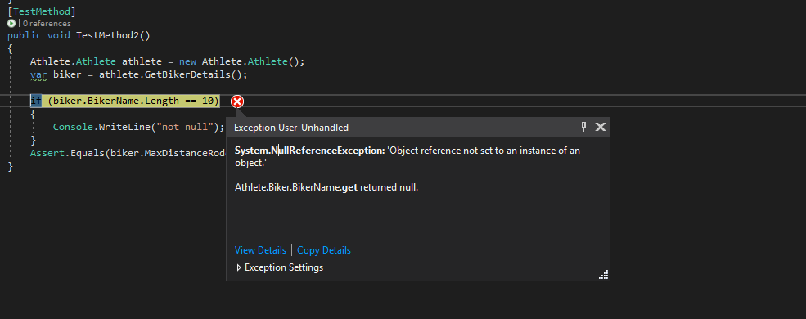
Demo – Productivity Redefined
Modify VS 2017
Enable Light Weight Solution load
Live Unit Testing
Object Reference exception message – Finally Useful
Find all references
Goto – Ctrl+T
.Editorconfig
Auto Complete Filter
Notes:
Modify VS 2017 – VS Installer in Search
Enable Light Weight Solution load – Tools-Options-Search for Lightweight-General
Live Unit Testing
Object Reference error and what element is null
Find all references
Auto Complete Filter
Refactor to new file
Suggestions
Goto – Ctrl+T
Editor.config

Slide 4
C# 7.0 New Features
Tuples
Out Variables
Patterns
Switch Statement with Patterns
Literal Improvement
Expression Bodied members – Constructor and Finalizers
Throw Expressions
Notes:
Tuples
Out Variables
Patterns
Switch Statement with Patterns
Literal Improvement
Return by ref
Expression Bodied members – Constructor and Finalizers
Throw Expressions

Slide 5
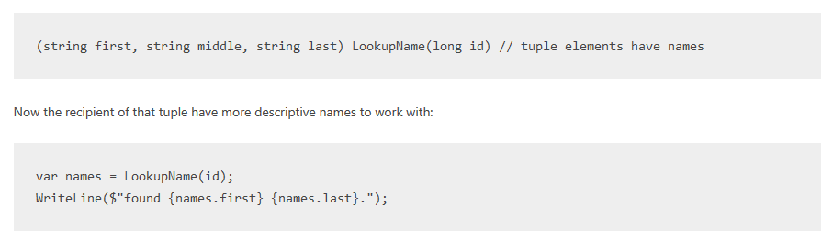
C# 7.0-Tuples
Notes:
Tuples
Out Variables
Patterns
Switch Statement with Patterns
Literal Improvement
Return by ref
Expression Bodied members – Constructor and Finalizers
Throw Expressions

Slide 6
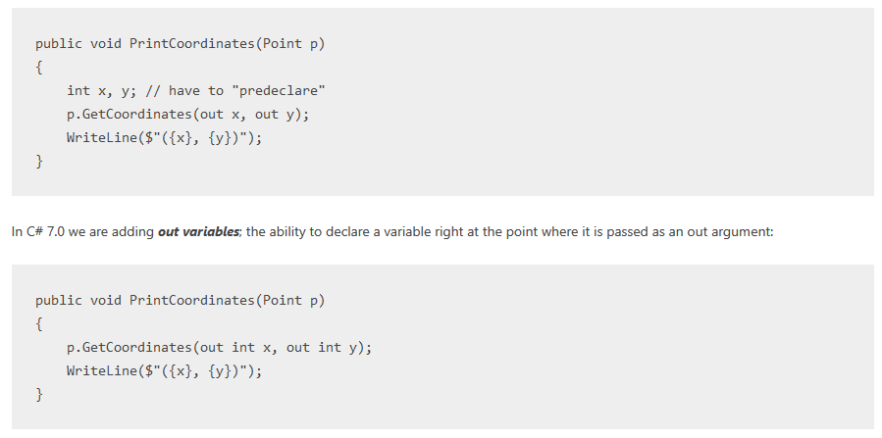
C# 7.0-Out Variables
Notes:
Tuples
Out Variables
Patterns
Switch Statement with Patterns
Literal Improvement
Return by ref
Expression Bodied members – Constructor and Finalizers
Throw Expressions

Slide 7
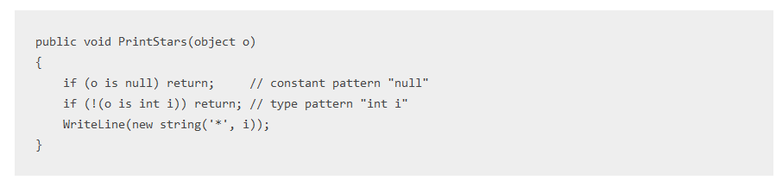
C# Patterns => Test & Extract
Notes:
Tuples
Out Variables
Patterns
Switch Statement with Patterns
Literal Improvement
Return by ref
Expression Bodied members – Constructor and Finalizers
Throw Expressions

Slide 8
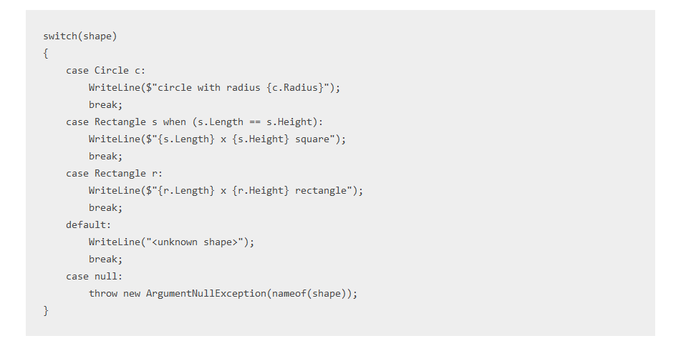
C# Patterns => Switch Cases…….
Notes:
Tuples
Out Variables
Patterns
Switch Statement with Patterns
Literal Improvement
Return by ref
Expression Bodied members – Constructor and Finalizers
Throw Expressions

Slide 9
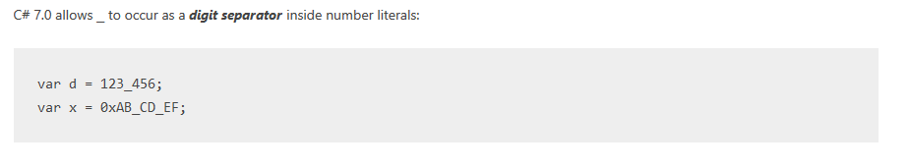
C# Patterns => Literal Improvements
Notes:
Tuples
Out Variables
Patterns
Switch Statement with Patterns
Literal Improvement
Return by ref
Expression Bodied members – Constructor and Finalizers
Throw Expressions

Slide 10
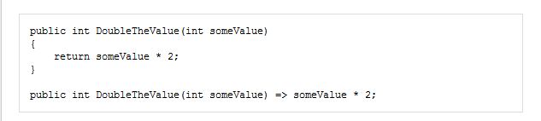
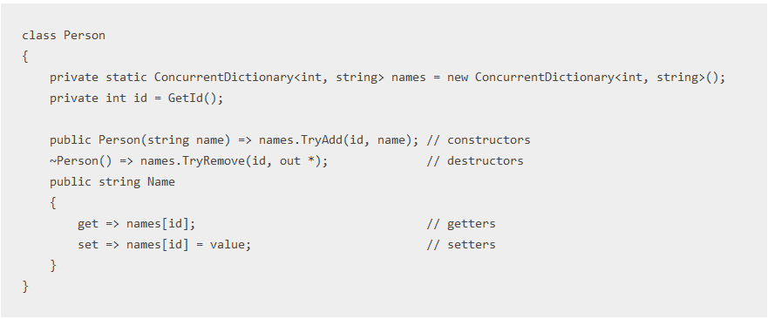
C# Patterns => More Embodied Expression
Notes:
Tuples
Out Variables
Patterns
Switch Statement with Patterns
Literal Improvement
Return by ref
Expression Bodied members – Constructor and Finalizers
Throw Expressions

Slide 11
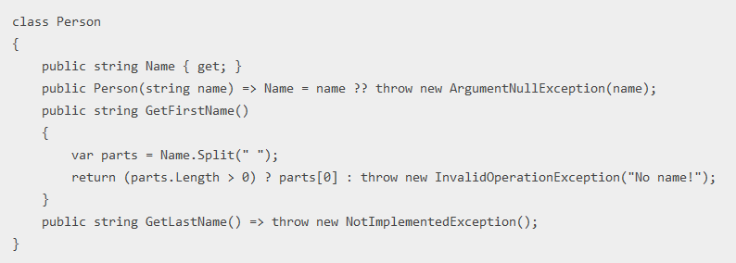
C# Patterns => Throw expressions
Notes:
Tuples
Out Variables
Patterns
Switch Statement with Patterns
Literal Improvement
Return by ref
Expression Bodied members – Constructor and Finalizers
Throw Expressions

Slide 12
Demo – Docker Integration
Notes:
Modify VS 2017 – VS Installer in Search
Enable Light Weight Solution load – Tools-Options-Search for Lightweight-General
Live Unit Testing
Object Reference error and what element is null
Find all references
Goto – Ctrl+T
Editor.config

Slide 13
Demo – Visualstudio.com
Notes:
https://github.com/karthikeyanVK/GABSampleCI.git
visualstudio.com

Slide 14
Resources
VS 2017 Keynote: https://github.com/Microsoft/VisualStudio2017Launch_KeynoteDemos
C# 7 features: https://blogs.msdn.microsoft.com/dotnet/2016/08/24/whats-new-in-csharp-7-0/
Editor config - https://microsoft.github.io/almvm/labs/tfs/editorconfig/
C# 7 features: https://blogs.msdn.microsoft.com/dotnet/2016/08/24/whats-new-in-csharp-7-0/
Editor config:
https://microsoft.github.io/almvm/labs/tfs/editorconfig/
Notes:
As shown

Slide 15

Thank You
@Karthik3030
Notes:
Let’s get started by creating a portable foundation that will work across many platforms.

