Slide 1


How to your Convert Monolithic to Microservices
Karthikeyan VK
@karthik3030
https://blogs.karthikeyanvk.in

Slide 2

Why Microservices ?
Enter Text
Resilience
Scaling
Removing Rewriting barrier
Ease of Deployment
Notes:
Resilience – One part of the service fails and whole application fails, so running application in spite of failures
Scaling – One part of application needs more resources and scalling is easy when Microservices
Removing Rewriting Barrier – Technology can be changed easily if it is small for specific needs

Slide 3
Why Microservices ?
Enter Text
Organization Alignment
Composability
Technology Heterogeneity
Notes:
Composability - a system design principle that deals with the inter-relationships of components. essential features - self-contained,Stateless

Slide 4
Organization Alignment
Enter Text
Microservices allows to align our architecture our organization, by helping us minimizing the number of people working on one codebase
Smaller codebases tend to be more productive.
Support Devops

Slide 5
Composability
Enter Text
Removing thinking in terms of narrow channel to more holistic concepts of customer engagement such as web/native/mobile/tablet/Wearable device and exposing API as service
Notes:
Composability - a system design principle that deals with the inter-relationships of components. essential features - self-contained, Stateless

Slide 6
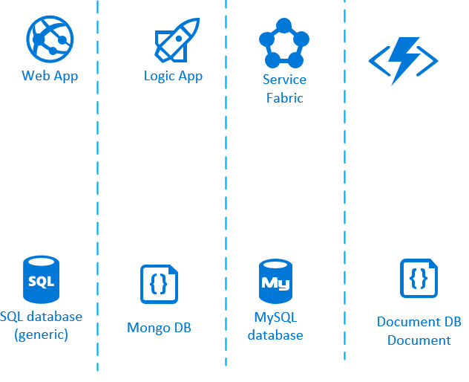
Technology Heterogeneity
Enter Text

Slide 7
What are Microservices ?
Enter Text
Microservices are small, autonomous services that work together.
Notes:
Gather together those things that change for the same reason, and separate those things that change for different reasons

Slide 8
How Small is Small ?
Enter Text
Lines of Code ?
Who has a system that is too big and that you’d like to break down?
Notes:
Gather together those things that change for the same reason, and separate those things that change for different reasons

Slide 9
How to define being small ?
Enter Text
Smaller the service, the more you maximize the benefits and downsides of Microservices architecture.
When you get smaller, the benefits around interdependence increase
When you get too smaller, the complexity emerges from having more and more moving parts

Slide 10
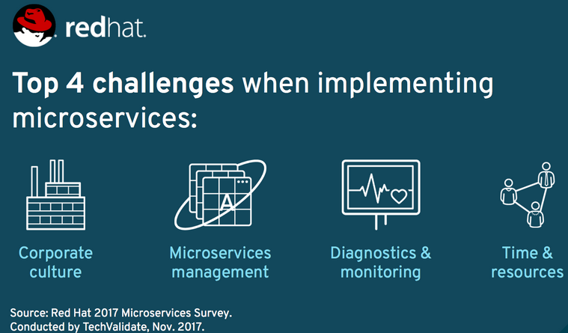
4 Challenges
Enter Text

Slide 11
Corporate Culture
Enter Text
Open to technology
Think of Task Force
Leave behind process and procedures
Culture of Automation
Expect failure
Autonomous
Notes:
learn new runtimes, technologies, or frameworks
In Search of Excellence - Tom Peters and Robert H. Waterman, Jr.. Published in 1982

Slide 12
Microservices Management
Enter Text
Defining Strategy
Implementing new projects
Migrating existing project

Slide 13
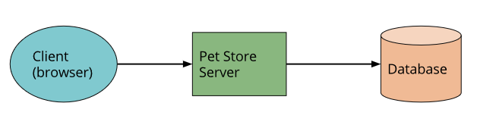
How to start ?
Enter Text

Slide 14
Pet Store Functionality
Enter Text
Authentication
Search Pet
Order Pet
Notes:
Composability - a system design principle that deals with the inter-relationships of components. essential features - self-contained,Stateless

Slide 15
Enter Text
What Makes a Good Service?

Slide 16
Enter Text
Main Principles in Splitting Microservices
Loose Coupling
High Cohesion
Notes:
A loosely coupled service knows as little as it needs to about the services with which it collaborates. This also means we probably want to limit the number of different types of calls from one service to another, because beyond the potential performance problem, chatty communication can lead to tight coupling.
We want related behavior to sit together, and unrelated behavior to sit elsewhere.
System design is all about trade-offs

Slide 17
Loose Coupling
Enter Text
Loosely coupled service knows as little as it needs to about the services with which it collaborates.

Slide 18
High Cohesion
Enter Text
Related behaviour to sit together, and unrelated behaviour to sit elsewhere.
Changing behaviour in lots of places to deliver a change, signals lack of high cohesion

Slide 19
Enter Text
Practices
Practices should underpin our principles
Sometimes practices reflect constraints in your organization
Coding guidelines
Integration Style – HTTP/REST

Slide 20
Combining Principles & Practices
Enter Text
One person’s principles are another’s practices
.NET Team practices and Java Team practises based on principles
Notes:
A loosely coupled service knows as little as it needs to about the services with which it collaborates. This also means we probably want to limit the number of different types of calls from one service to another, because beyond the potential performance problem, chatty communication can lead to tight coupling.
We want related behavior to sit together, and unrelated behavior to sit elsewhere.
System design is all about trade-offs,

Slide 21
What is Bounded Context?
Enter Text
Specific responsibility enforced by explicit boundaries.

Slide 22
What is Bounded Context?
Enter Text
A Domain consists of multiple bounded contexts, and residing within each are models that do not need to be communicated outside as well as things that are shared externally with other bounded contexts.
Notes:
Warehouse, finance, sales, front desk

Slide 23
What is Bounded Context?
Enter Text
Each bounded context has an explicit interface, where it decides what models to share with other contexts.

Slide 24
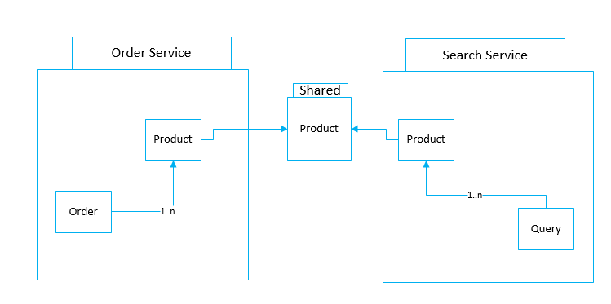
Models & Shared Models
Enter Text

Slide 25
Modules and Services
Enter Text
What models should be shared, and not shared
Identifying boundary within our domain.
Keep related code together and attempt to reduce the coupling to other modules in the system.
Microservices should cleanly align to bounded contexts.
Once proficient, skip the step of keeping the bounded context modelled as a module. Jump straight for a separate service

Slide 26
Shared Libraries
Enter Text
Monolithic codebase into multiple libraries.
Libraries give you a way to share functionality between teams and services.
Too much leads You to lose true Technology heterogeneity.
Solution is to create common tasks that aren’t specific to your business domain that you want to reuse across the organization
Notes:
Technology heterogeneity - The library typically has to be in the same language, or at the very least run on the same platform.

Slide 27
Premature Decomposition
Enter Text
Don’t start decomposition too quickly.
Initial Service boundary will not be right
CI/CD will break
Decompose into Microservices is much easier than trying to go to Microservices from the beginning.

Slide 28
Business Capabilities
Enter Text
Don’t think in terms of data that is shared
Think in terms of bounded context capabilities that is provided in the rest of the domain.
Communication in Terms of Business Concepts
Notes:
These capabilities may require the interchange of information — shared models — but I have seen too often that thinking about data leads to anemic, CRUD-based (create, read, update, delete) services. So ask first “What does this context do?”, and then “So what data does it need to do that?” When modeled as services, these capabilities become the key operations that will be exposed over the wire to other collaborators.
Communication in Terms of Business Concepts - It’s also important to think of the communication between these microservices in terms of the same business concepts.

Slide 29
Integration between Microservices
Enter Text
Avoid Breaking Changes
Keep Your APIs Technology-Agnostic
Make Your Service Simple for Consumers
Hide Internal Implementation Detail
Notes:
Technology Agnostic - Avoiding integration technology that dictates what technology stacks we can use to implement our Microservices. Ready shift to java or databases based on requirement

Slide 30
Interfacing with Customers
Enter Text
The Shared Database
Notes:
Remember when we talked about the core principles behind good microservices? Strong cohesion and loose coupling — with database integration, we lose both things. Database integration makes it easy for services to share data, but does nothing about sharing behavior.

Slide 31
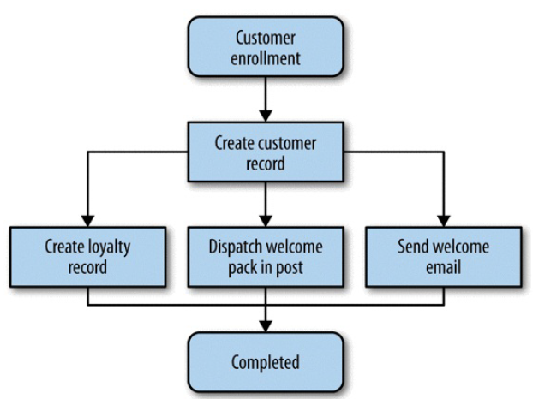
Orchestration Versus Choreography
Enter Text
Orchestration
Notes:
The downside to this orchestration approach is that the customer service can become too much of a central governing authority. It can become the hub in the middle of a web, and a central point where logic starts to live. I have seen this approach result in a small number of smart “god” services telling anemic CRUD-based services what to do.

Slide 32
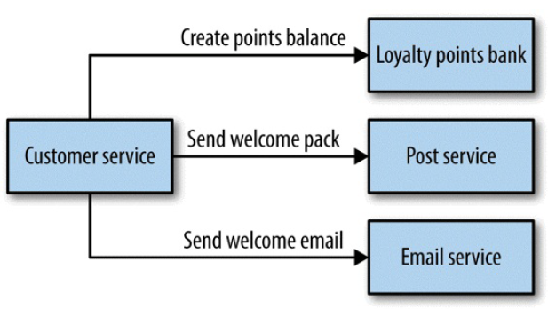
Orchestration Versus Choreography
Enter Text
Choreography
Notes:
Services should be dumb
With a choreographed approach, we could instead just have the customer service emit an event in an asynchronous manner

Slide 33
Conway's law and System Design
Enter Text
Any organization that designs a system (defined more broadly here than just information systems) will inevitably produce a design whose structure is a copy of the organization’s communication structure.
Notes:
Organizational issues to consider as well
Explain moore’s law
two-pizza teams
owning the whole lifecycle of their services
Explain how about three tier architecture and Microservices fits here wrt to teams

Slide 34
Enter Text
DEMO

Slide 35
Enter Text
References
https://middlewareblog.redhat.com/2017/12/05/the-state-of-microservices-survey-2017-eight-trends-you-need-to-know/
@karthik3030

Slide 36
Enter Text
Thank you /Q&A
@karthik3030

