Slide 1


How to your Convert Monolithic to Microservices
Karthikeyan VK
@karthik3030
https://blogs.karthikeyanvk.in

Slide 2

Why Microservices ?
Enter Text
Resilience
Scaling
Removing Rewriting barrier
Ease of Deployment
https://blogs.karthikeyanvk.in
Notes:
Resilience – One part of the service fails and whole application fails, so running application in spite of failures
Scaling – One part of application needs more resources and scalling is easy when Microservices
Removing Rewriting Barrier – Technology can be changed easily if it is small for specific needs

Slide 3
Why Microservices ?
Enter Text
Organization Alignment
Composability
Technology Heterogeneity
Notes:
Composability - a system design principle that deals with the inter-relationships of components. essential features - self-contained,Stateless

Slide 4
Organization Alignment
Enter Text
Microservices allows to align our architecture our organization, by helping us minimizing the number of people working on one codebase
Smaller codebases tend to be more productive.
Support Devops

Slide 5
Composability
Enter Text
Removing thinking in terms of narrow channel to more holistic concepts of customer engagement such as web/native/mobile/tablet/Wearable device and exposing API as service
Notes:
Composability - a system design principle that deals with the inter-relationships of components. essential features - self-contained,Stateless

Slide 6
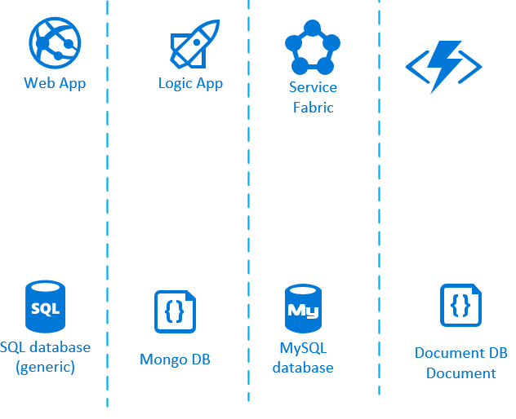
Technology Heterogeneity
Enter Text

Slide 7
What are Microservices ?
Enter Text
Microservices are small, autonomous services that work together.
Notes:
Gather together those things that change for the same reason, and separate those things that change for different reasons

Slide 8
How Small is Small ?
Enter Text
Lines of Code ?
Who has a system that is too big and that you’d like to break down?
Notes:
Gather together those things that change for the same reason, and separate those things that change for different reasons

Slide 9
How to define being small ?
Enter Text
Smaller the service, the more you maximize the benefits and downsides of microservice architecture.
When you get smaller, the benefits around interdependence increase
When you get too smaller, the complexity emerges from having more and more moving parts
Notes:
Gather together those things that change for the same reason, and separate those things that change for different reasons

Slide 10
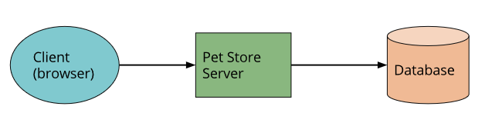
How to start ?
Enter Text
Notes:
Composability - a system design principle that deals with the inter-relationships of components. essential features - self-contained,Stateless

Slide 11
Pet Store Functionality
Enter Text
Authentication
Search Pet
Order Pet
Notes:
Composability - a system design principle that deals with the inter-relationships of components. essential features - self-contained,Stateless

Slide 12
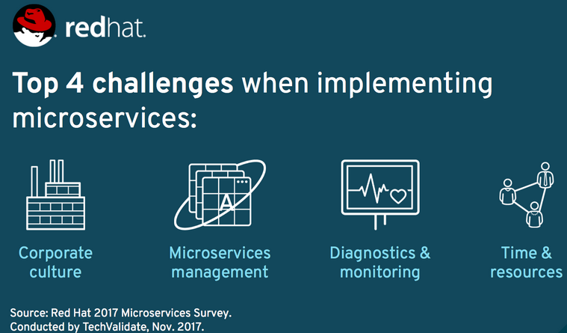
4 Challenges
Enter Text

Slide 13
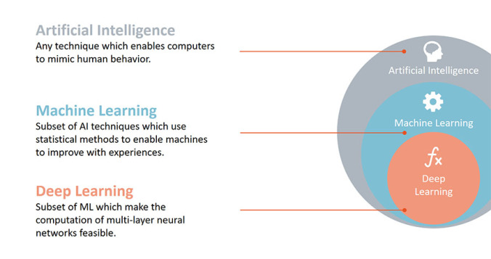
Artificial Intelligence vs ML vs Deep Learning
Enter Text
Notes:
Talk about neural networks
Talk about AI will never be AI
Talk about Siri, Cortana

Slide 14
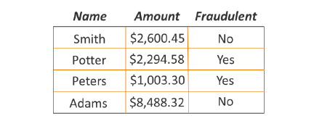
Find Patterns
Enter Text

Slide 15
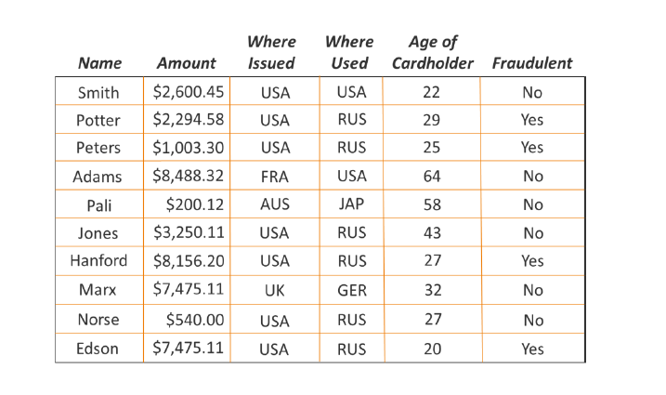
Enter Text
Find Patterns now

Slide 16
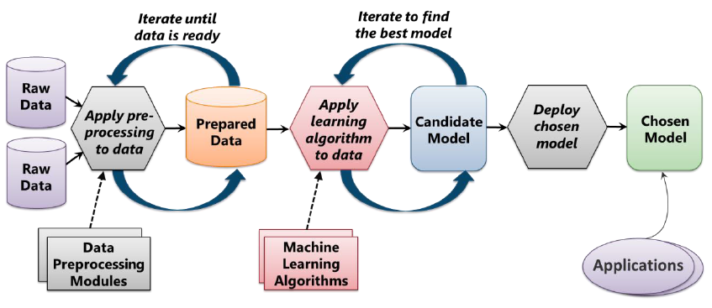
Enter Text
Machine Learning Process
Notes:
Prepare/Clean Data
Split Data between train and test
Choose algorithm
Train model
Test model
Evaluate model

Slide 17
Role of Data Scientist
Enter Text
Which raw data to use?
How should that data be processed to create prepared data?
Identify Combinations of prepared data and machine learning algorithms should you use to create the best model?
Notes:
data scientist is a specialist in solving problems like the ones that arise in machine learning. People in this role typically have a wide range of skills. They’re comfortable working with complex machine learning algorithms, for example, and they also have a strong sense of which of these algorithms are likely to work best in different situations. A data scientist might also need to have software development skills, as they’re often called upon to write code.

Slide 18
Basics
Enter Text
Statistics
Linear algebra
Probability
Standard deviation
Slope
Notes:
Naïve bayes – finding whose emails it might be based on word, the label is hidden

Slide 19
Fallacies vs Bias vs Variance
Enter Text
Fallacies are mistakes of reasoning
Thinking habits which are likely to threaten objectivity or to lead to errors in reasoning.
Error from sensitivity to small fluctuations(Including anomaly)

Slide 20
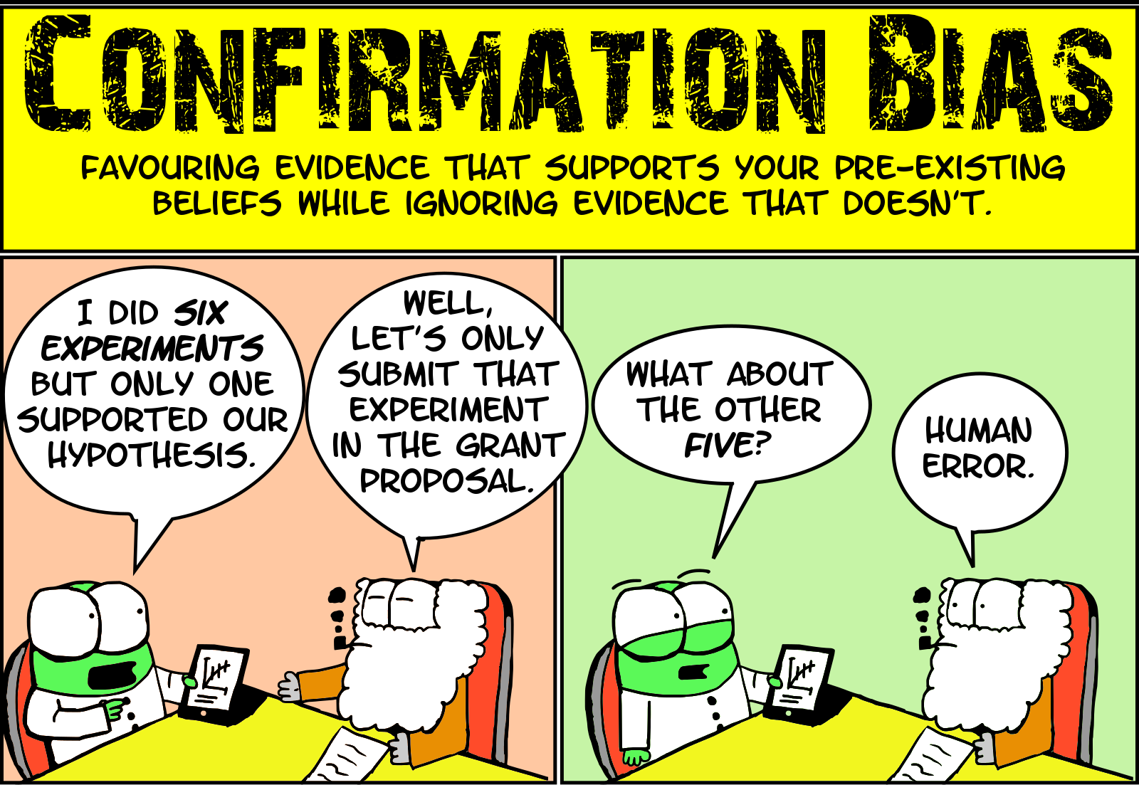
Enter Text

Slide 21
Features vs Labels
Enter Text
Features
Input
Labels
Output
Name, Amount, Where Issued, Age of Cardholder
Genuine/Fraud

Slide 22
Five Questions
Enter Text
Is this A or B ?
Is this Weird ?
How much or many ?
How this is organized ?
What should I do next ?
Notes:
Is this A or B ? - Classification
Is this Weird ? - Anomaly
How much or many ? - Regression
How this is organized ? - Cluster
What should I do next ? – Reinforcement Learning

Slide 23
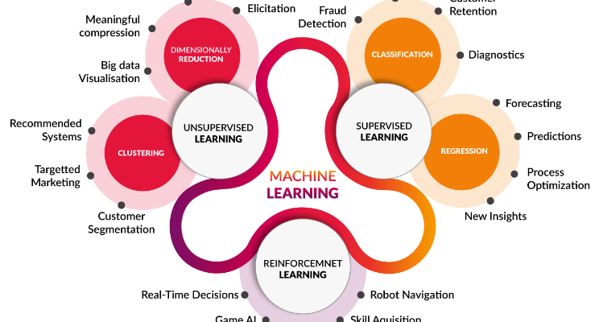
Types of algorithms
Enter Text
Notes:
Error from sensitivity to small fluctuations(Including anomaly) . Overfitting

Slide 24
Supervised Learning
Enter Text
Classification
Regression
Anomaly Detection
Notes:
Error from sensitivity to small fluctuations(Including anomaly) . Overfitting

Slide 25
Enter Text
Supervised Learning - Classification
Notes:
Error from sensitivity to small fluctuations(Including anomaly) . Overfitting

Slide 26
Enter Text
Supervised Learning - Regression
Notes:
Error from sensitivity to small fluctuations(Including anomaly) . Overfitting

Slide 27
Enter Text
Supervised Learning – Anomaly Detection
Notes:
Error from sensitivity to small fluctuations(Including anomaly) . Overfitting

Slide 28
Un-Supervised Learning
Enter Text
Clustering
Dimensionally Reduction
Notes:
Error from sensitivity to small fluctuations(Including anomaly) . Overfitting

Slide 29
Un-Supervised Learning - Clustering
Enter Text
Notes:
Error from sensitivity to small fluctuations(Including anomaly) . Overfitting

Slide 30
Enter Text
R vs Python
Notes:
Error from sensitivity to small fluctuations(Including anomaly) . Overfitting

Slide 31
Enter Text
Usages of Machine learning
Notes:
Error from sensitivity to small fluctuations(Including anomaly) . Overfitting

Slide 32
Enter Text
Philosophical question

Slide 33
Books & Movies
Enter Text
Cartoon Introduction to Statistics
Thinking Fast & Slow by Daniel Kaheman
Art of thinking clearly – Rolf Dobelli
I-Robot
Terminator 2
Notes:
I-Robot
Terminator 2

Slide 34
Enter Text
DEMO
Notes:
Scoring might be a new term to you, but is widely used in machine learning to mean the process of generating new values given a model and some new input. The generic term "score" is used, rather than "prediction", becuase the scoring process can generate so many different types of values:+
A list of recommended items and a similarity score
Numeric values, for time series models and regression models
A probability value, indicating the likelihood that a new input belongs to some existing category
The name of a category or cluster to which a new item is most similar
A predicted class or outcome, for classification models

Slide 35
Enter Text
References
https://middlewareblog.redhat.com/2017/12/05/the-state-of-microservices-survey-2017-eight-trends-you-need-to-know/
@karthik3030

Slide 36
Enter Text
Thank you /Q&A
@karthik3030

