Slide 1

US H1B Visa File Case by Karthikeyan Balusamy

Slide 2
Project Overview
"US H1B Visa dataset has extracted from US Department of labour Employment site. This public disclosure file contains 2009 year data about the US employers who employed foreign workers and also the details related to their H1B petition"

Slide 3
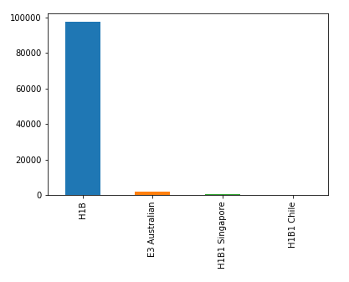
Visa applied by each H1B Category
Data in depth
Observation
It can be inferred from the plot that the 97% of Visa are applied for H1B. Other visa categories are less than 2%. It indicates that most of the visa are applied for H1B
H1B 97% E3 Australian 1.8%
H1B1 Singapore 0.306% H1B1 Chile 0.25%

Slide 4
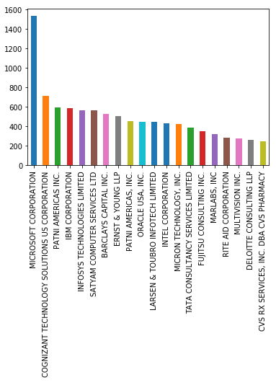
Top 20 Employer applied for H1B Visa
Problem statement
Observation
Microsoft is the top company applied for H1B Visa, followed by CTS, PATNI, IBM & Infosys. As opposed to other industry, IT companies are the topper in applying for the visa

Slide 5
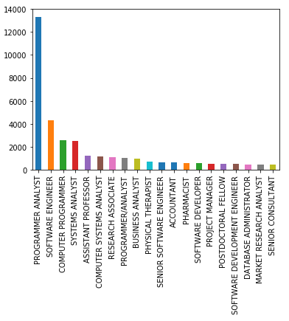
Top Jobs applied for H1B Visa
Observation
It has been observed that Programmer Analyst job is the most applied job for the H1B visa, followed by
Software Engineer, Computer Programmer, System Analyst, Assistant Professor. It clearly indicates that more jobs demand for Software industry.

Slide 6
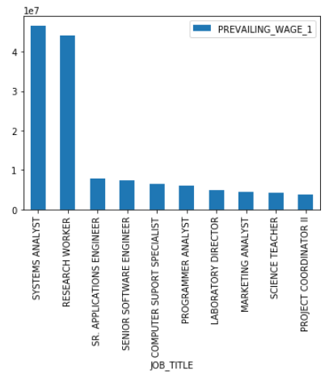
Top Salaried Jobs
Observation
System Analyst, Research Worker are the top most paid job in US. Followed by Sr. Applications Engineer, Sr. Software Engineer, Computer Support Specialist.

Slide 7
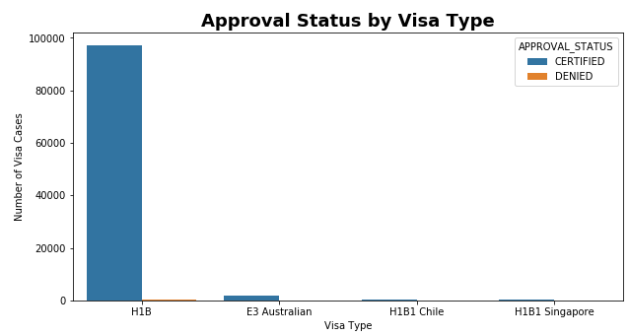
Approval Status by Visa Type
Observation
Rejected Visas are in H1B Visa category, other visa types such as Australian; H-1B1 Chile, H-1B1 Singapore have no rejection. Less than 1% of visa has been rejected.

Slide 8
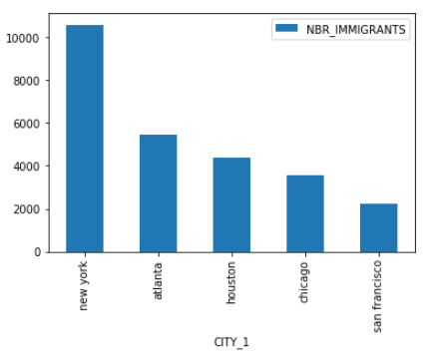
Employee Preferred City
Observation
Most of the workers (around 50%) prefers to work in New York city.
Next 50% of the people prefers the below cities: Houston (18%), Chicago (12%), Redmond (11%) & Atlanta (10%)
Overall, New York stands in top, while comparing to other cites

Slide 9
Conclusion
H1B Visa petition analysis helps us to know the Visa Approval/Rejection rate, Demand on Jobs, Highly paid salary on Jobs, Top recruiters & Employee preferred city.
From the overall Visa application received, 97% of the Visas are applied for H1B. 1% of the visa has been rejected in H1B category. Other visa type have no rejection.
Top Recruiters: Microsoft, CTS, PATNI, IBM, Infosys
Top Jobs applied for visa: Program Analyst, Software Engineer, Computer Programmer, System Analyst, Ass Professor
Top Salaried Jobs : System Analyst, Research Worker
IT Industry is the top in Salary, Demand and recruiters as opposed to other industry.
Based on the result, this certainly helps the US Job workers to make a decision on the above data.

