Slide 1

Oil Price Predition Submitted by Karthikeyan Balusami

Slide 2
Project Overview
“Oil Price Prediction” model have been developed to predict the Oil Price for the future timeframe using the ML - Linear Regression Model.

Slide 3
Oil Price DataSet
Europe Brent Oil Prices (Annual/ Monthly/ Weekly/ Daily) from EIA U.S. (Energy Information Administration).
Brent : A blended crude stream produced in the North Sea region which serves as a reference or “marker” for pricing a number of other crude streams.
Primarily, Dataset have Oil Price & Date.

Slide 4
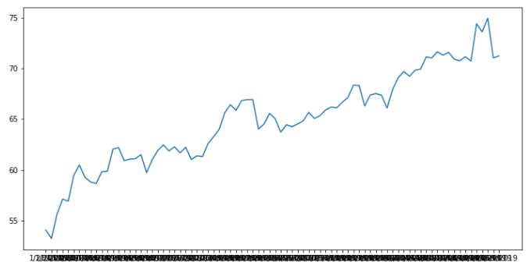
Oil Pricing Trends
Line Graph shows the trend of Oil pricing from the Year May-1987 to Apr-2019

Slide 5
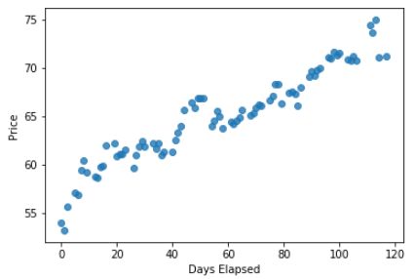
Regression Line Graph
Date Series has been converted from Date Index to DataTime Index. Elapsed Time have been calculated.
Trend shows the Oil Price (Y) increases gradually, which is satisfy the assumptions of LR

Slide 6
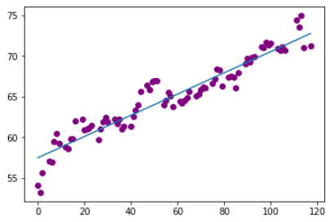
Plot the Regression Line based on the Best fit line
Best Fit line have been predicted based on the 75/25 of train, test data split. Predicted the best fit line using the co-efficient & Intercept.
Using this line, Oil Price can be predicted for the future date.

Slide 7
Evaluating the Model Performance
Root Mean Squared Error (RMSE) : 1.44
Mean Absolute Error (MAE) : 1.17
Mean Squared Error (MSE) : 2.06
Conclusion
Coefficient of the prediction shows the 0.905 ie 91% accuracy.
For Instance, Oil Price on 2019-04-29 is 71.22, where as the model predicted as 72.75

