Slide 1
Industrial Copper Modelling
present by Karthikeyan.M

Slide 2

Skills and Domain:
Python Scripting
Data Pre-processing
Exploratory Data Analysis
Streamlit
Domain : Manufacturing

Slide 3
Problem Statement:
Two challenges copper industry facing:
1.It deals with complex data related to sales and pricing that result in not able
to fix optimal price.
2.The second challenge is capturing the leads and its conversion assertion.
Objective:
1.To Predict the Optimal Price using Regression model
2.To Predict the Lead Status conversion

Slide 4
Approach:
1.Data understanding:
Identify the types of variables (continuous, categorical) and their distributions.
If any rubbish values found such as '0000',it should be converted into null.
2.Data Pre-processing:
Handle missing values with mean/median/mode.
Treat Outliers using IQR
Identify Skewness in the dataset and treat skewness with appropriate data transformations, such as log transformation.
Encode categorical variables using suitable techniques, such as one-hot encoding, label encoding, or ordinal encoding,
based on their nature and relationship with the target variable.

Slide 5
3. Exploratory Data Analysis:
Try visualizing outliers and skewness(before and after treating skewness) using Seaborn’s boxplot.
4. Feature Engineering:
Engineer new features if applicable, such as aggregating or transforming existing features to create more informative
representations of the data. In this project a lead time has been developed as new feature.
5. Model Building and Evaluation:
Split the dataset into training and testing/validation sets.
Train and evaluate with different classification models and measure it using appropriate evaluation metrics such as
accuracy, precision, recall, F1 score, and AUC curve.
Optimize model hyper parameters using techniques such as cross-validation and grid search to find the best-performing model.
Interpret the model results and assess its performance based on the defined problem statement.

Slide 6
6. Model Deployment using Streamlit:
Develop interactive GUI using Streamlit
Task input( Regression or Classification)
Create an input field where the user can enter each column value except ‘Selling Price’ for regression model and except ‘Status’ for classification model.
Two Models have been developed for this project:
For Price Prediction – The Linear Regression model has been used
For Status Prediction – The KNN model has been used.

Slide 7

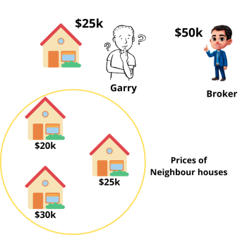
KNN Algorithm:
The idea of the KNN is mimicking the neighbours. The ML model first decide the neighbours by calculating the distance. That distance is called as 'Euclidean distance".
Once the neighbours are ascertained, the new data points will mimic the attributes of neighbours which is majority.
In regression problem, the model takes the average value of the neighbours.
In binary classification, to avoid the tie situation, the choice of no of neighbours are always odd.
The formula for calculating the distance is root of (x2-x1)^2 + (y2 - y1)^2.
This algorithm is also called as "Lazy learning algorithm" - i.e. training is not actually happening, based on the previously available data, the prediction is done.
It's really time consuming, since it has to compute the distance for every new prediction. If data size is large, it will take more time.

Slide 8
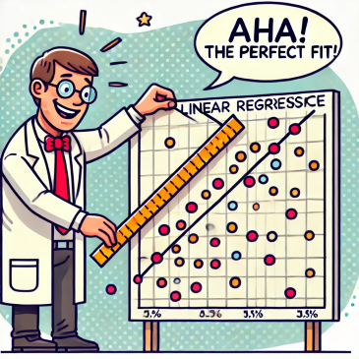
Linear Regression Algorithm:
Linear Regression is a statistical supervised learning technique to predict the quantitative variable by forming a linear relationship with one or more independent features.
The objective of the Linear Regression is to get the minimised error or Cost/Loss function which is achieved by fitting the straight line as close as possible to data points.
The Intercept and values of slope are playing pivotal role determining the position or fitting of the line along the data points.

Slide 9
Key Elements:
Simple Linear Regression: helps to find the linear relationship between two continuous variables,one independent and one dependent feature. Formula : y = mx+c
Multiple Linear Regression: Involves multiple independent variables to predict the target variable.
Formula:
y=β0​+β1​x1​+β2​x2​+...+βn​xn​
y = the value to be predicted, β0 – Intercept , β1, β2, βn – Coefficients.
Intercept : when the value of x is 0,atwhich value in y axis the straight line cutting is called as Intercept.
In other terms, when all the x values are set to zero, the value of y is called as Intercept.
Slope : If the value of x axis is increased by 1 unit ,how much increment can be expected in the y -axis is what slope does. m = [y2-y1/x2-x1]

Slide 10
In Linear regression, the position of straight line @ regression line decides the accuracy of the prediction.
To fit the line close to the data points, the values of beta0 and beta1 plays pivotal role. If line is on the data points, the prediction will be accurate.
Intercept is responsible for distance from the origin. if the intercept is away from zero it is farther from the origin.
slopes are responsible for the rotation of the line.

Slide 11
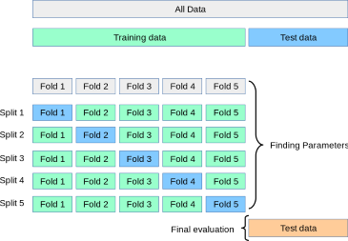
Cross-validation:
Cross validation is used to reduce the overfitting of the model & to find the best values of parameters.
How it works?
It works on the training data only. The training data is divided into the folds given by the user. The number of folds to be divided completely is choice of the user. For an instance if the number of folds is 5,the training data will be divided into 5 folds.1/5 of the training data will be used for test and remaining 4/5 of the training data will be used for the training purpose. For each iteration, the test fold is getting changed sequentially. hence, all the folds are getting both trained and tested. hence the overfitting of the model is getting reduced and can find the best values of the parameters which can be applied in the final evaluation of actual test data.

