Slide 1
FLOOD MONITORING & EARLY WARNING

Slide 2
Batch members
NAMES
G.KARTHIKEYAN (ECE) (leader)
R.KIRUBAKARAN (ECE)
S.GOPINATHI (ECE)
G.DHIVAGAR (CSE)
M.AKASH (CSE)

Slide 3
ABSTRACT
Floods and excessive rainfall are unavoidable phenomena that can cause massive loss of people's lives and destruction of infrastructure.
Flash floods rise rapidly in flood-prone areas.
There are many systems widely in practice by disaster management agencies in monitoring flood levels.
most of these systems are limited range .
sophisticated to be used and maintained.

Slide 4
INTRODUCTION
To develop a real-time flood monitoring and early warning system.
One of advantage of ultrasonic sensing.
Work falls under the utilization of the Arduino, ultrasonic sensors, GSM module, web-monitoring.
The paper envisions helping flood-prone area.

Slide 5
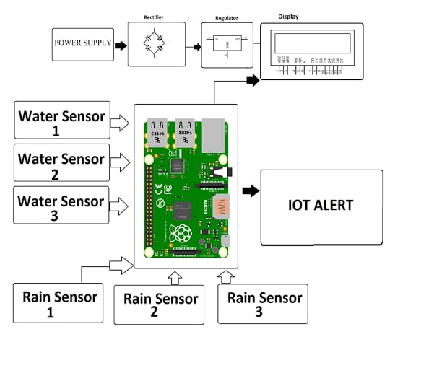
BLOCK DIAGRAM

Slide 6
WORKING PRINCIPLE
The Ultrasonic sensor works on the principle of SONAR.
It is designed to measure the distance using ultrasonic wave.
To determine the distance of an object from the sensor.
For value Adriano decides width for opening of gates of dam.

Slide 7
i) IOT ALEART
The early warning system is a web-based system that users can access which includes web flood information.
Flood sensors installed on bridges for convenient access to the river.
The ultrasonic sensors used temperature

Slide 8
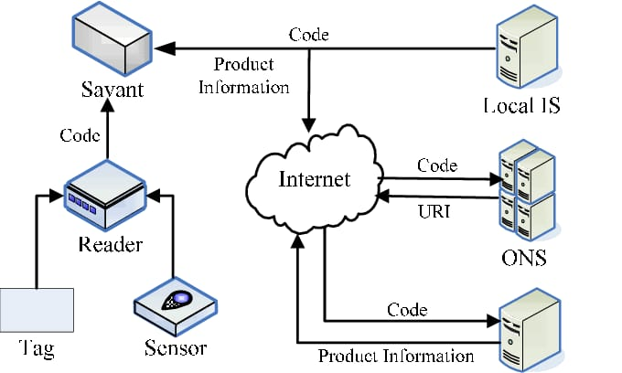
IOT DIAGRAM

Slide 9

IOT SENSOR

Slide 10
ii) Water sensor
ENVIRA IoT’s system controls the flow.
Its behavior in real time.
Detects possible water course.
Alerts about the flood risk with real and accurate data.
The data captured by the sensors.

Slide 11
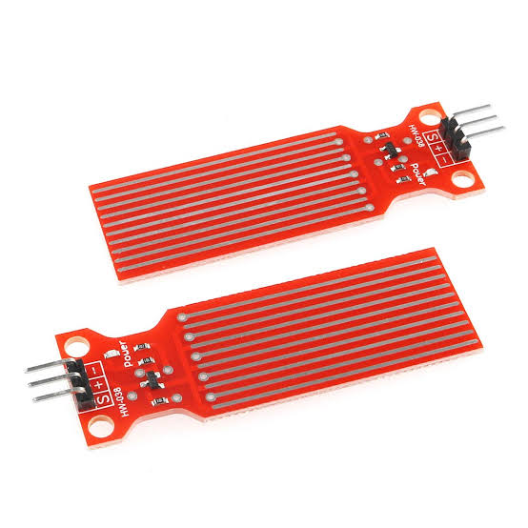
WATER SENSOR DIAGRAM

Slide 12
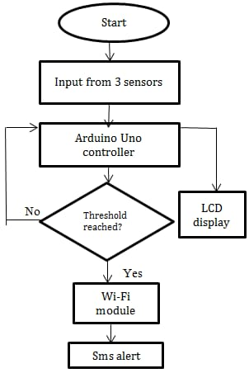
FLOW CHART

Slide 13
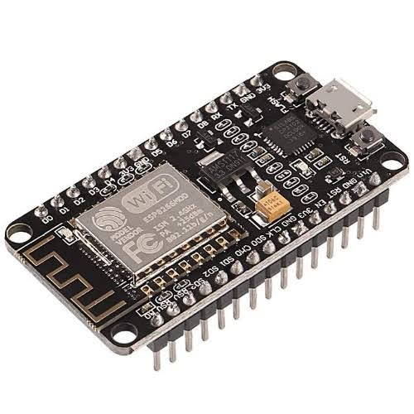
WI-FI MODULE

Slide 14
WI-FI MODULE WORKING
Wi-Fi modules or Wi-Fi microcontrollers are used to send.
Receive data over Wi-Fi. They can also accept commands over the Wi-Fi.
Wi-Fi modules are used for communications between devices.
They are most commonly used in the field of Internet of Things

Slide 15
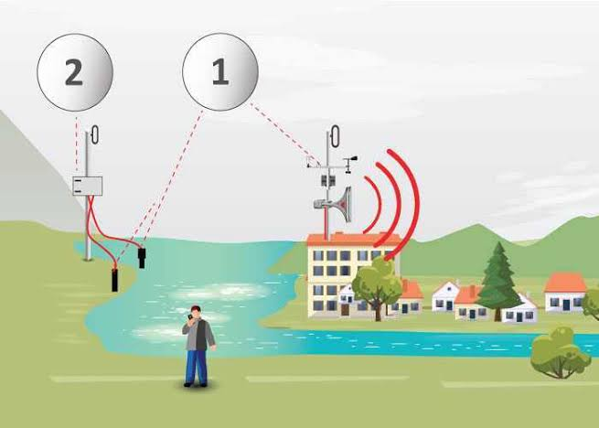
FLOOD MONITORING PUBLIC WARNING

Slide 16
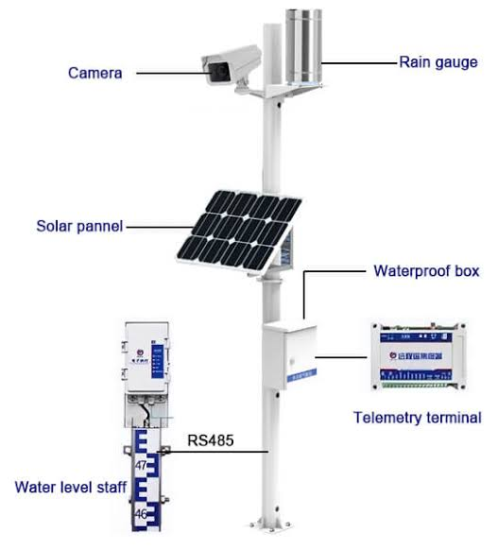
Flood monitoring types

Slide 17
ADVANTAGES
Timely detection of possible flood risks and floods.
Highly reliable and available real-time data.
Tailored solution that can be integrated with external developments at any level

Slide 18
DISADVANTAGES
System has some limitations because the devices are built for peer-to-peer connectivity.
Not built in context of mesh network .
The device is not suitable to be implemented in a large network.

Slide 19
APPLICATION
The system sends alerts in the event of rising water levels.
It can do classification such as warning, critical and high critical.
These alerts can be extended to the public via a website or thru SMS/Text alerts.

Slide 20
REFERENCE
Pagatpa J C, Arellano A C and Gerast J (Iligan City, Philippines: Mindanao-State University- Iligan Institute of Technology).
Vitales J S, Villajin L D, Destreza F G, Ricafranca D V and Rodriguez V M R 2016 College of Engineering and Computing Sciences (Batangas, Philippines: Batangas State University ARASOF Nasugbu).

