Slide 1
23CS4219 — SOFTWARE ENGINEERING LABORATORY
Campus Complaint & Maintenance
Management System
A Role-Based Full-Stack Web Application for Institutional Facility Grievance Tracking
CORE WORKFLOW: Student Grievance Lodging → Administrative Triage → Technician Work Orders → Audited Resolution
Student Name: Karthikeyan Gullipalli (Roll No: [ROLL NUMBER])
Course & Dept: B.Tech CSE | Department of Computer Science and Engineering
Institution: Anil Neerukonda Institute of Technology & Sciences (ANITS)
Faculty Guide: [GUIDE NAME] | Academic Year: 2024–2025

Slide 2
1. PROBLEM & MOTIVATION
Traditional Paper Process vs. Proposed CCMS System
Traditional Process (Manual)
Proposed System (CCMS Web Portal)
Paper Register
Web Portal (24/7 Access)
Admin Verification
Physical Counter
Staff Assignment
Verbal Work Order
Status Tracking
No Tracking
Resolution & Feedback
Core Bottlenecks Eliminated: No Tracking → No Accountability → No Centralized Records
Campus Complaint & Maintenance Management System | Software Engineering Lab
Slide 2 of 10

Slide 3
2. SOFTWARE ENGINEERING APPROACH
SDLC Progression & Requirements Traceability
Requirements
Design
Implementation
Security
Testing
Maintenance
Requirement → Implementation Traceability Mapping
• Secure Access → Stateless JWT authentication + bcryptjs hashing + verifyToken middleware
• Complaint Lodging → Dynamic React form + campus category & room mapping + Multer photo upload
• Admin Control → Centralized administrative dashboard with status filters + staff assignment
• Audited Lifecycle → Strict server-side Finite State Machine validator + immutable complaint_updates log
• Technician Execution → Dedicated work order queue with real-time status progression (IN_PROGRESS → RESOLVED)
• Quality Feedback → Post-resolution 1 to 5 star rating submission + reopening mechanism for recurring issues
Campus Complaint & Maintenance Management System | Software Engineering Lab
Slide 3 of 10

Slide 4
3. SYSTEM ARCHITECTURE
Decoupled 3-Tier Layered Architecture with Stateless API Security
Student • Faculty • Admin • Maintenance Staff
Key Architectural Principles
• Separation of Concerns
Presentation layer is strictly decoupled from storage. The client never accesses MySQL directly; all operations are governed by validated REST endpoints.
• Stateless JWT Authorization
Eliminates server session storage. Each request carries a signed HS256 Bearer token, enabling horizontal scaling and high concurrency.
• Relational Integrity & ACID
Normalized schema with foreign key constraints, atomic transactions, and parameterized SQL queries eliminating SQL injection risks.
React 18 + Vite Frontend (SPA)
Component Hierarchy • Tailwind CSS • Axios Client
Node.js + Express REST API
Authentication • Validation • Multer Upload • State Machine
JWT Auth Sideflow
verifyToken Guard
MySQL 8 Relational Database (ccms_db)
7 Normalized 3NF Tables • InnoDB Engine • Connection Pool
Campus Complaint & Maintenance Management System | Software Engineering Lab
Slide 4 of 10

Slide 5
4. COMPLAINT WORKFLOW & LIFECYCLE
Finite State Machine Enforcing Audited Status Progression
NEW
VERIFIED
ASSIGNED
IN PROGRESS
RESOLVED
CLOSED
REJECTED (Invalid)
REOPENED (Persistent)
Student / Faculty
Submit → Track → Rate
• Lodges complaint with campus building & room.
• Attaches optional photographic evidence.
• Monitors real-time status progression.
• Submits 1–5 star rating upon resolution.
Administrator
Verify → Assign → Close
• Reviews complaint details and authenticity.
• Accepts (VERIFIED) or dismisses (REJECTED).
• Assigns task to active technician.
• Reviews repair notes & confirms closure.
Maintenance Staff
Accept → Work → Resolve
• Accesses assigned work orders queue.
• Begins physical remediation (IN PROGRESS).
• Logs diagnostic & repair remarks.
• Marks complaint successfully RESOLVED.
Campus Complaint & Maintenance Management System | Software Engineering Lab
Slide 5 of 10

Slide 6
5. MAJOR MODULES & TECHNOLOGY STACK
Functional System Modules & Production Software Stack
System Functional Modules
Production Technology Stack
Authentication & RBAC
(Registration, login, JWT token issuance, and role access guards)
Frontend Tier
React 18 • Vite 5 • Tailwind CSS • Axios • React Router
Complaint Lodging
(Dynamic React form, category/room selection, Multer file upload)
Backend Tier
Node.js 18 LTS • Express 4.19 • express-validator • Multer
Admin Control Center
(Campus-wide triage, status filters, staff assignment interface)
Database & Storage
MySQL 8.0 • mysql2 Connection Pool • InnoDB Engine (7 Tables)
Maintenance Work Orders
(Technician task queue, work commencement, resolution remarks)
Security & Testing
JSON Web Tokens (JWT HS256) • bcryptjs (10 rounds) • Playwright
Audit History & Feedback
(Append-only status history in complaint_updates + student rating)
Campus Complaint & Maintenance Management System | Software Engineering Lab
Slide 6 of 10

Slide 7
6. DATABASE DESIGN
Simplified Entity-Relationship Architecture & Data Integrity
USERS
id (PK) • name • email
role • department
COMPLAINTS (Core Entity)
id (PK) • complaint_number • user_id (FK)
category_id (FK) • location_id (FK) • status
LOCATIONS & CATEGORIES
building • floor • room
category_name
COMPLAINT_ASSIGNMENTS
staff_id (FK) • assigned_by (FK)
assigned_at • notes
COMPLAINT_UPDATES (Audit Log)
old_status • new_status
remarks • updated_by (FK) • created_at
FEEDBACK
complaint_id (FK) • user_id (FK)
rating (1–5) • comments
3NF Normalization
Redundancy eliminated across all tables. Campus buildings, rooms, and issue categories are maintained as independent master entities.
Referential Integrity
Foreign key constraints with ON UPDATE / ON DELETE rules guarantee that tickets and history always map to valid users and rooms.
Immutable Audit Trail
The complaint_updates table operates as an append-only transaction log, recording every status transition with operator IDs and timestamps.
Campus Complaint & Maintenance Management System | Software Engineering Lab
Slide 7 of 10

Slide 8
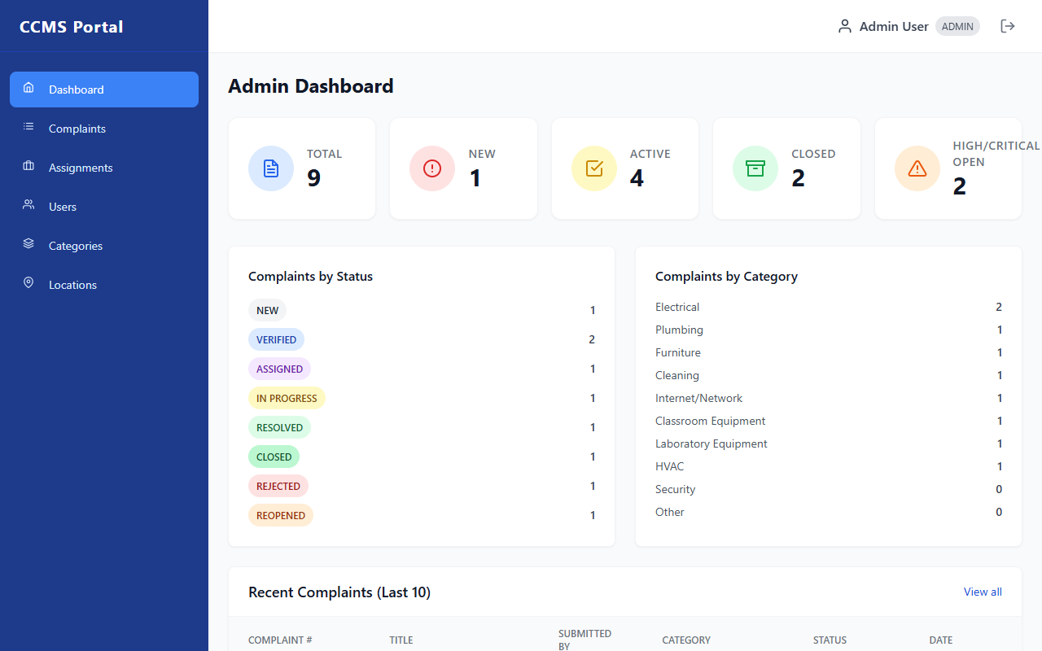
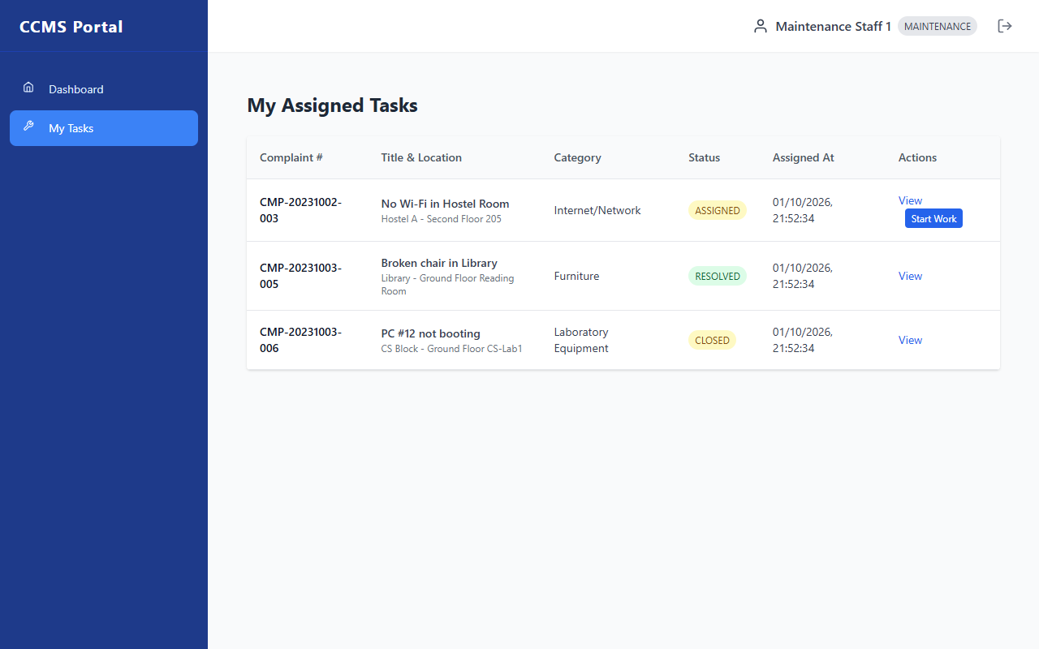
7. APPLICATION SCREENSHOTS
Authentic User Interfaces from the Running CCMS Application
1. Administrator Control Center
• Real-Time Campus KPIs: Total, open, resolved, and critical ticket counts.
• Interactive Triage: Instant search, category filters, and verify/reject controls.
2. Technician Work Order Queue
• Room-Level Dispatching: Displays exact campus building, floor, room, and urgency.
• Work Execution: Single-click 'Start Work' and diagnostic resolution remarks submission.
Campus Complaint & Maintenance Management System | Software Engineering Lab
Slide 8 of 10

Slide 9
8. TESTING & QUALITY VERIFICATION
Rigorous Multi-Level Verification with 100% Pass Rate
Testing Methodology
• Unit Testing:
Validated bcrypt password salting, token signing/verification, and unique CMP-ID generators.
• Basis Path Testing:
Mapped Cyclomatic Complexity V(G) = 11 for statusController.js; validated all legal and illegal transition paths.
• Role Access Testing:
Verified that student tokens cannot access administrative or technician endpoints (HTTP 403 Forbidden).
• System Integration:
Automated browser validation via Playwright confirming end-to-end user journeys.
✓ 30 / 30 Executed Test Cases PASSED (100%)
Test ID | Scenario Evaluated | Observed Result | Status
TC-01 | Administrator Authentication | HTTP 200; JWT issued; Admin access | PASS
TC-02 | Student User Authentication | HTTP 200; JWT issued; Student view | PASS
TC-03 | Complaint Lodging with Photo | HTTP 201; CMP-ID generated in DB | PASS
TC-04 | Illegal Transition (NEW→CLOSED) | HTTP 400 Bad Request; FSM guarded | PASS
TC-05 | Technician Work Assignment | HTTP 200; Dispatched to staff queue | PASS
TC-06 | Unauthorized Endpoint Access | HTTP 403 Forbidden; Access blocked | PASS
Campus Complaint & Maintenance Management System | Software Engineering Lab
Slide 9 of 10

Slide 10
9. CONCLUSION & FUTURE SCOPE
System Achievements, Practical Limitations & Future Roadmap
What CCMS Achieved
✓ Eliminated error-prone manual logbooks with a 24/7 web-based grievance portal.
✓ Enforced strict role-based access across Student, Faculty, Staff, and Admin.
✓ Implemented an audited Finite State Machine preventing illegal status jumps.
✓ Established an immutable audit log ensuring complete administrative transparency.
Current Limitations
• Notification delivery relies on active web sessions (no external SMS/Email gateway).
• Evidence images stored on local server filesystem rather than cloud object storage.
• Technician assignment requires manual administrative allocation.
Future Roadmap
→ Integration of Nodemailer (SMTP) and Twilio (SMS) for automated push alerts.
→ Migration of evidence storage to Amazon S3 / Cloudinary cloud buckets.
→ Development of cross-platform mobile app using React Native.
→ Automated technician dispatching based on active workload and trade skills.
Thank You | Questions & Answers
Campus Complaint & Maintenance Management System | Software Engineering Lab
Slide 10 of 10

