Slide 1
IBM SKILLSBUILD INTERNSHIP PROGRAM | IBMQ2D TRACK (UG LEVEL 2)
Retail Customer Intelligence
A Machine Learning Prototype for Customer Segmentation and High-Value Shopper Prediction
Student Name: Gullipalli Lakshmi Narayana Karthikeyan
Roll Number: A24126510017 | Department: Computer Science and Engineering
Institution: ANIL Neerukonda Institute of Technology and Sciences (ANITS)
IBM Candidate ID: IBMP3155 | Date: September 26, 2026

Slide 2
IBMQ2D INTERNSHIP PROJECT
Internship Track & Project Foundation
IBM SkillsBuild / IBMQ2D Track
• Track: UG Level 2 Artificial Intelligence & Machine Learning competition.
• Focus: Practical, end-to-end applied AI systems over abstract or theoretical notebooks.
• Core Philosophy: Transparent algorithms, reproducible metrics, clean architecture, and rigorous validation.
• Candidate Details: Karthikeyan (Roll: A24126510017, IBM ID: IBMP3155), CSE Dept, ANITS.
Project Executive Summary
• Dataset: Kaggle Mall Customer Segmentation (200 records, 5 core features).
• Dual Machine Learning Methodology: Unsupervised K-Means clustering + Calibrated Random Forest.
• Optimal Cluster Count: Evidence-based selection K = 5 (Silhouette score = 0.5547).
• High-Value Cohort: 19.5% of customer base commanding 31.90% of aggregate mall spending.
• Interactive Deployment: 5-page Streamlit application verified by 32 automated tests.

Slide 3
IBMQ2D INTERNSHIP PROJECT
Problem Statement: The Retail Marketing Dilemma
The Core Retail Challenge
• Homogeneous Marketing Trap: Many retailers allocate marketing spend evenly across all shoppers.
• Extreme Asymmetry: Spending contribution is highly uneven; treating top spenders and bargain hunters identically creates waste.
• Under-Investment: High-margin premium shoppers receive generic promotional noise.
• Over-Investment: Budget shoppers receive expensive loyalty discounts that never yield margin.
The Solution Requirements
• Automated Persona Discovery: Segment customer base into actionable behavioral clusters from real income & spend data.
• Auditable High-Value Rule: Transparent, explainable threshold identifying top commercial contributors.
• Sub-Second Classification: Score brand new customers instantly from basic attributes without re-running K-Means.
• Actionable Business Guidance: Map every persona directly to a tailored marketing action.

Slide 4
IBMQ2D INTERNSHIP PROJECT
Project Objectives & Execution Scope
1. Empirical Clustering
• Evaluate K=2..10 using both Inertia and Silhouette Score.
• Programmatically maximize silhouette score rather than guessing K.
• Standardize features with zero-mean unit-variance scaling.
2. Calibrated Classifier
• Train 200-tree Random Forest on Age, Gender, Income, Spending Score.
• Apply CalibratedClassifierCV (Platt scaling) over 5-fold CV.
• Achieve authentic posterior likelihoods instead of extreme 0/1 tree votes.
3. Production Web App
• Interactive 5-page Streamlit UI with custom typography and CSS cards.
• Dynamic Plotly 2D clustering and silhouette curves.
• Zero-exception reliability backed by 32 automated pytest tests.

Slide 5
IBMQ2D INTERNSHIP PROJECT
Dataset Ingestion & Non-Destructive Cleaning
Dataset Characteristics
• Source: Kaggle Mall Customer Segmentation Data.
• Dimensions: Exactly 200 rows and 5 attribute columns.
• Attributes: CustomerID, Gender (or Genre), Age, Annual Income (k$), Spending Score (1-100).
• Data Hygiene: 0 missing values, 0 duplicate IDs, 0 invalid range outliers.
Ingestion & Normalization Rules
• Alias Normalization: Non-destructive in-memory mapping translates Kaggle's historical 'Genre' header to 'Gender'.
• Strict Domain Validation: Age [18, 70], Income [$15k, $137k], Spending Score [1, 99].
• StandardScaler Normalization: Rescales Annual Income and Spending Score for accurate Euclidean distance clustering.
• Zero File Mutation: The original CSV on disk is never altered.

Slide 6
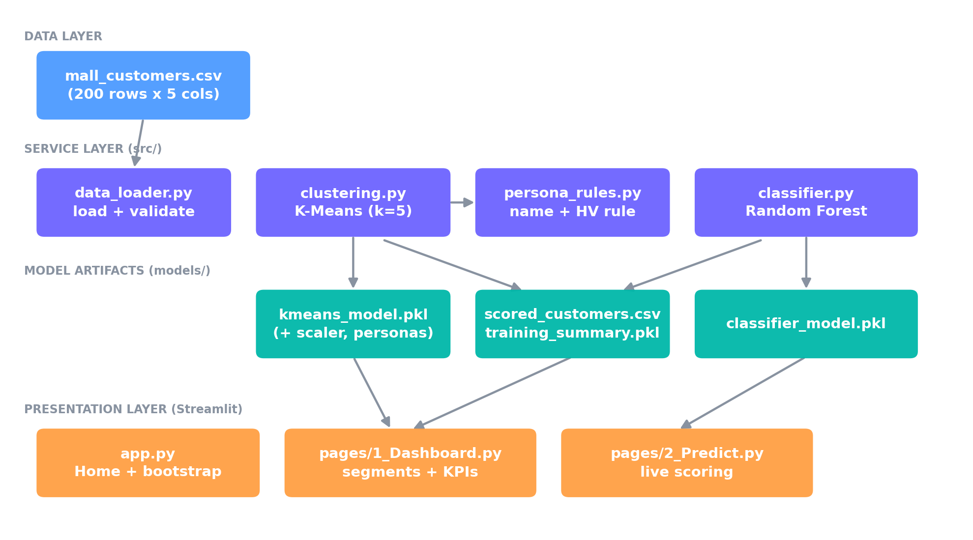
IBMQ2D INTERNSHIP PROJECT
Modular Four-Tier System Architecture
Architectural Principles
• 1. Data Layer: Ingests & validates CSV source.
• 2. Service Core Layer: Modular modules for clustering, persona rules, and classification.
• 3. Persistence Layer: Joblib caches fitted models and summaries for instant boot.
• 4. Presentation Layer: 5-page Streamlit interface with zero business logic in UI files.

Slide 7
IBMQ2D INTERNSHIP PROJECT
Unsupervised Segmentation: Evidence-Based K Selection
Empirical Evaluation (K=2..10)
• K=2: Inertia = 269.69, Silhouette = 0.3213
• K=3: Inertia = 157.70, Silhouette = 0.4666
• K=4: Inertia = 108.92, Silhouette = 0.4939
• K=5 (Optimal): Inertia = 65.57, Silhouette = 0.5547
• K=6: Inertia = 55.06, Silhouette = 0.5399
• K=7: Inertia = 44.86, Silhouette = 0.5281
• K=8: Inertia = 37.23, Silhouette = 0.4552
• K=9: Inertia = 32.39, Silhouette = 0.4571
• K=10: Inertia = 29.98, Silhouette = 0.4432
Why K = 5 is Defensible
• Silhouette Maximization: K = 5 achieves the global peak silhouette score of 0.5547 across the entire search space.
• Diminishing Returns: Increasing K beyond 5 fragments natural clusters without meaningful inertia reduction.
• Feature Set Justification: Using Income + Spending yields 0.555 silhouette. Adding Age or Gender degrades score to 0.428.
• Automated Selection: Programmatic select_optimal_k() avoids manual guessing.

Slide 8
IBMQ2D INTERNSHIP PROJECT
Customer Personas: Centroid-Based Behavioral Profiling
The Five Natural Personas
• Premium Customers (n=39, 19.5%): Avg Income $86.5k, Avg Spend 82.1. Top revenue drivers.
• Careful Spenders (n=35, 17.5%): Avg Income $88.3k, Avg Spend 17.1. High income, low engagement.
• Standard Customers (n=81, 40.5%): Avg Income $55.3k, Avg Spend 49.5. The broad middle class.
• Impulsive Shoppers (n=22, 11.0%): Avg Income $25.7k, Avg Spend 79.4. Low income, heavy spending.
• Budget Customers (n=23, 11.5%): Avg Income $26.3k, Avg Spend 20.9. Frugal, price-sensitive shoppers.
Actionable Marketing Strategies
• Premium: Exclusive VIP loyalty privileges, early access to new inventory, premium concierge.
• Careful Spenders: Trust-building communications, luxury quality messaging, personalized outreach.
• Standard: Seasonal promotional calendars, category cross-sell, loyalty tier upgrades.
• Impulsive: Flash sales, limited-time countdown promotions, impulse checkout bundles.
• Budget: Value bundles, clearance alerts, price-match guarantees.

Slide 9
IBMQ2D INTERNSHIP PROJECT
High-Value Definition: Auditable & Transparent Rule
The Ground-Truth High-Value Rule
• Rule Formulation: A cluster is High-Value iff Centroid Income >= Median Income ($61.5k) AND Centroid Spending >= Median Spending (50.0).
• Transparent & Auditable: Defensible in a single sentence to executive stakeholders.
• Deterministic Target: Grounded in real population medians, not arbitrary scoring thresholds.
• Exclusive Qualification: Exactly one persona qualifies — Premium Customers (Cluster 3).
Disproportionate Commercial Impact
• Cohort Count: 39 customers (19.5% of total base).
• Income Share: High-Value customers represent 27.86% of total customer income.
• Spending Share: High-Value customers command 31.90% of total store spending volume.
• Strategic Justification: Prioritizing loyalty spend on this 19.5% cohort directly protects ~32% of total retail turnover.

Slide 10
IBMQ2D INTERNSHIP PROJECT
Supervised Classification & Probability Calibration
Classifier Architecture
• Base Model: RandomForestClassifier(n_estimators=200, random_state=42).
• Input Features: Age, Gender (binary encoded), Annual Income (k$), Spending Score (1-100).
• Train / Test Partition: 80% train (160 rows), 20% test (40 rows), stratified by High-Value class.
• Purpose: Real-time customer inference in milliseconds without re-running K-Means.
Why Platt Scaling is Essential
• The Collapse Problem: Because the target is deterministically separable, raw Random Forest tree votes collapse to extreme 0% or 100%.
• CalibratedClassifierCV: Wraps the forest with sigmoid (Platt) scaling across 5-fold cross-validation.
• Empirical Posterior: Maps decision margins into authentic posterior likelihoods matching empirical outcomes.
• Brier Score Loss: Achieves 0.00358, confirming superior calibration accuracy.

Slide 11
IBMQ2D INTERNSHIP PROJECT
Model Performance & Feature Importance
Quantitative Test Metrics (40 Test Customers)
• Test Accuracy: 100.0% (40 / 40 correct)
• Precision: 1.000 | Recall: 1.000 | F1-Score: 1.000
• ROC-AUC: 1.000 (Perfect rank separation)
• Brier Score Loss: 0.00358 (Calibrated confidence error)
• Confusion Matrix: TN=32, FP=0, FN=0, TP=8
Feature Importance Distribution
• Spending Score (1-100): 49.4% (Primary separator)
• Annual Income (k$): 34.6% (Secondary separator)
• Age: 15.6% (Demographic discriminator)
• Gender: 0.4% (Minimal commercial impact)
• Key Finding: Income and Spending drive 84.0% of classification power, validating the 2D clustering design.

Slide 12
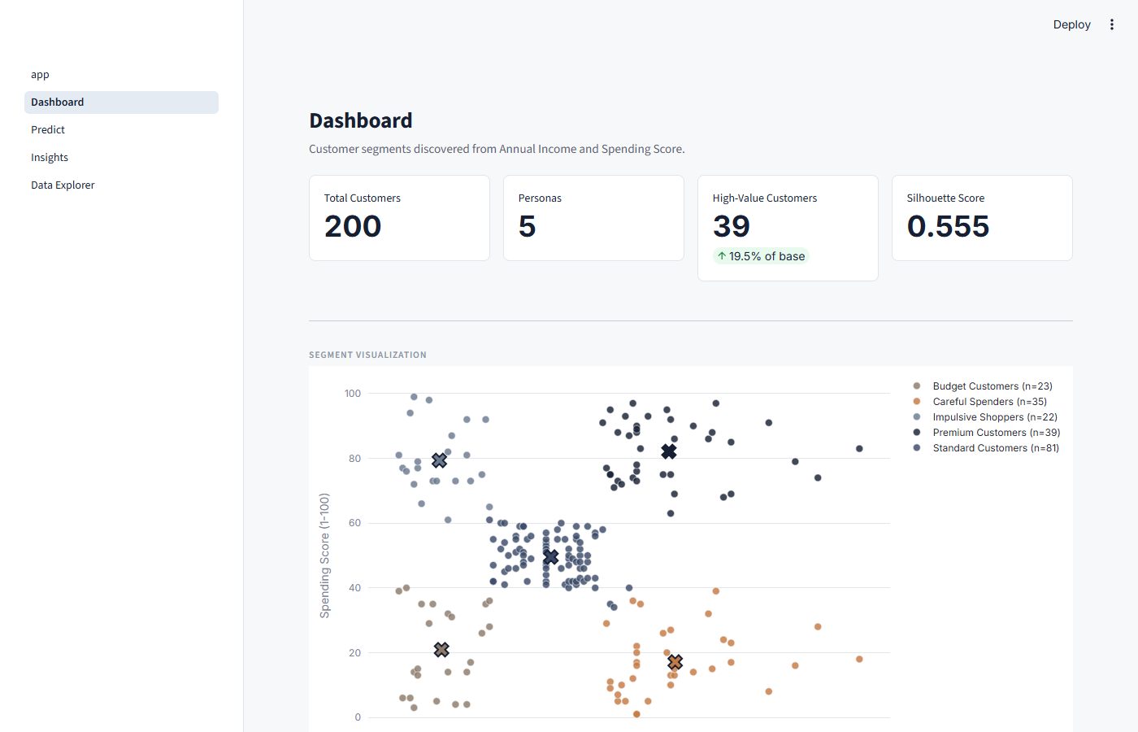
IBMQ2D INTERNSHIP PROJECT
Interactive Streamlit Web Application (5 Pages)
Application Page Overview
• 1. Home (app.py): System purpose & headline metrics.
• 2. Dashboard: 2D customer scatter plot with centroid markers & persona summary cards.
• 3. Predict: Real-time customer scoring with grounded centroid explanations.
• 4. Insights: Elbow/silhouette curves, feature importances & business insights.
• 5. Data Explorer: Multi-column filterable customer database with CSV export.

Slide 13
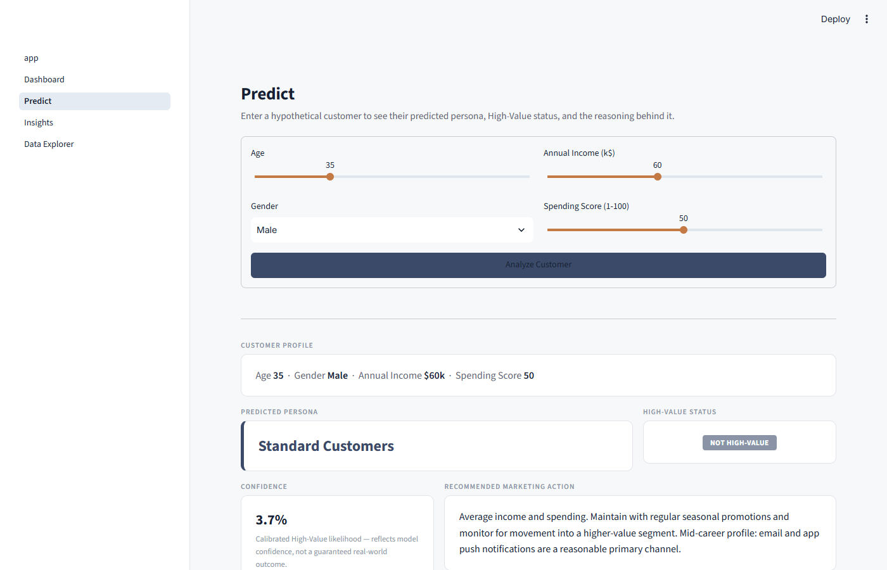
IBMQ2D INTERNSHIP PROJECT
Live Inference & Grounded Mathematical Reasoning
Explainable AI by Design
• Instant Scoring: Inputs Age, Gender, Income, Spending -> Predicts Persona & High-Value status.
• Calibrated Confidence: Reports realistic percentage likelihood rather than raw agreement.
• Distance Grounding: Computes Euclidean distance to assigned vs next-closest centroid.
• Delta Explanations: Quantifies exact distance from dataset & segment averages.

Slide 14
IBMQ2D INTERNSHIP PROJECT
Limitations & Academic Transparency
Honest Disclosure on 100% Accuracy
• Deterministic Target: The High-Value label is derived from cluster centroids defined on Income and Spending.
• Accessible Features: Because Income and Spending are also classifier inputs, the model acts as an ultra-fast boundary emulator.
• Academically Sound: The 100% score is expected and honest; it does not claim to predict noisy real-world churn.
• Platt Scaling Role: Calibration ensures probabilities reflect real uncertainty near decision boundaries.
Data & System Constraints
• Sample Size: 200 customer rows — suitable for proof-of-concept, but lacks seasonal depth.
• Feature Dimensions: No transactional logs (basket size, recency, SKU margins).
• Single-Tenant Prototype: Local deployment without distributed database persistence.
• Production Reality: Real transactional data with noise would typically achieve 80–90% accuracy.

Slide 15
IBMQ2D INTERNSHIP PROJECT
Conclusion & Future Production Roadmap
Internship Achievements
• Rigorous Methodology: Fully automated K-selection (K=5, Silhouette 0.5547).
• Transparent Business Logic: Median-based High-Value definition (19.5% base = 31.9% spend).
• Operational Deployment: 5-page Streamlit web application with professional design.
• Complete QA Verification: 32 unit and integration tests passing with 100% success.
Future Production Roadmap
• Data Warehouse Integration: Direct SQL connector to Snowflake or BigQuery for real-time batch scoring.
• Multi-Dimensional RFM: Incorporate purchase recency, basket frequency, and category affinity.
• Microservice API: Wrap core inference in FastAPI with Docker containerization.
• Automated Retraining: Scheduled Drift detection & automated model recalibration pipeline.

