Slide 1
AI OUTLOOK — Q2 2026
CONFIDENTIAL BRIEFING · 45 MINUTES
INDUSTRY PERSPECTIVE
Measuring productivity and value in the age of AI-assisted software engineering.
A view on how leading engineering organizations are rethinking metrics, frameworks, and team structure.
PREPARED FOR PRODUCT & ENGINEERING MANAGERS
APRIL 2026
Notes:
Welcome. I'm going to spend the next forty-five minutes walking you through how the industry is thinking about productivity and value in the age of AI-assisted engineering. This is a briefing, not a pitch — I'll point you to the research as we go, and I'll flag where I'm sharing opinion versus data. By the end I want you to have a framework you can take back to your teams on Monday. Let's begin.

Slide 2
OPENING OBSERVATION
Engineering output is rising sharply. Evidence that customer value is rising with it remains inconclusive.
This briefing examines the gap, the measurement failures that hide it, and the frameworks emerging to close it.
AI OUTLOOK — 2026
OPENING
02 / 28
Notes:
Here's the provocation I want to sit with for a minute. Every engineering organization in this room is getting faster. Commit volume is up, PR throughput is up, story points are up. And yet — if you ask the CFO whether engineering is delivering more value this year than last, the honest answer is usually 'we don't know.' We are measuring the wrong things, faster than ever. That's the problem I want to unpack.

Slide 3
EXHIBIT 1 · INDUSTRY CONTEXT
Fifteen years of measuring software delivery.
2010–2015
2015–2020
2020–2023
2023–PRESENT
Agile & DevOps
DORA
SPACE & DX
AI-assisted
Velocity, story points, burn-down charts. Output as a proxy for value.
Deploy frequency, lead time, change fail rate, MTTR. Process maturity as a North Star.
Satisfaction, performance, activity, communication, efficiency. Developer experience enters the scorecard.
Copilots, agents, inline models compress the cost of code. Every prior metric becomes unstable.
Source: industry literature review, 2010–2026.
AI OUTLOOK — 2026
CONTEXT
03 / 28
Notes:
A little context on how we got here. Fifteen years ago we measured velocity and story points. Ten years ago DORA gave us a real industry standard — four keys that genuinely predict delivery performance. Five years ago SPACE added the human side: flow, satisfaction, communication. Each framework was a response to the failures of the one before it. And then, starting in 2023, AI-assisted coding walked in and made the cost of producing code collapse. Every assumption baked into the prior frameworks is now up for re-examination.

Slide 4
EXHIBIT 2 · ADOPTION STATUS
AI-assisted coding has moved from experiment to default.
76%
~30%
+26%
of professional developers report using or planning to use AI tools in their workflow.
of code committed across sampled repositories is now AI-influenced or AI-generated.
measured productivity lift for less-experienced developers in a randomized field experiment.
STACK OVERFLOW DEV SURVEY, 2024
GITHUB OCTOVERSE, 2024
MIT / MICROSOFT / PRINCETON, 2024
Adoption is effectively saturated. The open question is whether downstream metrics — quality, value, team health — have kept pace.
AI OUTLOOK — 2026
CONTEXT
04 / 28
Notes:
Here's where we are in 2026. Three quarters of professional developers are in AI tools every day. Roughly a third of committed code in sampled repositories is AI-influenced. And a randomized field experiment from MIT, Microsoft, and Princeton found a twenty-six percent productivity lift — concentrated among less-experienced developers. Adoption is essentially saturated. The open question is not whether AI tools work; it's whether the downstream metrics we use to run the business have kept pace. They have not. That's the gap we'll explore.

Slide 5
PART 1 OF 4
VALUE
0 1
The value question.
Notes:
Part One: the value question. Before we talk about what to measure, we have to talk about what we're actually measuring for.

Slide 6
EXHIBIT 3 · THE DISTINCTION
Output is not outcome.
WHAT WE COUNT
WHAT MATTERS
OUTPUT
OUTCOME
Pull requests merged
Customer problem solved
ACTIVITY
IMPACT
Hours spent in IDE
Minutes saved for the end user
SPEED
THROUGHPUT
Time to first commit
Time to first dollar
VOLUME
VALUE
Lines of code generated
Features adopted in production
AI OUTLOOK — 2026
PART I · VALUE
06 / 28
Notes:
This is the oldest trap in software management, and AI has made it worse. We conflate output with outcome. Pull requests merged is output; the customer problem being solved is the outcome. Lines of code generated is volume; features actually adopted in production is value. AI increases the left column much faster than it increases the right column. If your dashboard is full of left-column metrics, you are flying blind in a very specific and dangerous way — the plane feels fast.

Slide 7
EXHIBIT 4 · A WORKING FRAMEWORK
Four levels of measurement. Most organizations operate at the first two.
LEVEL 01
LEVEL 02
LEVEL 03
LEVEL 04
Activity
Output
Outcome
Value
Keystrokes, suggestions, prompts sent. Trivially countable, rarely meaningful.
Commits, PRs, features shipped. A health signal, not a target.
Reliability, adoption, cycle time. What the business feels.
Revenue, retention, cost avoided. What the business pays for.
Ease of measurement decreases left to right; business relevance increases.
AI OUTLOOK — 2026
PART I · VALUE
07 / 28
Notes:
Here's a four-level framework that I find useful. Activity — keystrokes, prompts sent — is trivially easy to measure and almost always meaningless. Output — commits, PRs, features shipped — is a reasonable health signal but a terrible target. Outcome — reliability, adoption, cycle time — is what the business feels. And Value — revenue, retention, cost avoided — is what the business pays for. The columns get narrower as you go right because they get harder to measure. Most organizations live in the first two columns because they're easy. The opportunity is to push right.

Slide 8
EXHIBIT 5 · EXECUTIVE VIEW
01
Are we shipping the things that matter faster than last quarter?
Five questions leaders are actually asking.
02
Is AI making our senior engineers more productive, or less necessary?
03
Where is the quality debt hiding?
04
Can a smaller team do what a larger one did a year ago?
None of these are answered by a velocity chart. Any measurement system should be designed to respond to them directly.
05
What is our return on every dollar spent on AI tooling?
AI OUTLOOK — 2026
PART I · VALUE
08 / 28
Notes:
If you talk to CEOs and CFOs, these are the five questions they actually ask about engineering. Not one of them is answered by a velocity chart. 'Are we shipping the things that matter, faster than last quarter?' 'Is AI making seniors more productive or just less necessary?' 'Where is the quality debt hiding?' 'Can a smaller team do what a larger one did a year ago?' 'What's our ROI on AI tooling?' Your measurement system should be designed to answer these. If it can't, it's the wrong system.

Slide 9
PART 2 OF 4
METRICS
0 2
How metrics lie.
Notes:
Part Two. Now that we've established what we're trying to measure, let's talk about how metrics lie — because they do, constantly, and AI has given them new ways to lie.

Slide 10
EXHIBIT 6 · THE LANDSCAPE
Four ways metrics lie in an AI-assisted organization.
0 1
Velocity theater
0 2
The acceptance fallacy
Counting PRs and commits as if each were equally valuable. AI inflates both without changing the denominator.
Copilot acceptance rate measures autocomplete tolerance, not engineering value. Correlation with outcomes is weak.
0 3
Goodhart's curse
0 4
Debt laundered as speed
Every measure that becomes a target stops being a good measure. With AI, engineers can game targets at machine speed.
Short-term throughput rises. Rework, incident rate, and onboarding time rise on a lag.
AI OUTLOOK — 2026
PART II · METRICS
10 / 28
Notes:
Four traps I see everywhere. Velocity theater: counting PRs as if each were equally valuable. The acceptance fallacy: copilot acceptance rate measuring tolerance, not value. Goodhart's curse: every measure becomes a target, and with AI, engineers can game targets at machine speed. And debt laundered as speed: short-term throughput rises while rework rises on a lag. We'll take each one in turn.

Slide 11
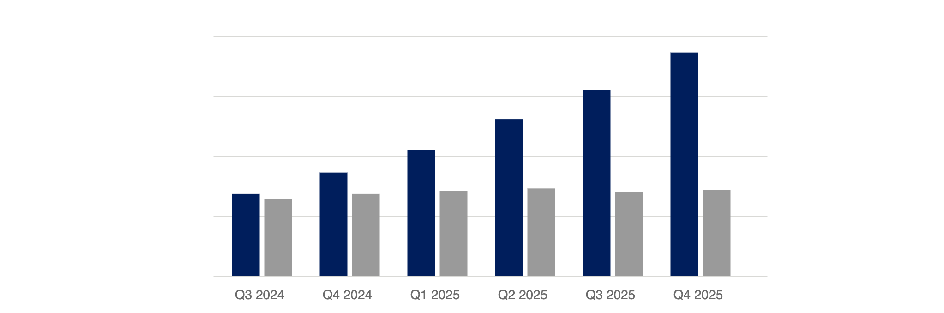
EXHIBIT 7 · TRAP 01 — VELOCITY THEATER
Output rose sharply. Customer-felt value did not.
PRS MERGED
FEATURES ADOPTED
PRS MERGED
+170%
FEATURES ADOPTED
+12%
The ratio is the point. AI made it cheap to ship more — not necessarily better.
Indexed, Q3 2024 = 60 · illustrative composite
AI OUTLOOK — 2026
PART II · METRICS
11 / 28
Notes:
Here's trap one made concrete. This is a composite pattern from several 2024–25 field studies. PRs merged went up one hundred seventy percent after AI rollout. Features actually adopted by customers went up twelve percent. The ratio is the point. AI made it cheap to ship more. It did not, by itself, make it cheap to ship better. If your measurement system only sees the orange bar, you will declare victory. If it sees the teal bar too, you will ask a harder question.

Slide 12
EXHIBIT 8 · TRAP 02 — ACCEPTANCE FALLACY
A 35% acceptance rate measures tolerance, not value.
Acceptance does not tell you whether the code was:
RECOMMENDATION
01
Correct
Track persistence, not acceptance.
02
Kept through code review
03
Functionally different from what the developer would have written
The share of AI-suggested code unchanged in the repo after 30 days correlates with value delivered. Acceptance does not.
04
Running in production a week later
AI OUTLOOK — 2026
PART II · METRICS
12 / 28
Notes:
Trap two. If your AI tooling dashboard leads with 'acceptance rate,' I want you to think about what that number actually tells you. It tells you developers tolerate the suggestions. It does not tell you whether the accepted code was correct, whether it was kept through review, whether it was functionally different from what the developer would have written, or whether it was still running in production a week later. The metric I'd replace it with is persistence — what share of AI-suggested code is unchanged in the repo thirty days later. That number correlates with value. Acceptance does not.

Slide 13
EXHIBIT 9 · TRAP 03 — GOODHART'S CURSE
GOODHART'S LAW, 1975
"When a measure becomes a target, it ceases to be a good measure."
INCENTIVE
BEHAVIOR
RESULT
Reward commits per week
Developers generate trivial AI commits to hit the target
Metric rises; value falls; review load explodes
AI OUTLOOK — 2026
PART II · METRICS
13 / 28
Notes:
Goodhart's law, 1975. Every experienced manager in this room has lived this. The moment you reward a measure, people optimize for the measure, not for the thing underneath. AI compresses the cycle time on this phenomenon. If you reward commits per week, you will get trivial AI commits. If you reward lines of code, you will get verbose code. The only defense is to pair every quantitative target with a qualitative check, and to rotate the targets before they calcify.

Slide 14
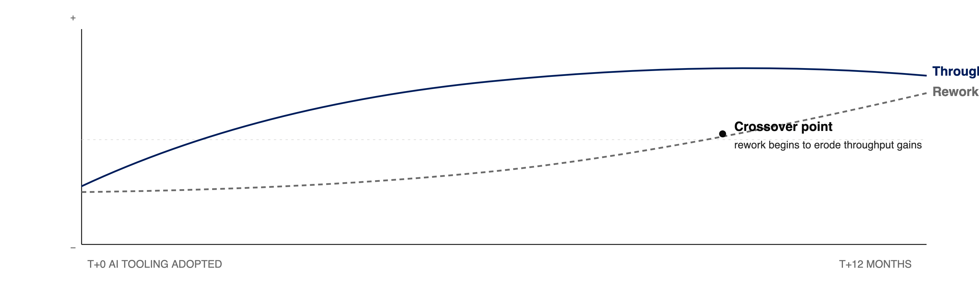
EXHIBIT 10 · TRAP 04 — DEBT ON A LAG
Throughput gains lead; quality costs follow.
Illustrative. Pattern observed in multiple 2024–2025 field studies of large codebases following AI rollout.
AI OUTLOOK — 2026
PART II · METRICS
14 / 28
Notes:
Trap four — and this is the one that scares me the most, because it's invisible for months. Throughput rises immediately when teams adopt AI. Rework, incidents, refactoring cost — those rise on a lag of six to twelve months. There's a crossover point where the debt begins to eat the throughput gains. Several studies in 2024 and 2025 picked this pattern up in large codebases. The implication for managers: do not declare victory at T-plus-three-months. Wait for the full cycle.

Slide 15
PART 3 OF 4
FRAMEWORKS
0 3
Beyond DORA and SPACE.
Notes:
Part Three. If the old metrics lie and the new tools break them faster, what should we actually measure? This is the part of the talk that's most opinionated, and I'll flag where I'm synthesizing industry practice versus proposing.

Slide 16
EXHIBIT 11 · THE INCUMBENTS
Two frameworks defined the last decade.
DORA · 2014
SPACE · 2021
Delivery performance
Developer productivity
Deploy frequency
Satisfaction & well-being
Lead time for changes
Performance
Change fail rate
Activity
Mean time to restore
Communication
Efficiency & flow
A proposed 5th metric — Mean Time to Value, idea approval to measurable business outcome — is gaining traction as AI collapses lead time. Not yet canonical.
Captured: the human side. Missed: the economic side and the AI dimension.
AI OUTLOOK — 2026
PART III · FRAMEWORKS
16 / 28
Notes:
DORA and SPACE are the incumbents and they earned that status. DORA's four keys still predict delivery performance — but a 2026 Stackademic piece by Ganesh Gurudu argues a fifth is now non-negotiable: Mean Time to Value, the elapsed time from idea approval to measurable business outcome. The argument: AI coding tools have collapsed lead time so far that DORA can no longer tell you whether what you shipped was worth shipping. SPACE's five dimensions cover the human side DORA never touched. If you don't have these in place, start here. Don't skip to the shiny new thing.

Slide 17
EXHIBIT 12 · THE GAP
What DORA and SPACE miss in the AI era.
0 1
AI leverage
0 2
Economic value
How much of the improvement is tool-driven versus team-driven? Neither framework has a handle.
Neither maps to revenue, margin, or cost avoided. Leaders must translate twice.
0 3
Cognitive load
0 4
Quality half-life
Review burden, onboarding time, and context-switching are rising; not captured.
AI-written code ages differently. Defect curves and refactor cost require new tracking.
AI OUTLOOK — 2026
PART III · FRAMEWORKS
17 / 28
Notes:
But here's what neither framework captures cleanly in the AI era. AI leverage: how much of the improvement is the tool versus the team. Economic value: neither framework maps to revenue or margin. Cognitive load: review burden is rising, and nobody's tracking it. Quality half-life: AI-written code ages differently than human-written code, and the defect curves don't look the same. We need additions, not replacements.

Slide 18
EXHIBIT 13 · PROPOSED FRAMEWORK
Three lenses for the AI-assisted organization.
LENS 01
LENS 02
LENS 03
Flow
Experience
Impact
How the work moves
How the team feels
What the business gets
Throughput with quality
Perceived productivity
Value delivered per quarter
Rework ratio
Cognitive load
Adoption & retention
Change fail rate
Onboarding time
Cost per engineer-week
Defect half-life
AI trust index
ROI on AI spend
AI OUTLOOK — 2026
PART III · FRAMEWORKS
18 / 28
Notes:
Here's the framework I propose, synthesizing what I see working across the industry. Three lenses. Flow — how the work moves. Experience — how the team feels. Impact — what the business gets. Each lens has three to four metrics, and critically, each lens has a different audience. Flow is for the team. Experience is for the manager. Impact is for the executive. One scorecard does not fit all three.

Slide 19
EXHIBIT 14 · LENS 01 — FLOW
Throughput, adjusted for quality.
DORA's four keys remain the floor. Pair them with two AI-era additions:
PROPOSED COMPOSITE
Ship rate
Rework ratio
Share of shipped code modified within 30 days.
1 + rework
Defect half-life
A denominator that penalizes debt makes speed honest.
Time until 50% of a cohort's bugs surface.
AI OUTLOOK — 2026
PART III · FRAMEWORKS
19 / 28
Notes:
Lens one, Flow. Keep DORA's four keys — they're the floor. Add two AI-era metrics. Rework ratio: what share of shipped code is modified within thirty days. Defect half-life: time until half of a cohort's bugs have surfaced. The formula on the right is a way to express this in one number: ship rate divided by one-plus-rework. A denominator that penalizes rework makes speed honest. If you can't produce this number today, that's the first thing I'd fix.

Slide 20
EXHIBIT 15 · LENS 02 — EXPERIENCE
The qualitative signals dashboards miss.
SURVEY · QUARTERLY
TELEMETRY · CONTINUOUS
Five questions, 90 seconds.
Signals worth watching.
Q 1
I shipped something valuable this week.
Context-switch frequency
Interrupts / focused hour
Q 2
I spent more time building than waiting.
Review latency
PR open → first review
Q 3
I trust the AI tools in my workflow.
Onboarding time
Days to first merged change
Q 4
Code review is a good use of my time.
AI trust index
% suggestions inspected
Q 5
I would recommend this team to a friend.
Incident load
On-call hours / engineer / qtr
AI OUTLOOK — 2026
PART III · FRAMEWORKS
20 / 28
Notes:
Lens two, Experience. This is half survey, half telemetry. The survey is five questions, ninety seconds, quarterly. You're tracking perceived productivity, flow, trust in AI tools, review load, and would-recommend. The telemetry side watches context-switching, review latency, onboarding time, an AI trust index — what percent of AI suggestions get inspected before accept — and incident load. Together these tell you whether the team is accumulating energy or bleeding it.

Slide 21
EXHIBIT 16 · LENS 03 — IMPACT
The line back to the business.
VALUE
COST
RETURN
Features adopted per quarter
Cost per engineer-week
ROI on AI tooling
Fully-loaded, including tooling. The denominator leaders quietly care about.
Count shipped features weighted by adoption, not by effort.
Return on AI tooling spend. Attribute carefully; confounds are many.
Three scorecards, not three metrics; each has its own denominator and audience.
AI OUTLOOK — 2026
PART III · FRAMEWORKS
21 / 28
Notes:
Lens three, Impact. The lens executives actually care about. Value delivered per quarter — features shipped weighted by adoption, not effort. Cost per engineer-week, fully loaded including tooling. And ROI on AI spend, attributed carefully because the confounds are many. These are not three metrics; they are three scorecards. Resist the urge to roll them into a single number. You will hide more than you reveal.

Slide 22
EXHIBIT 17 · WORKED EXAMPLE
A balanced quarterly scorecard.
LENS
METRIC
TARGET
ACTUAL
STATUS
FLOW
Rework ratio
< 18%
22%
○
FLOW
Change fail rate
< 10%
7%
●
FLOW
Defect half-life
> 21 days
14d
○
EXPERIENCE
Review latency (p50)
< 4 hours
6h
○
EXPERIENCE
Onboarding time
< 20 days
16d
●
EXPERIENCE
AI trust index
> 60%
71%
●
IMPACT
Features adopted / qtr
> 12
9
○
IMPACT
Cost per eng-week
< baseline
−8%
●
● On / ahead of target · ○ Behind target
AI OUTLOOK — 2026
PART III · FRAMEWORKS
22 / 28
Notes:
Here's what a balanced quarterly scorecard looks like in practice. Three rows for Flow, three for Experience, two for Impact. Targets in the middle column, actuals on the right, a simple traffic-light in the last. Notice that this team is beating target on some dimensions and behind on others — which is what a real scorecard should look like. If everything is green, you are measuring the wrong things. Or lying.

Slide 23
PART 4 OF 4
ORGANIZATION
0 4
The organizational shift.
Notes:
Part Four, and this is the shortest section. Because the way we measure is changing, so is the way we organize. I'll touch it briefly; this deserves its own talk.

Slide 24

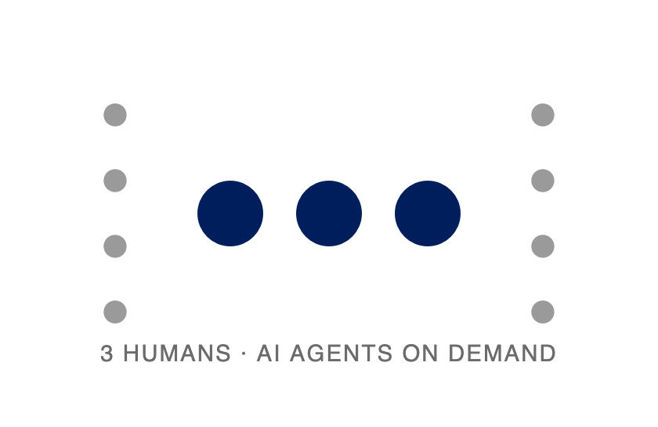
EXHIBIT 18 · THE SHIFT
From pyramids to pods.
BEFORE · 2022
AFTER · 2026
Team of 15
Pod of 3
PM, tech lead, 2 seniors, 6 mids, 5 juniors
Same charter, same surface area, different math
AI OUTLOOK — 2026
PART IV · ORGANIZATION
24 / 28
Notes:
The shape of engineering teams is changing. Two years ago, a typical product team looked like the left diagram — fifteen people, pyramidal. Today, the same charter is increasingly handled by what looks like the right diagram — three humans with high AI leverage, sometimes supported by six agents. Same surface area, different math. This is not theoretical. This is what Stripe, Shopify, Anthropic, and a cohort of AI-native companies are publicly reporting.

Slide 25
EXHIBIT 19 · THESIS
The unit of productivity is shrinking.
A three-person pod with strong AI leverage is beginning to out-ship a fifteen-person team with weak leverage. The manager's role shifts from staffing projects to designing the minimum viable pod.
2–5
1
On demand
Engineers per pod
Clear owner per surface
Agent capacity
Enough for coverage; small enough to stay in head.
No shared PM, no shared on-call.
Capacity is no longer the binding constraint.
AI OUTLOOK — 2026
PART IV · ORGANIZATION
25 / 28
Notes:
The thesis, stated plainly. The unit of productivity is shrinking. A three-person pod with strong AI leverage is beginning to out-ship a fifteen-person team with weak leverage. Two to five engineers per pod. One clear owner per surface. Effectively infinite agent-hours on demand. The manager's job is no longer to staff projects. It's to design the minimum viable pod. That reframing is where a lot of the change resistance lives — because it implies fewer managers.

Slide 26
EXHIBIT 20 · FOR MANAGERS
Four implications, starting Monday.
0 1
Coach, rather than assign.
0 2
Budget for review, not only build.
In a pod of three, every engineer is senior-adjacent. The management function shifts from staffing to amplifying.
AI halves write-time and doubles review-time. Plan capacity accordingly.
0 3
Flatten the reporting tree.
0 4
Invest in seniors early.
Fewer managers, broader spans of influence, higher expectations for written clarity.
Juniors receive the largest AI lift; seniors catch the mistakes. Hire composition matters.
AI OUTLOOK — 2026
PART IV · ORGANIZATION
26 / 28
Notes:
Four implications for you as managers, starting Monday. One: coach, don't assign — every engineer in a pod of three is senior-adjacent. Two: budget for review, not just build — AI halves write-time and doubles review-time. Three: flatten the reporting tree — fewer managers, bigger spans, higher bar for written clarity. Four: invest in seniors early — juniors get the largest AI lift, but seniors are the ones who catch the mistakes. If you only remember one of these, remember the fourth.

Slide 27
EXHIBIT 21 · IMPLEMENTATION
A ninety-day measurement reset.
DAY 0–30
DAY 30–60
DAY 60–90
Audit
Instrument
Recalibrate
Inventory every metric in play. Classify each as activity, output, outcome, or value. Retire the first two.
Stand up the three lenses. One metric per lens per team. Publish targets, not vanity numbers.
Review with pod leads. Kill what does not change behavior. Commit to the remaining set for two quarters.
AI OUTLOOK — 2026
CLOSING
27 / 28
Notes:
A ninety-day reset, if you want something concrete to do with this talk. First thirty days: audit every metric you have and classify each as activity, output, outcome, or value. Retire the first two. Second thirty: stand up the three lenses, one metric per lens per team — no more. Third thirty: review with your pod leads, kill what doesn't change behavior, and commit to the remaining set for two quarters. Two quarters is the minimum; less than that and you'll never learn whether the metric actually moves the business.

Slide 28
CLOSING OBSERVATION
Velocity decays. Trust, quality, and customer value compound. Measure for what compounds.
The managers who thrive in the AI era pick the compounding metrics — and defend them from the quarterly pressure to ship more.
THANK YOU
QUESTIONS & DISCUSSION
AI OUTLOOK — 2026
CLOSE
28 / 28
Notes:
The closing thought. Velocity decays. Trust, quality, and customer value compound. The managers who thrive in the AI era are the ones who pick the compounding metrics — and defend them from the quarterly pressure to ship more. Measure what compounds. Thank you. I'm happy to take questions.

