Slide 1


CS8811- PROJECT VIVA VOCE – APRIL/MAY-2023 EXAMINATIONS
CUSTOMER LOAN ELIGIBILITY PREDICTION AND VISUALIZATION USING MACHINE LEARNING AND DATA ANALYTICS
BATCH MEMBERS
1. Srinivasan S (513419104043)
2. Vasanthavasan G (513419104053)
3. Karthi keyan kalathi S (513419104701)
GUIDED BY
Dr. K.SELVABHUVANESHWARI, M.E, Ph.D,
ASSISTANT PROFESSOR, HOD.

Slide 2

Banks are making major part of profits through loan, even if many people are looking for loans. It's challenging to choose a genuine applicant who will return the loan.
Many errors may occur when selecting the real applicant when the process is done manually so machine learning model is used.
Proposed model is created by an machine learning-based loan prediction system and dashboard visualization that will choose the qualified applicants on its own.
Both the applicant and the bank staff will benefit from this proposed model
There will be a significant reduction in the loan sanctioning period of time. In this project proposed system uses machine learning technique to predict the loan and data analytics to visualize an stunning dashboard.

Slide 3

To Cut-off the direct contact of Customer with the bank employee to know about their loan status.
To accomplish improved accuracy of the models used for predicting person eligibility for loan.
To design a web application for Prediction and Analysis of bank loan eligibility
To predict whether the loan approval to a specific individual is safe or not.
To visualize an Stunning Dashboard, Story and Report
CS8811- PROJECT VIVA VOCE – APRIL/MAY-2023 EXAMINATIONS

Slide 4

Sl. No | TITLE | AUTHOR AND PUBLICATIONS | YEAR | DRAWBACKS
1 | Logistic Regression Model for Loan Prediction:A Machine Learning Approach | Richa Manglani and AnujaBokhare”, IEEE | 2021 | Logistic Regression algorithm is utilized for the prediction. A fuse of different strategies that beat the presentation of well-known data mining models must be carried out and tested for space to achieve better accuracy in the model.
2 | Prediction of Modernized Loan Approval System Based on Machine Learning Approach | Vishal Singh, Vishal Singh, Rajat Awasthi, IEEE | 2021 | data testing and data training processes is low in preffered paper
CS8811- PROJECT VIVA VOCE – APRIL/MAY-2023 EXAMINATIONS

Slide 5

Sl. No | TITLE | AUTHOR AND PUBLICATIONS | YEAR | DRAWBACKS
3 | Machine Learning Models for Predicting Bank Loan Eligibility | Ugochukwu .E. Orji, Chikodili.H.Ugwuishiwu, Joseph.C.N. Nguemaleu, Peace. N. Ugwuanyi,IEEE Conference 2022 | 2022 | In this paper, They have provided evidence to validate this concept here using a presents six (6) machine learning algorithms with low accuracy.
4 | Customer Loan Eligibility Prediction using Machine Learning Algorithms in Banking Sector | Ch. Naveen Kumar, D.keerthana, M.Kavitha, M Kalyani, IEEEConference2022 | 2022 | The analysis of implemented models reveals that machine learning models are suitable for customer loan eligibility prediction and identified that the existing models are not giving 100% accuracy.
CS8811- PROJECT VIVA VOCE – APRIL/MAY-2023 EXAMINATIONS

Slide 6

User will enter the required personal data to make a prediction of loan eligibility criteria.
Once the data has been loaded, system will preprocess the data and feature extraction will be done.
Once the features required for the prediction have been extracted, System will compare the features with model and prediction will be given as final result in the end whether the person is eligible for loan approval or not.
There is need for improvement in accuracy of prediction of loan eligibility
There is a chance that a loan could be assigned to an ineligible applicant due to low accuracy.
There is no graphical visualization of data that which person is approved and rejected for loan.

Slide 7

The primary goal of this study is to use machine learning models to predict whether a new application will be approved for a loan or not.
With the use of data analytics and a browser interface, this proposed system attempt to create flexible graphical concepts for user interfaces in this project which is user friendly.
Our objective is to develop a machine learning model to classify with the highest degree of accuracy possible for Customer and beautiful data insights for banking sector

Slide 8

This proposed systems goal is to create user-friendly interfaces and to implement an Interactive Dashboard representation using data analytics.
This proposed systems objective is to develop a machine learning model to classify with the highest degree of accuracy possible.
From the Accuracies obtained, the Decision Tree Algorithm has gained maximum accuracy of 96%
Responsive web application is developed with prediction and data analytics technique.
CS8811- PROJECT VIVA VOCE – APRIL/MAY-2023 EXAMINATIONS

Slide 9

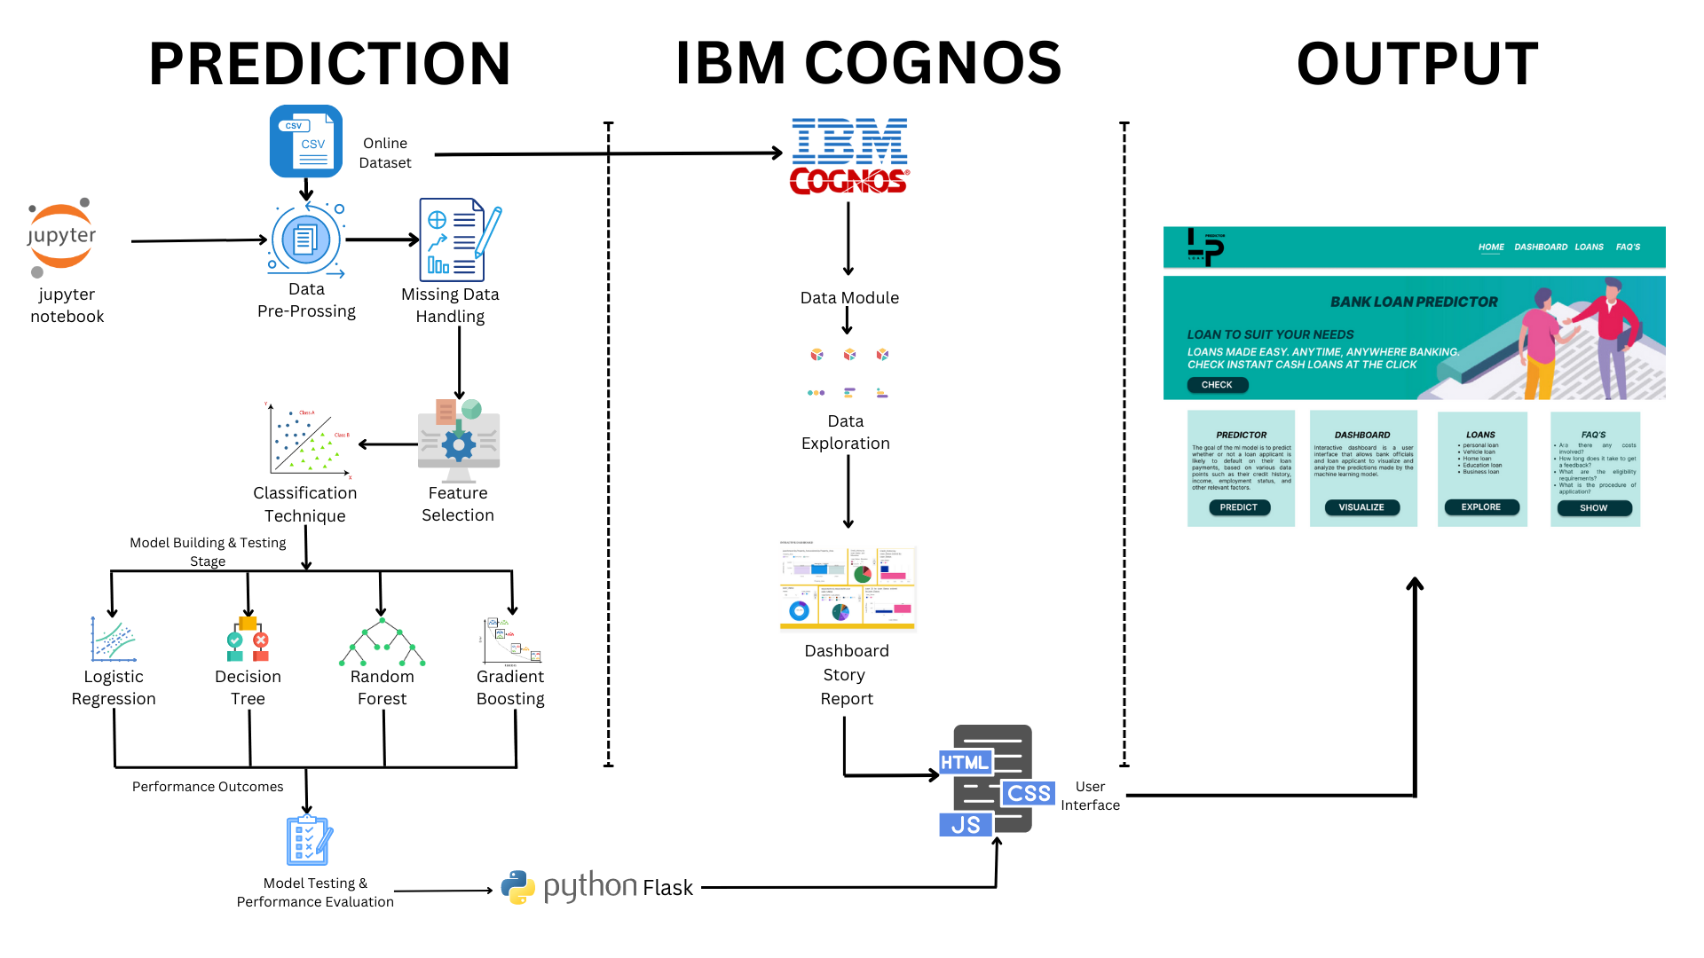
CS8811- PROJECT VIVA VOCE – APRIL/MAY-2023 EXAMINATIONS

Slide 10

Decision Tree:
Decision tree is a type of supervised learning algorithm that is mostly used in classification problems. Decision Trees are a non-parametric algorithm that can handle both numerical and categorical variables.
2. Logistic Regression:
Logistic Regression is a simple and fast algorithm that can be used for binary classification problems like loan prediction.
It models the probability of the target variable (loan approval) as a function of the input variables (credit score, income, etc.) using a logistic function.

Slide 11
3. Random Forest:
Random Forest is a tree-based bootstrapping algorithm wherein a certain no. of weak learners (decision trees) are combined to make a powerful prediction model. For every individual learner, a random sample of rows and a few randomly chosen variables are used to build a decision tree model.
4. K-Nearest Neighbor:
KNN is one of the simplest MLalgorithms based on Supervised Learning technique K-NN algorithm assumes the similarity between the new case/data and available cases and put the new case into the category that is most similar to the available categories

Slide 12

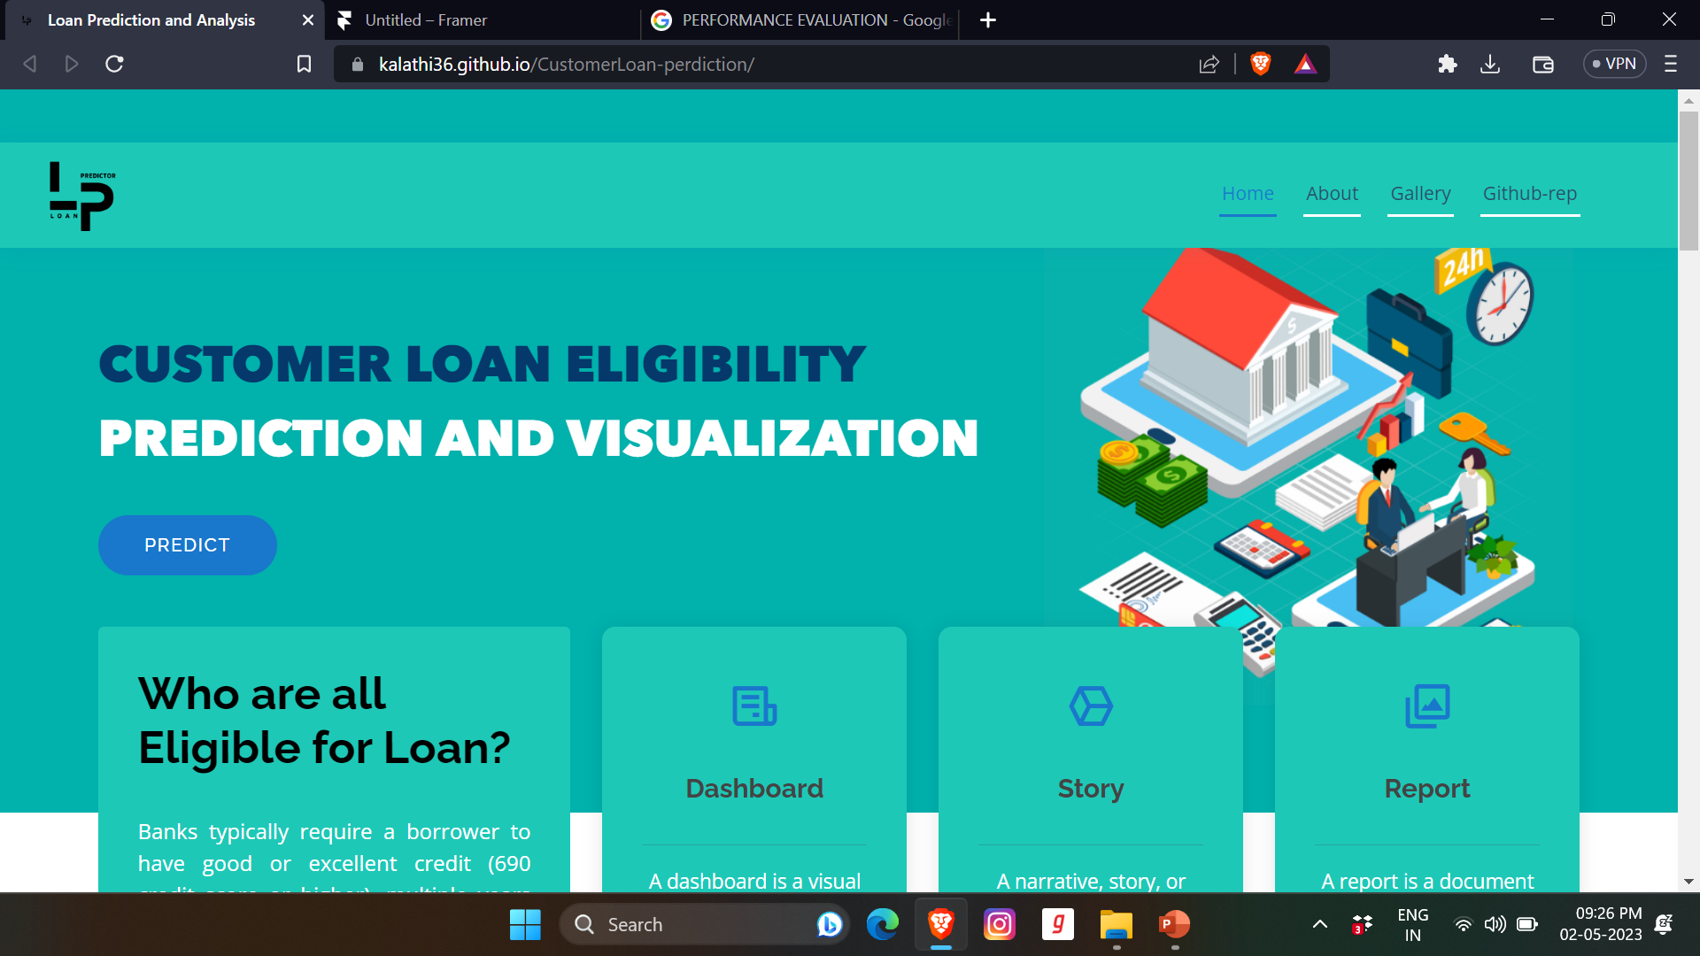
CS8811- PROJECT VIVA VOCE – APRIL/MAY-2023 EXAMINATIONS

Slide 13

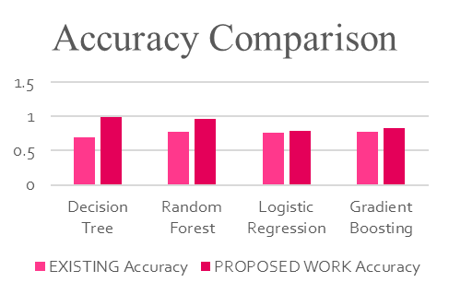
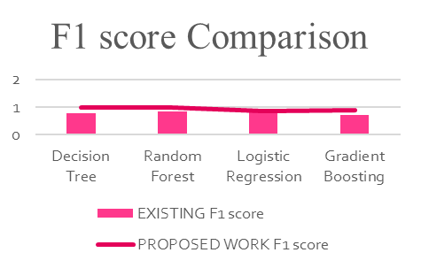
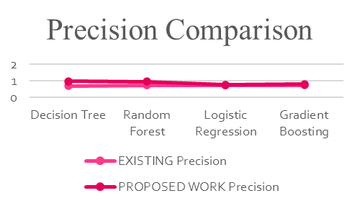
 | EXISTING |  |  |  | PROPOSED WORK
 | Accuracy | Precision | Recall | F1 score | Accuracy | Precision | Recall | F1 score
Decision Tree | 0.69 | 0.72 | 0.83 | 0.77 | 0.99 | 0.98 | 1 | 0.99
Random Forest | 0.78 | 0.75 | 0.98 | 0.85 | 0.97 | 0.96 | 1 | 0.98
Logistic Regression | 0.76 | 0.74 | 0.97 | 0.84 | 0.79 | 0.77 | 0.97 | 0.86
Gradient Boosting | 0.78 | 0.75 | 0.98 | 0.71 | 0.83 | 0.8 | 0.99 | 0.89
CS8811- PROJECT VIVA VOCE – APRIL/MAY-2023 EXAMINATIONS

Slide 14

In conclusion, the proposed system of Bank Loan Prediction using Machine Learning and Data Analytics with an Interactive Dashboard has the potential to revolutionize the loan approval process in banks.
By automating the loan eligibility prediction using machine learning algorithms and presenting the results in a user-friendly interactive dashboard, this system can significantly reduce the time and effort required by bank staff to process loan applications.
The predictive model trained on historical loan data can accurately classify loan applications into eligible or ineligible categories, and the data analytics dashboard provides valuable insights into the loan approval process.

Slide 15

The predictive model could be further improved by incorporating additional data sources, such as social media activity, employment history, or educational background, to better assess the credit worthiness of customers.
The accuracy of the predictive model could be improved by fine-tuning the model's parameters, such as the learning rate or regularization term, using techniques such as grid search or random search.
While the model used in the project achieved good accuracy, The model could be enhanced by incorporating more complex features such as loan payment history or customer behavior patterns, which can help to identify potential risks and opportunities for more accurate loan eligibility predictions.

Slide 16

    xolani dastile , turgay celik, and hans vandierendonck ,"Model-Agnostic Counterfactual Explanations in Credit Scoring",IEEE ACCESS,2022,VOLUME 10, 2022.
    Richa Manglani and Anuja Bokhare, “Logistic Regression Model for Loan Prediction:A Machine Learning Approach ”, IEEE XPLORE, 2021, ETI 4.0
    Ch. Naveen kumar, D.keerthana, M.Kavitha, M.Kalyani, “Customer Loan Eligibility Prediction using Machine Learning Algorithms in Banking Sector”, IEEE XPLORE, 2022, (ICCES 2022).
    Ugochukwu .E. Orji, Chikodili.H.Ugwuishiwu, Joseph. C. N. Nguemaleu, Peace. N. Ugwuanyi, “Machine Learning Models for Predicting Bank Loan Eligibility”, IEEE XPLORE, 2022, 4th (NIGERCON).
    Vishal Singh, Vishal Singh, Rajat Awasthi, “Prediction of Modernized Loan Approval System Based on Machine Learning Approach”, IEEE ACCESS, CONIT, Karnataka, India. June 25-27, 2021.
CS8811- PROJECT VIVA VOCE – APRIL/MAY-2023 EXAMINATIONS

Slide 17

    L. Udaya Bhanu1 , Dr. S. Narayana, “Customer Loan Prediction Using Supervised Learning Technique ”, International Journal of Scientific and Research Publications, 2021.
    Yu Zhong And Huiling Wang, “Internet Financial Credit Scoring Models Based on Deep Forest and Resampling Methods”, IEEE ACCESS,2023.
    Rana Alasbahi And Xiaolin Zheng, “An Online Transfer Learning Framework With Extreme Learning Machine for Automated Credit Scoring” , IEEE ACCESS,2022.
    Min Sue Park , Hwijae Son, Chongseok Hyun, And Hyung Ju Hwang , “Explainability of Machine Learning Models for Bankruptcy Prediction” , IEEE ACCESS, 2021.
    Yen-Ru Chen , Jenq-Shiou Leu , Sheng-An Huang , Jui-Tang Wang , “Predicting Default Risk on Peer-to-Peer Lending Imbalanced Datasets” , IEEE ACCESS, 2021.
CS8811- PROJECT VIVA VOCE – APRIL/MAY-2023 EXAMINATIONS

Slide 18
THANK YOU
CS8811- PROJECT VIVA VOCE – APRIL/MAY-2023 EXAMINATIONS

