Slide 1
Lane Line Detection for Autonomous Vehicles
Introduction
Authors -
Manish Sharma, Anwesh Badapanda, Sunisth Kumar, Daksh Jain, Karthikeyan Rathore

Slide 2
Introduction
In this Project we are building one of the components of the autonomous driving system (ADS) that is lane line detection on the road.
Lane lines are designed for humans to follow while driving. In the same way, an autonomous driving system uses lane lines to steer the vehicle accordingly and follow the road track in the correct orientation.
Lane Line detection includes localization of the road, the determination of the relative position between vehicle and road, and the analysis of the vehicles heading direction.

Slide 3
Introduction
Safety is the main objective of all the road lane detection systems due to the reason is that most of the vehicle road accident happens because of the driver miss leading of the vehicle path.
India, ranks 1st in the number of road accident deaths across the 199 countries reported in the World Road Statistics, 2018 followed by China and US. As per the WHO Global Report on Road Safety 2018, India accounts for almost 11% of the accident related deaths in the World.

Slide 4
Introduction
Our main intend behind this project, was to build a system which alerts (BEEP Sound) the driver, when he is not in lane.
Therefore, this system will provide a means of warning to the driver in case of any danger and has the potential to save a considerable number of lives.

Slide 5
Environmental variables

Slide 6
ideas/methods

Slide 7
Hough Transform Method (Explain)

Slide 8
Hough Transform Method (Example)

Slide 9
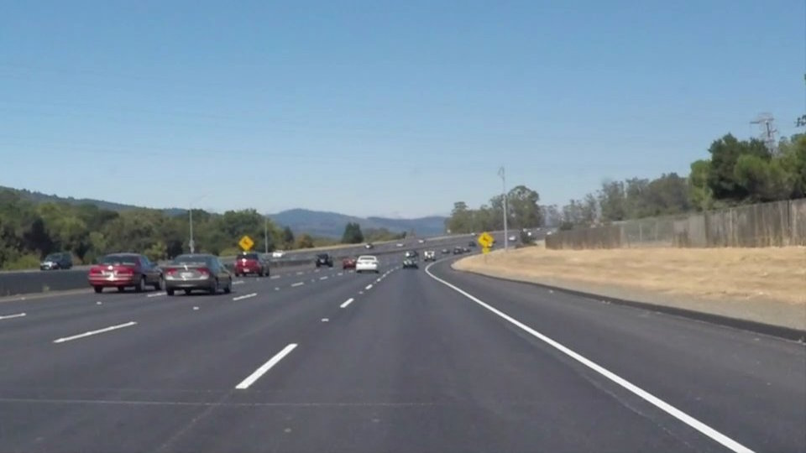
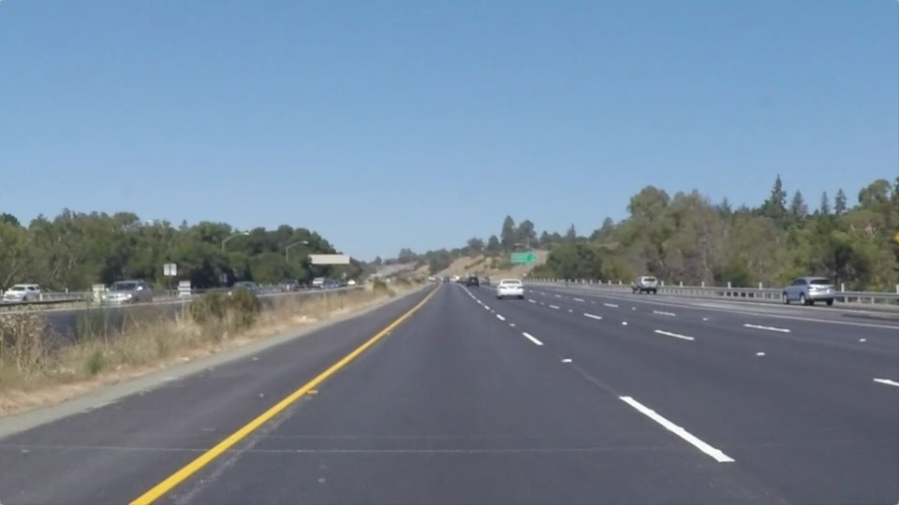
Dataset
All the images in our dataset is 540x960 RGB images.
For dash cam footage we are capturing each frame per second & applying our algorithm pipeline to each image frame.
White Lane Lines
Yellow Lane Lines

Slide 10
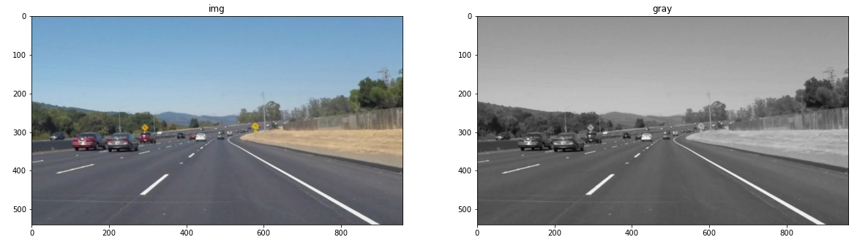
image preprocessing (White Lane Lines)
In our dataset, the colour of surface of the road was changing from one region to another due to factors such as: shadows, different age or style of the road.
To remove this problem we converted the images to grayscale first, meaning converting 24bit, 3 channel colour image to 8bit , 1 channel image.
gray: cv2.cvtColor(img , cv2.COLOR_RGB2GRAY)

Slide 11
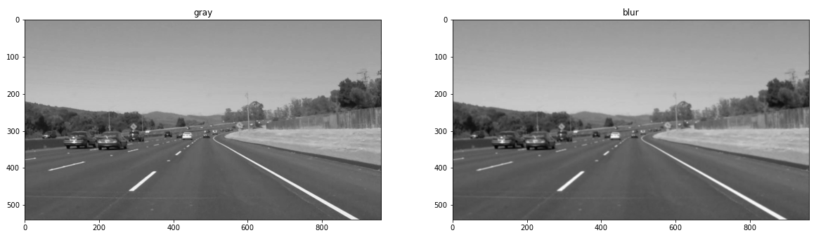
image preprocessing
Noise Reduction
Noise in our image will impact our edge detection.
Gaussian Blur: cv2.GaussianBlur(gray, (5, 5), 0), kernel size=5

Slide 12
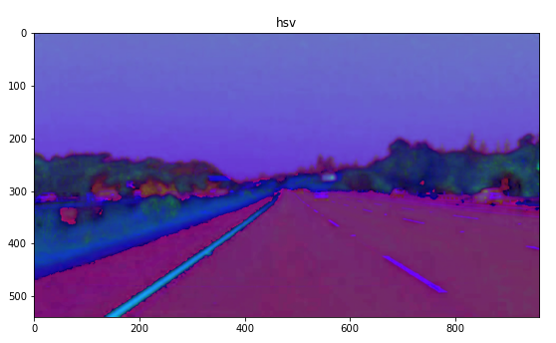
image preprocessing (Yellow Lane Lines)
hsv = cv2.cvtColor(img, cv2.COLOR_BGR2HSV)

Slide 13
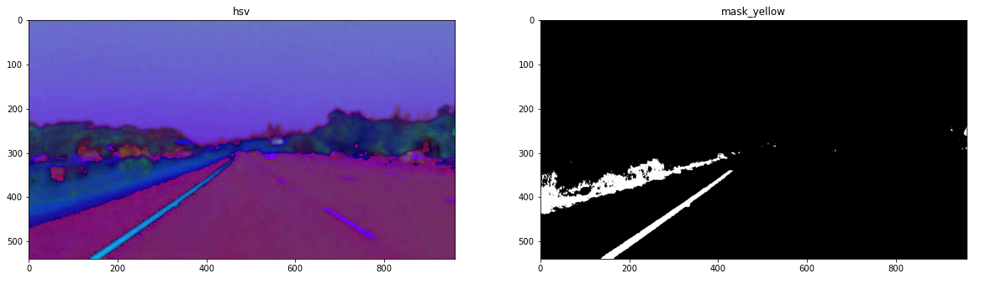
image preprocessing
mask_yellow = cv2.inRange(hsv, (15,60,20), (25, 255, 255))

Slide 14
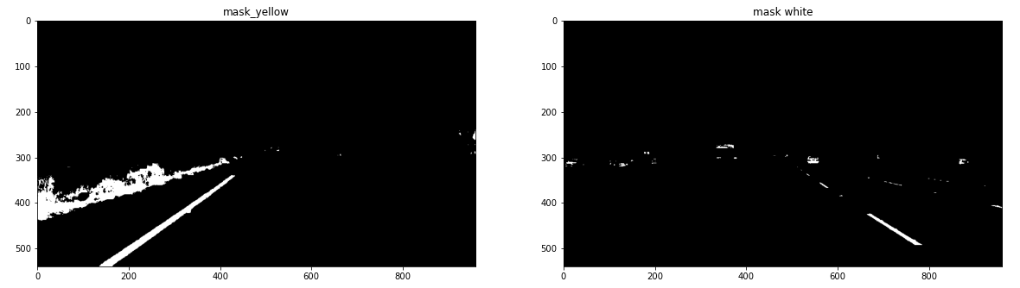
image preprocessing
mask_white = cv2.inRange(img, (200,200,200), (255, 255, 255))

Slide 15
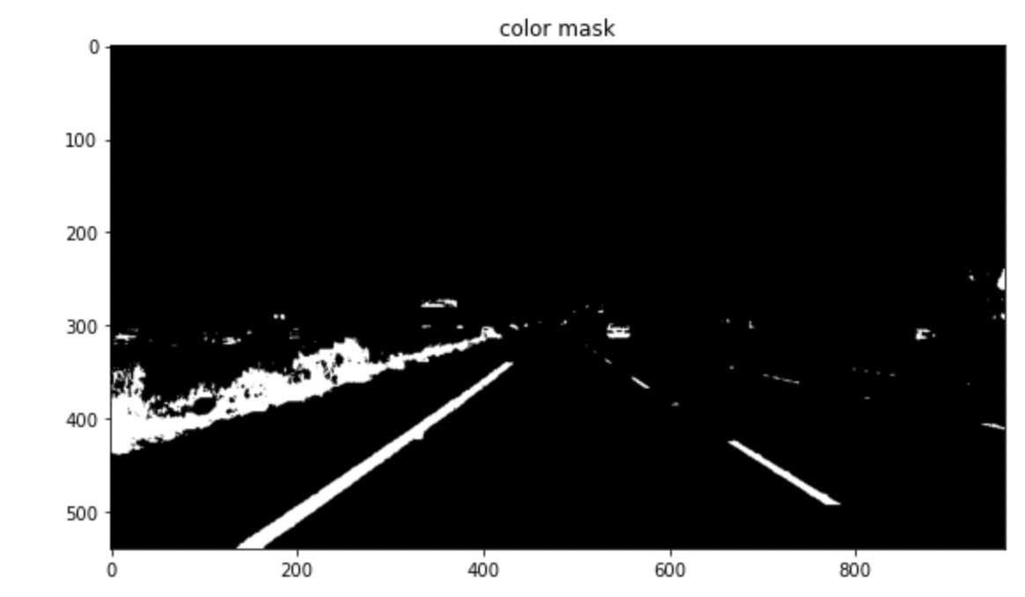
image preprocessing
color_mask = cv2.bitwise_or(mask_white, mask_yellow)

Slide 16
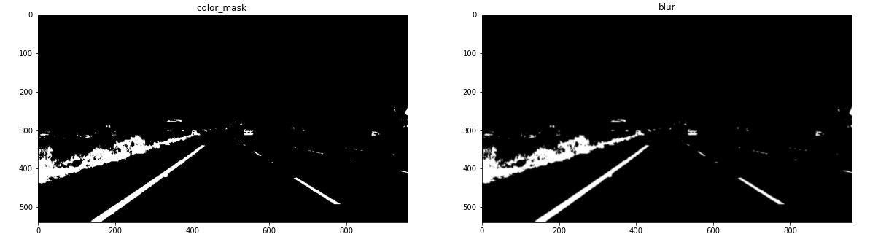
image preprocessing
blur = cv2.GaussianBlur(color_mask, (5,5), 0)

Slide 17
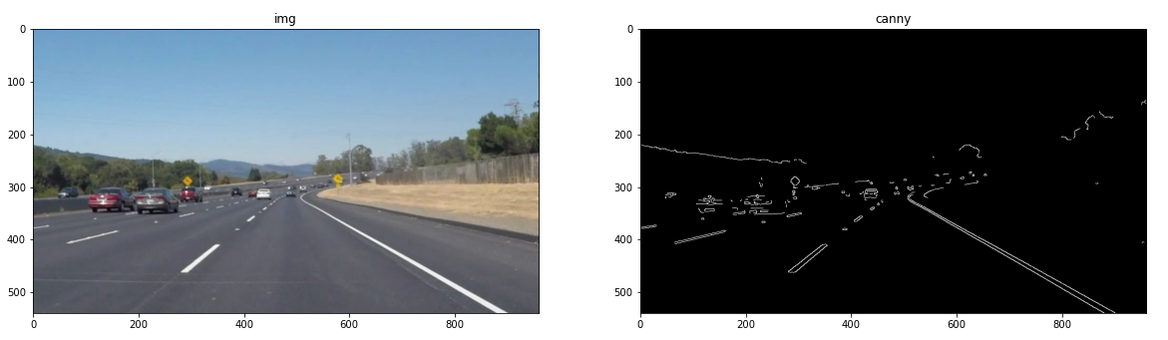
edge detection
cv2.Canny(gray, 200, 300)
Edge detection is applied to extract lane lines boundaries from the image.
There were many edge detection algorithms such as Roberts, Prewitt, Sobel, Canny.

Slide 18
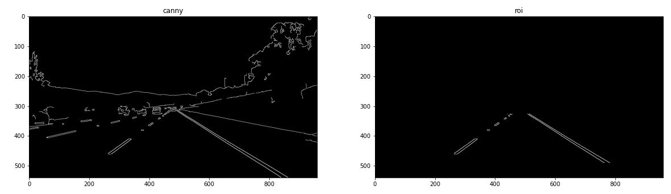
Region of Interest
Explain this

Slide 19

Hough Transform

Slide 20
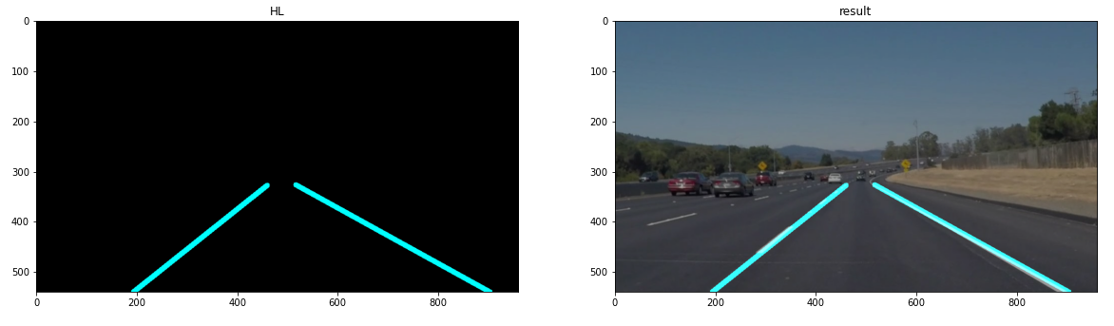
Result

Slide 21
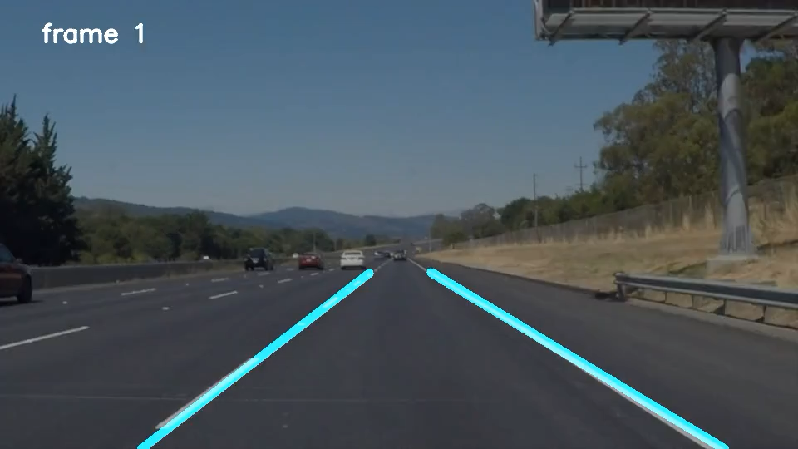
Result (video)

Slide 22
End (maybe)

