Slide 1
Seminar: CAPTCHA
Introduction
Author: Karthikeyan Rathore
Course: Seminar on Special Topics in Emerging Areas
Course Code: ECSE321P

Slide 2
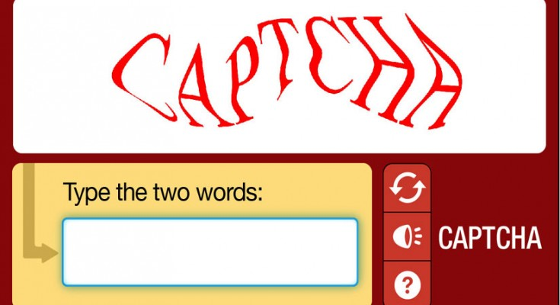
Introduction
captcha is a software for generating codes that are easy for humans to pass but difficult for computer programs such as BOTS.

Slide 3
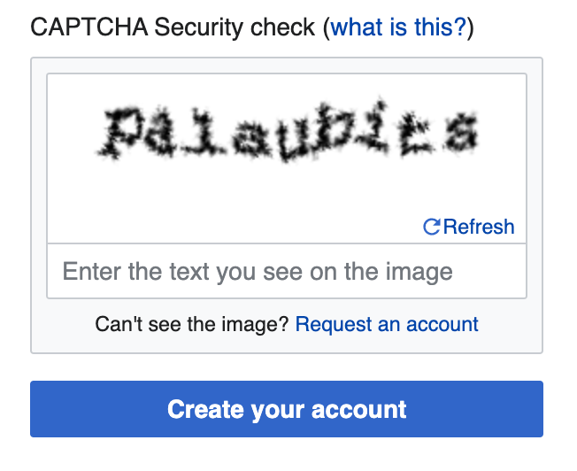
Introduction
captcha is a simple process, where the user is prompted with automated system-generated question and the system has to classify between human and a bot based upon the answer from the user.

Slide 4
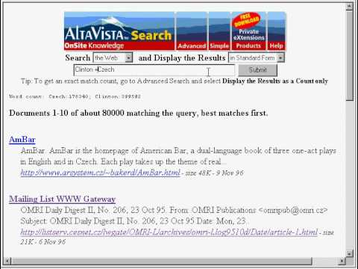
Introduction (History)
captcha (completely automated public turing test to tell computers and human apart) was developed in 1997 by Andrei Broder to distinguish between human and computer.

Slide 5
Idea/Why? captcha
captcha is a unique security measure to protect the internet-based services from exploitations performed automatically by millions of bots with offensive intentions.

Slide 6
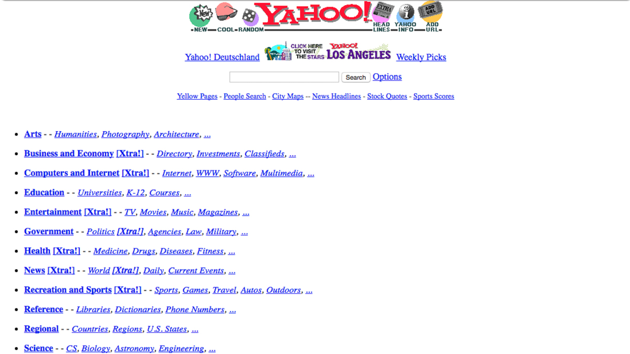
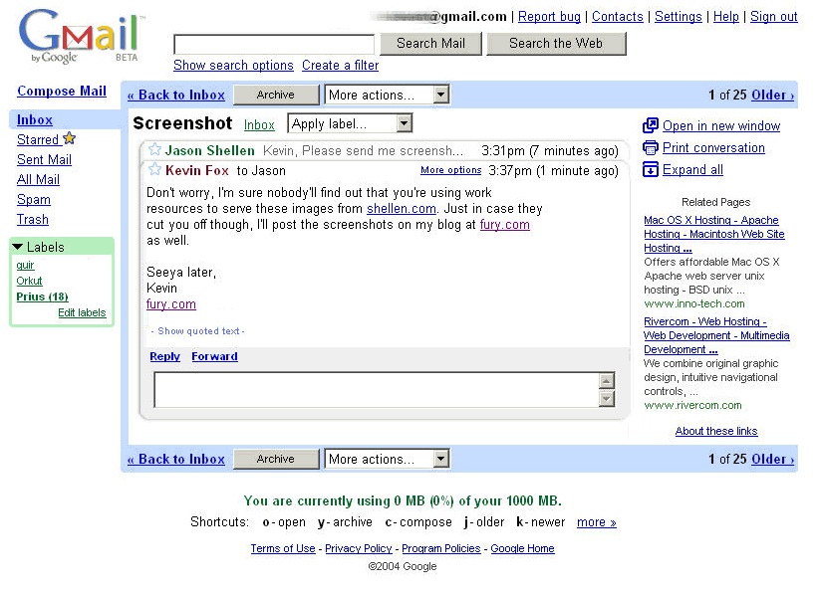
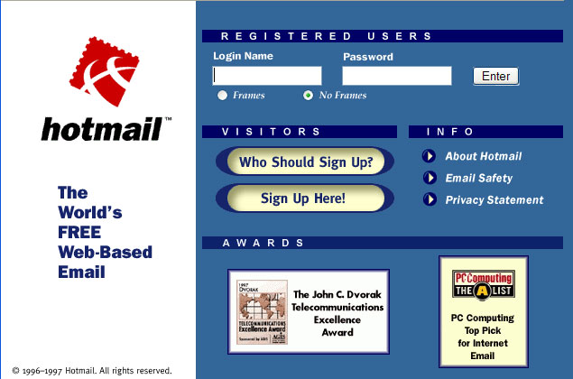
Idea/Why? captcha
Most of internet based services such as Yahoo, Hotmail, Gmail were getting attacked by malicious bots which used to fill registration forms in these websites automatically with unfitting information which further resulted in the performance of the systems and in some cases system failure was caused.

Slide 7
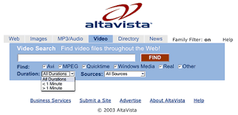
Idea/Why? captcha
AltaVista attacked by malicious internet bots in 1997.

Slide 8
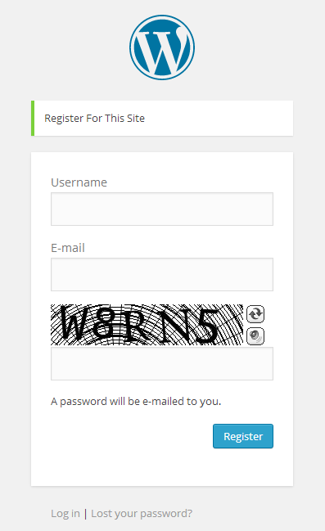
APPLICATIONS/WHERE? CAPTCHA
Website Registration: captcha systems are used in most of the email-services such as gmail, yahoo, outlook etc to prevent against bots that used to register thousands of accounts.

Slide 9
APPLICATIONS/WHERE? CAPTCHA
Search Engine Bots: captcha can be used by administrators to stop search engine bots from indexing to prevent others from reading or downloading these sites because they may contain private information.
Dictionary Attacks: captcha can be used to prevent comp programs from being able to repeat through the entire space of password by asking the user to solve a CAPTCHA test after a number of unsuccessful logins.

Slide 10
APPLICATIONS/WHERE? CAPTCHA
Online Polls: captcha are utilized to prevent Web crawlers and bots from engaging in online polling by asking the user who wants to vote to solve a CAPTCHA before the vote submission. However, this process cannot prevent users from voting many times.
Protecting Email Addresses from Scrapers: This can be done by hiding a user’s email address from Web scrapers by asking the user to solve a CAPTCHA before displaying his or her email address.

Slide 11
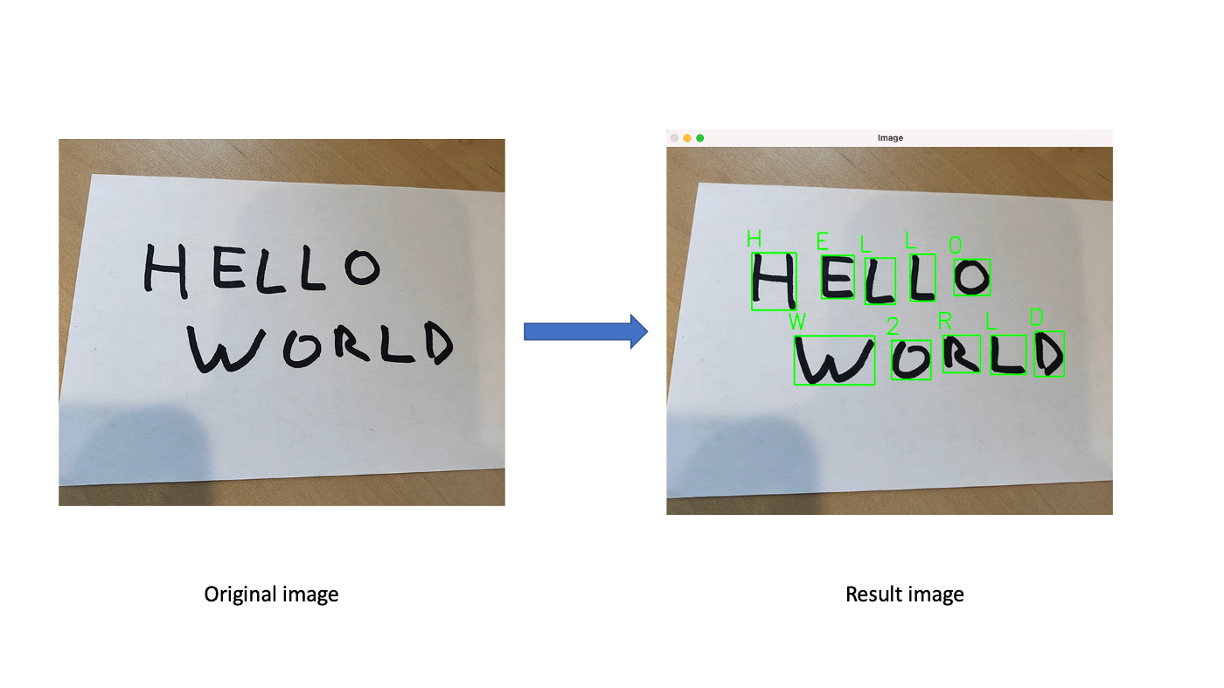
BYPASS CAPTCHA TEST/HOW?
OCR (Optical Character Recognition) is a technique / mechanism that converts images of typed, handwritten or printed text into machine-encoded text, whether from a scanned document, photo of a document or a scene-photo. Some of the software can use this technique to bypass captcha challenge.

Slide 12
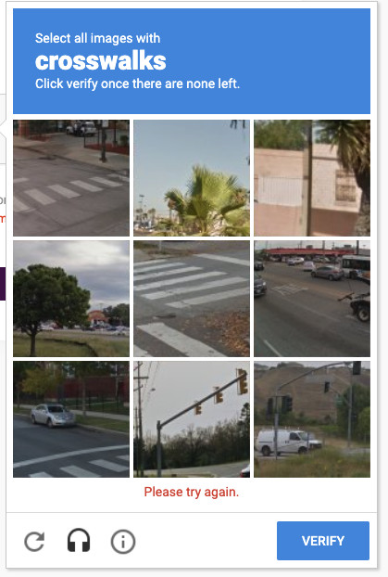
BYPASS CAPTCHA TEST/HOW?
Random Guessing Attack: It is "the situation when an attacker randomly passes the CAPTCHA challenges without any effort".

Slide 13
BYPASS CAPTCHA TEST/HOW?
Pictionary-based Attack: the bot maintains a picture dictionary (Pictionary) or a look-up table of object pictures along with their object names and any associated information useful in picture matching.

Slide 14
TYPES OF CAPTCHA
Text Based CAPTCHAs
Image Based CAPTCHAs
Audio Based CAPTCHAs
Video Based CAPTCHAs
Puzzle Based CAPTCHAs

Slide 15
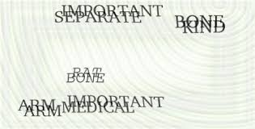

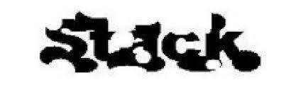
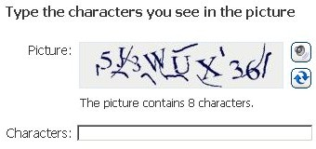
Text Based CAPTCHAs
Text-based CAPTCHAs, the earliest and most deployed CAPTCHA type, typically asks users to recognize a distorted sequence that consists of English letters or Arabic numerals.
EZ–Gimpy
baffle
GIMPY
MSN

Slide 16
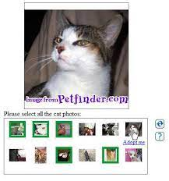
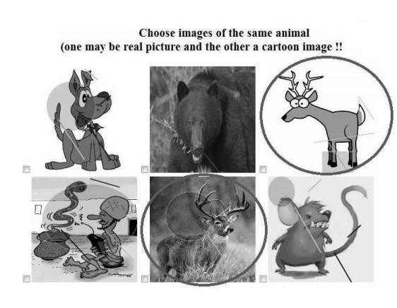
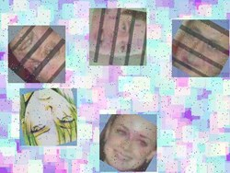
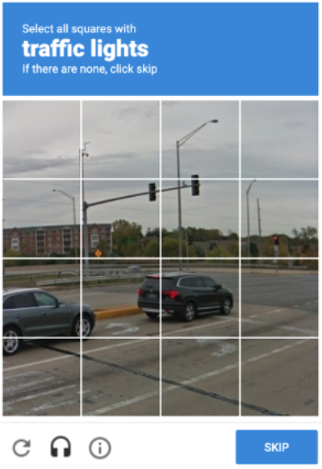
Image Based CAPTCHAs
Image-based CAPTCHAs are based on the human recognition ability of a specific picture from a collection of similar pictures.
asirra captcha
semage captcha
FaceDCAPTCHA
google captcha

Slide 17
Audio Based CAPTCHAs
Sound-based CAPTCHAs are Audio CAPTCHAs specially designed for visually impaired person. It contains audio clips that can be downloaded on the client-side.

