Slide 1
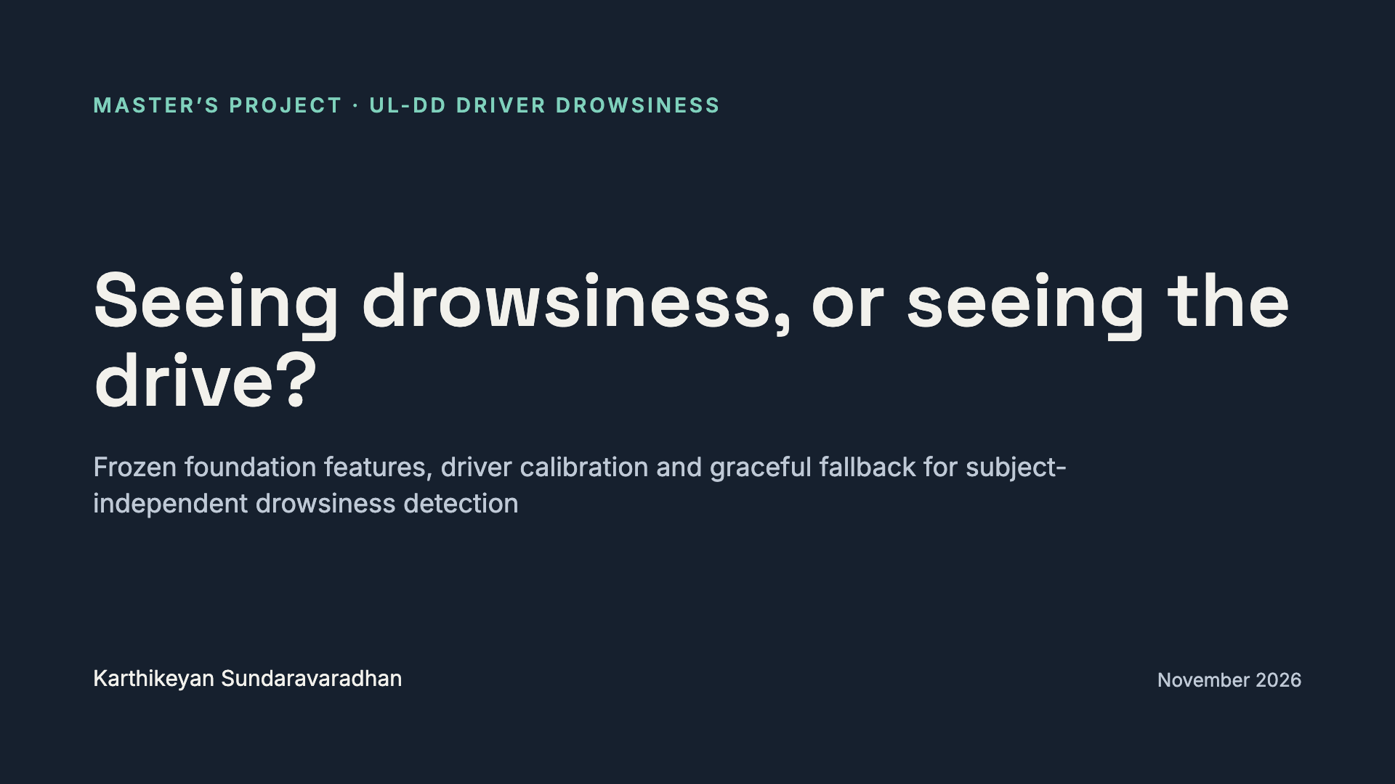
Notes:
Opening line: we built drowsiness detection on UL-DD up from honest baselines, made it robust to camera failure, and measured how much of what the models learn is really drowsiness. The title question is the twist we reach at the end.

Slide 2
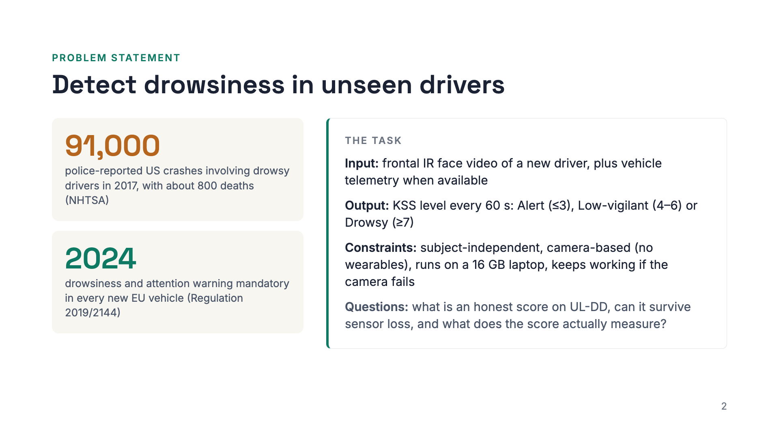
Notes:
Drowsy driving causes tens of thousands of crashes a year, and camera-based driver monitoring is now required in new European vehicles. The task we set is concrete. Given the frontal infrared video of a driver the model has never seen, plus telemetry when it is available, predict the three-class KSS level for every 60 second window. It must be camera-based, run on a laptop, and degrade gracefully when the camera fails. Three questions follow: what an honest score looks like on UL-DD, whether the system survives sensor loss, and what the score really measures.

Slide 3
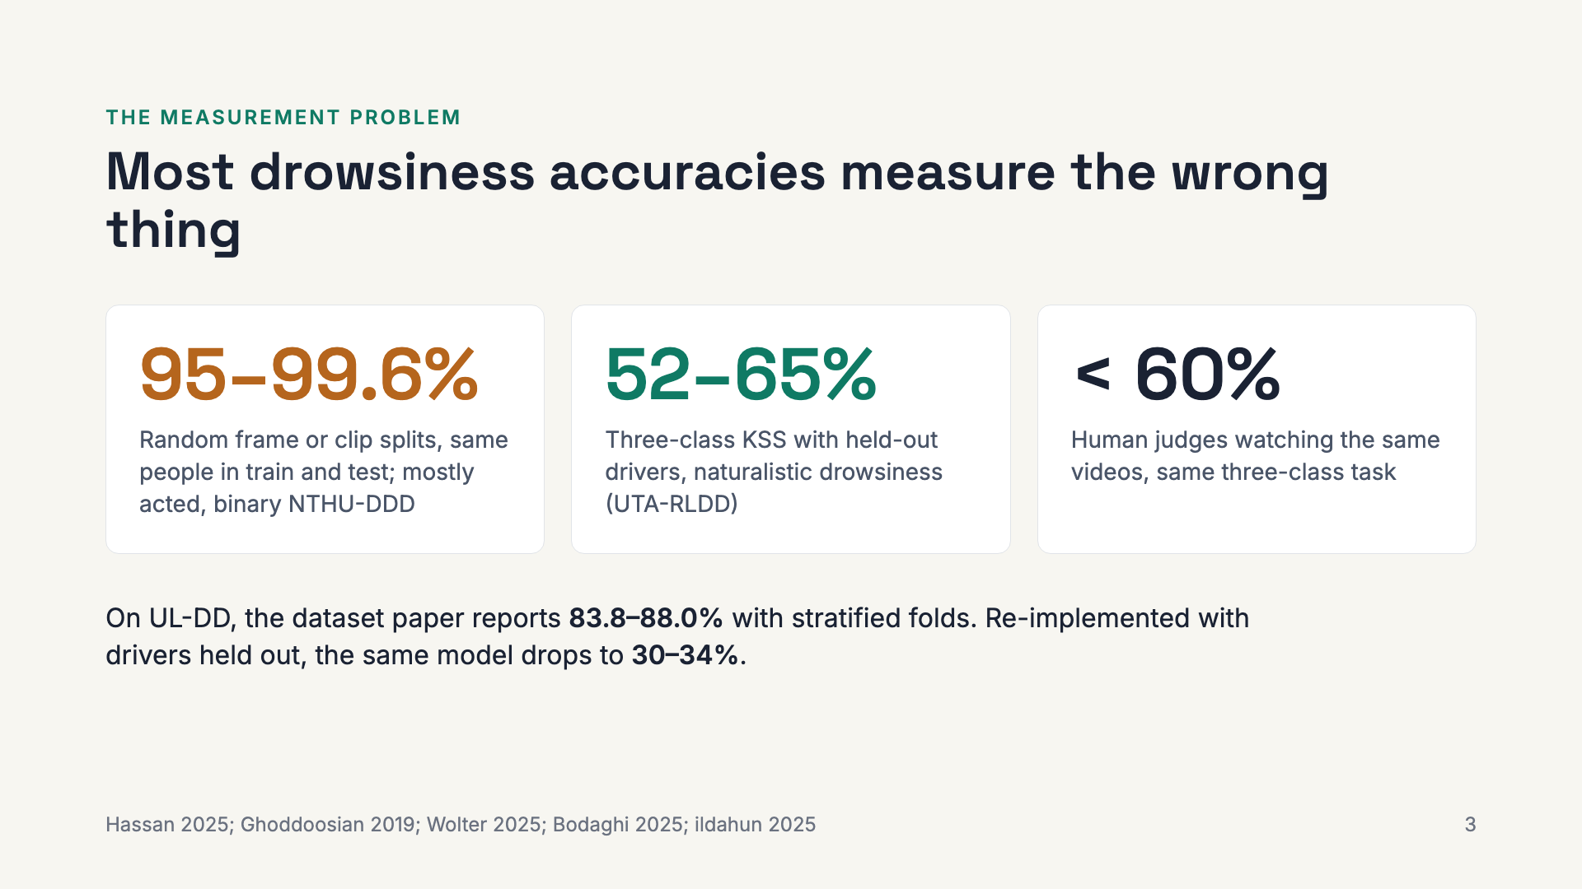
Notes:
The field’s headline numbers come from splits that let the same person appear in train and test. Under subject-independent, naturalistic KSS labels, published results are 52–65% three-class accuracy, and humans do under 60%. UL-DD’s own paper is in the leaky group: an independent re-implementation fell from 75% on a random split to about 30% per driver. So the question for this thesis is what an honest number looks like on UL-DD video.

Slide 4
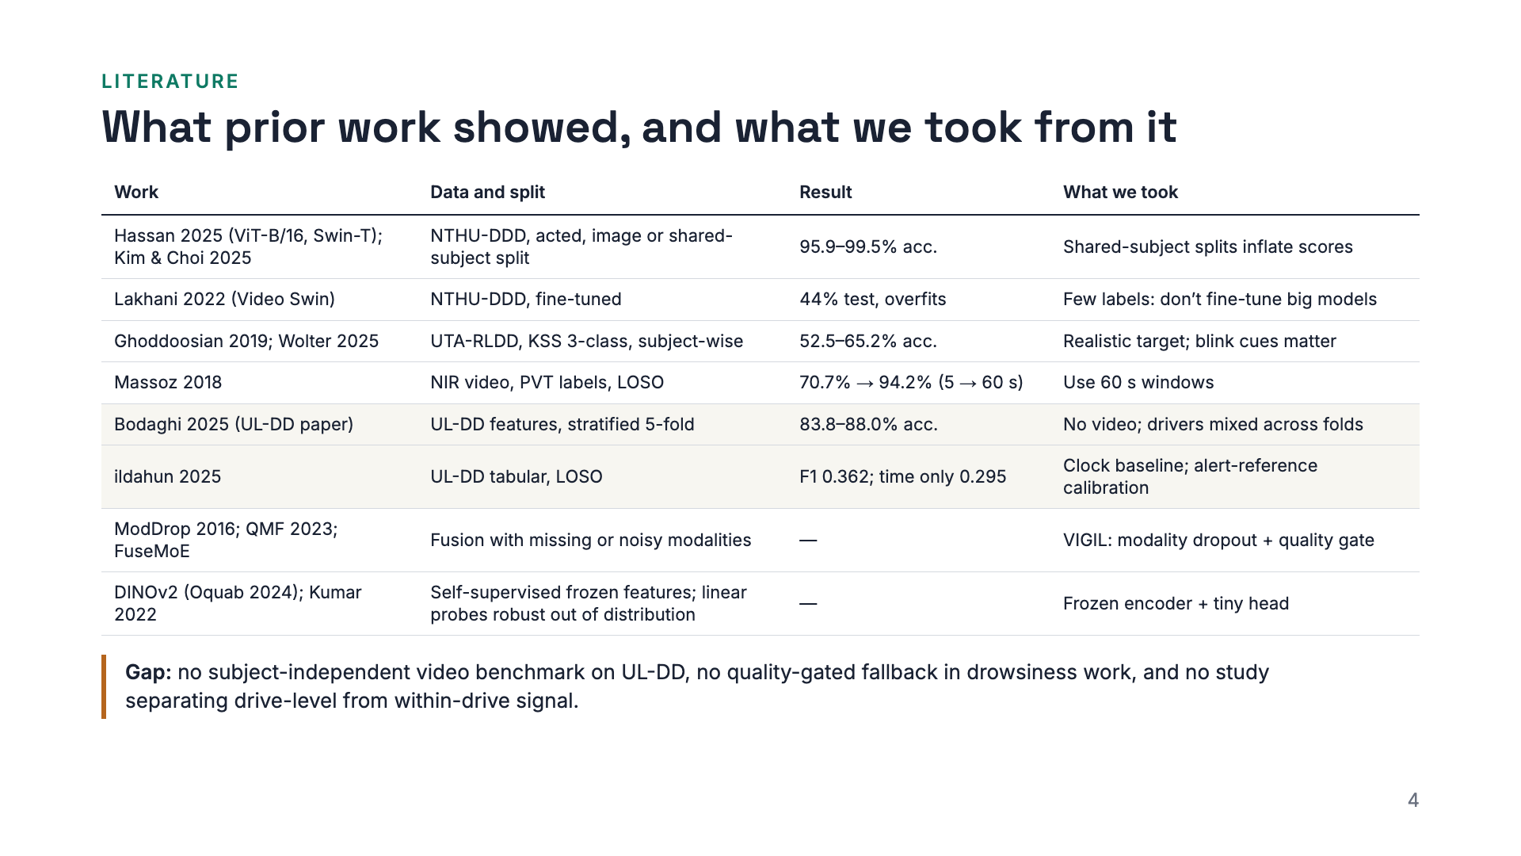
Notes:
The literature splits cleanly in two. Models evaluated with the same people in train and test report 95 to 99 percent. Under subject-wise evaluation on naturalistic KSS, the best results are 52 to 65 percent, and fine-tuning a large video transformer overfits. Massoz showed that 60 second windows matter, which is why we use them. On UL-DD itself, the dataset paper benchmarks only features with stratified folds, and the one subject-independent study reaches macro-F1 0.36, with a time-only model at 0.30. From fusion work we took modality dropout and quality-aware gating, and from foundation-model work the case for frozen features with a linear head. Three gaps remain, and they become our contributions.

Slide 5
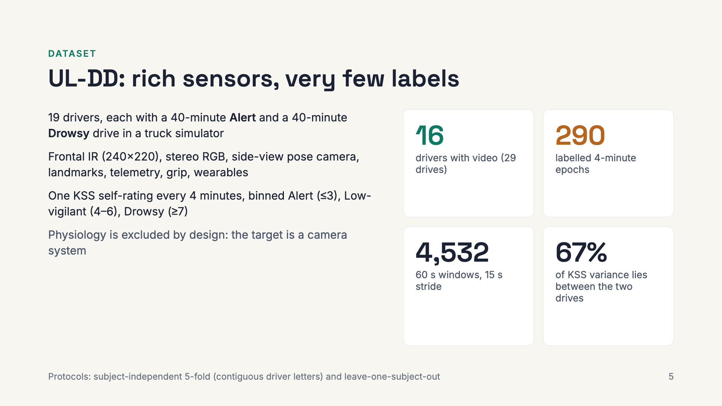
Notes:
Three things to remember about UL-DD. First, the label budget is tiny: 290 epochs; the 4,532 windows are overlapping views of them. Second, KSS rises inside every drive, so time-on-task is a confound. Third, two thirds of KSS variance is between the Alert and Drowsy drive, so a model that recognises the recording scores well. Every result is subject-independent: 5-fold over contiguous driver letters, and LOSO.

Slide 6
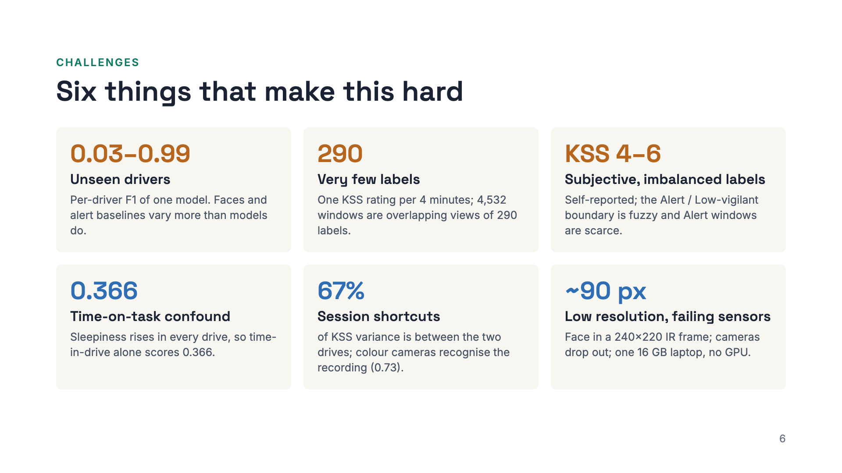
Notes:
Six challenges shaped every design decision. Drivers differ enormously: the same model scores from 0.03 to 0.99 depending on the driver. There are only 290 labels, so anything large overfits. The labels are self-reports with a fuzzy middle class, and Alert is rare in the drowsy drive. Two confounds sit in the data: sleepiness rises with time in every drive, and the two drives differ in lighting and clothing, which colour cameras pick up. Finally, the face is small in the IR frame, cameras fail, and everything had to run on one laptop.

Slide 7
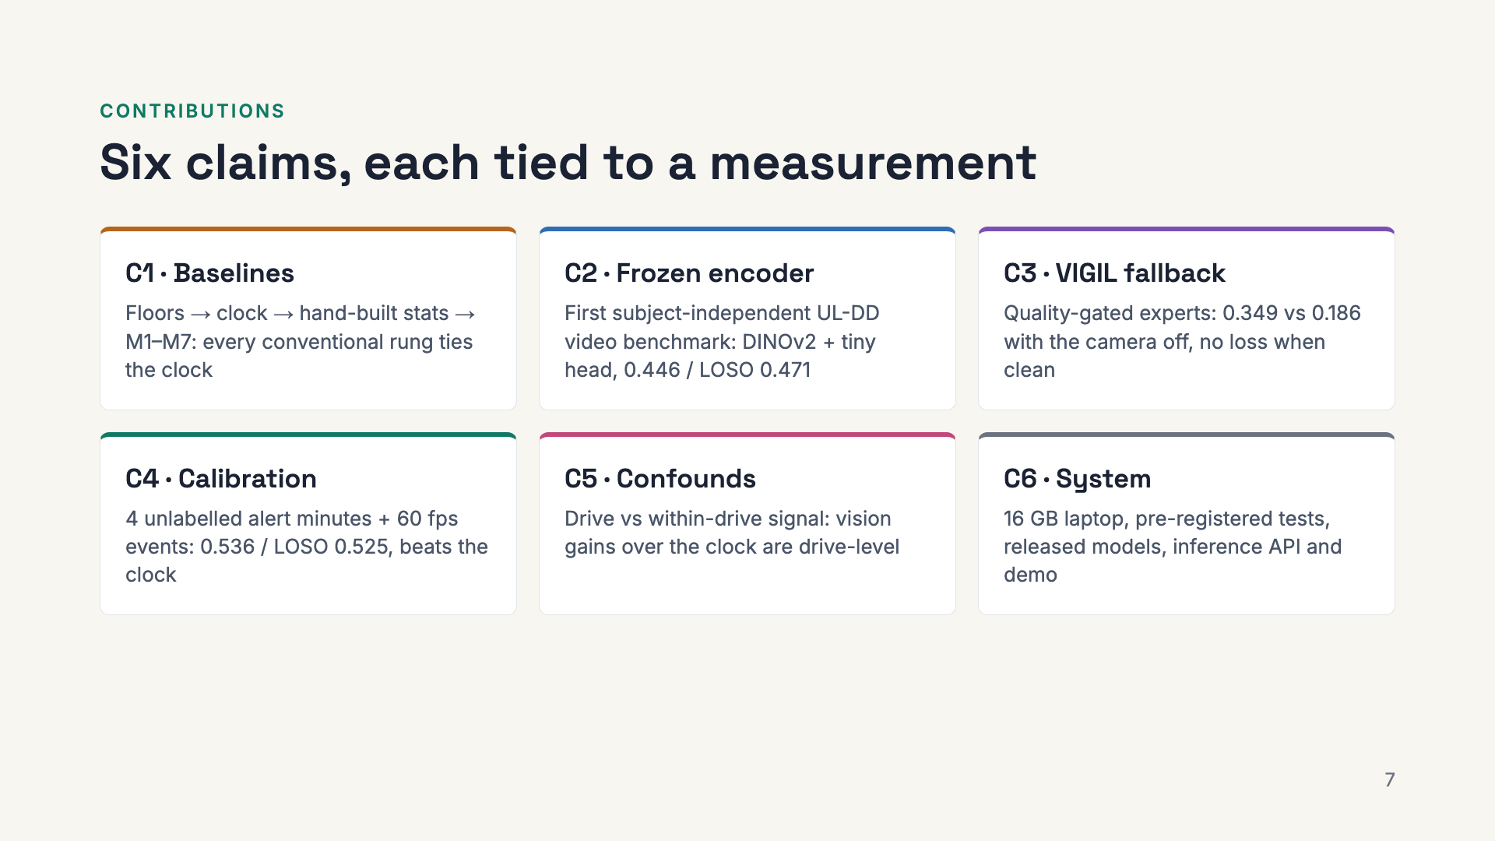
Notes:
The six contributions. C1 and C5 are about honesty: C1 sets the bar with a ladder of baselines built from the ground up, and C5 asks what our numbers really measure. C2, C3 and C4 are the modelling contributions: a frozen-encoder core, a fallback that survives camera failure, and driver calibration. C6 is the engineering. Each claim maps to one result slide that follows.

Slide 8
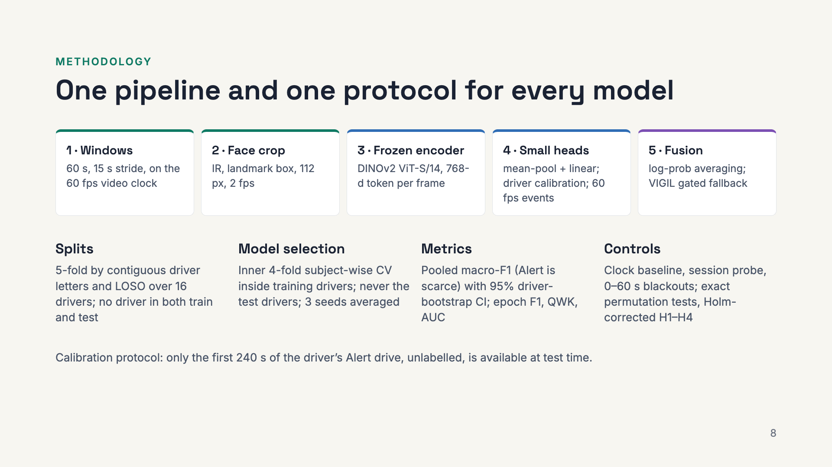
Notes:
The method in one picture. Every model reads the same 60 second windows, anchored on the video clock. Vision models take a 112 pixel IR face crop at two frames per second, pass it through a frozen DINOv2 encoder, and train only a small head; calibration and event features are added on top, and fusion is either fixed log-probability averaging or VIGIL’s gated fallback. The protocol is what makes the numbers honest: drivers are never shared between train and test, all model selection happens inside the training drivers, the headline metric is pooled macro-F1 with confidence intervals over drivers, and every model is compared against a clock and a session-identity probe, with pre-registered, Holm-corrected tests.

Slide 9
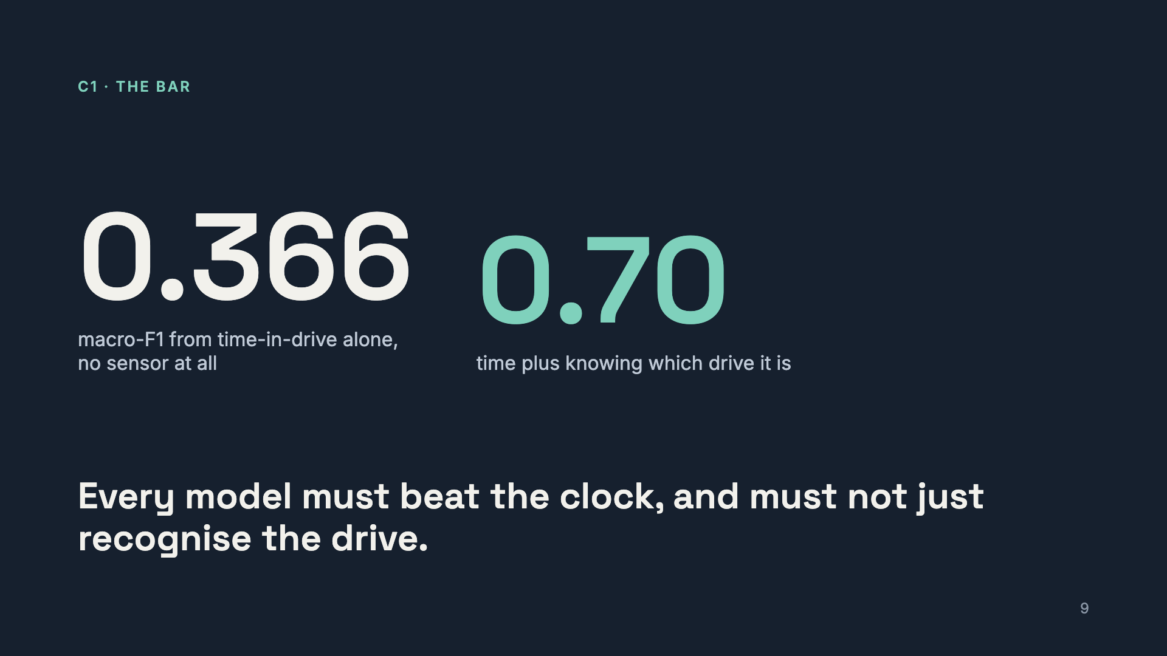
Notes:
Two controls frame everything that follows. Sleepiness rises within every drive, so a logistic regression on time-in-drive already reaches 0.366. And because the Drowsy and Alert drives differ, time plus the drive label reaches 0.70. Any vision model that can tell the two recordings apart, through lighting or clothing, can score high without seeing drowsiness. We test for both.

Slide 10
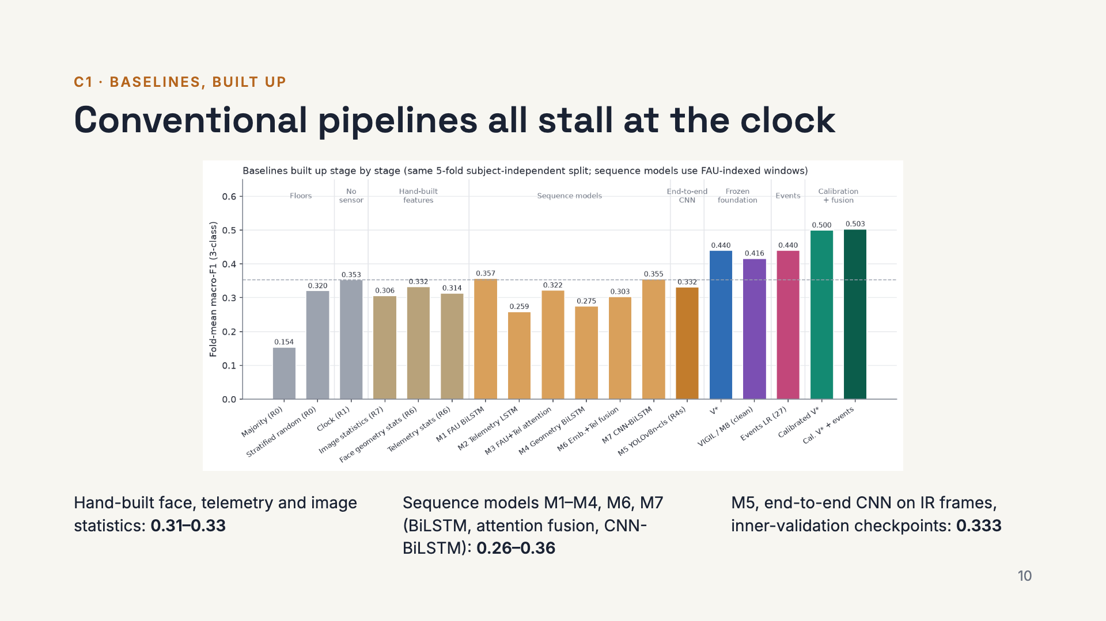
Notes:
We built the system up one rung at a time, each under the same subject-independent protocol, with all model selection inside the training drivers. Floors first, then the clock. Then hand-built window statistics of face geometry and telemetry, and an image-statistics probe that rules out a lighting shortcut. Then six sequence models, M1 to M4, M6 and M7: BiLSTMs on facial action units, telemetry and geometric features, attention fusion of face and telemetry, embedding fusion, and a CNN-BiLSTM on IR frames. Then M5, an end-to-end YOLOv8n classifier fine-tuned on IR frames with three seeds and checkpoints chosen on inner-validation drivers. Every one of them lands between 0.26 and 0.36 fold-mean, level with the clock, and fusing modalities never beats the better single stream. With 290 labelled epochs, features learned from scratch do not transfer to new drivers. That motivates the next rung: features learned elsewhere and kept frozen. These bars are fold-means; the sequence models use FAU-indexed windows. The bars on the right are where the rest of the talk goes.

Slide 11
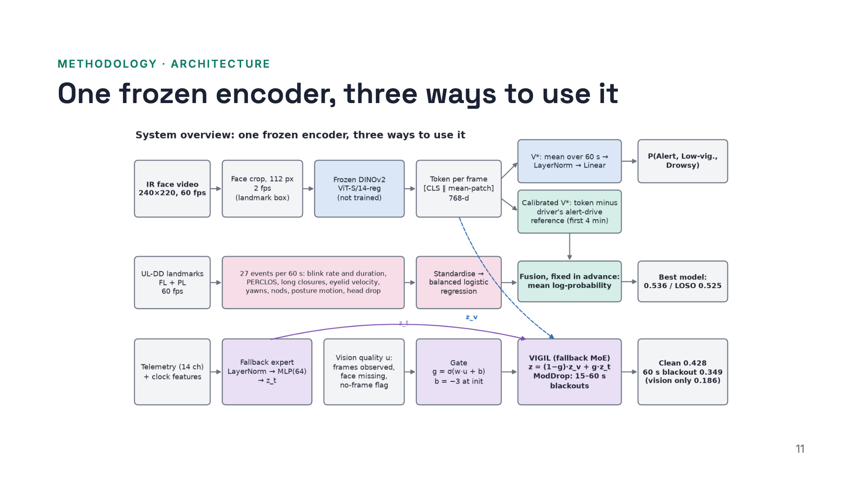
Notes:
The whole system rests on one frozen DINOv2 ViT-S/14, run on 112 pixel IR face crops at 2 frames per second. Nothing in the encoder is trained. Top row: V-star averages the tokens of a 60 second window and applies one linear layer, 3,843 parameters. Calibrated V-star subtracts the driver’s reference token from their first four alert minutes. Middle row: 27 interpretable event features from the 60 fps landmarks, fused by averaging log-probabilities. Bottom row: VIGIL, a mixture of the vision expert and a telemetry plus clock expert, mixed by a gate that only looks at vision quality.

Slide 12
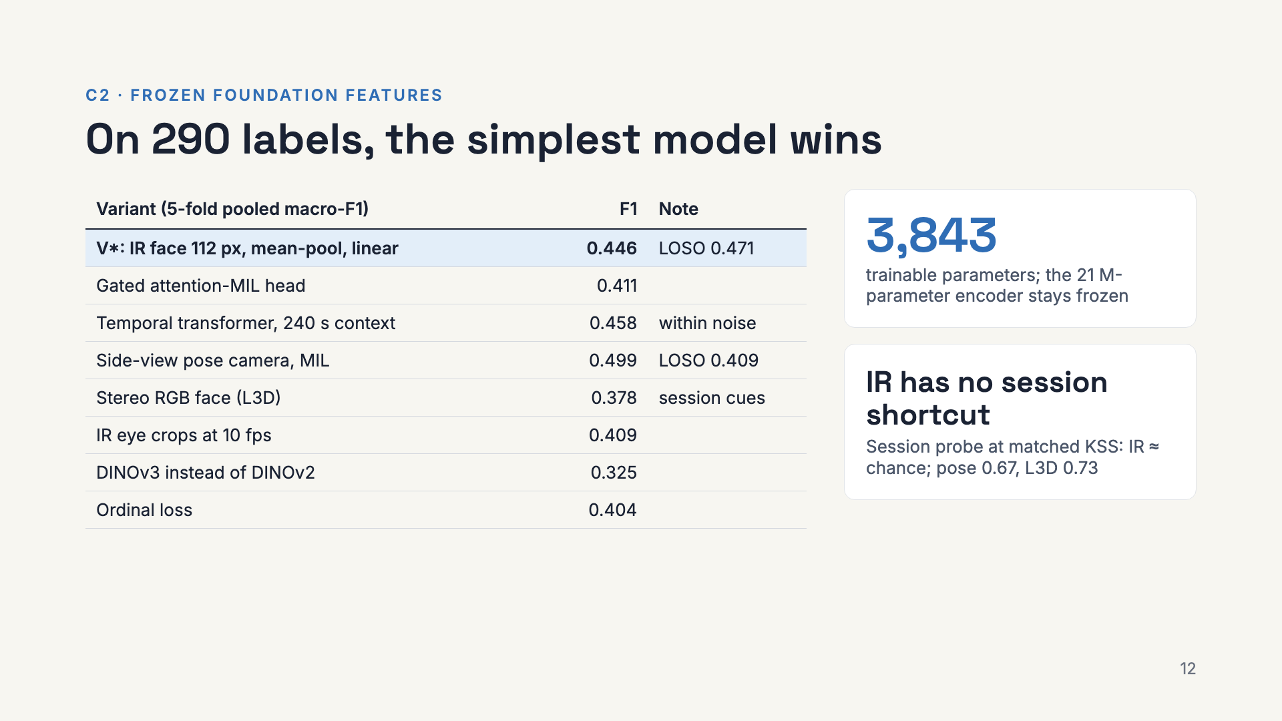
Notes:
Twenty ablations, and none beats a linear layer on mean DINOv2 tokens from 112 pixel IR face crops. Pose looks better under 5-fold, but drops to 0.409 under LOSO and fails the session audit: the colour cameras see lighting and clothing that differ between the two recording days. IR does not. V-star scores 0.446 under 5-fold and 0.471 under LOSO; it beats the end-to-end CNN baseline by 0.084, but that is not significant after Holm at n equals 16.

Slide 13
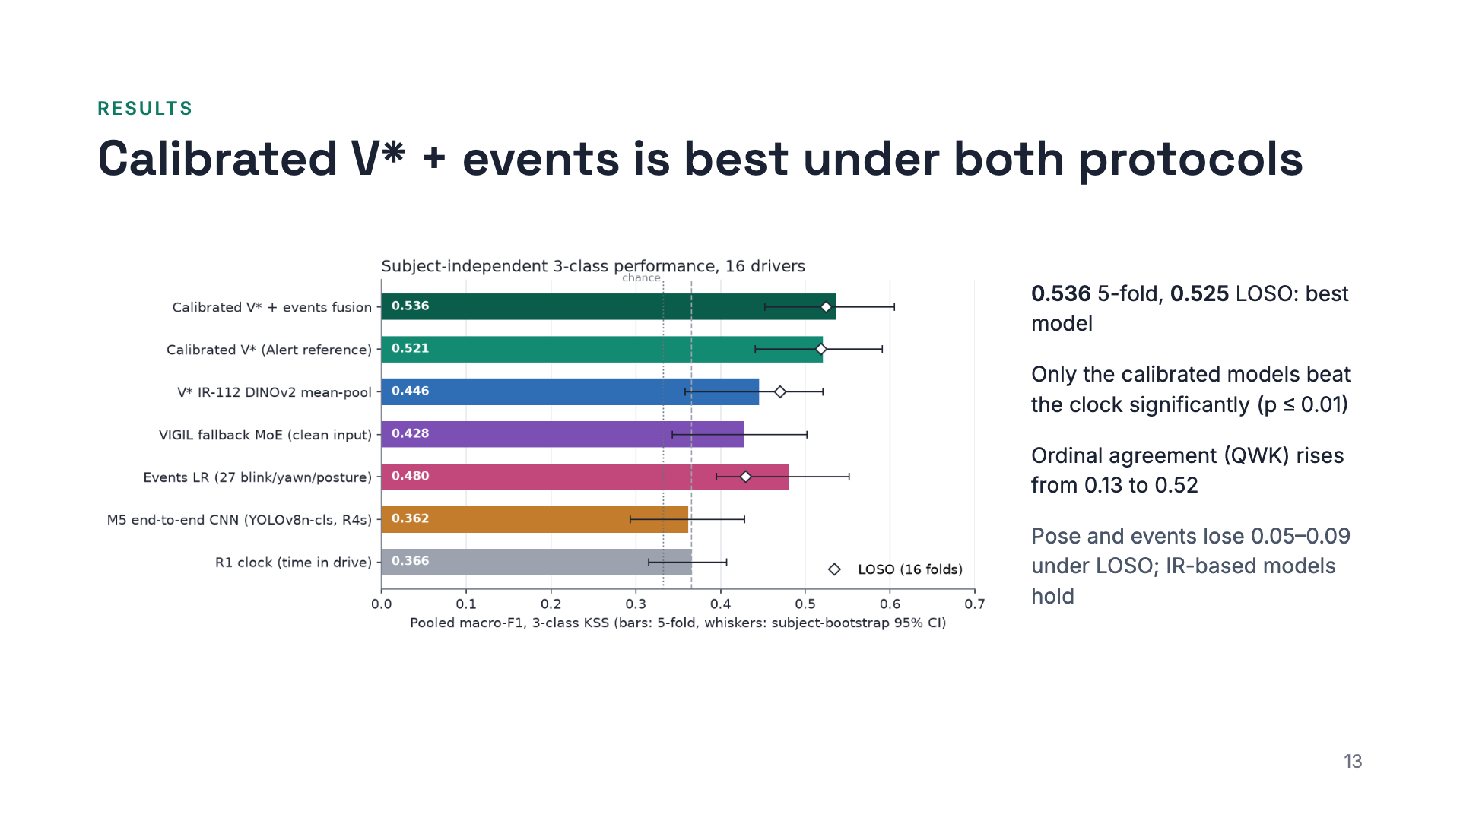
Notes:
All models on one chart, pooled macro-F1 with subject-bootstrap confidence intervals, and LOSO as diamonds. The clock and the end-to-end CNN baseline sit at 0.36. V-star reaches 0.446, and 0.471 under LOSO. Calibrating against four unlabelled alert minutes lifts it to 0.52, and fusing with the event features to 0.536, or 0.525 under LOSO. These calibrated models are the only ones that beat the clock significantly, and the only ones whose predictions track KSS beyond time in drive.

Slide 14
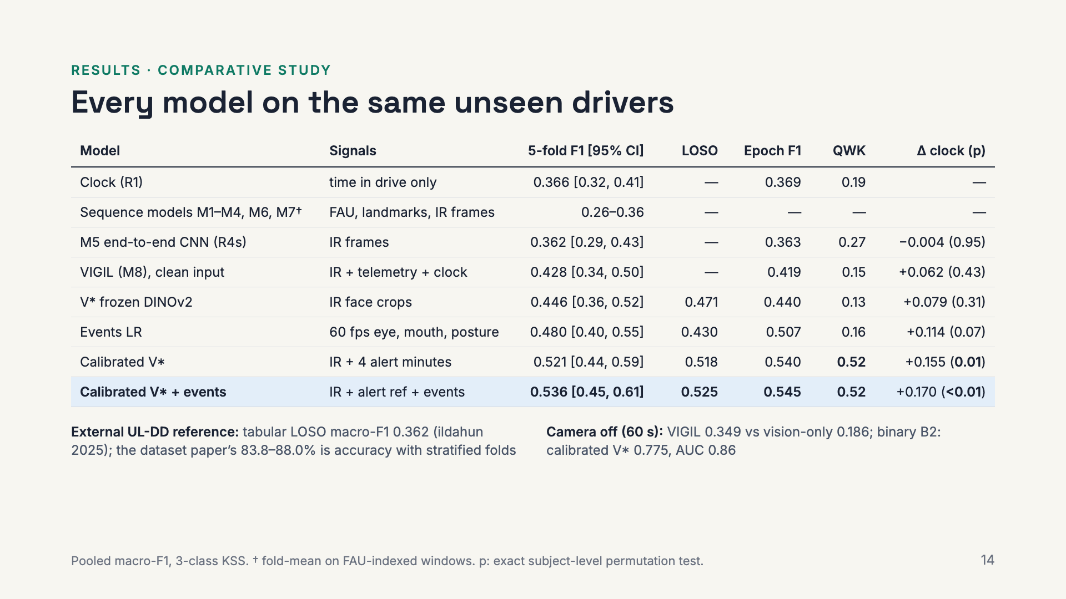
Notes:
The full comparison on one table, all under the same subject-independent protocol. The clock, the sequence models and the end-to-end CNN all sit between 0.26 and 0.37. Frozen DINOv2 features reach 0.446, and 0.471 under LOSO. Events alone reach 0.48 but lose more under LOSO. The calibrated models are best on every metric: 0.536 pooled, 0.525 LOSO, epoch F1 0.545, ordinal agreement 0.52, and they are the only ones significantly above the clock. For context, the only other subject-independent UL-DD result is a tabular model at 0.362 macro-F1, and the dataset paper’s 84 to 88 percent uses stratified folds that mix drivers.

Slide 15
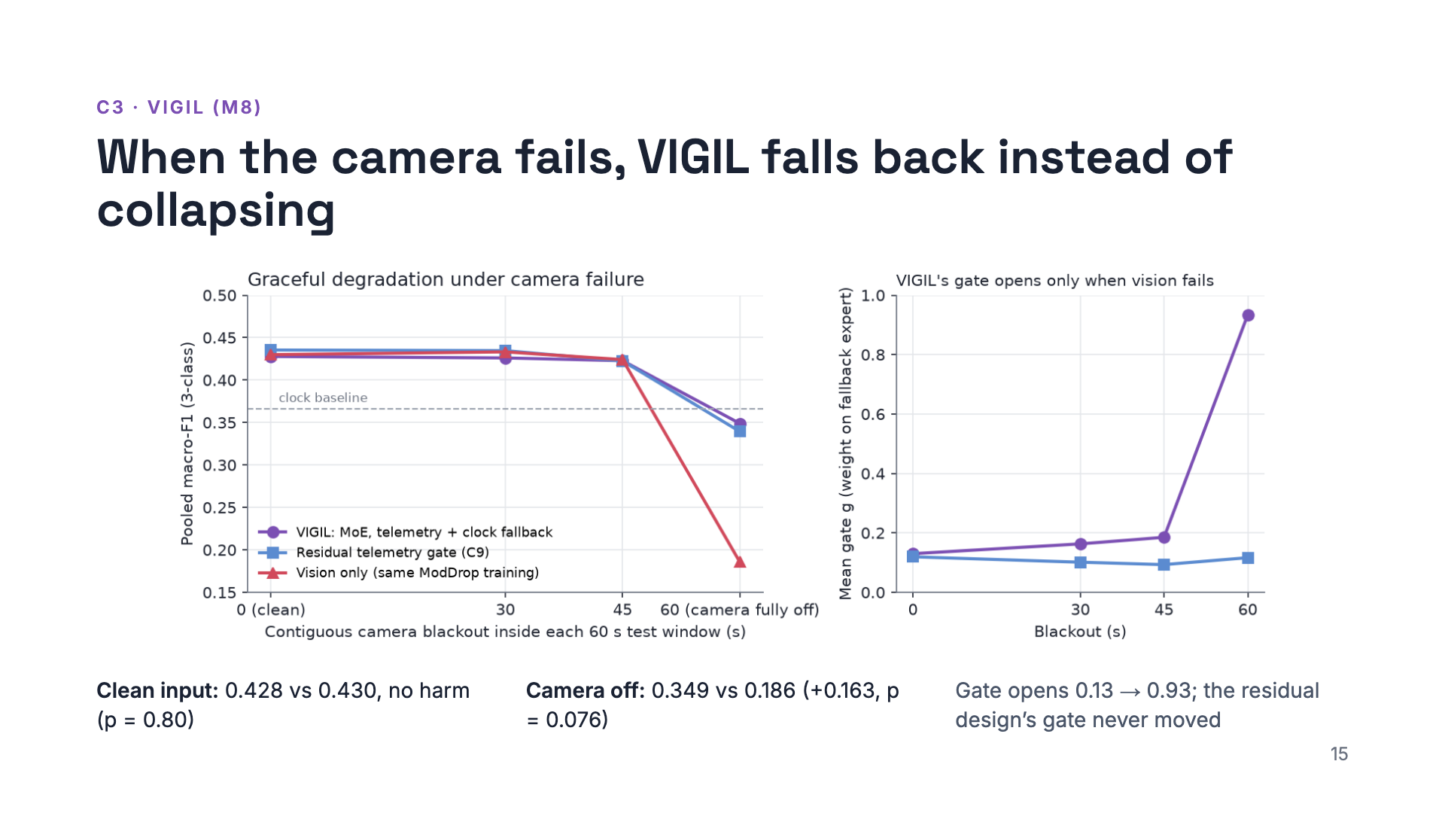
Notes:
VIGIL is trained with simulated camera blackouts of 15 to 60 seconds, so the gate sees vision fail. On clean input it equals the vision model. With the camera fully off for a window, the vision model collapses to 0.186, predicting one class, while VIGIL keeps 0.349, close to the clock, because the gate opens to 0.93 and hands the decision to the telemetry plus clock expert. An earlier residual-gate design looked robust too, but its gate never moved: that negative result is why VIGIL is a mixture of experts. The effect is large but not significant after Holm with 16 drivers.

Slide 16
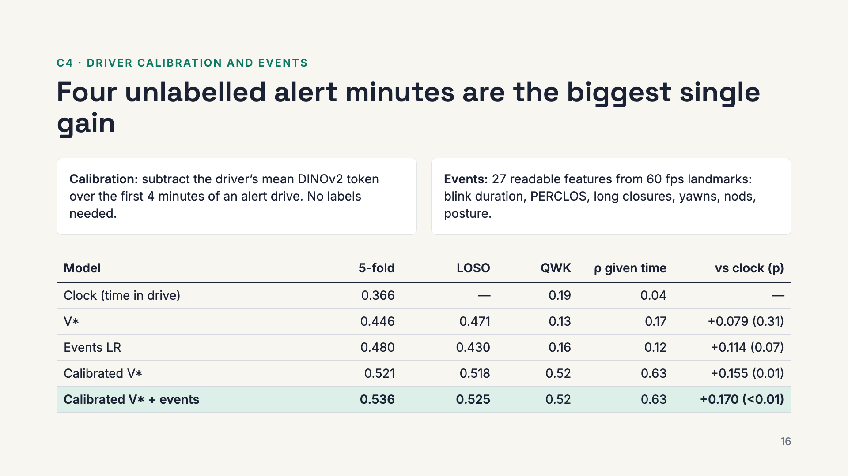
Notes:
Calibration subtracts each driver’s reference appearance, taken from the first four minutes of their alert drive, with no labels. It is the largest single gain, plus 0.075, and holds under LOSO. The 27 event features are interpretable and alone match the foundation model at 0.480. Fused, the two give 0.536 and 0.525. The calibrated models are the only ones that beat the clock significantly, and their predictions correlate with KSS at 0.63 after removing time in drive. Hold on to that, because the next section asks where this gain comes from.

Slide 17
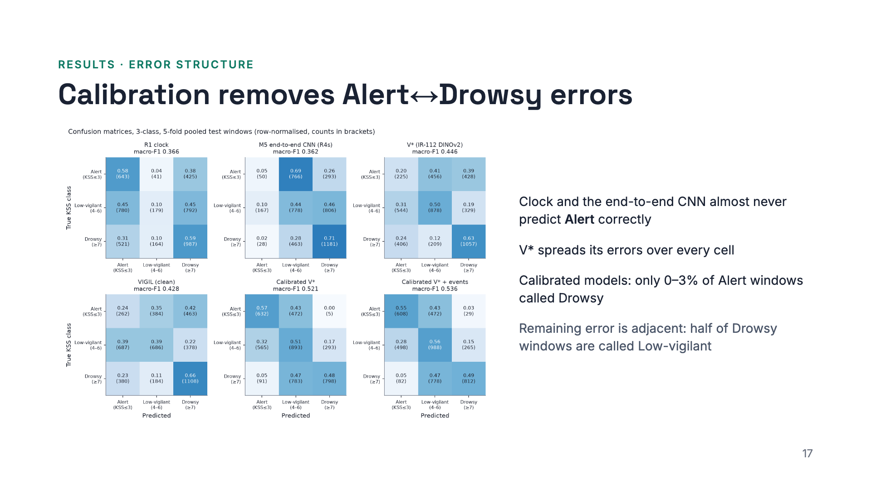
Notes:
The confusion matrices show the shape of the errors. The clock and the end-to-end CNN cannot recognise Alert. V-star spreads errors everywhere. The calibrated models almost never confuse Alert with Drowsy, which is why ordinal agreement jumps, but they call about half of the Drowsy windows Low-vigilant: the adjacent boundary remains hard, as in the UTA-RLDD literature.

Slide 18
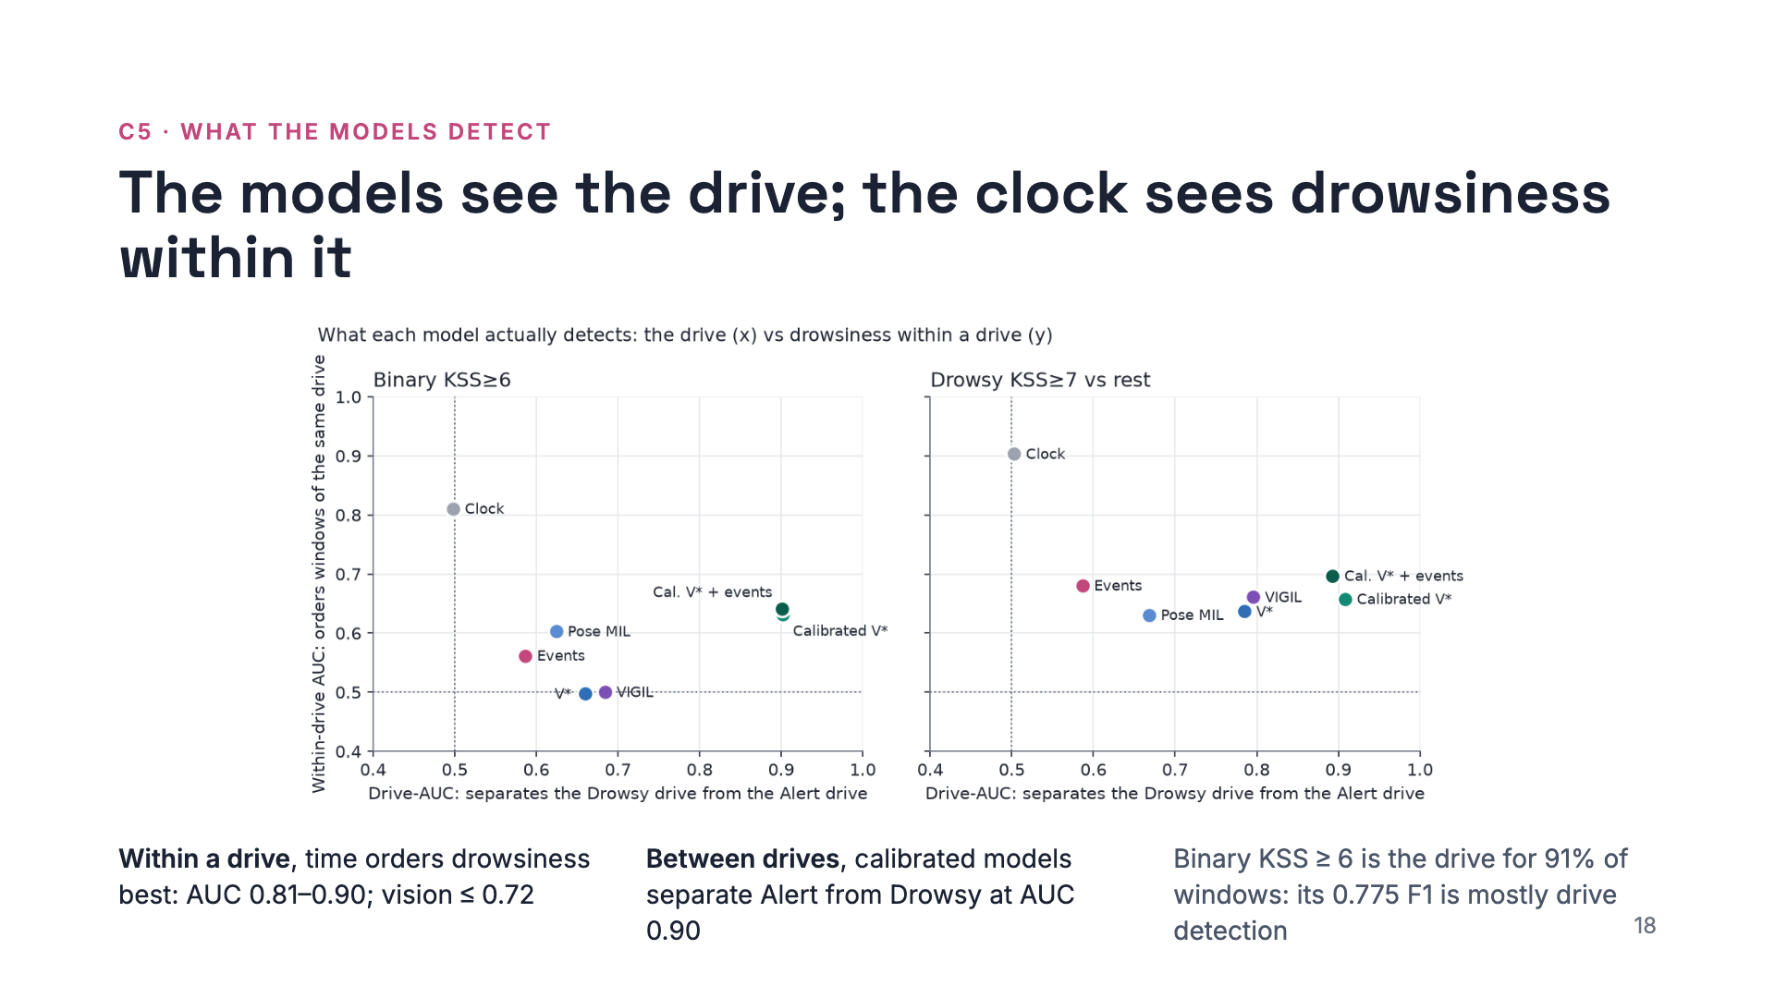
Notes:
This is the twist. We split each model’s AUC into two parts. Drive-AUC: does the score separate the Drowsy recording from the Alert recording? Within-drive AUC: does it order windows inside one recording? The clock has no drive signal but orders windows within a drive at 0.81 to 0.90. Every vision model is the opposite: strong between drives, weaker within. So the gains over the clock are drive-level. That is not useless, the Drowsy drive is sleepier, but a deployed system calibrated on an earlier drive might mistake new lighting or clothing for drowsiness. The binary result of 0.775 is mostly this drive detection, so we only report it next to its within-drive AUC of 0.63.

Slide 19
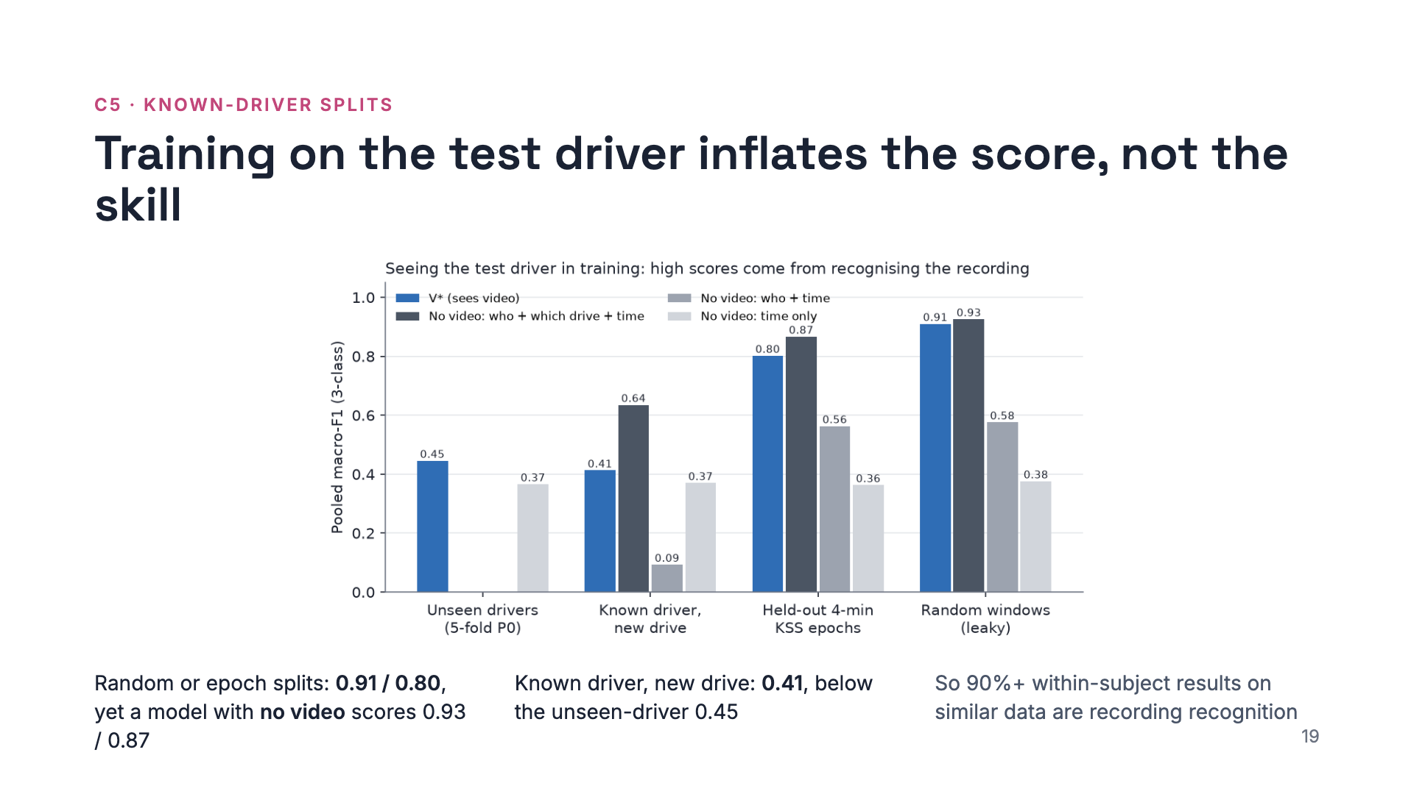
Notes:
A question we were asked: what if we split each driver’s data between train and test? The score jumps to 0.91 with random windows and 0.80 with whole held-out epochs. But a logistic regression that sees no video, only who, which drive and when, scores even higher. Within a drive, drowsiness is nearly a smooth function of time, so seeing part of a drive gives away the rest. The realistic version, a known driver on a new drive, scores 0.41, below unseen drivers, because the model learns this face means that drive’s KSS level.

Slide 20
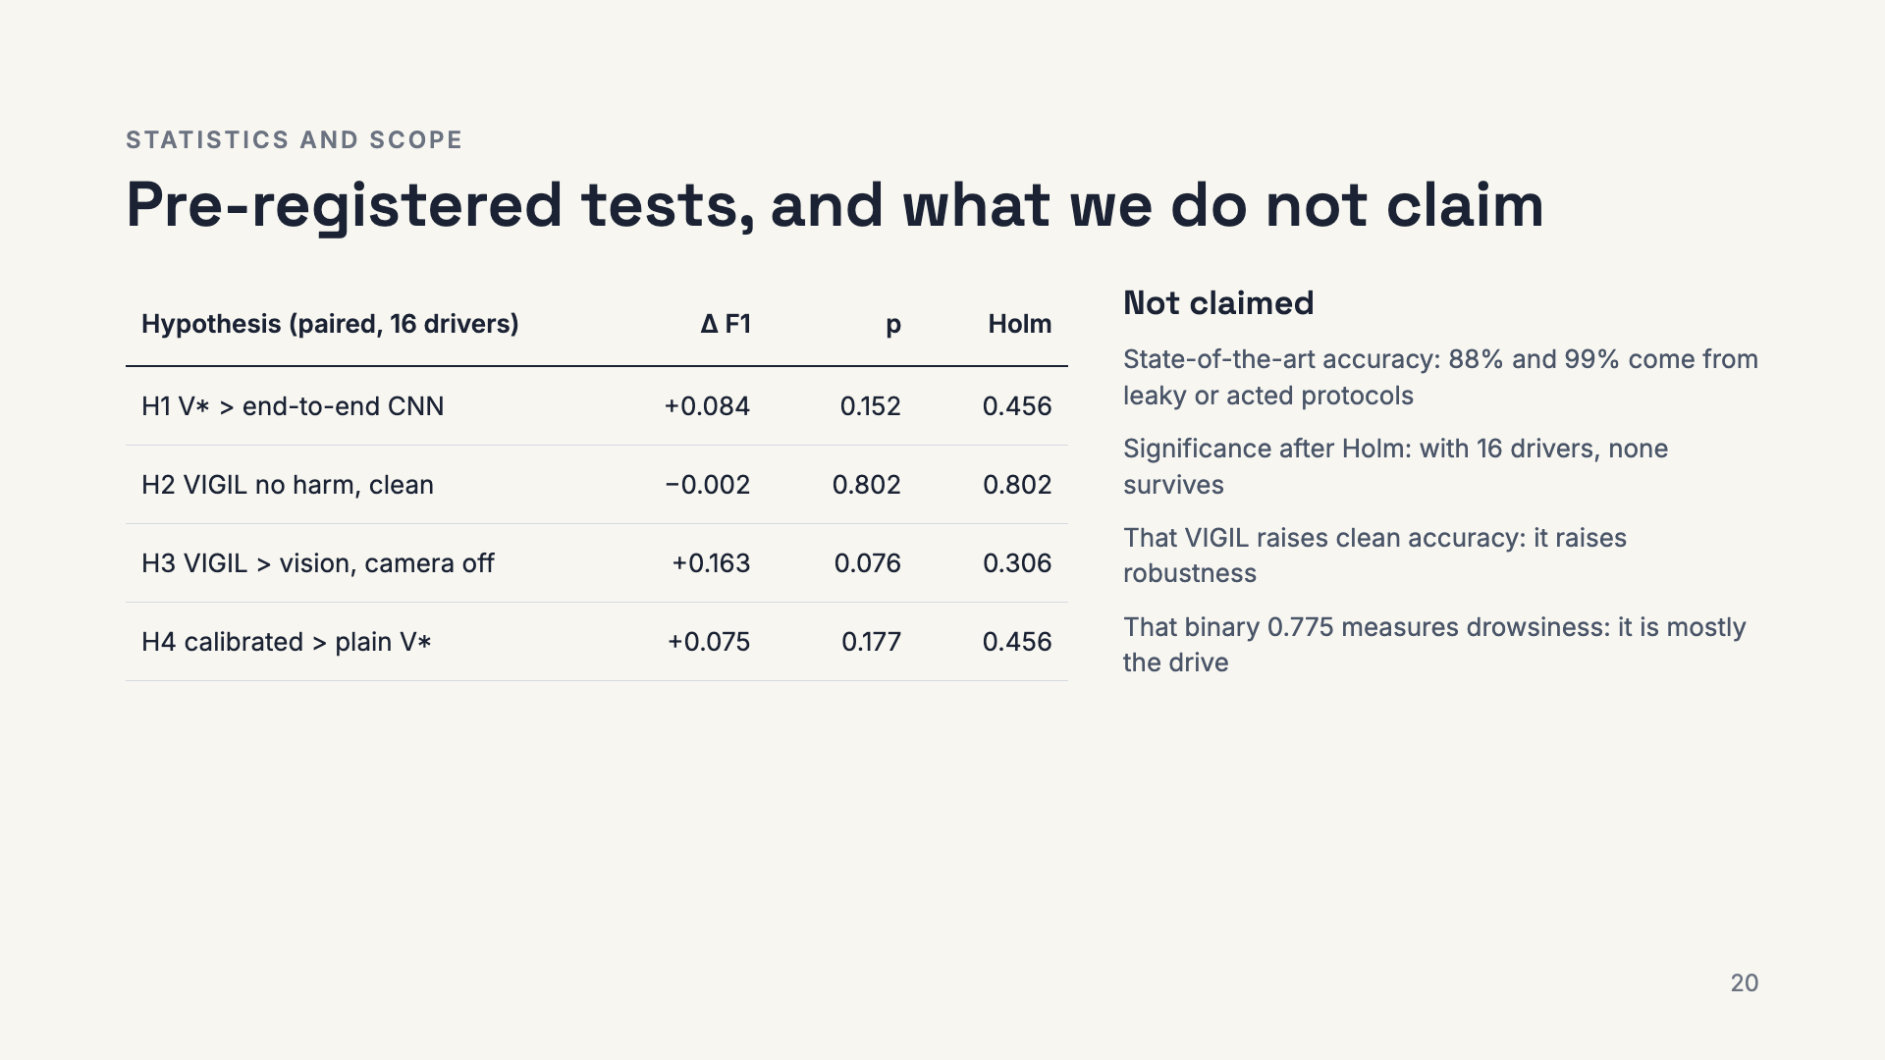
Notes:
Four hypotheses were fixed before the final evaluation and tested with exact subject-level permutation tests and Holm correction. None is significant: with 16 drivers and per-driver F1 ranging from 0.03 to 0.99, the test has little power below about 0.15 F1. We report effect sizes and intervals instead of claiming significance, and we are explicit about what the results do not show.

Slide 21
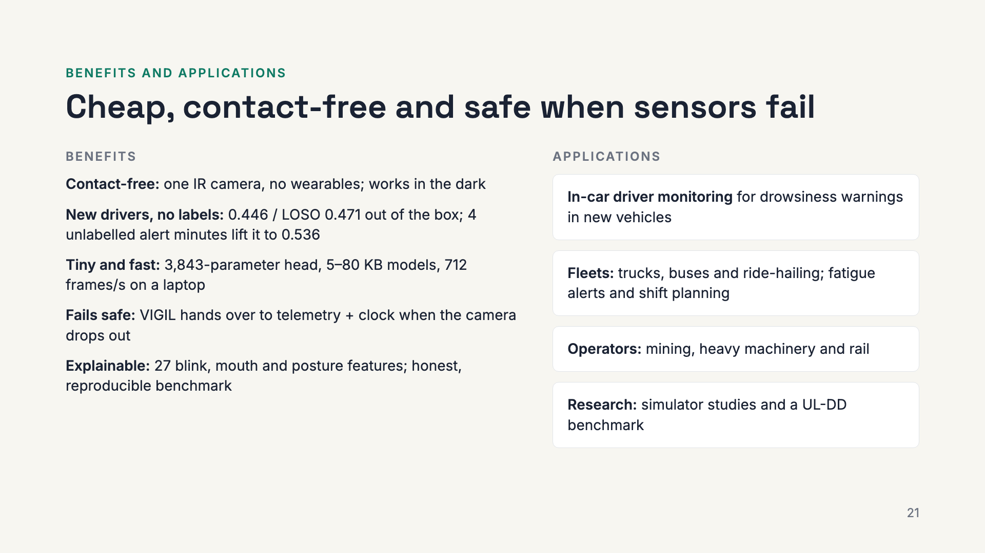
Notes:
What this buys in practice. The system needs only one infrared camera, so it works at night and without wearables. It works on new drivers with no labels from them, and four minutes of normal driving at the start make it better. The trained parts are tiny and the encoder runs at hundreds of frames per second on a laptop, so it fits embedded hardware. If the camera fails, VIGIL hands over to telemetry and time instead of producing nonsense. The event features keep decisions explainable. The natural users are in-car driver monitoring, commercial fleets, operators of heavy machinery and rail, and researchers who need an honest benchmark on UL-DD.

Slide 22
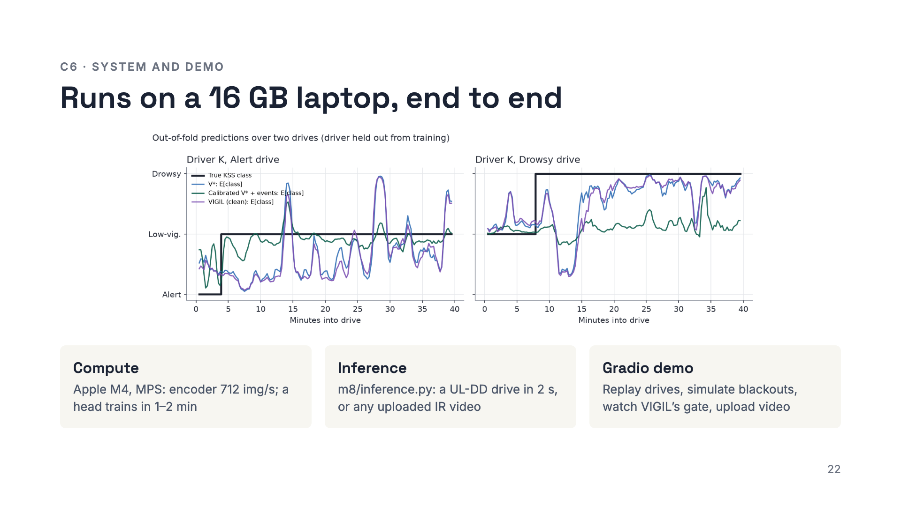
Notes:
Everything ran on a MacBook with an M4 and 16 GB. The final models are tens of kilobytes on top of the public DINOv2 weights. The inference module scores a UL-DD drive with all five models in about two seconds, or an uploaded IR video through a Haar face detector. The Gradio demo replays any drive with honest out-of-fold predictions, like this out-of-fold view of driver K’s two drives, shows the IR frame and model input, and lets you black out the camera to watch VIGIL’s gate open. Live demo here if time allows.

Slide 23
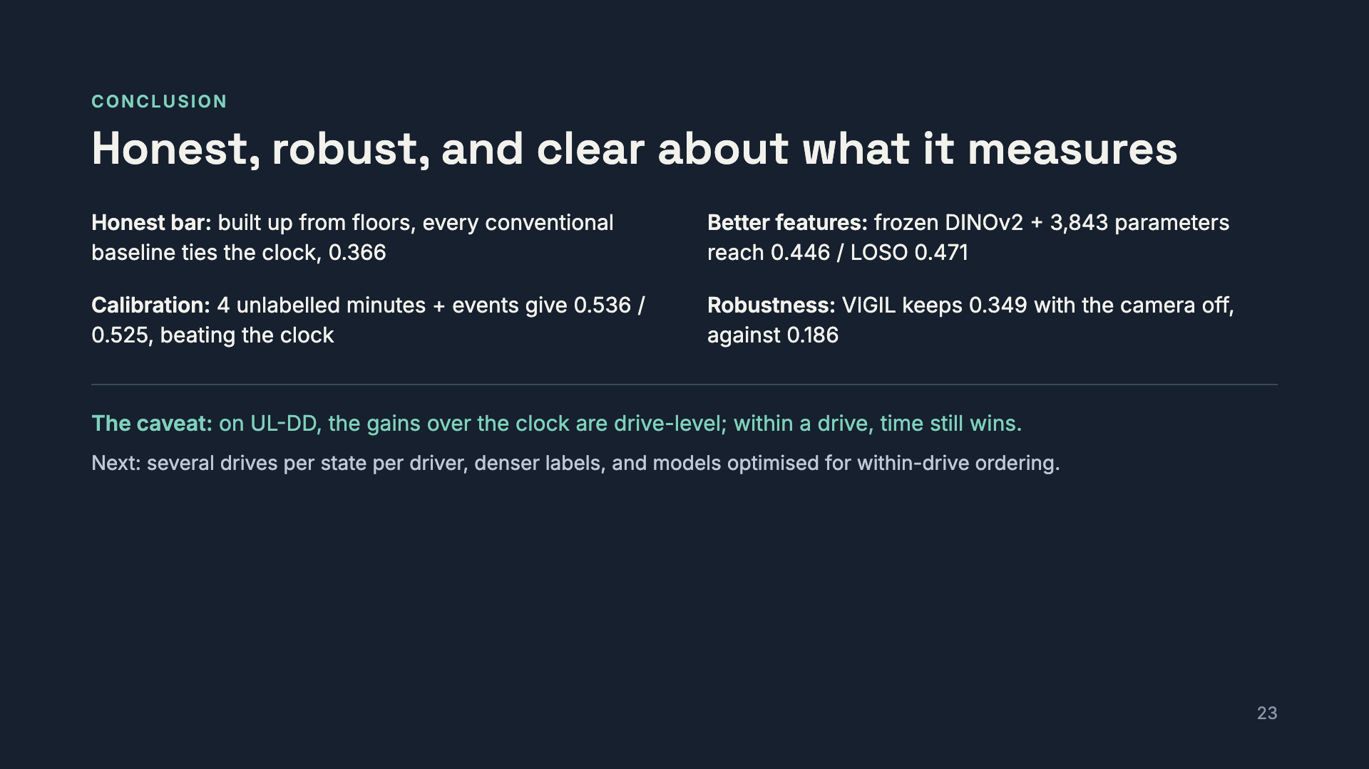
Notes:
To close. Built up from the simplest baselines, the honest bar is the clock: hand-built features and an end-to-end CNN do not clear it. Frozen foundation features clear it with a tiny head. Four unlabelled alert minutes and interpretable events push to 0.54, the only models that beat the clock significantly. VIGIL keeps working when the camera fails. And the caveat that answers the title: on UL-DD, what separates these models from the clock is mostly which drive they are watching. To go further we need datasets with several drives per state per driver and denser labels. Thank you, happy to take questions.

