Slide 1

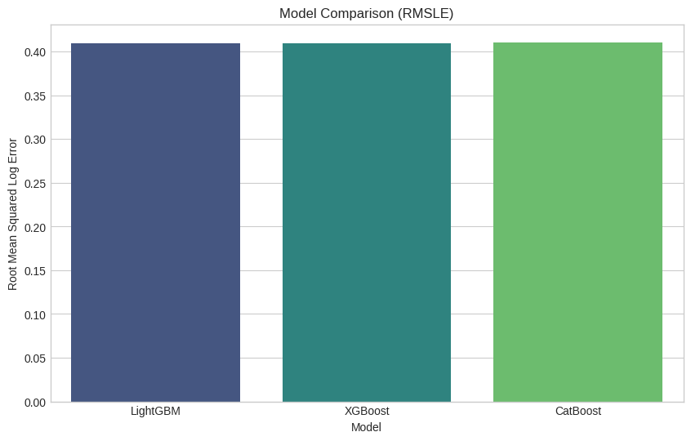
Store Sales Time Series Forecasting
  Author List:
    Bhanu Harsha Yanamadala
    Kobe Zheng
    Sai Karthikeyan Sura
Introduction
Methods
Experiments & Results
Conclusions
Objective: Forecast daily unit sales for thousands of product families at "Corporación Favorita" stores in Ecuador.
Challenge: The dataset includes complex seasonality (weekly/yearly), holiday effects, oil price fluctuations, and earthquake events affecting supply chains.
Goal: Minimize the Root Mean Squared Logarithmic Error (RMSLE) to accurately predict demand and optimize inventory management.
Data Processing:
      Target Transformation: Applied log1p (Log + 1) to sales data to handle high skewness and prevent negative predictions.
      Imputation: Forward/Backward filled missing oil prices; handled missing store transactions using median values.
Feature Engineering:
      Time Features: Extracted day, month, year, day_of_week, and is_payday (15th/end of month).
      Lag Features: Created lags of 1, 7, 14, and 28 days to capture autocorrelation.
      Rolling Windows: Calculated rolling means and standard deviations (7, 14, 28 days) to capture recent trends.
Models:
      Trained three Gradient Boosting models: LightGBM, XGBoost, and CatBoost.
      Ensemble: Final prediction is a weighted average: 0.5 * LGBM + 0.25 * XGB + 0.25 * Cat.
Model Performance (Validation Set):
    All three models performed similarly, with LightGBM showing a slight edge.
    LightGBM: RMSLE = 0.4067 (Best Single Model)
    XGBoost: RMSLE = 0.4087
    CatBoost: RMSLE = 0.4099
    R² Score: ~0.975 (Explaining 97.5% of variance)
Feature engineering (specifically rolling windows and lags) was far more impactful than algorithm selection. The ensemble approach stabilized predictions but yielded diminishing returns over the best single model.
Future Improvements:
    Hybrid Models: Combine ARIMA (for linear trends) with XGBoost (for non-linear residuals).
    Deep Learning: Experiment with LSTMs or Transformers to better capture long-term dependencies and holiday spikes.
    Holiday Interaction: specifically engineering features for "Days until next holiday" to anticipate pre-holiday spikes.
Goal of Project
References
Briefly outline what your work aims to achieve.
Mention the research questions or hypotheses if applicable.

