Slide 1
For this tutorial, we’re going to use a neural network with two inputs, two hidden neurons, one output neurons. Additionally, the hidden and output neurons will include a bias.
Here’s the basic structure:
w1
i1
h1
w5
w2
o1
w3
w6
i2
h2
w4
b1
b2
1
1

Slide 2

Calculating total net input for h1 ${Inp}_{h1 }$ = ${\text{i}}_{1}$*${\text{w}}_{1}$ + ${\text{i}}_{2}$* ${\text{w}}_{3}$ +${\text{w}}_{b1}$*1 ${Inp}_{h2 }$ = ${\text{i}}_{1}$*${\text{w}}_{2}$ + ${\text{i}}_{2}$* ${\text{w}}_{4}$ + ${\text{w}}_{b2}$*1 Calculating total net output from h1 ${Out}_{h1 }$ = $\frac{1}{(1 + \frac{1}{\exp^{{(Inp}_{h1 })}})}$ ${Out}_{h2 }$ = $\frac{1}{(1 + \frac{1}{\exp^{{(Inp}_{h2 })}})}$ Calculating total net input for Result Node ${Inp}_{ResNode }$ =${Out}_{h1 }$* ${\text{w}}_{5}$ +${Out}_{h2 }$* ${\text{w}}_{6}$ +1*${\text{w}}_{b2}$ Calculating total net output for Result Node ${Out}_{ResNode}$ = $\frac{1}{(1 + \frac{1}{\exp^{{(Inp}_{ResNode})}})}$ Error for output neuron using the squared error function $E_{Total }$ = ½ ${\text{(}\text{target}\text{ − }{Out}_{ResNode}\text{)}}^{2}$
The Forward Pass

Slide 3
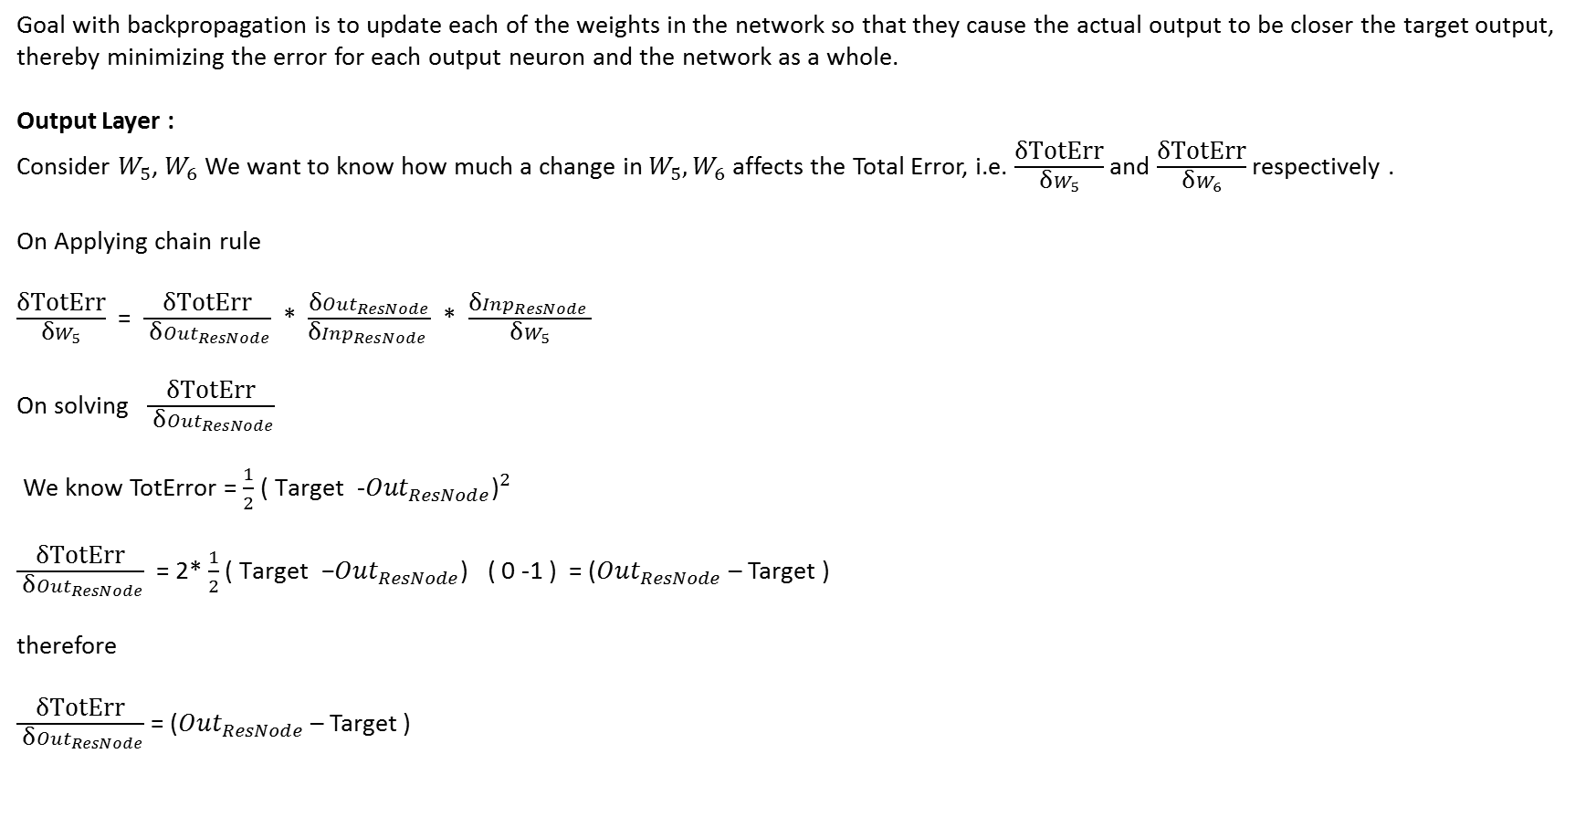
The Backwards Pass
Goal with backpropagation is to update each of the weights in the network so that they cause the actual output to be closer the target output, thereby minimizing the error for each output neuron and the network as a whole.
Output Layer :
Consider $W_{5}$, $W_{6}$We want to know how much a change in $W_{5}, W_{6}$ affects the Total Error, i.e. $\frac{\text{δ}\text{TotErr}}{\text{δ}W_{5}}$ and $\frac{\text{δ}\text{TotErr}}{\text{δ}W_{6}}$ respectively .
On Applying chain rule
$\frac{\text{δ}\text{TotErr}}{\text{δ}W_{5}}$ = $\frac{\text{δ}\text{TotErr}}{ \text{δ}{Out}_{ResNode}}$ * $\frac{\text{δ}{Out}_{ResNode}}{\text{δ}{Inp}_{ResNode }}$ * $\frac{\text{δ}{Inp}_{ResNode }}{\text{δ}W_{5}}$
On solving $\frac{\text{δ}\text{TotErr}}{ \text{δ}{Out}_{ResNode}}$
We know TotError = $\frac{1}{2}$ ${\text{( }\text{Target}\text{ −}{Out}_{ResNode}\text{)}}^{2}$
$\frac{\text{δ}\text{TotErr}}{ \text{δ}{Out}_{ResNode}}$ = 2* $\frac{1}{2}$ ${\text{( }\text{Target}\text{ −}{Out}_{ResNode}\text{)}}^{}$( 0 -1 ) = (${Out}_{ResNode}$ – Target )
therefore
$\frac{\text{δ}\text{TotErr}}{ \text{δ}{Out}_{ResNode}}$ = (${Out}_{ResNode}$ – Target )
1
2

Slide 4

The Backwards Pass
Similarly we will get
$\frac{\text{δ}{Out}_{ResNode}}{\text{δ}{Inp}_{ResNode }}$ = ${Out}_{ResNode}$(1 - ${Out}_{ResNode}$)
$\frac{\text{δ}{Inp}_{ResNode }}{\text{δ}W_{5}}$ = $W_{5}$
From results 1, 2, 3 and 4, we will be able to calculate the contribution of weight $W_{5}$ towards total error $\text{TotErr}$
$\frac{\text{δ}\text{TotErr}}{\text{δ}W_{5}}$ = (${Out}_{ResNode}$ – Target ) * ${Out}_{ResNode}$(1 - ${Out}_{ResNode}$) * $W_{5}$
Similarly the contribution of weight $W_{6}$ towards total error $\text{TotErr}$ is as below
$\frac{\text{δ}\text{TotErr}}{\text{δ}W_{6}}$ = (${Out}_{ResNode}$ – Target ) * ${Out}_{ResNode}$(1 - ${Out}_{ResNode}$) * $W_{6}$
3
4
5

Slide 5
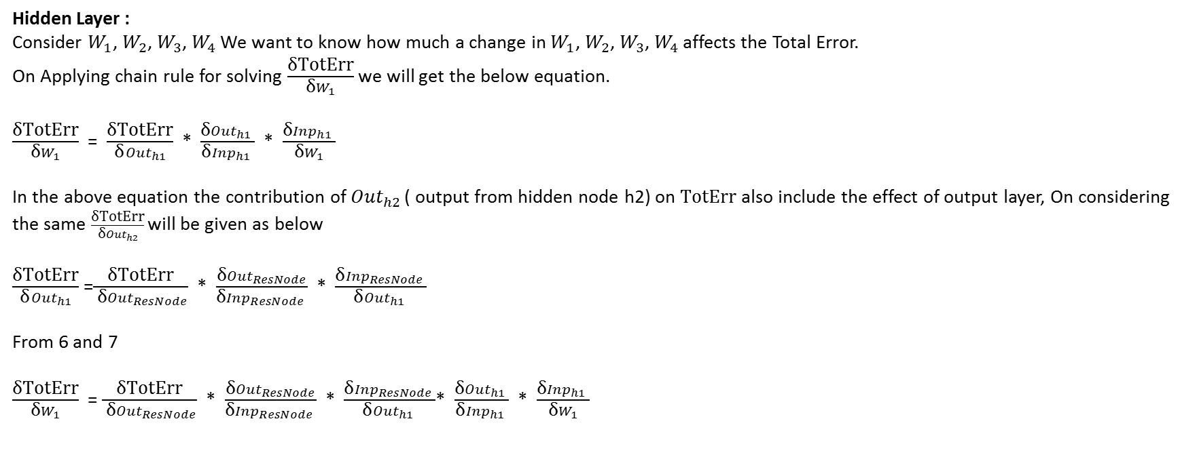
The Backwards Pass
Hidden Layer :
Consider $W_{1}$, $W_{2}$, $W_{3}$, $W_{4}$ We want to know how much a change in $W_{1}$, $W_{2}$, $W_{3}$, $W_{4}$affects the Total Error.
On Applying chain rule for solving $\frac{\text{δ}\text{TotErr}}{\text{δ}W_{1}}$ we will get the below equation.
$\frac{\text{δ}\text{TotErr}}{\text{δ}W_{1}}$ = $\frac{\text{δ}\text{TotErr}}{ \text{δ}{Out}_{h1 }}$ * $\frac{\text{δ}{Out}_{h1 }}{\text{δ}{Inp}_{h1 }}$ * $\frac{\text{δ}{Inp}_{h1 }}{\text{δ}W_{1}}$
In the above equation the contribution of ${Out}_{h2 }$( output from hidden node h2) on $\text{TotErr}$ also include the effect of output layer, On considering the same $\frac{\text{δ}\text{TotErr}}{ \text{δ}{Out}_{h2 }}$ will be given as below
$\frac{\text{δ}\text{TotErr}}{ \text{δ}{Out}_{h1 }}$ =$\frac{\text{δ}\text{TotErr}}{ \text{δ}{Out}_{ResNode}}$ * $\frac{\text{δ}{Out}_{ResNode}}{\text{δ}{Inp}_{ResNode }}$ * $\frac{\text{δ}{Inp}_{ResNode }}{\text{δ}{Out}_{h1 }}$
From 6 and 7
$\frac{\text{δ}\text{TotErr}}{\text{δ}W_{1}}$ = $\frac{\text{δ}\text{TotErr}}{ \text{δ}{Out}_{ResNode}}$ * $\frac{\text{δ}{Out}_{ResNode}}{\text{δ}{Inp}_{ResNode }}$ * $\frac{\text{δ}{Inp}_{ResNode }}{\text{δ}{Out}_{h1 }}$* $\frac{\text{δ}{Out}_{h1 }}{\text{δ}{Inp}_{h1 }}$ * $\frac{\text{δ}{Inp}_{h1 }}{\text{δ}W_{1}}$
6
7
8

Slide 6
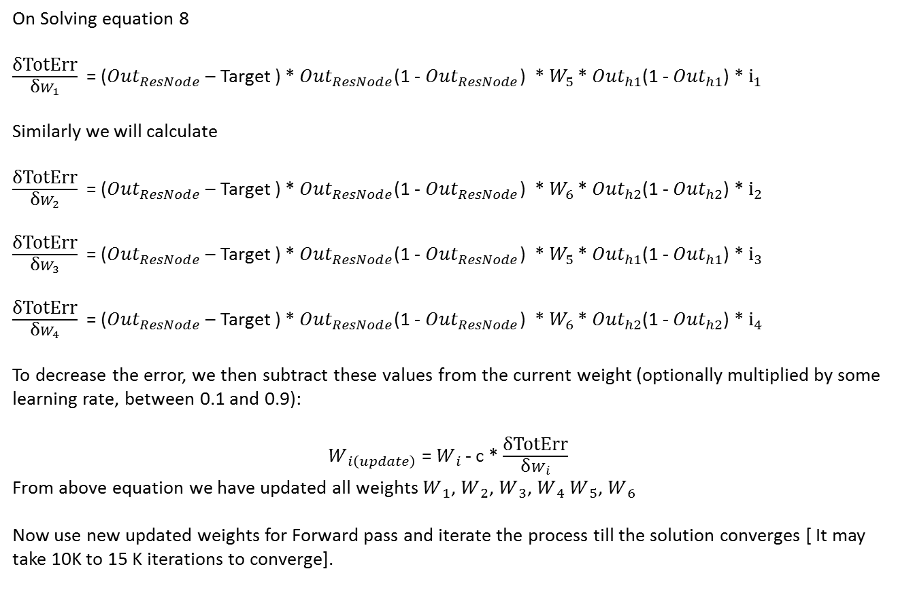
The Backwards Pass
On Solving equation 8
$\frac{\text{δ}\text{TotErr}}{\text{δ}W_{1}}$ = (${Out}_{ResNode}$ – Target ) * ${Out}_{ResNode}$(1 - ${Out}_{ResNode}$) * $W_{5 }$* ${Out}_{h1}$(1 - ${Out}_{h1}$) * ${\text{i}}_{1}$
Similarly we will calculate
$\frac{\text{δ}\text{TotErr}}{\text{δ}W_{2}}$ = (${Out}_{ResNode}$ – Target ) * ${Out}_{ResNode}$(1 - ${Out}_{ResNode}$) * $W_{6 }$* ${Out}_{h2}$(1 - ${Out}_{h2}$) * ${\text{i}}_{2}$
$\frac{\text{δ}\text{TotErr}}{\text{δ}W_{3}}$ = (${Out}_{ResNode}$ – Target ) * ${Out}_{ResNode}$(1 - ${Out}_{ResNode}$) * $W_{5 }$* ${Out}_{h1}$(1 - ${Out}_{h1}$) * ${\text{i}}_{3}$
$\frac{\text{δ}\text{TotErr}}{\text{δ}W_{4}}$ = (${Out}_{ResNode}$ – Target ) * ${Out}_{ResNode}$(1 - ${Out}_{ResNode}$) * $W_{6 }$* ${Out}_{h2}$(1 - ${Out}_{h2}$) * ${\text{i}}_{4}$
To decrease the error, we then subtract these values from the current weight (optionally multiplied by some learning rate, between 0.1 and 0.9):
$W_{ i\left(update\right)}$ = $W_{ i }$- c * $\frac{\text{δ}\text{TotErr}}{\text{δ}W_{i}}$
From above equation we have updated all weights $W_{ 1}$, $W_{ 2}$, $W_{ 3}$, $W_{ 4}$ $W_{ 5}$, $W_{ 6}$
Now use new updated weights for Forward pass and iterate the process till the solution converges [ It may take 10K to 15 K iterations to converge].

