Slide 1

CaptureShield
Geofence-Based Camera Lockdown App
Presented by Karthikeyan V K
GitHub: https://github.com/karthikeyanvk18/geo-camera-lock
KP
by Karthikeyan P

Slide 2
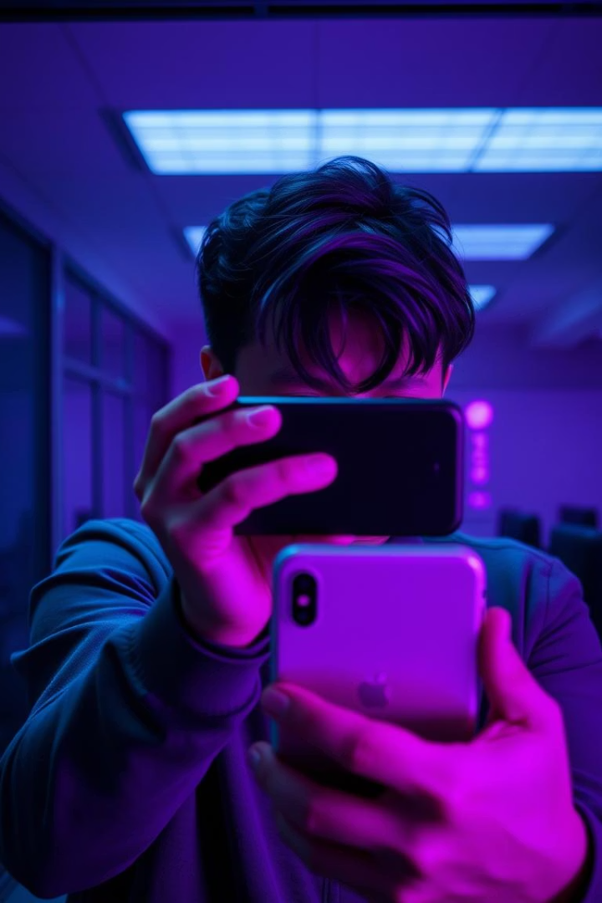
Problem Statement: Preventing Camera Misuse in Sensitive Areas
Unauthorized Photography Risks
Real-World Challenges
Despite policies, employees and visitors sometimes capture sensitive information inadvertently or maliciously, leading to data leaks and breaches.
In secure environments such as corporate offices, government buildings, and research labs, unauthorized use of cameras poses significant privacy and data security risks.
Need for Automated Control
Manual enforcement is inefficient; a technical solution to automatically disable cameras is essential for compliance and security assurance.

Slide 3
Solution Overview: CaptureShield's Approach
Geofencing Integration
Camera Control via DevicePolicyManager
CaptureShield utilizes geofencing technology to define secure zones where camera usage is restricted automatically.
The app programmatically disables or enables the device camera based on user location to prevent unauthorized photography without disrupting user experience.

Slide 4
Key Features
Admin and User Roles
Geofence Management
Camera Lockdown with DevicePolicyManager
Distinct permissions for admins to manage geofences and users to comply with restrictions.
Create, modify, and delete multiple geofenced zones for dynamic security needs.
Effective camera disabling using Android's DevicePolicyManager API ensures compliance and prevents bypass.
Offline and Online Support
Foreground Service
Seamless operation regardless of connectivity, with geofence logic running locally.
Persistent background service ensures continual geofence monitoring and camera state enforcement.

Slide 5
Architecture Diagram
Admin Sets Geofence Zone
Geofence Triggered on Entry/Exit
DevicePolicyManager Enforces Camera Lock
Foreground Service Supports Monitoring
Admin interface triggers geofence creation and management via LocationManager API.
GeofenceClient monitors user location and detects entry or exit events in real-time.
Upon zone entry, DevicePolicyManager disables the camera; it re-enables camera upon exit.
Runs persistently to ensure reliable geofence event detection and camera control, even under resource constraints.

Slide 6





Technical Stack Behind CaptureShield
Kotlin
Modern language choice for Android app development offering concise syntax and powerful features.
Android SDK
Platform APIs leveraged for geofencing, service management, and security permissions.
Google Maps API
Visualizes geofence zones and assists with location accuracy and user interface.
Geofencing API
Core location proximity monitoring to trigger security events on zone entry and exit.
DevicePolicyManager
Essential Android security API that enforces camera lockdown preventing user override.

Slide 7

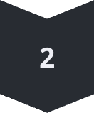
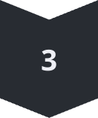
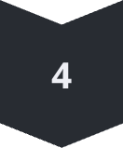

User Flow: Seamless Camera Control
Admin Defines Geofence
Admin configures geographic boundaries via app interface for sensitive zones.
User Enters Zone
The app detects user location crossing into the geofenced area and triggers camera lockdown.
Camera Automatically Locked
Camera functionality is disabled silently, ensuring no recording or photo capture.
User Exits Zone
Upon leaving the area, the camera is automatically re-enabled restoring full user functionality.
Background Enforcement
Foreground service continuously guards against attempts to bypass lockdown, ensuring compliance.

Slide 8
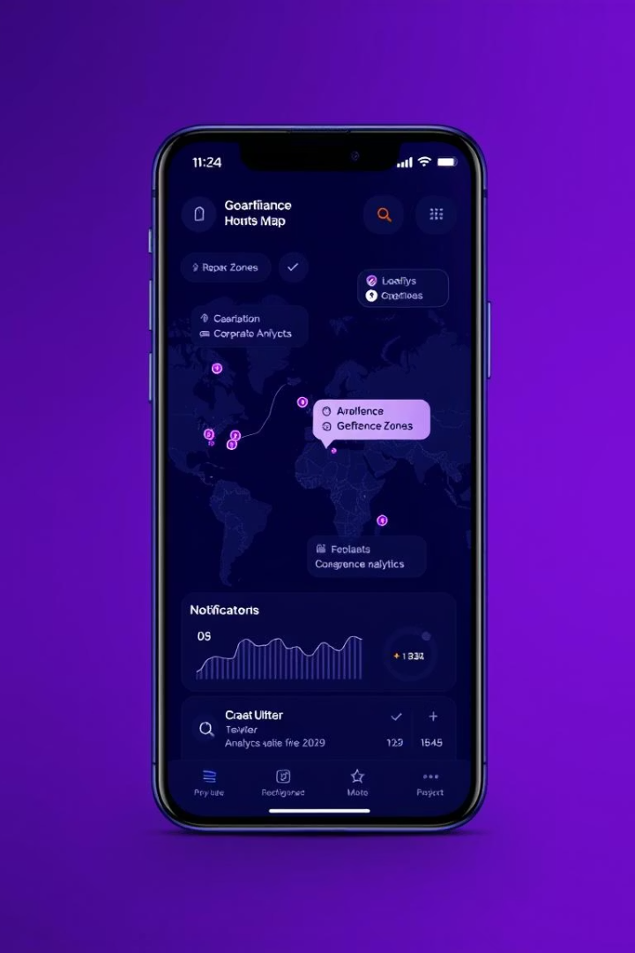
Future Enhancements: Expanding CaptureShield's Capabilities
Multi-Geofence Support
Implement the ability to manage overlapping or multiple geofence zones for complex site requirements.
Web-Based Admin Dashboard
Enable administration and zone management from a centralized web portal for convenience and scalability.
Notification System
Integrate real-time alerts for users and admins on geofence entry/exit and camera state changes.
Role-Based Analytics
Provide detailed insights on user compliance and camera lock events differentiated by roles.

Slide 9

Thank You / Contact
Thank you for exploring CaptureShield, the comprehensive solution for geofence-based camera lockdown.
Explore the code and contribute on GitHub: https://github.com/karthikeyanvk18/geo-camera-lock
Connect on LinkedIn (optional): https://www.linkedin.com/in/karthikeyan-p-138564250

