Slide 1

AI Revolution in Autonomous Vehciles
Autonomous vehicles (AVs) represent a pinnacle of artificial intelligence integration in transportation. These self-driving marvels leverage complex AI systems to perceive, interpret, and navigate their environment without human intervention. As we stand on the cusp of a transportation revolution, AVs promise to reshape our cities, redefine mobility, and fundamentally alter our relationship with vehicles.
The current state of AV technology is rapidly evolving, with various levels of autonomy already deployed on public roads. From driver assistance features to fully autonomous prototypes, AI is the cornerstone enabling these advancements. This transformative technology not only aims to enhance road safety but also promises to optimize traffic flow, reduce emissions, and provide mobility solutions for those unable to drive conventional vehicles.
by Karthikeya Veruturi (22071A67C7)

Slide 2
How AI powers AV’s
Computer Vision
Sensor Fusion
Deep Learning
Advanced algorithms process visual data from cameras, enabling AVs to identify objects, read traffic signals, and detect pedestrians with high accuracy. This technology mimics human visual perception but with greater precision and constant vigilance.
By integrating data from multiple sensors including LIDAR, radar, and GPS, AVs create a comprehensive 3D map of their surroundings. This fusion allows for robust environmental understanding even in challenging conditions.
Neural networks trained on vast datasets learn to recognize patterns and make decisions, continually improving their performance through experience and updates. This forms the backbone of AV decision-making systems.

Slide 3
Levels of Autonomous Vehicle Technology
1
Level 0-2: Driver Assistance to Partial Automation
These levels range from no automation to vehicles that can control steering or acceleration under specific circumstances, but still require constant driver supervision.
2
Level 3: Conditional Automation
The vehicle can handle most driving tasks, but may require human intervention in certain situations. The driver must be ready to take control when alerted.
3
Level 4: High Automation
The vehicle is capable of handling all driving tasks within specific operational domains, such as highway driving or urban environments, without human intervention.
4
Level 5: Full Automation
The holy grail of autonomous driving, where the vehicle can operate under all conditions without any human input, essentially replacing the need for a human driver entirely.

Slide 4
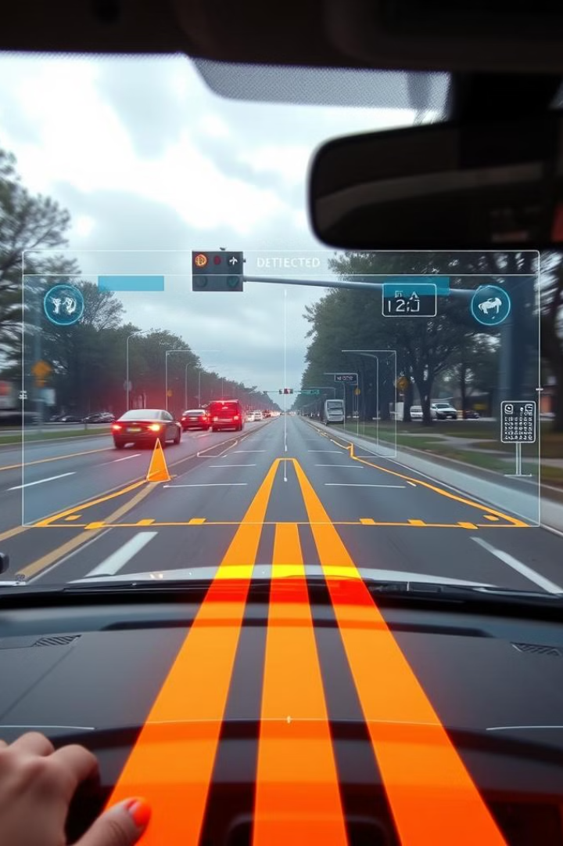
AI-Based Perception Systems in Autonomous Vehicles
1
Object Detection and Tracking
AI algorithms continuously scan the environment, identifying and classifying objects such as vehicles, pedestrians, and cyclists. These systems can predict the trajectory of moving objects, enabling proactive decision-making.
2
Lane Detection
Advanced computer vision techniques allow AVs to detect lane markings, even in challenging conditions like faded lines or adverse weather. This ensures the vehicle maintains proper road positioning.
3
Environmental Understanding
AI systems interpret complex road scenarios, recognizing traffic lights, road signs, and temporary obstacles. This comprehensive understanding allows AVs to navigate dynamic urban environments safely.

Slide 5




AI in Decision-Making and Path Planning
Route Optimization
Collision Avoidance
Rules Interpretation
AI algorithms analyze real-time traffic data, road conditions, and historical patterns to determine the most efficient route. This dynamic path planning adapts to changing conditions, ensuring optimal travel times and fuel efficiency.
Predictive algorithms continuously assess the risk of collision with surrounding objects. The system can initiate evasive maneuvers or emergency braking when necessary, often reacting faster than human drivers.
AI models are trained to understand and apply complex traffic rules and regulations. This allows AVs to navigate intricate scenarios like four-way stops or merging onto highways while adhering to local traffic laws.

Slide 6

Challenges in AI for Autonomous Vehicles
Challenge
Description
Potential Solutions
Safety and Reliability
Ensuring AVs can handle unpredictable situations safely
Extensive real-world testing, advanced simulation environments
Ethical Dilemmas
Decision-making in critical, life-threatening scenarios
Developing ethical frameworks, public discourse on AI ethics
AI Biases
Impact of training data on AV performance in diverse environments
Diverse and representative datasets, continuous model evaluation
Regulatory Issues
Navigating different rules across various regions
International standardization efforts, adaptive AI systems

Slide 7
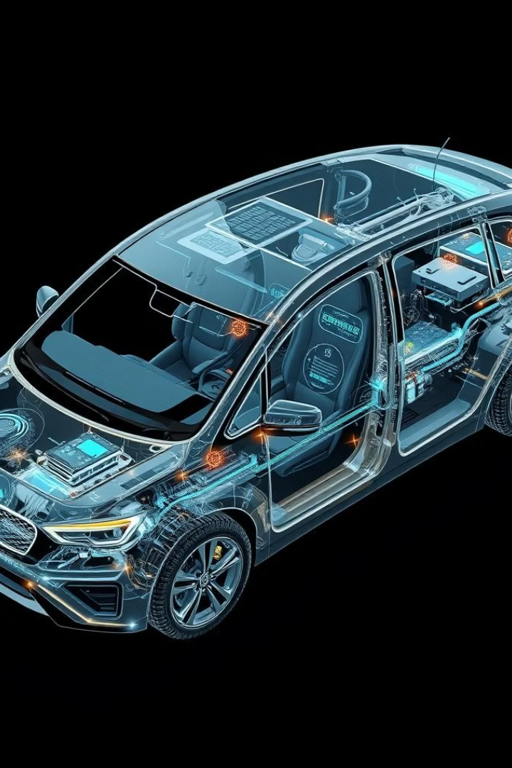




AI-Driven Sensors and Hardware in Autonomous Vehicles
LIDAR
Light Detection and Ranging (LIDAR) systems use laser pulses to create detailed 3D maps of the vehicle's surroundings, providing crucial depth perception and object detection capabilities.
Radar
Radio Detection and Ranging (Radar) systems complement LIDAR by providing accurate distance and velocity measurements of objects, especially effective in adverse weather conditions.
Cameras
High-resolution cameras capture visual information, enabling AI systems to interpret traffic signs, lane markings, and other visual cues essential for navigation and decision-making.
AI Hardware
Specialized processors like NVIDIA Drive and Tesla's custom AI chips provide the immense computing power required to process sensor data and make real-time decisions.

Slide 8
The Future of AI in Autonomous Vehicles
As we look towards the horizon of autonomous vehicle technology, the role of AI becomes increasingly pivotal. The pursuit of Level 5 autonomy—where vehicles can operate without any human intervention under all conditions—is driving rapid advancements in AI capabilities. This ultimate goal promises to revolutionize not just personal transportation, but entire urban infrastructures and mobility paradigms.
Experts predict that fully autonomous vehicles could become mainstream within the next 10-15 years, though widespread adoption may take longer due to regulatory hurdles and public acceptance. As AI continues to evolve, we can expect to see dramatic improvements in safety, efficiency, and accessibility of transportation. Smart cities of the future will likely feature interconnected networks of autonomous vehicles, optimizing traffic flow and reducing emissions.
The journey towards this AI-driven future of mobility is complex and challenging, but the potential benefits to society are immense. As researchers and engineers continue to push the boundaries of what's possible, we stand on the brink of a transportation revolution that will reshape our world in profound ways.

