Slide 1
IntelliMetrics AI
A governed semantic layer with TARA, an AI assistant for trusted business metrics
Devi Priya, Priyanka, Akshay and Bhaskar
KL University | AY 2026-27
University project (academic capstone). Demonstration data is synthetic.
Devi Priya, Priyanka, Akshay and Bhaskar | KL University | University project, synthetic demonstration data | 1/16
Notes:
Introduce yourself, the guide and the project name. Say at once that it is a university project with synthetic data.

Slide 2
The problem: one word, many numbers
• Sales: Revenue = taxable value of goods sold (excluding GST)
• Finance: Revenue = sales less refunds
• Marketing: Revenue = invoice value including GST
• Nobody notices until two reports disagree; changes are not recorded
• Generic AI chatbots answer confidently even when wrong
Devi Priya, Priyanka, Akshay and Bhaskar | KL University | University project, synthetic demonstration data | 2/16
Notes:
Use the Indian GST example because the audience recognises it. Stress that nobody is lying; the same word means different calculations.

Slide 3
Objectives
• One governed live definition per business metric
• Detect conflicting definitions automatically and measure the detector
• Immutable version history with safe rollback
• Let non-technical users ask questions without risking wrong or unsafe queries
• Localise to India: INR (lakh/crore), April-March FY, GST, festivals, IST
Devi Priya, Priyanka, Akshay and Bhaskar | KL University | University project, synthetic demonstration data | 3/16
Notes:
Map each objective to a result later in the talk.

Slide 4
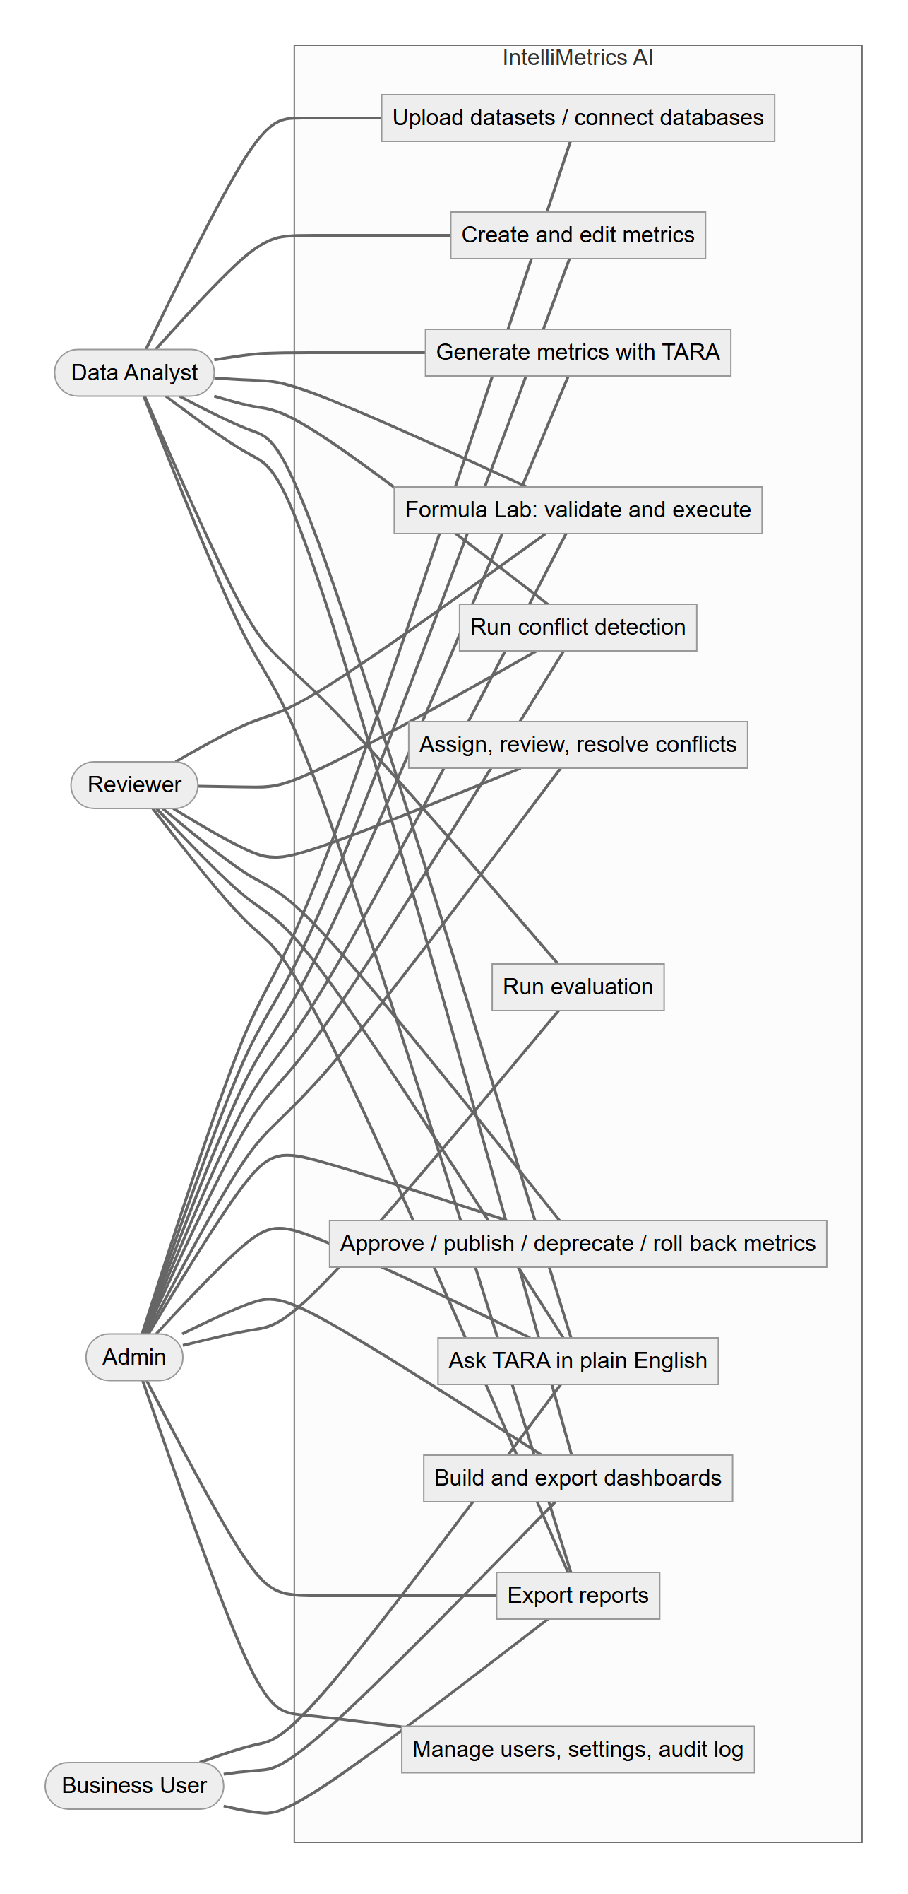
The solution at a glance
• Datasets in, governed metrics and dashboards out
• Workflow: draft, review, approve, publish (exactly one live per metric)
• Conflict centre: assign, review, approve, resolve
• Formula Lab: safe, parameterised execution
• Ask TARA: plain-English questions answered from approved metrics
• 96 API endpoints | 25 pages | 4 roles | 2 isolated workspaces
Devi Priya, Priyanka, Akshay and Bhaskar | KL University | University project, synthetic demonstration data | 4/16
Notes:
Give the one-minute product tour using the use-case diagram: four roles, each with a distinct job.

Slide 5
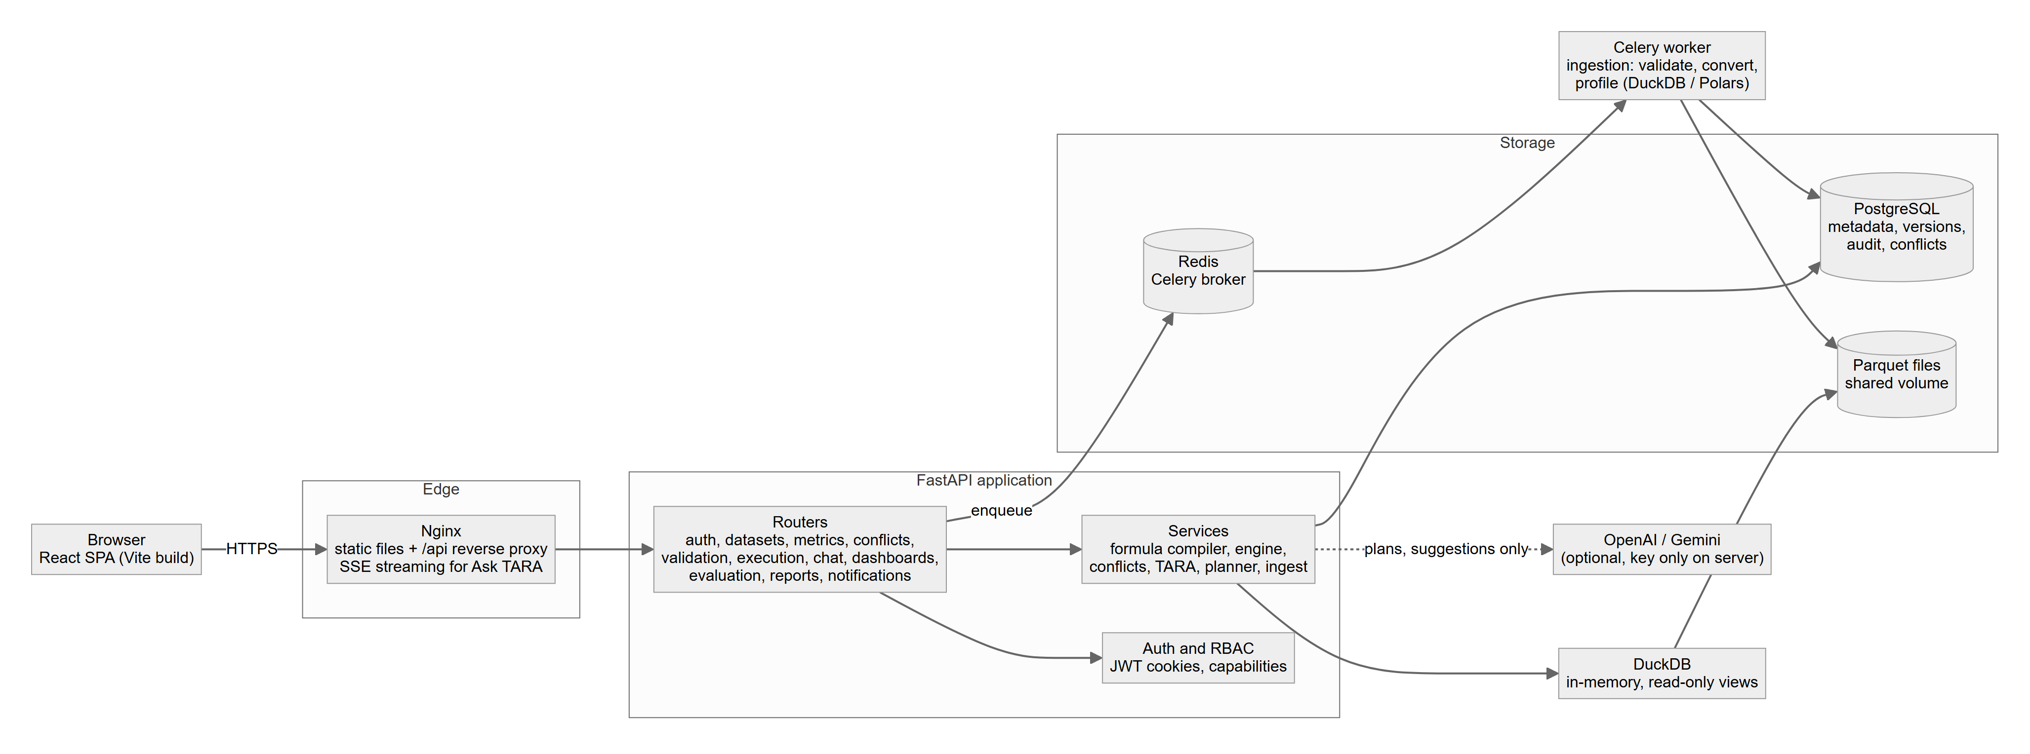
Architecture
• React + TypeScript single-page app
• FastAPI back end: RBAC on every route, workspace filter on every query
• PostgreSQL / SQLite for metadata, DuckDB + Parquet for analytics
• Celery + Redis for background ingestion (thread fallback)
Devi Priya, Priyanka, Akshay and Bhaskar | KL University | University project, synthetic demonstration data | 5/16
Notes:
Explain that analytics never touch the transactional database; DuckDB reads Parquet files produced by ingestion.

Slide 6
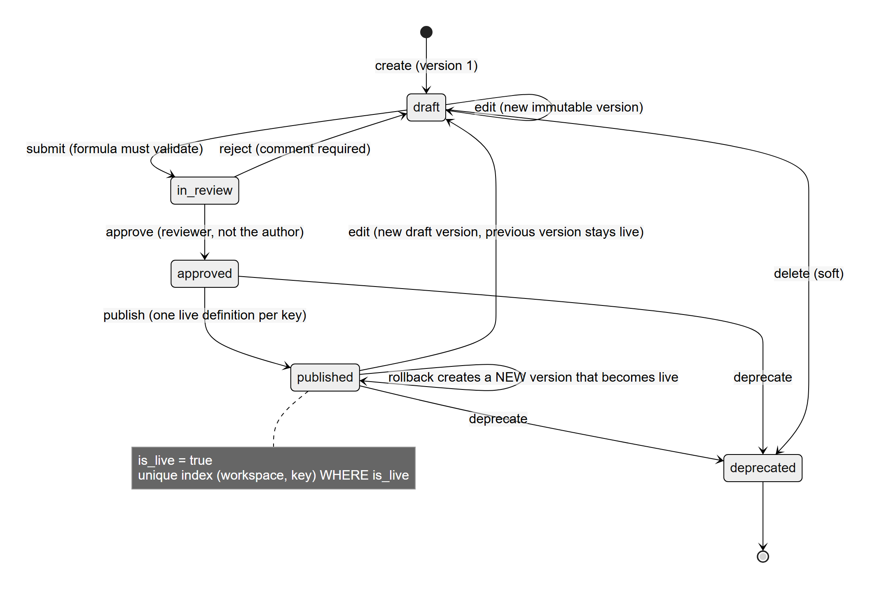
Governance: versions that cannot be changed
• Partial unique index: one live definition per metric key
• Version rows immutable: ORM guard + database trigger
• Rollback creates a NEW version; history is never rewritten
• Dashboards follow latest published or pinned versions
Devi Priya, Priyanka, Akshay and Bhaskar | KL University | University project, synthetic demonstration data | 6/16
Notes:
Say that the guarantee is in the database, so a bug in the application cannot break it. Verified on real PostgreSQL 18.

Slide 7
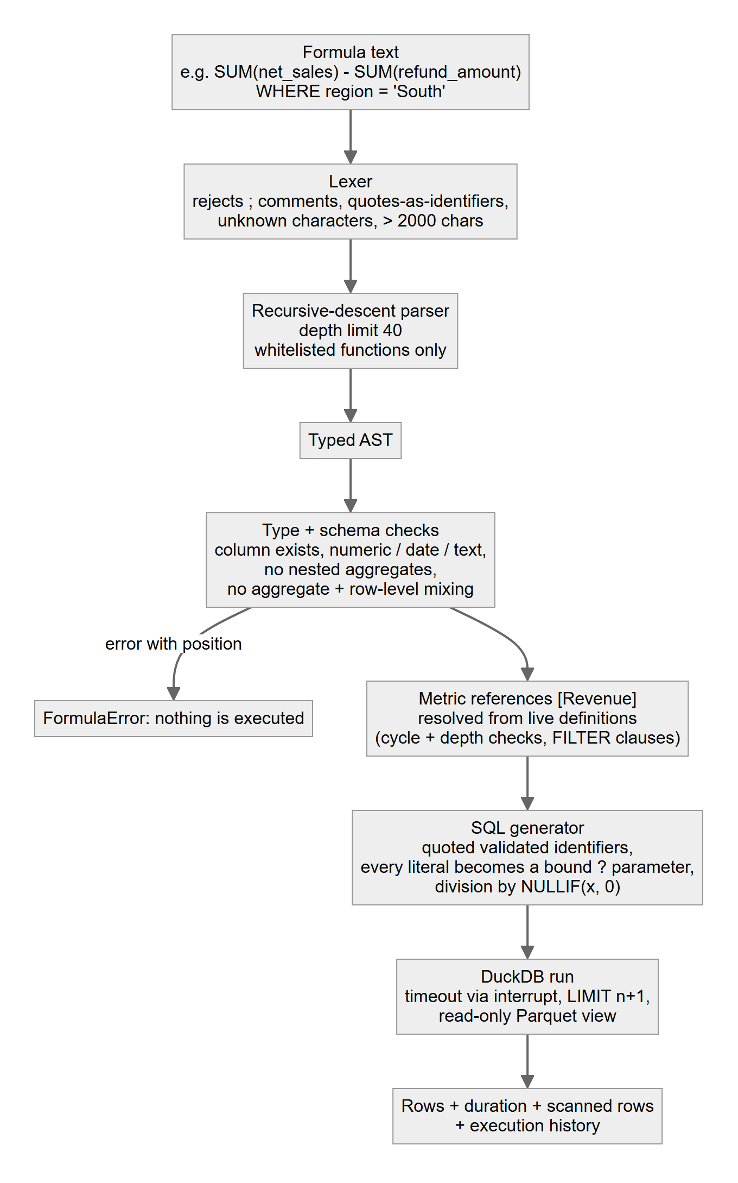
A formula engine that cannot be injected
• Lexer, recursive-descent parser, typed syntax tree
• Whitelisted functions; columns checked against the schema
• Every value is a bound parameter; division is zero-safe
• Limits: 2,000 characters, depth 40, 10,000 rows, 20 s timeout
• 25 hostile inputs tested: all rejected before execution
Devi Priya, Priyanka, Akshay and Bhaskar | KL University | University project, synthetic demonstration data | 7/16
Notes:
No user text ever becomes SQL text. That is why injection is structurally impossible rather than filtered.

Slide 8
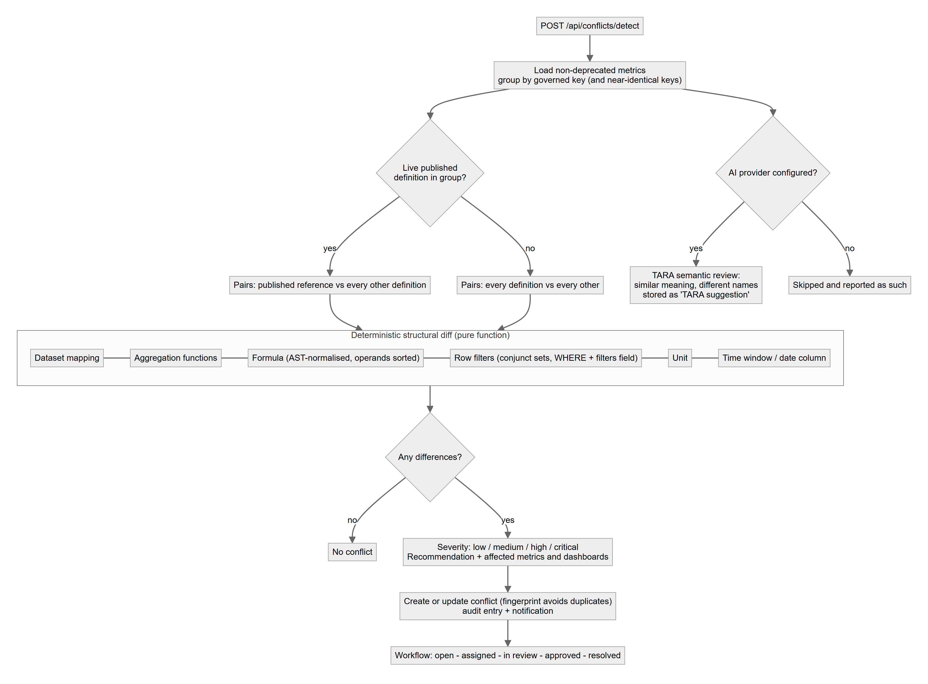
Automatic conflict detection
• Compares formula, aggregation, filters, unit, time window, dataset
• Severity score, side-by-side diff, recommended resolution
• 27 labelled cases: precision 1.00, recall 1.00
• Plain text comparison baseline: precision 0.55, recall 0.81
Devi Priya, Priyanka, Akshay and Bhaskar | KL University | University project, synthetic demonstration data | 8/16
Notes:
Be candid: the cases were written by me, so this shows the rules behave as designed and is not an independent benchmark.

Slide 9
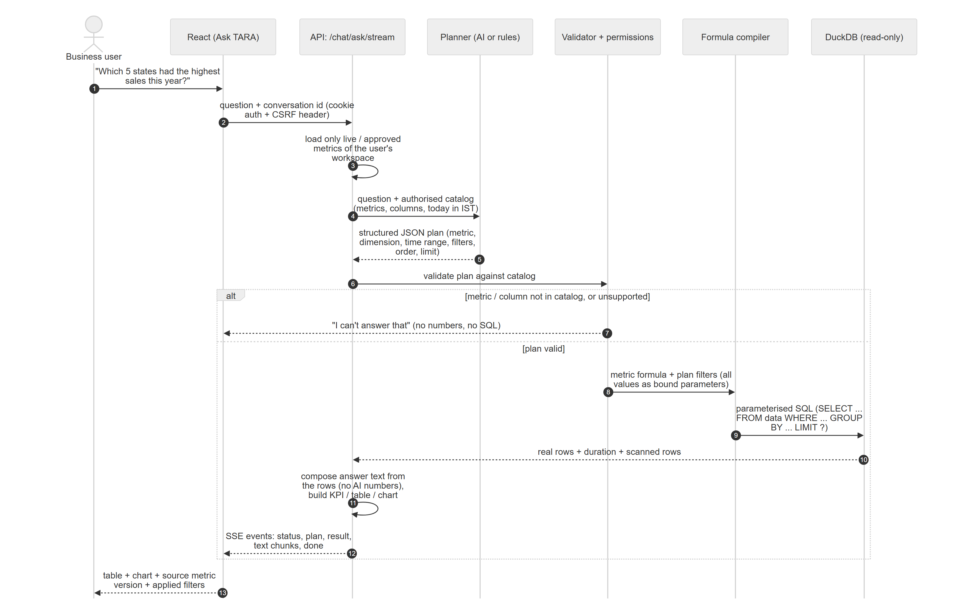
Ask TARA: the AI never writes numbers
• Question becomes a plan; the plan is validated against approved metrics
• Same safe compiler runs it; the answer text is composed from rows
• Compare ranges, second dimension, share of total, default fallbacks
• Refuses when the data cannot answer
Devi Priya, Priyanka, Akshay and Bhaskar | KL University | University project, synthetic demonstration data | 9/16
Notes:
Walk through the sequence diagram. Mention the offline deterministic mode and that no live AI key was used.

Slide 10
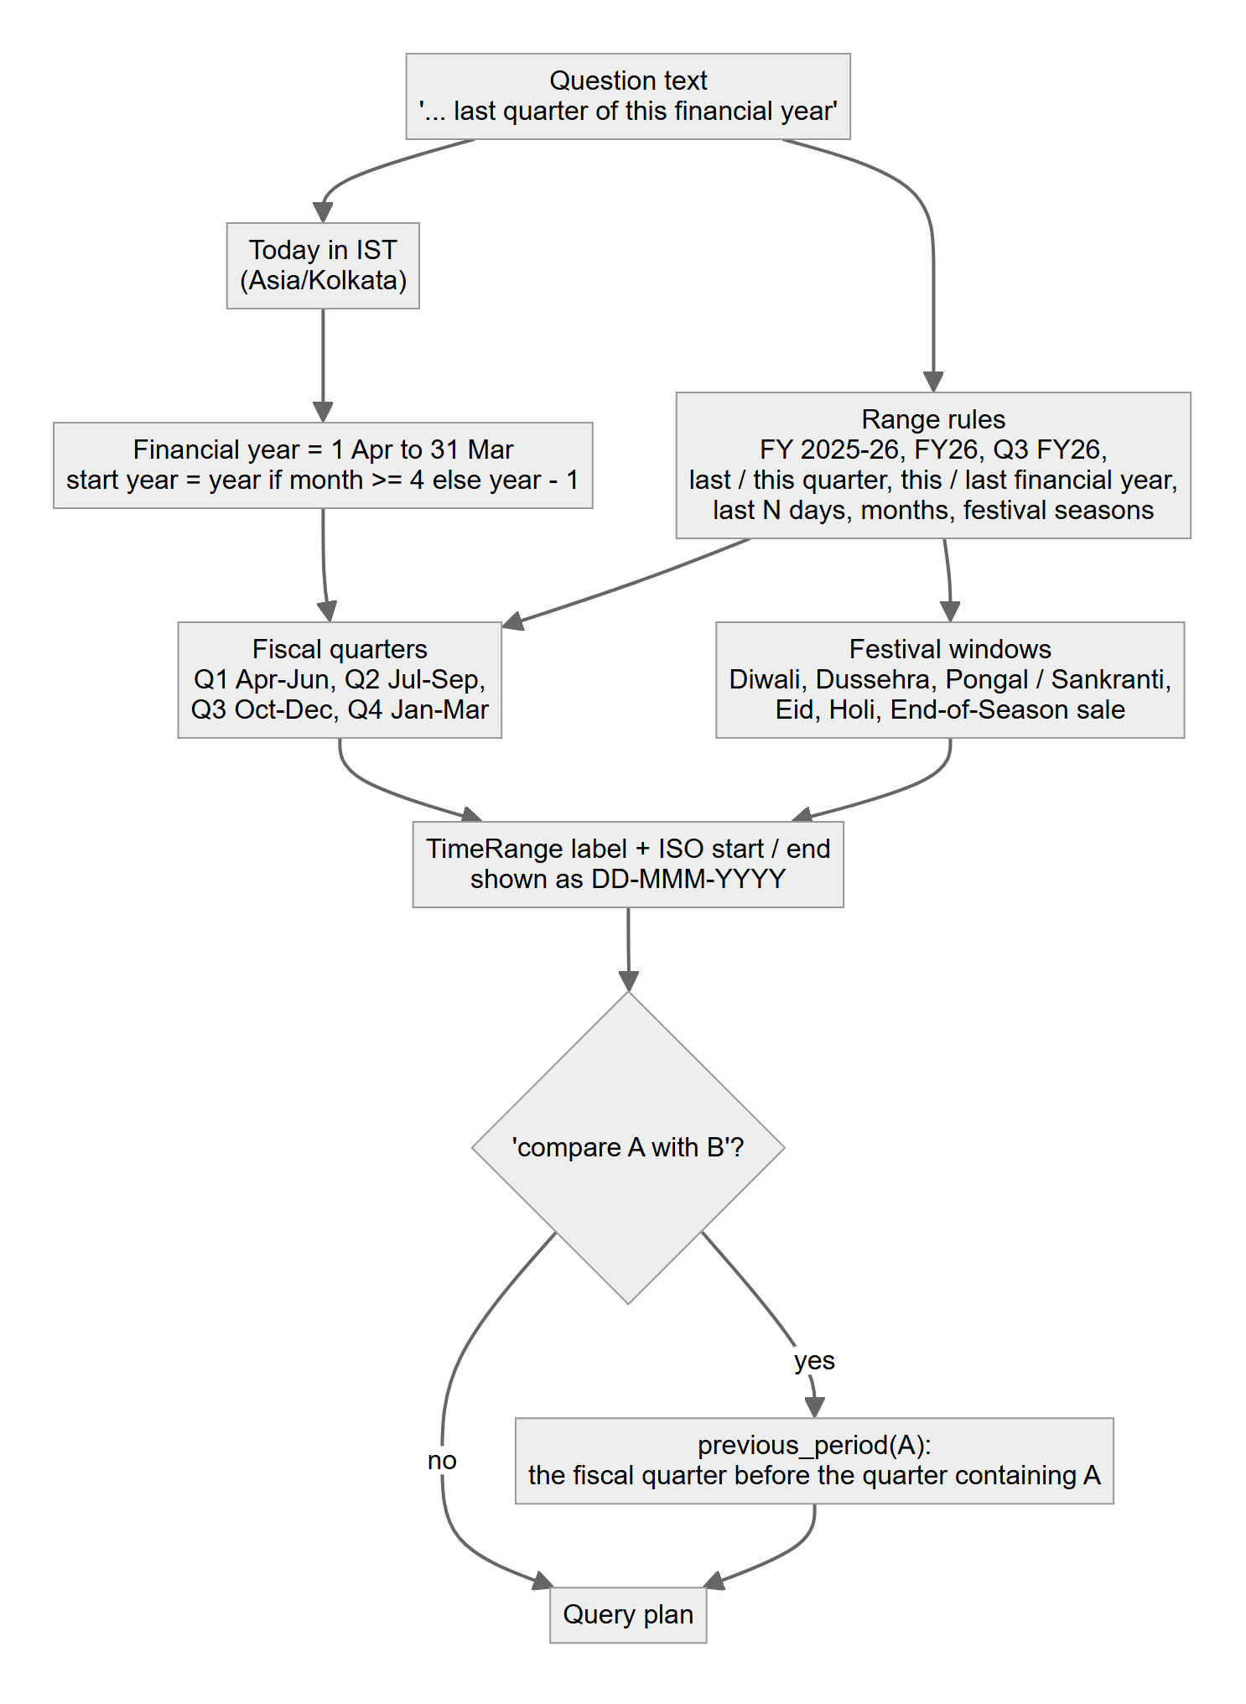
Built for India
• INR with lakh/crore grouping; compact forms ₹45 L, ₹1.2 Cr
• Financial year 1 April to 31 March; fiscal quarters
• GST: taxable value vs invoice value; slabs 0/5/12/18/28 %
• Festival windows: Diwali, Dussehra, Pongal, Eid, Holi, End-of-Season sale
• DD-MMM-YYYY dates in IST
Devi Priya, Priyanka, Akshay and Bhaskar | KL University | University project, synthetic demonstration data | 10/16
Notes:
Explain that 'last quarter' resolves to the last completed fiscal quarter, and 'this year' to the financial year to date.

Slide 11
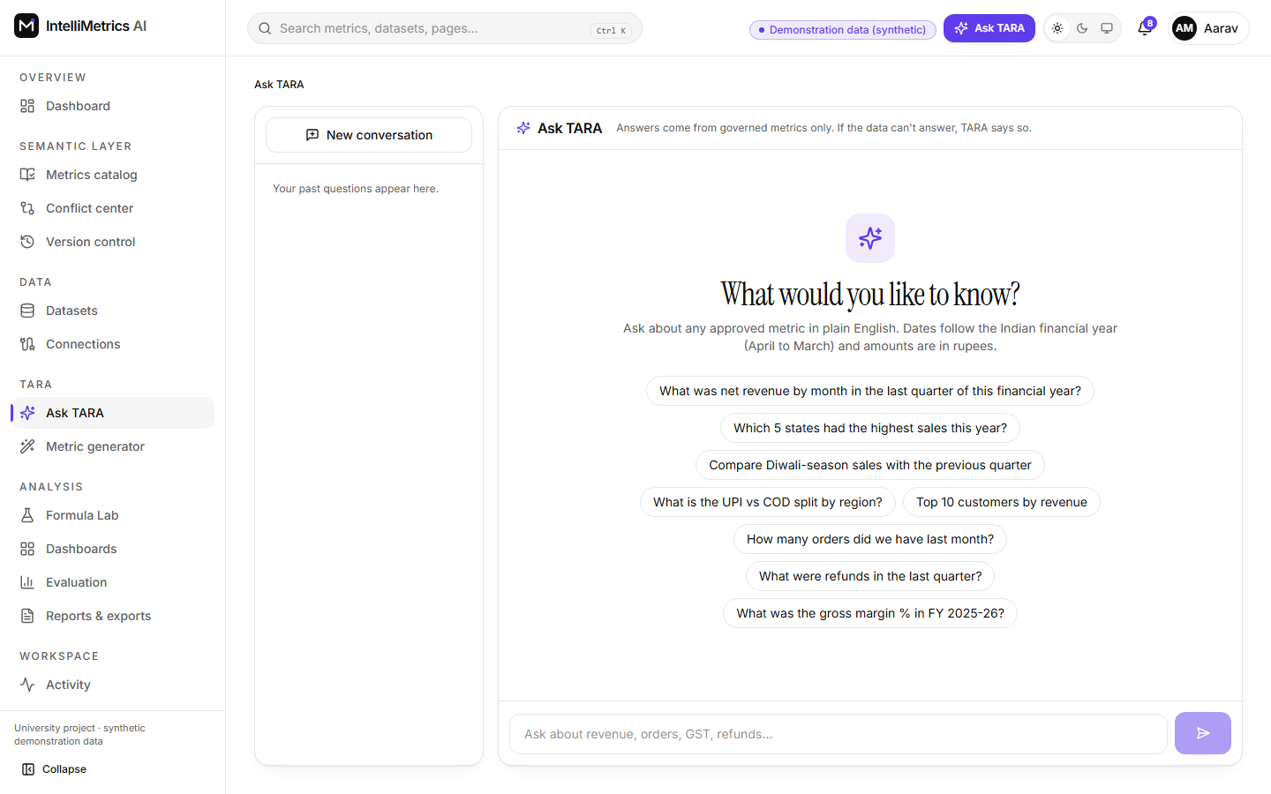
Demonstration
• Reviewer: detect and resolve the Revenue conflict
• Analyst: Formula Lab, including a rejected injection
• Business user: Diwali comparison and UPI vs COD split
• Admin: audit log; other workspace: no cross-company data
Devi Priya, Priyanka, Akshay and Bhaskar | KL University | University project, synthetic demonstration data | 11/16
Notes:
Run the live demo here (8 minutes). The screenshot is a backup if the demo fails.

Slide 12
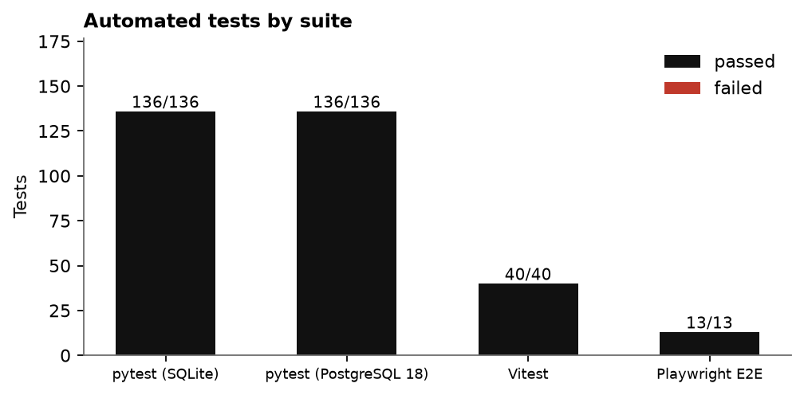
Testing
• 325 automated tests, 0 failed
• pytest 136 (+ 136 on PostgreSQL 18), Vitest 40, Playwright 13
• Back-end statement coverage 82.8 %
• Security tests: injection, token forgery, CSRF, isolation, escalation
• Every page screenshotted in light and dark mode
Devi Priya, Priyanka, Akshay and Bhaskar | KL University | University project, synthetic demonstration data | 12/16
Notes:
Each row of the test-case table in the report is linked to a measured result, so the table cannot claim a pass that did not happen.

Slide 13
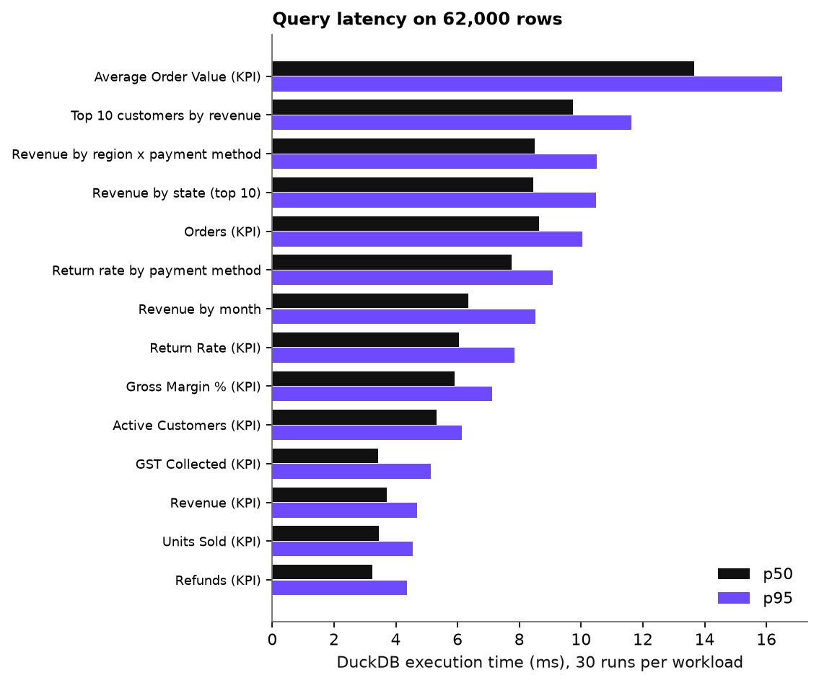
Measured performance
• Query engine median 6.37 ms, p95 12.77 ms on 62,000 rows
• Ingestion about 86,494 rows per second
• Dashboard load 167.2 ms on average
• Time-saving estimates rely on stated assumptions, not measurements
Devi Priya, Priyanka, Akshay and Bhaskar | KL University | University project, synthetic demonstration data | 13/16
Notes:
Single-user numbers from one Windows machine. Say clearly that there was no load test.

Slide 14
Honest limitations
• Docker Compose tested on GitHub Actions, not on our own machines
• No live AI provider tested; offline planner only
• Synthetic data; no user study; no external security audit
• Chromium only; no load test; per-process rate limiter
• Verified instead: PostgreSQL 18.2, Redis + Celery, MySQL 8.0
Devi Priya, Priyanka, Akshay and Bhaskar | KL University | University project, synthetic demonstration data | 14/16
Notes:
Say these before the examiner asks. It builds trust.

Slide 15
Future scope and conclusion
• Evaluate with a real LLM on a held-out question set
• Redis-backed rate limiting; e-mail delivery; single sign-on
• Column-level security; connectors to real BI sources; user study
• One definition, one history, answers you can trace
Devi Priya, Priyanka, Akshay and Bhaskar | KL University | University project, synthetic demonstration data | 15/16
Notes:
Close with the contribution: an integrated, tested, honest implementation.

Slide 16
Thank you. Questions?
• Devi Priya, Priyanka, Akshay and Bhaskar
• Documents: Project Report, Concept Note, Architecture, Testing Report, User Guide, Deployment Guide, Viva Preparation
Devi Priya, Priyanka, Akshay and Bhaskar | KL University | University project, synthetic demonstration data | 16/16
Notes:
Invite questions. The Viva Preparation document lists forty likely ones.

