Slide 1
Bivariate Analysis using Heatmaps

Slide 2
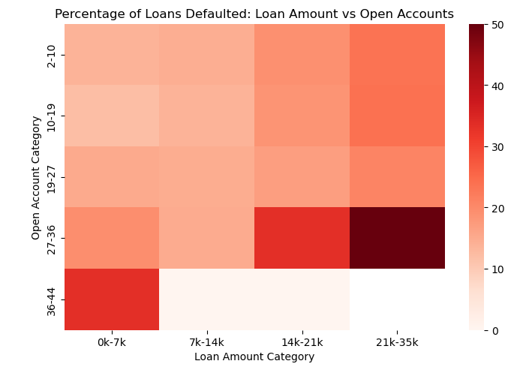
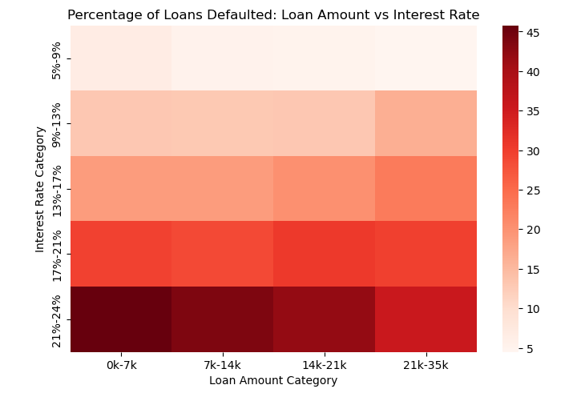
Loan amount category vs other quantitative variables
Conclusions drawn
More than 50% of borrowers with Loan amount between 21k & 35k and Active credit lines between 27 & 36 defaulted.
More than 45% of borrowers with Loan amount less than 7k and Interest rates between 21% & 24% defaulted.

Slide 3
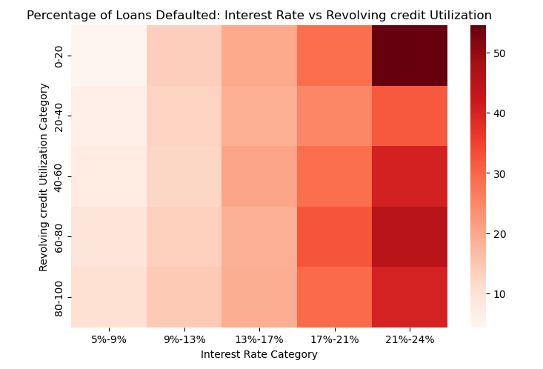
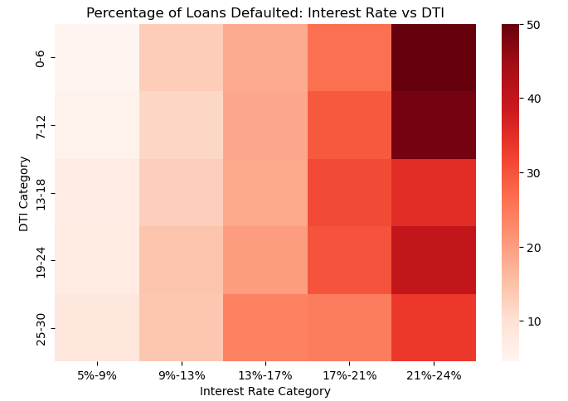
Interest rate category vs other quantitative variables
Conclusions drawn
More than 54% of borrowers with Interest rates between 21% & 24% and Revolving credit utilization between 0% & 20% defaulted.
More than 50% of borrowers with Interest rates between 21% & 24% and Debt to income ratio between 0% & 6% defaulted.

Slide 4
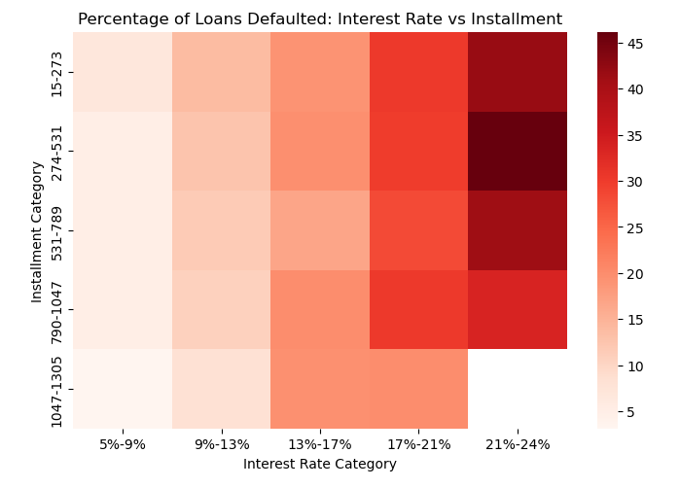
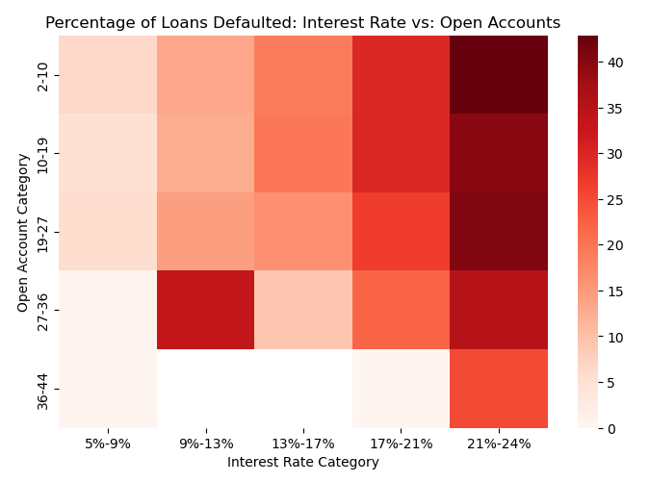
Interest rate category vs other quantitative variables
Conclusions drawn
More than 45% of borrowers with Interest rates between 21% & 24% and Installment amount between 274 & 531 defaulted.
More than 40% of borrowers with Interest rates between 21% & 24% and Active credit lines between 2 & 10 defaulted.

Slide 5
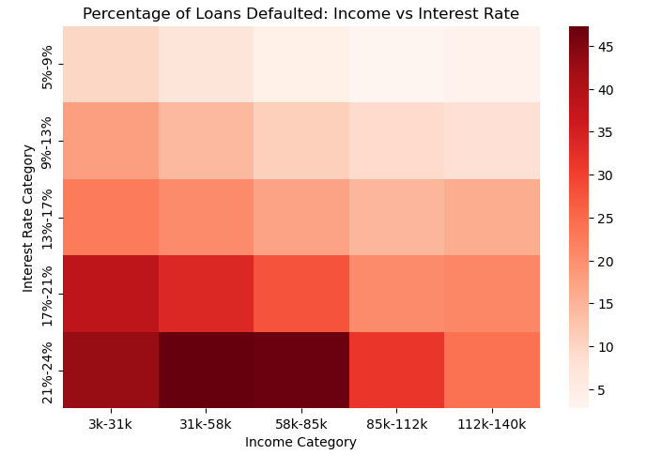
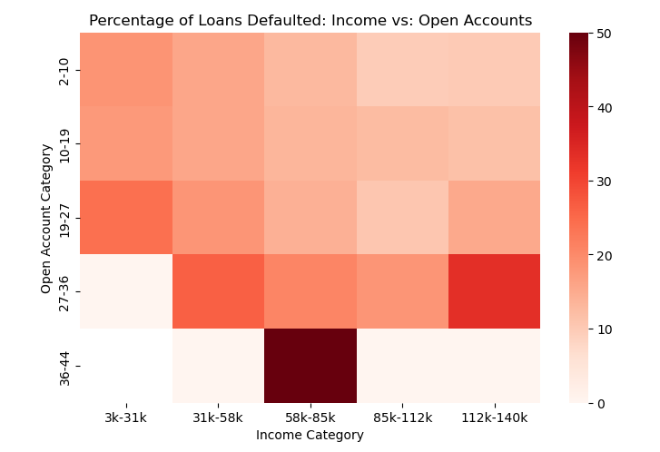
Annual income category vs other quantitative variables
Conclusions drawn
More than 50% of borrowers with Annual income between 58k and 85k and Active credit lines between 36 & 44 defaulted.
More than 47% of borrowers with Annual income between 31k and 85k and Interest rates between 21% & 24% defaulted.

