Slide 1
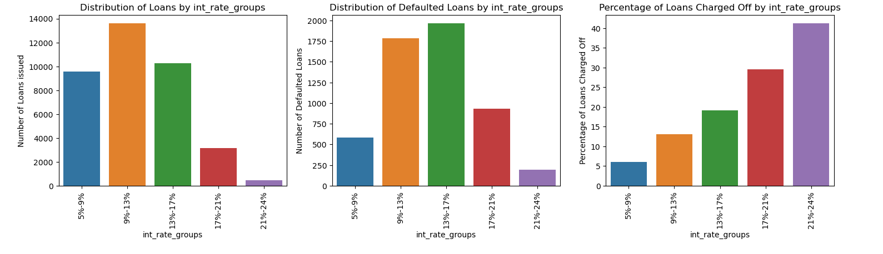
Analysis of Interest rate groups
Conclusions drawn
More loans were disbursed under 9%-13% interest rate bracket.
More loans were defaulted under 13%-17% interest rate bracket.
We can clearly see the trend that charged-off loan percentage is increasing as the rate of interest is increasing.

Slide 2
Bivariate Analysis continuous variables using binning

Slide 3
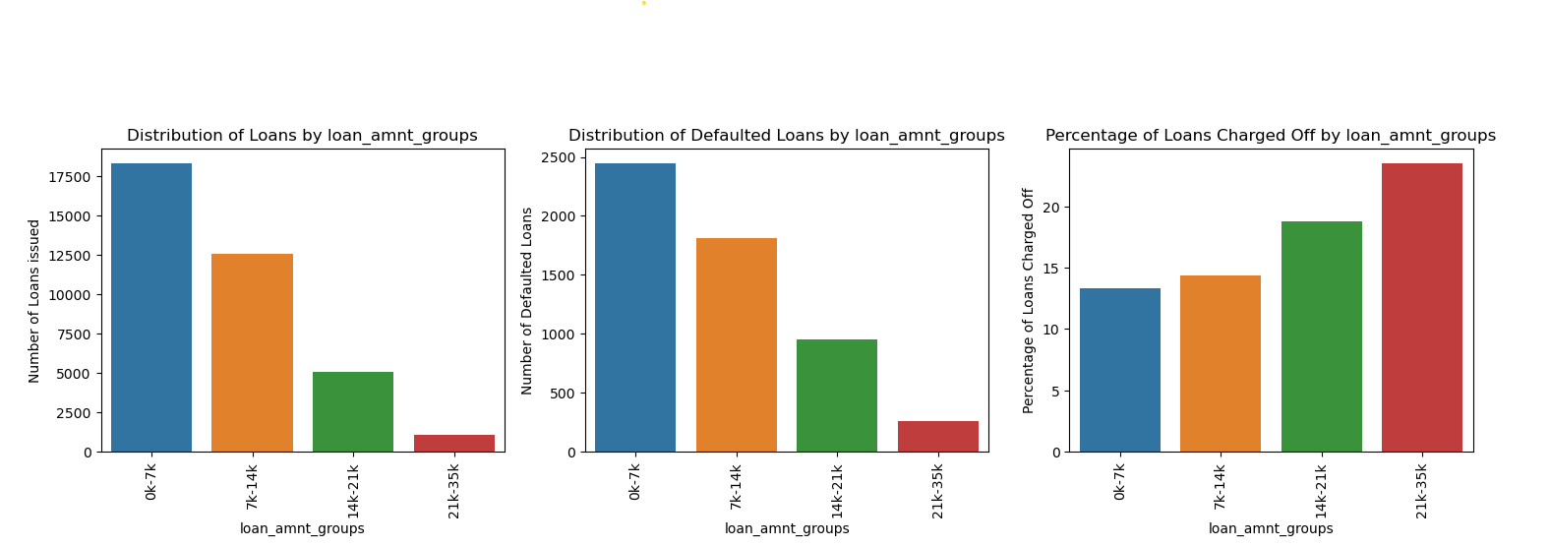
Analysis of Loan amount groups
Conclusions drawn
More loans were disbursed to with loan amounts under 7k.
Trend is that % of defaulting increases as the loan amount increases, >20% of loans with loan amount >21k were defaulted.

Slide 4
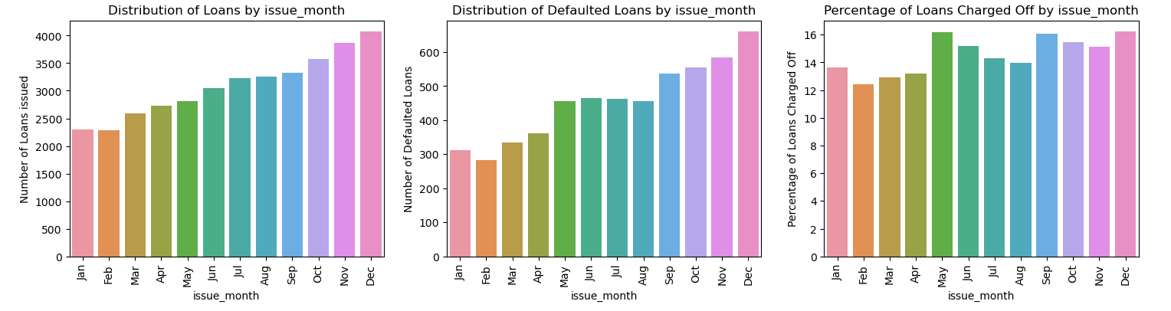
Analysis of Loan issue month
Conclusions drawn
Number of loans taken and defaulted kept on increasing from Jan to Dec and peaked in Dec.
Percentage of loans defaulted were highest when issued in May, Sep and Dec.

Slide 5
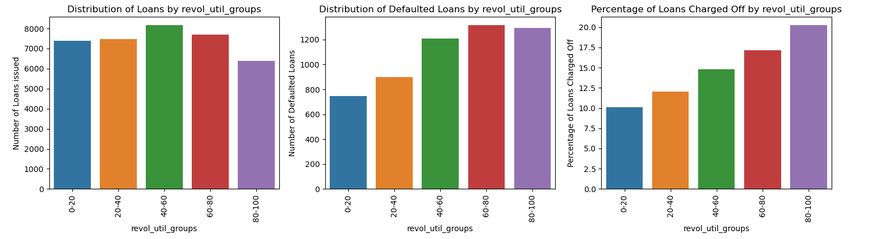
Analysis of Revolving utilization groups
Conclusions drawn
Loan borrowers with high credit line utilization (>40%) are defaulting loans more.
We can clearly see the trend that charged-off loan percentage is increasing as the credit revolving line utilization percent is increasing.

Slide 6
Bivariate Analysis using Heatmaps

Slide 7
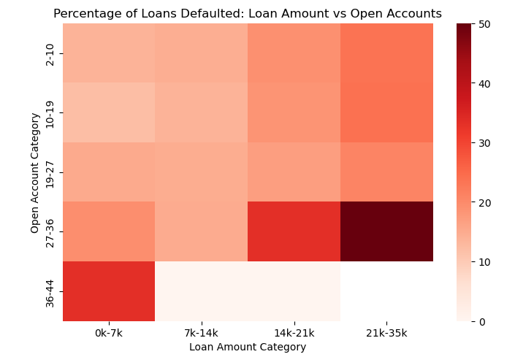
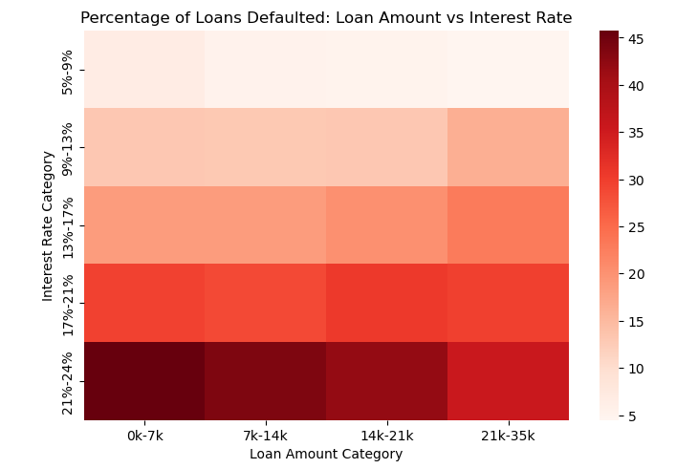
Loan amount category vs other quantitative variables
Conclusions drawn
More than 50% of borrowers with Loan amount between 21k & 35k and Active credit lines between 27 & 36 defaulted.
More than 45% of borrowers with Loan amount less than 7k and Interest rates between 21% & 24% defaulted.

Slide 8
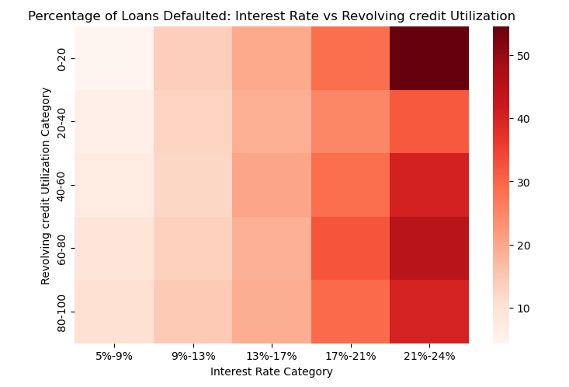
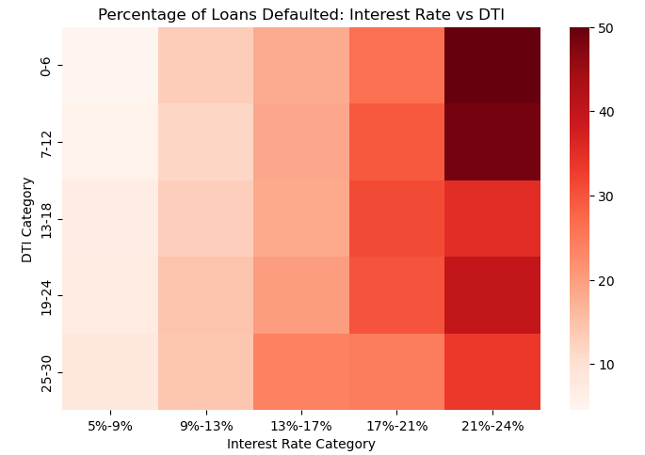
Interest rate category vs other quantitative variables
Conclusions drawn
More than 54% of borrowers with Interest rates between 21% & 24% and Revolving credit utilization between 0% & 20% defaulted.
More than 50% of borrowers with Interest rates between 21% & 24% and Debt to income ratio between 0% & 6% defaulted.

Slide 9
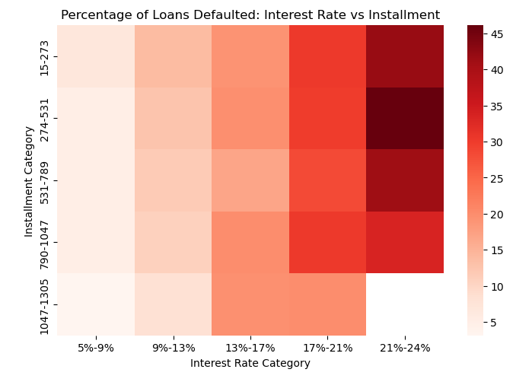
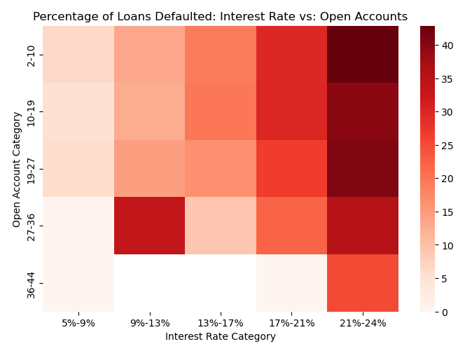
Interest rate category vs other quantitative variables
Conclusions drawn
More than 45% of borrowers with Interest rates between 21% & 24% and Installment amount between 274 & 531 defaulted.
More than 40% of borrowers with Interest rates between 21% & 24% and Active credit lines between 2 & 10 defaulted.

Slide 10
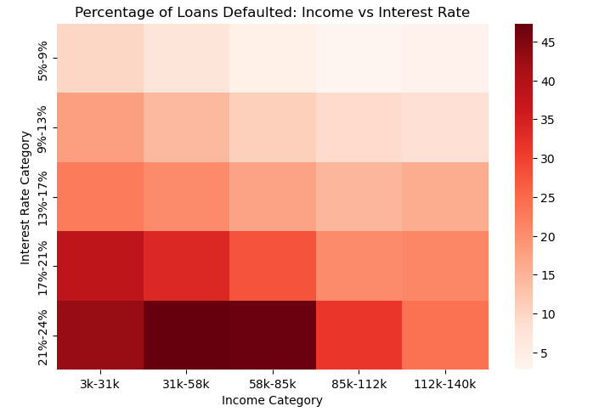
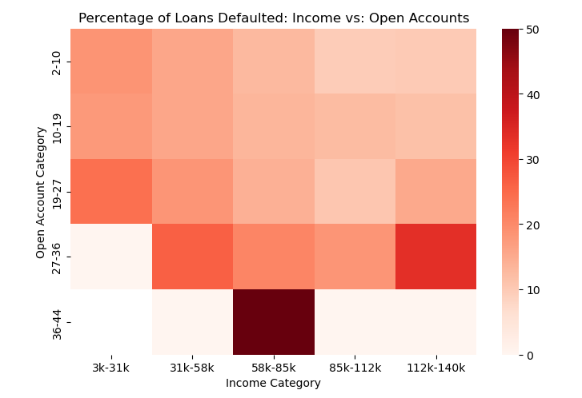
Annual income category vs other quantitative variables
Conclusions drawn
More than 50% of borrowers with Annual income between 58k and 85k and Active credit lines between 36 & 44 defaulted.
More than 47% of borrowers with Annual income between 31k and 85k and Interest rates between 21% & 24% defaulted.

