Slide 1
AI-Powered Content Creation and Recommendation Platform
Presented by: Gangiredla Karthik
Guided by : Nikhil Sharma

Slide 2
Table of Contents
Introduction
Platform Architecture
Methodology
Database Schema
Streamlit UI & Pages
Recommendation Engine
Analysis & Insights
Challenges Faced
Conclusions & Findings
Future Enhancements

Slide 3
Introduction
Goal: Build an AI-driven platform for content creation & recommendation.
Core Focus:
High-quality article generation with LLMs.
Personalized recommendations via vector embeddings.
Technologies Used:
LangChain, Gemini, FastAPI etc.
MySQL for relational storage and ChromaDB for vector-based retrieval.

Slide 4
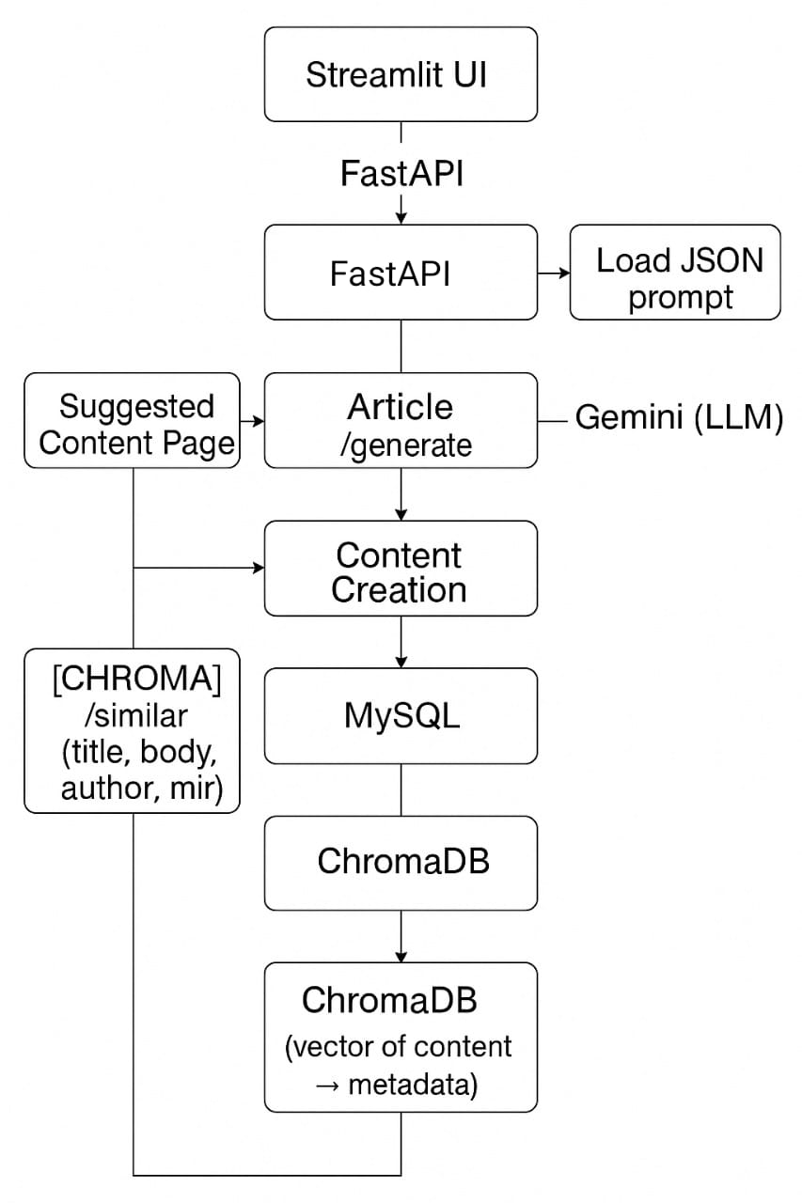
Platform Architecture
Frontend: Streamlit (2 pages: Content Generation & Similar Articles).
Backend: FastAPI.
Database: MySQL + ChromaDB.
Models: Gemini (content generation)
Embedding Layer:Sentence-Transformers.

Slide 5
Methodology
Content Creation Process:
Choose model, personality, and topic.
Use LangChain’s Chain system to constructs prompts.
Send to Gemini.
Store output in MySQL.
Recommendation Process:
Embed articles (Sentence-Transformers).
Store in ChromaDB.
Retrieve top-K using RAG.

Slide 6
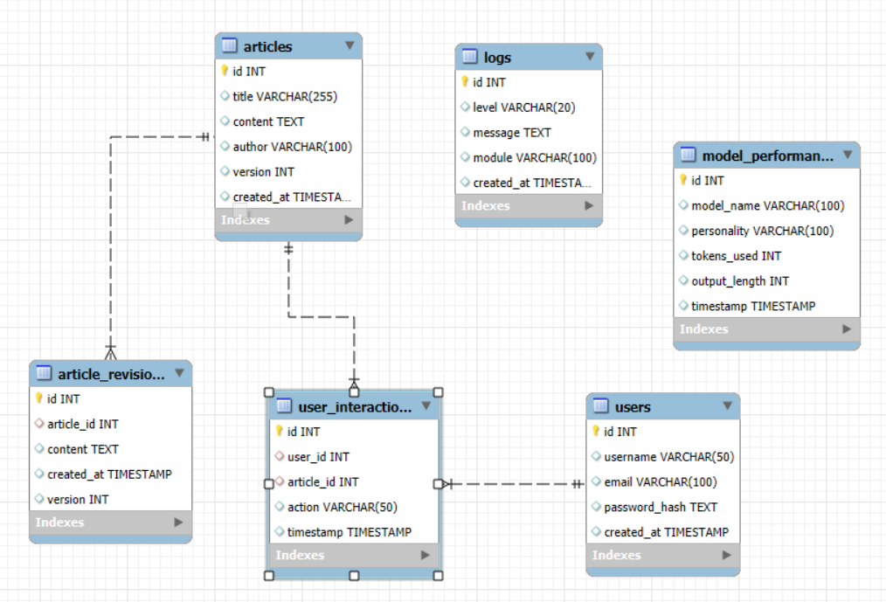
Database Schema
Articles Table: Title, Body, Author, Timestamps.
Revisions Table: Version history of articles.
Users Table: Username, email, password hash.
Interactions Table: Views, likes, dislikes of articles.
Model Performance Table: Logs, metrics.

Slide 7
Streamlit UI & Pages
Page 1: Content Creation
Users input a Topic and pick a Personality template
The system generates an article using LangChain to structure prompts.
Final content is stored along with revision history, enabling easy updates and comparisons.
Page 2: Similar Articles
After reading the selected articles, similar articles are recommended using vector embeddings from ChromaDB
Each recommended article opens in a dedicated HTML page for a clean and focused reading experience

Slide 8
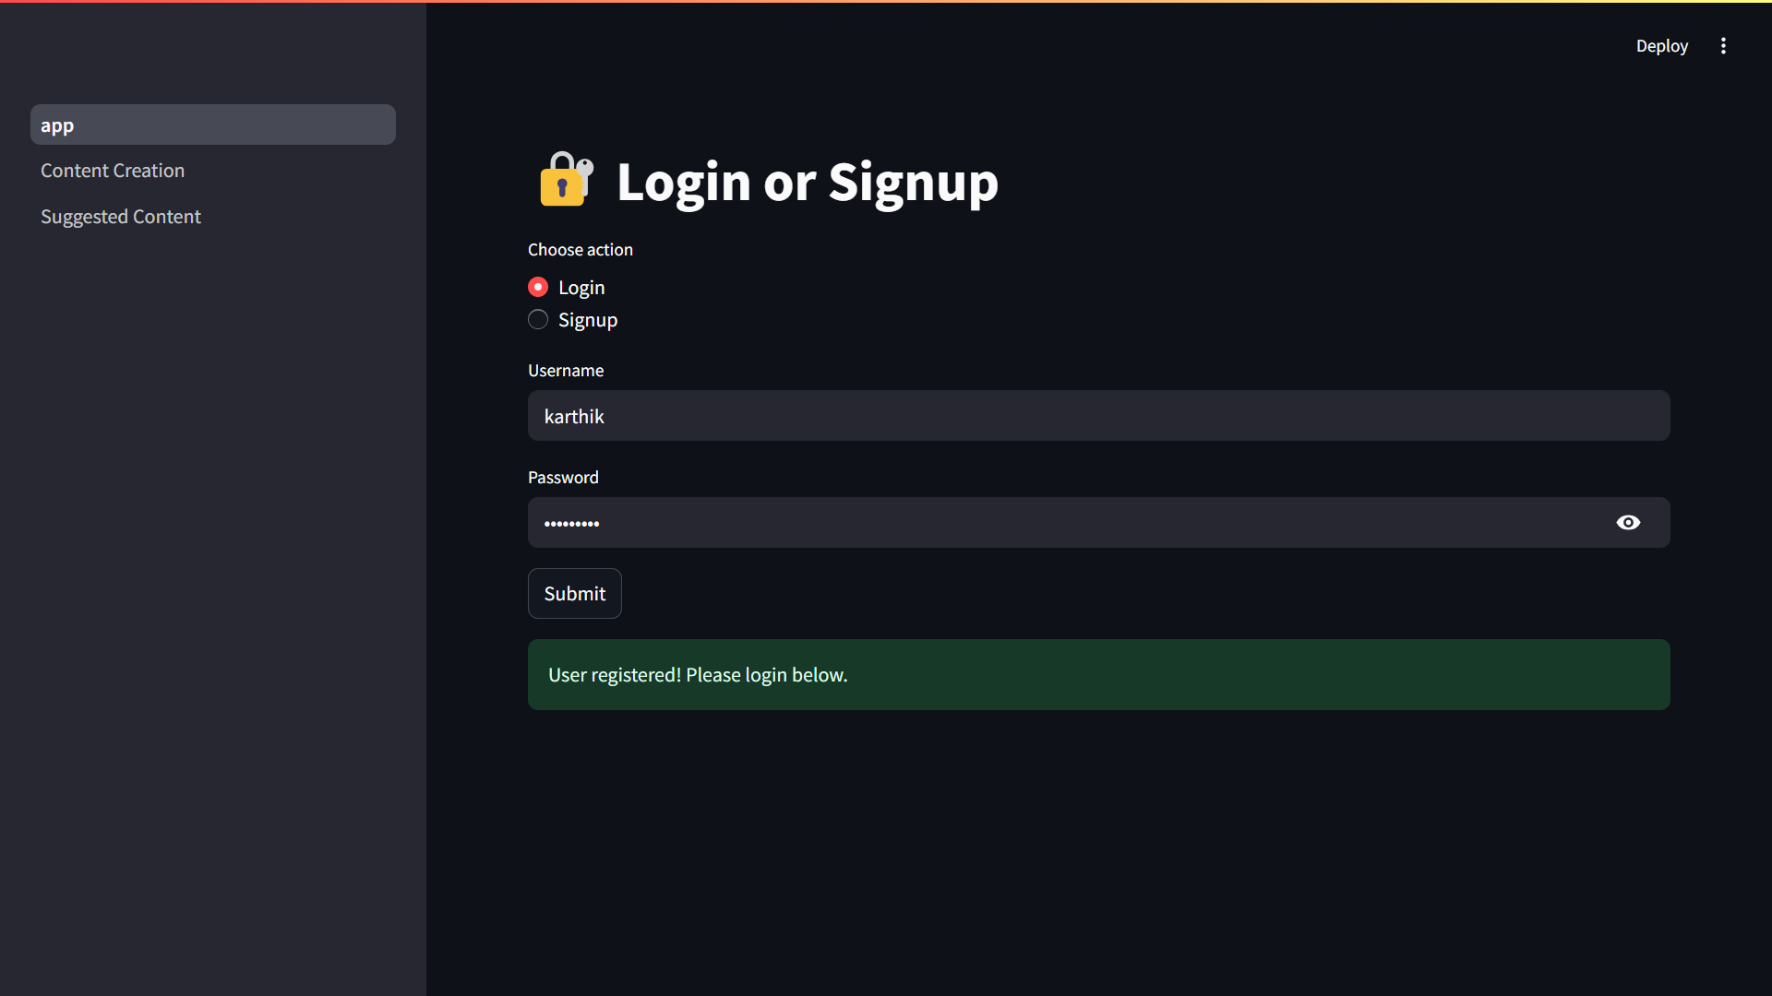
Login/Signup Page

Slide 9
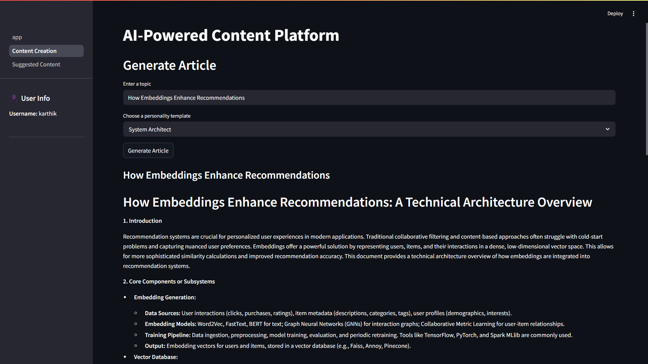
Content Creation Page

Slide 10
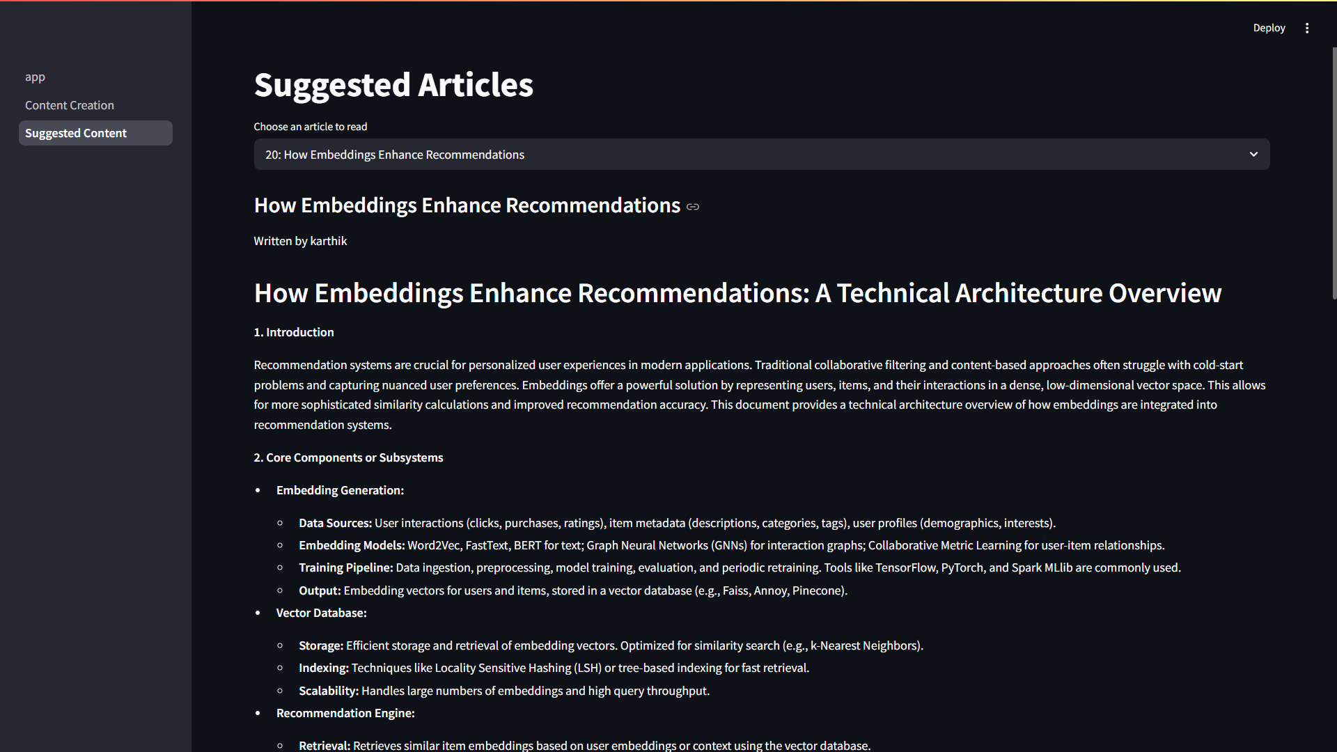
Suggested Articles Page

Slide 11
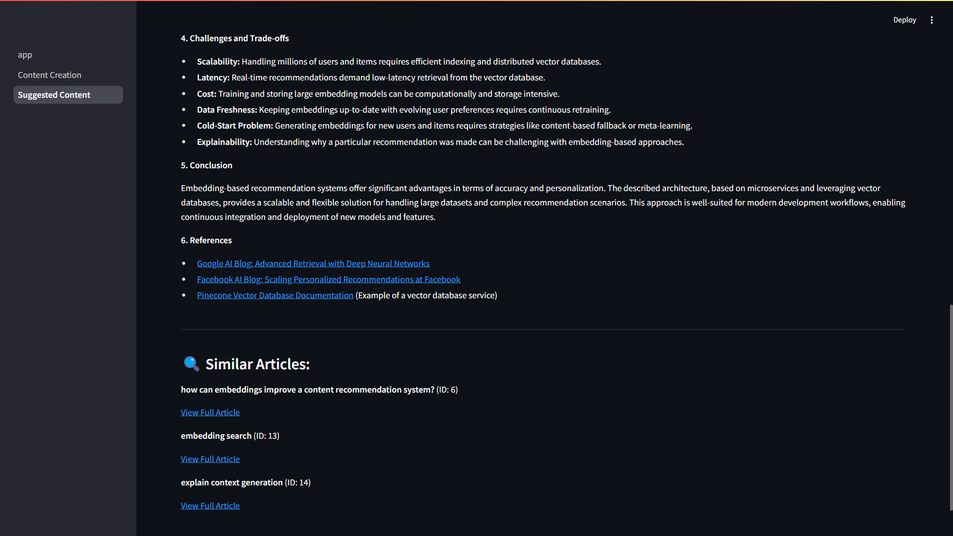
Similar Articles Recommender

Slide 12
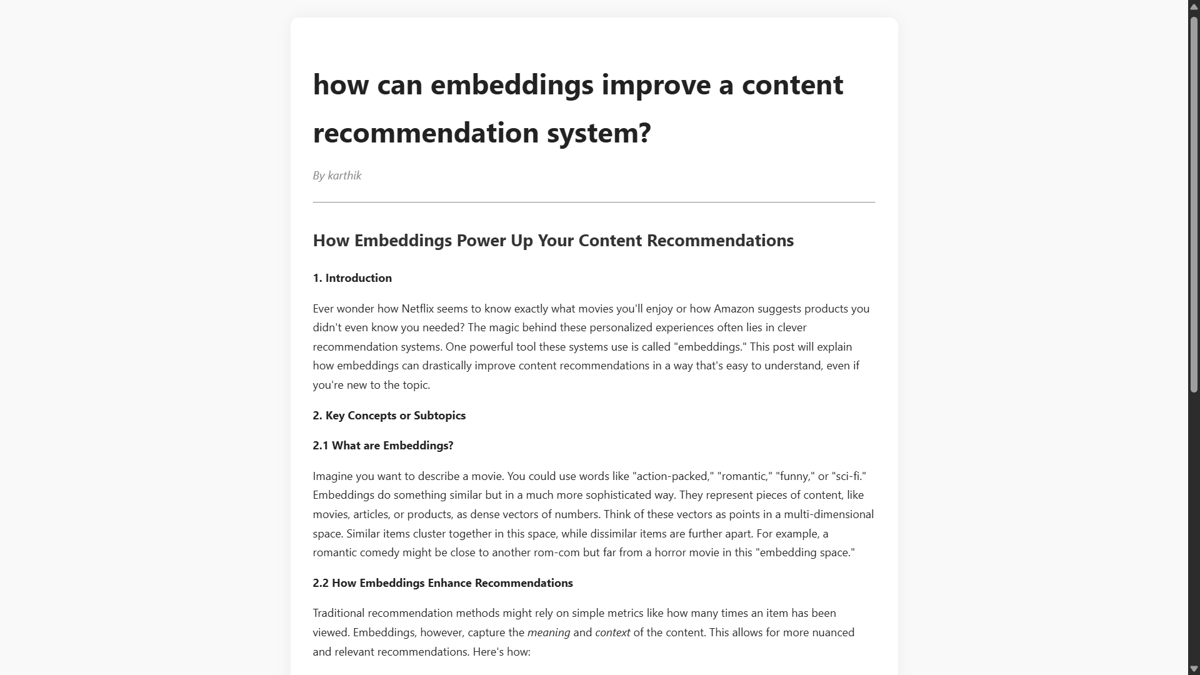
Similar Articles Page

Slide 13
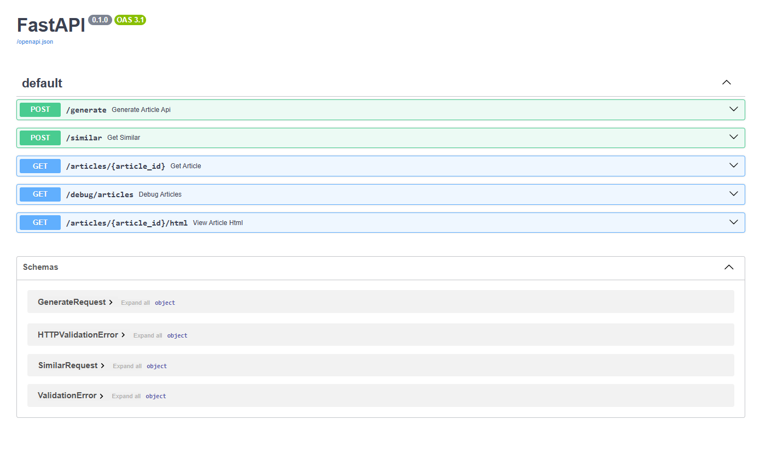
FastAPI Docs

Slide 14
Recommendation Engine
Vector Embeddings: Converts articles into dense vector representations, capturing their semantic meaning for effective comparison.
Top-K Retrieval:Quickly retrieves the most similar articles by performing similarity search over stored vectors in ChromaDB.
Gemini: Delivers contextually rich and factually accurate content, ensuring relevance to the user's input.
Personality Templates: Enables creation of varied and creative articles by simulating different writing styles
Semantic Similarity: Uses embedding-based matching to recommend highly relevant articles, increasing user interest and platform engagement.
Analysis & Insights

Slide 15
Challenges Faced
API Rate Limits & Latency: Challenges in handling external API calls efficiently, especially under high load or network delays.
Semantic Consistency: Ensures the generated articles remain meaningful, contextually accurate, and logically connected throughout
Performance Tuning: Optimization of MySQL and ChromaDB queries for faster data retrieval and embedding searches, even at scale.
Functionality: Seamless LLM-based content creation integrated with dynamic, context-aware article recommendations.
User Engagement: Boosted by offering personalized, semantically similar content suggestions based on users reading patterns.
Model Quality: Leverages Gemini for factual, detailed writing and creative, imaginative content generation
Conclusions & Findings

Slide 16
Future Enhancements
User Analytics Dashboard: Monitor behavior, preferences, and optimize content strategy
Fine-Tuning Models per User: Personalize LLM outputs based on individual user needs.
Enhanced Version Control: Maintain full history of article revisions with easy rollback.
Automatic Optimization: Improve content suggestions dynamically using engagement metrics.

Slide 17
Thank You
Contact Information:
Email: gangiredlakarthik14@gmail.com
GitHub: https://github.com/karthikgangiredla/AI-Powered-Content-Creation-and-Recommendation-Platform
LinkedIn: https://www.linkedin.com/in/karthik-gangiredla-273231241

