Slide 1
DEMON SLAYER
Generated by AvA

Slide 2
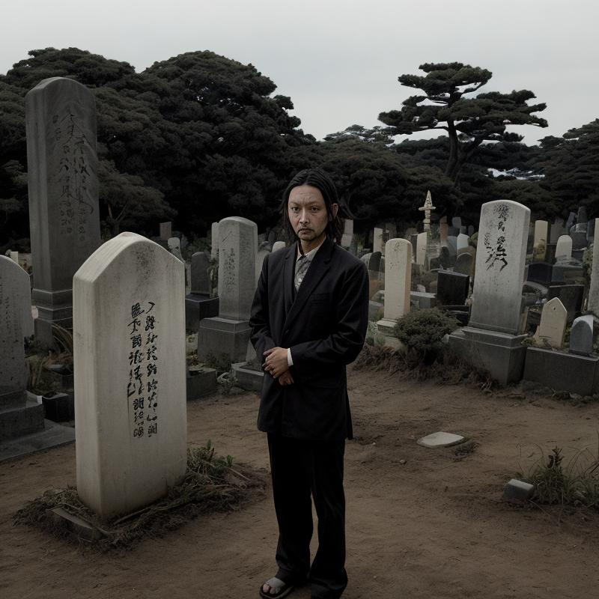
Tanjiro Kamado's Journey Begins
• Tanjiro Kamado is the main protagonist of Demon Slayer
• He becomes a demon slayer after his family is slaughtered by demons
• He vows to avenge his family and cure his sister Nezuko of her demonic transformation

Slide 3
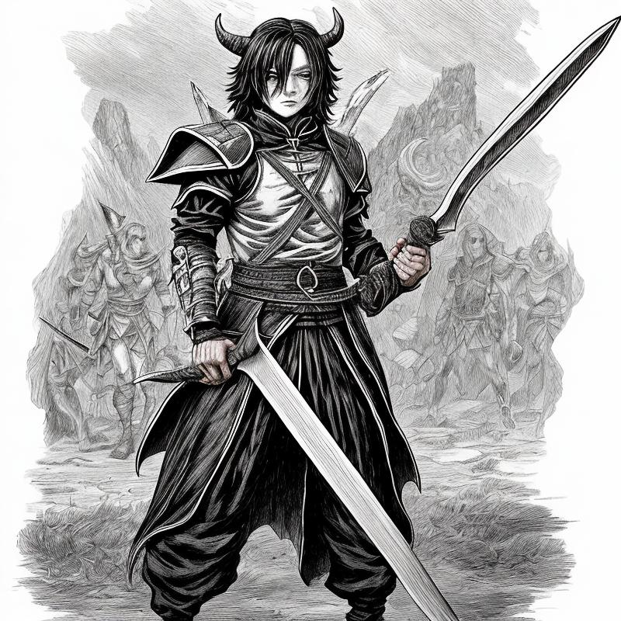
The Power of the Demon Slayers
• The Demon Slayers are a group of powerful warriors tasked with protecting humans from demons.
• They are trained by the Demon Slayer Corps, a secret organization dedicated to eradicating demons from the world.
• The Demon Slayers possess unique abilities and techniques, such as breathing styles and demon-slaying marks, which allow them to fight against demons.

Slide 4
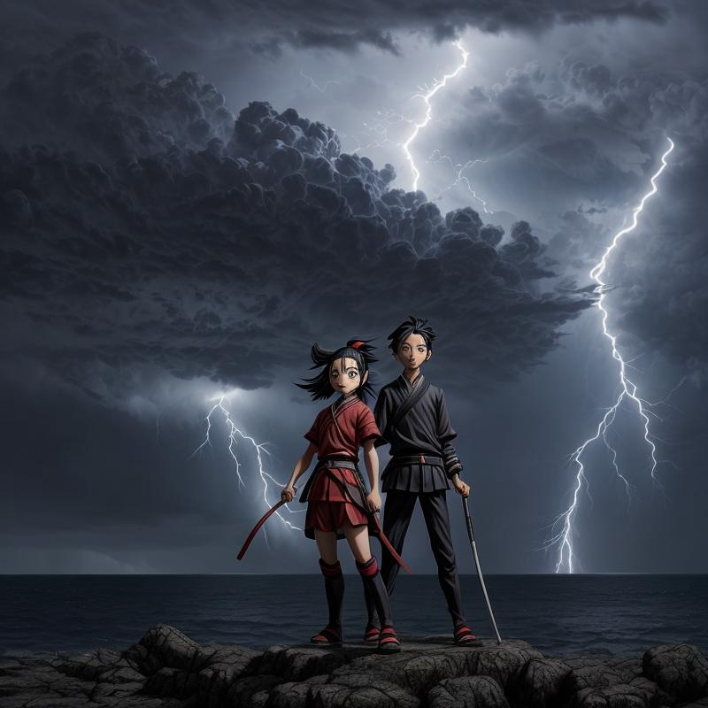
Tanjiro's Journey
• Tanjiro Kamado is the main protagonist of the Demon Slayer series, a kind and compassionate boy who becomes a demon slayer to protect his sister.
• Tanjiro's journey is marked by his determination to find a cure for his sister Nezuko, who has been turned into a demon.
• Throughout his journey, Tanjiro faces many challenges and battles against powerful demons, but he never loses sight of his goal to protect his sister and find a cure.

Slide 5
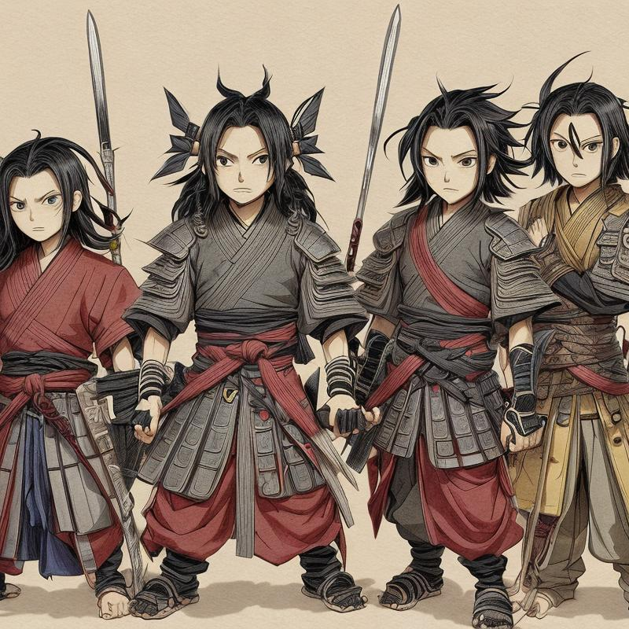
Demon Slayer: Conclusion
• Demon Slayer is a popular Japanese manga and anime series that has gained a large following worldwide.
• The series follows Tanjiro Kamado, a young boy who becomes a demon slayer after his family is slaughtered by demons.
• The series explores themes of friendship, sacrifice, and the struggle between good and evil.

