Slide 1
Ansible Introduction
    Presented By
    - Sandeep Yerramsetti

Slide 2
Agenda
1. Ansible Introduction
2. Why Ansible?
3. Ansible Architecture / How Ansible Works?
4. Ansible Components/Concepts
5. Ansible – Playbooks
6. Ansible – Role
7. Demo

Slide 3

Introduction - What is Ansible?
“ Simple, agent-less and powerful open source IT automation Tool ”
Provisioning
Configuration Management
Application Deployment
Continuous Delivery
Security & Compliance
Orchestration
Products:
Ansible CLI
Ansible Tower

Slide 4
Why Ansible?
It is very simple and powerful
Agent-less – No need for agent installation and management
Secure – SSH based connection
Python / yaml based
Highly flexible and configuration management of systems.
Large number of ready to use modules available for system management
Custom modules can be added if needed
Human readable & Self documenting

Slide 5
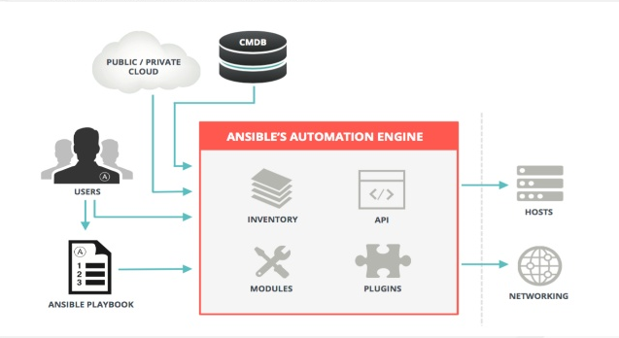
How Ansible Works?
Ansible works by connecting to your nodes and pushing out small programs, called “Ansible Modules” to them. Ansible then executes these modules (over SSH by default) and removes then when finished.

Slide 6
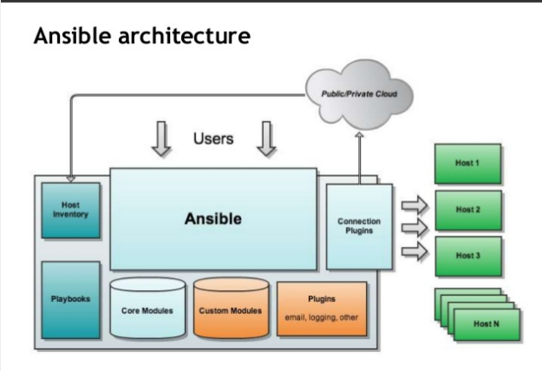
Ansible Architecture

Slide 7
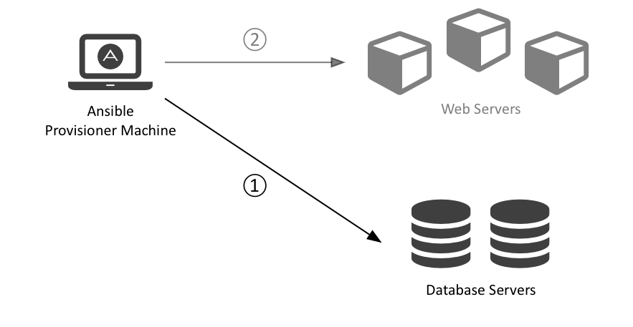
Ansible is an Orchestration Engine. So What?
Notes:
Manage complex multi-tier deployments in a controlled fashion:
Deploy the database before deploying web servers and enabling new web server code
Configure the database with the web servers IP addresses so they can connect to it
Add the web servers to a load balancing pool
Add the servers to a pool of monitored hosts

Slide 8
Installation of Ansible
Install packages below on the Server Machine
sudo yum install pip
Sudo yum install ansible
Install packages below on the client Machines
sudo yum install python

Slide 9
Create the RSA Key Pair
The first step is to create the key pair on the Server machine
ssh-keygen –t rsa
Once you have entered the Gen Key command, you will get a few more questions:
Enter file in which to save the key (/home/test/.ssh/id_rsa):
Enter no password for the next prompt
Copy the Public Key
ssh-copy-id test@192.168.85.135
Repeat the same process for other machines you wish to login automatically with.
Ensure the test username has sudo access to the remote clients

Slide 10
Configuration of ansible
Do the following on the Server machine
Create the list of client machines you wish to access via this server
vi /etc/ansible/hosts ( And enter the following lines and save file)
[Servers]
192.168.85.135
192.168.85.136
Run the ping command below to see if indeed you are reaching both client nodes
ansible -m ping all

Slide 11
Ansible Components/Concepts
Inventory
File where you declare the list of hosts and groups
Modules
Ansible ships with a number of modules (called the 'module library') that can be executed directly on remote hosts or through Playbooks. Users can also write their own modules
Playbooks – Play, Tasks and Modules
A playbook is a yaml file where you run series of tasks on the hosts
Variables
Ansible provides a mechanism for overriding variables.
Templates
Templates are a powerful resource for generating files on the hosts. A template will have a common structure and it will be populated with specify variable values at runtime.
Roles
Roles are ways of automatically loading certain vars_files, tasks, templates, and handlers based on a known file structure. Grouping content by roles also allows easy sharing of roles with other users.

Slide 12
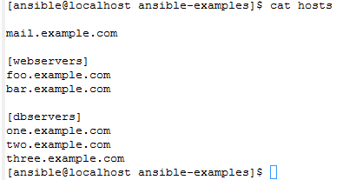
Inventory / Host file
Group
Hosts/Nodes

Slide 13
Tasks: Modules
Almost 600 modules
Cloud: Amazon (EC2, S3), Azure, Docker, OpenStack, VMWare
Commands: command, expect, raw, script, shell
Database: MySQL, PostgreSQL, MongoDB
Files: copy, find, lineinfile, patch, unarchive, xattr
Monitoring: BigPanda, Nagios, Monit, Zabbix
Notification: Campfire, IRC, Jabber, Mail, Slack, osx_say
Systems: firewalld, GlusterFS, IPTables, Puppet, ZFS
Windows: IIS, MSI, regedit, Robocopy

Slide 14
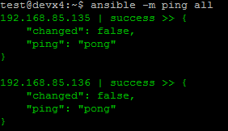
Examples of ansible commands
The output show ping result success as shown below

Slide 15
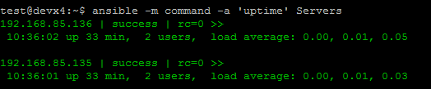
Examples of ansible commands (Cnt)
How to run commands to fetch hard drives utilization
ansible -m command -a 'df -h' Servers
How to run commands to fetch system uptime
ansible -m command -a ‘uptime' Servers

Slide 16
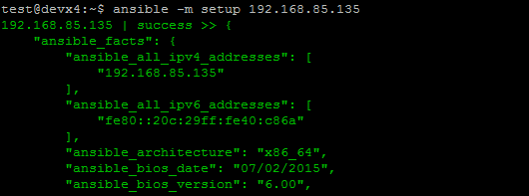
Examples of ansible commands ( Cnt)
The full configuration environment inventory of a particular client machine can be obtain using the command below.
ansible -m setup 192.168.85.135 ( output as shown below)

Slide 17
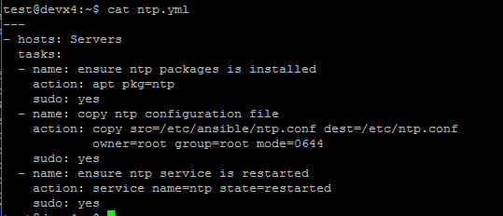
Creating an ansible-playbook template
Create a template to enable the installation of an NTP service with content as shown below and file saved as ntp.yml

Slide 18
Ansible Concepts: Playbooks

Slide 19
Understanding ansible playbook configurations
In order to use ansible with SSH passwords you will need to install the program below
sudo apt-get install sshpass
Ansible-playbook command can be executed to run the ntp.yml file as below
ansible-playbook -k -K ntp.yml
The –k –K switches allow you to be able to use your ssh key and passwordless sudo.
Every playbook configuration begins with triple dash ( ----)
The hosts, tasks, name, action are various instructions commands to help automate your ntp installation process.

Slide 20
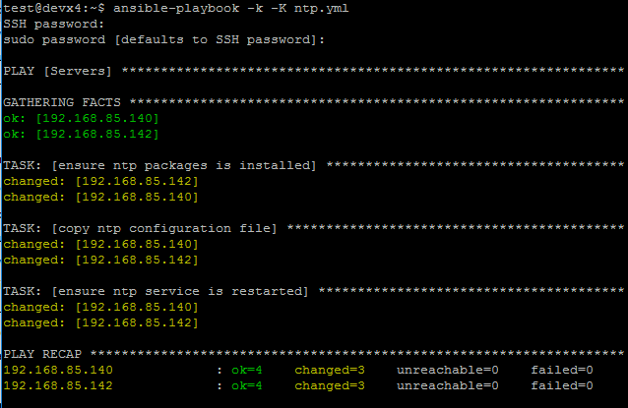
Understanding ansible playbook configurations (cnt)
The output of the ansible-playbook command as below

Slide 21
Ansible Playbooks
$> ansible-playbook [–i <inventory>] <playbook.yml>
What is a Playbook?
Describes policies your managed machines shall enforce
Consist of vars, tasks, handlers, files, templates and roles
Expressed in the YAML format (dictionaries, lists and scalars)

Slide 22
Example: Ansible Playbook
--- # file: webservers.yml - hosts: webservers handlers: - name: reload apache2 service: name=apache2 state=reloaded tasks: - name: Install Apache HTTP Server apt: name=apache2 update_cache=yes - name: Install Apache Modules apache2_module: name={{ item }} state=present with_items: - proxy - proxy_httpd notify: reload apache2 remote_user: deploy sudo: yes
Play
Module
Arguments
Variable
Notify Handler

Slide 23
Example: Ansible Playbook
--- # file: playbook.yml include: balancers.yml include: webservers.yml include: dbservers.yml include: monitoring.yml

Slide 24
Example: Ansible Playbook
$> ansible-playbook –i production webservers.yml PLAY [webservers] ******************************************************* TASK: [Install Apache HTTP Server] ******************************************************* changed: [www0.example.com] changed: [www1.example.com] ... PLAY RECAP ******************************************************* web0.example.com: ok=3 changed=3 unreachable=0 failed=0 web1.example.com: ok=3 changed=3 unreachable=0 failed=0 ...

Slide 25
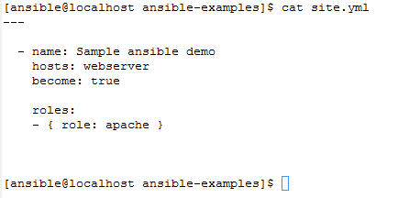
Playbook Structure
Play
Role

Slide 26
Ansible Concepts: Roles

Slide 27
Ansible Roles
Are the best way to organize a playbook!
Structure content into related vars, tasks, files, handlers, etc.
File structure for automated inclusion of role-specific content
Roles can be shared and pulled from Ansible Galaxy, GitHub, etc.

Slide 28
Role Structure
ROLE
defaults
tasks
files
templates
handlers
vars
meta

Slide 29
Ansible Roles: File Structure
ansible.cfg
production
staging
webservers.yml
roles/
common/
defaults/
files/
handlers/
meta/
tasks/
templates/
vars/
apache2/
...

Slide 30
Example: Ansible Playbook
--- # file: webservers.yml - hosts: webservers roles: - { role: common } - { role: apache2 } remote_user: deploy sudo: yes

Slide 31
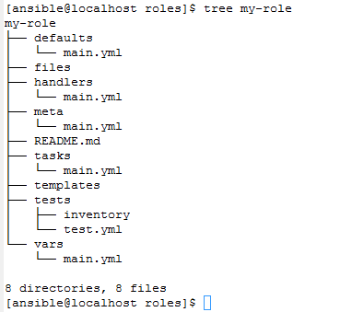
Roles Directory Structure

Slide 32
Ansible for the Cloud

Slide 33
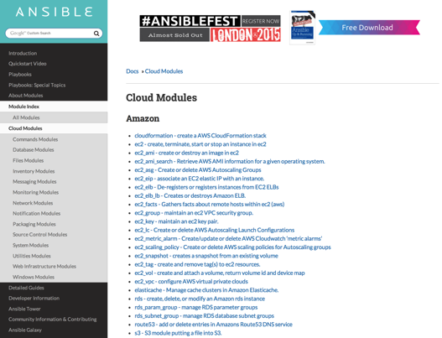
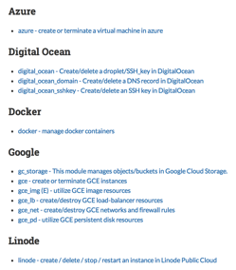
Ansible Cloud Modules
Notes:
Ansible Cloud Modules for Amazon include modules to manage: instances in the EC2, AMIs, Auto Scaling Groups (ASGs), Elastic Ips (EIPs), Elastic Load Balancers (ELBs), Key Pairs, Security Groups, Elastic Block Storage (EBS) Volumes, Route53, RDS, etc.

Slide 34
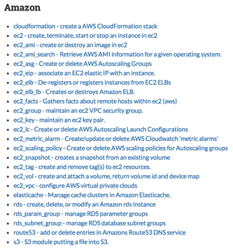
Ansible Cloud Modules
Notes:
Ansible Cloud Modules for Amazon include modules to manage: instances in the EC2, AMIs, Auto Scaling Groups (ASGs), Elastic Ips (EIPs), Elastic Load Balancers (ELBs), Key Pairs, Security Groups, Elastic Block Storage (EBS) Volumes, Route53, RDS, etc.

Slide 35
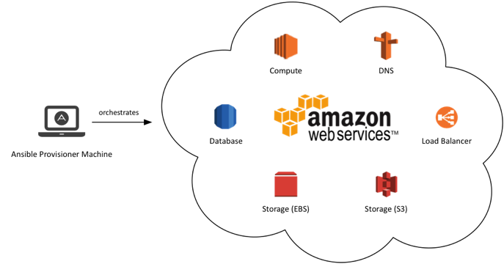
Ansible Cloud Modules for Amazon

Slide 36
Ansible Documentations
You can find more explanation in the Ansible Docs.
  Ad-hoc commands
  Inventories
  Variables
  Modules
  Playbook Roles

Slide 37
Demo…

Slide 38
Thank you…

Slide 39
Questions?

