Slide 1

CareerOps
An AI-Powered Career Operating System
Resume Analysis · Resume Tailoring · Application Tracking · Analytics
Built with Streamlit, Python, PostgreSQL, LangChain & Multi-Provider AI

Slide 2

The Job Search Pain Point
Why resume tailoring is broken
The Core Problem
Candidates apply to many roles, each with different requirements & keywords
Resume tailoring is repetitive and time-consuming
Users paste resumes & job descriptions into multiple AI tools repeatedly
Outputs are inconsistent — each AI session lacks shared context
No single place to track resume versions, match scores, and application progress
Job seekers spend hours rewriting the same resume for every application — with no memory, no tracking, and no consistency across AI tools.

Slide 3

One Platform, Multiple AI Models, Multiple Agents
The CareerOps Vision
Multi-Model Platform
Structured AI Agents
Hold multiple AI providers under one roof — Gemini, OpenAI, Grok, Qwen, and Ollama.
Agents with clear roles and instructions, like a professional resume writing team.
Master Profile
Job-Specific Versions
One source of truth for the candidate profile — no more copy-paste per application.
Generate tailored resume versions from the master profile for each opportunity.

Slide 4

What CareerOps Aims To Deliver
Project Objectives
Create and manage complete candidate profiles
Analyze job descriptions against candidate profile
Identify matching and missing keywords
Generate tailored resume versions using AI
Export resumes as PDF or DOCX
Track applications through a Kanban pipeline
Show analytics on application progress
Resume performance trends & insights

Slide 5

High-Level Architecture
Main System Layers
Frontend / UI
Streamlit pages & reusable components
Application Logic
Python modules for workflow orchestration
AI Intelligence
LangChain agents & LLM provider wrappers
Database Layer
PostgreSQL with normalized schema & CRUD helpers
Export Layer
PDF and DOCX generation utilities

Slide 6

Why Streamlit Was Chosen
Initial Framework Decision
Fast Development
Easy Integration
Build a working frontend with pure Python — no HTML/CSS/JS needed.
Seamlessly connect forms, charts, data, and backend logic.
Rapid Prototyping
Team Focus
Ideal for Initial Prototype development timelines.
Allowed the team to concentrate on AI workflow and database design.

Slide 7

Streamlit Limitations We Learned
Key Development Challenges
Dynamic feature loading becomes harder as the app grows
Session state management can become complex at scale
Modular frontend development is limited compared to React
Highly interactive UI behavior is harder to control
Complex production apps may benefit from React + JavaScript

Slide 8
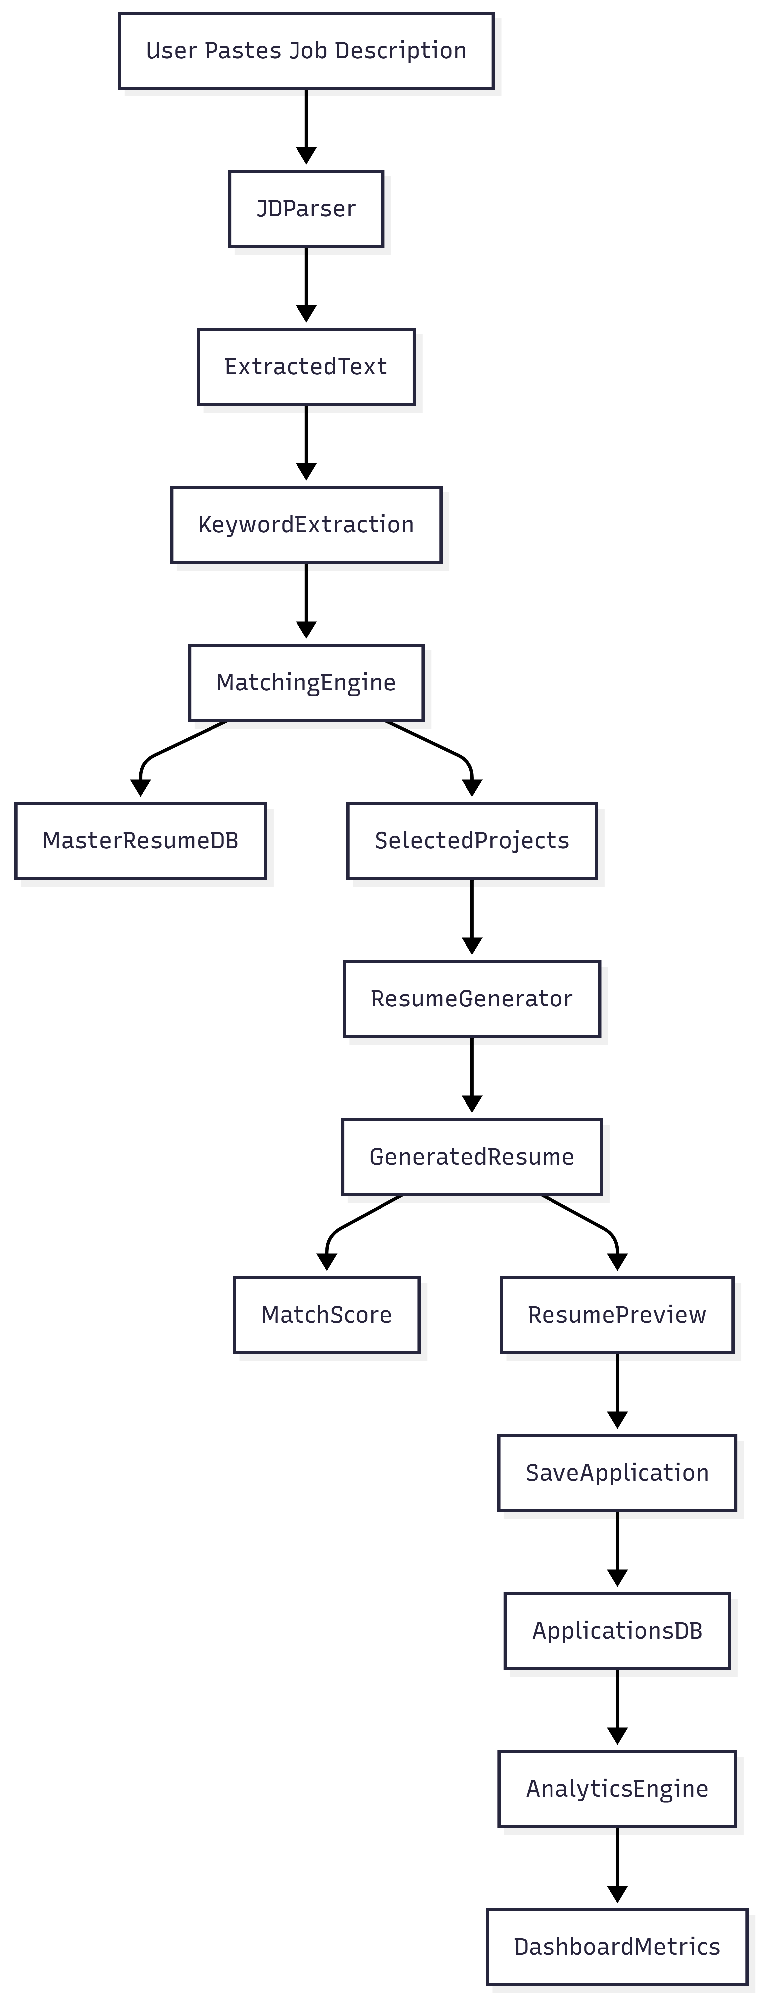

Core User Workflow
From Profile To Application Tracking
1
Create or select a master candidate profile
2
Paste or fetch a job description
3
Select an AI model provider
4
Run match analysis and agent-based review
5
Generate a tailored resume version
6
Export the resume as PDF or DOCX
7
Save the job into the application tracker

Slide 9

AI Agent Workflow
Resume Writing Team Concept
Extractor
Researcher
Matcher
Writer
Re-matcher
Finds company name & job title from the JD
Searches & summarizes company/role insights
Compares the resume against the job description
Rewrites resume preserving factual accuracy
Re-analyzes upgraded resume & shows improvement

Slide 10

Multi-Model AI Strategy
Supported Model Providers
Gemini
Qwen
Google's multimodal model — strong reasoning & current knowledge
Alibaba's open-source model — accessible & capable for free tier
OpenAI
Ollama
Industry-leading GPT models with robust API reliability
Local model runner — offline, private, and cost-free
Grok
xAI model with real-time web access for up-to-date context

Slide 11

Token Usage & Cost Learning
What We Learned From Model Usage
Long Inputs
Multi-Agent Cost
Free Tiers
Long resumes & JDs spike token use quickly
Each agent call consumes tokens — design carefully
Good for experimentation; less reliable for production
Paid Models
Cost Control
Better reliability, stronger reasoning
Text-focused models reduce context generation cost

Slide 12

Database Architecture
Why PostgreSQL Was A Good Choice
Strong relational database with reliable structure
Prior hands-on experience helped in schema design
Candidate profile data is normalized across multiple tables
Applications and activity logs stored for tracking & analytics
PostgreSQL provides a strong base for future AI memory & RAG workflows
Why Relational?
Structured data — candidates, skills, experience, projects, certs, applications — maps perfectly to relational tables. Joins, constraints, and ACID compliance make the system reliable.

Slide 13

Database Schema Highlights
Main Tables In The Repository
Table | Purpose
`candidate` | Master profile information
`technical_skills` | Categorized skills
`work_experience` | Professional experience & contributions
`education` | Education history
`projects` | Project portfolio
`certifications` | Certifications & credentials
`applications` | Job tracking, match score, resume version, status
`activity_log` | Timeline events & status changes

Slide 14

Application Tracking Features
Kanban & Dashboard
Saved
Applied
Interviewing
Offered
Rejected
Dashboard shows total applications, interviews, offers & conversion rate
Daily goal progress shown in the header
Activity timeline records important user actions
Analytics page visualizes trends & resume version performance

Slide 15
Resume Generation & Versioning
Current Resume Output Flow
1
Master Profile → Markdown
The candidate profile is converted to structured Markdown resume text
2
AI Writer Tailors
The writer agent creates a job-specific resume version
3
Version History
Previous versions are saved and selectable
4
Export to PDF/DOCX
Download in the preferred format
5
Smart File Naming
Files named: Company_Role_Version — e.g. Google_DataAnalyst_v1.pdf

Slide 16
Current Resume Formatting Limitation
Known Area For Improvement
PDF & DOCX Export
Export works, but alignment can still be improved for professional presentation
Markdown Conversion
Markdown-to-document conversion can produce formatting inconsistencies
Layout Control
Resume layout needs more professional spacing and structure
Template Engine
Future versions should use stronger resume templates
Rendering Engine
A dedicated rendering pipeline may produce cleaner final resumes

Slide 17

Tools & Packages Explored
Development & Functionality Choices
Streamlit
Pandas & Plotly
UI & routing
Analytics & charts
psycopg2
LangChain
PostgreSQL connection
Multi-agent orchestration
AI SDKs
BeautifulSoup
Google GenAI, OpenAI, Groq, Qwen
Job description fetching
markdown2 / fpdf2
python-docx
Markdown & PDF generation
DOCX export

Slide 18

Repository Structure
How The Codebase Is Organized
`app.py`
Main entry point and page routing
`pages/`
Dashboard, resume gen, applications, analytics, profile, settings
`components/`
Reusable UI: header, Kanban, charts, timeline
`data/`
PostgreSQL schema (schema.sql) and query utilities (db_utils.py)
`intelligence/`
AI matching, LLM providers, and LangChain agents
`scripts/`
Database initialization scripts

Slide 19

Future Architecture Direction
Next Technical Improvements
1
Move complex frontend workflows toward React + JavaScript
2
Keep Python backend services for AI and database operations
3
Improve document rendering with professional resume templates
4
Add long-term AI chat history and resume memory
5
Use RAG architecture for better context retrieval & token efficiency
6
Improve authentication, deployment, and production security

Slide 20

RAG Architecture Plan
Why RAG Is Important For Future Development
Store History
Long-Term Memory
Save resume versions, job descriptions & AI feedback as retrievable knowledge
Preserve career history, application patterns, and outcomes over time
Retrieve Context
Smarter AI
Fetch only relevant context — no need to send full history every time
Enable increasingly intelligent recommendations as the dataset grows
Reduce Tokens
Smaller prompts = lower cost and better model efficiency

Slide 21

Key Learning Outcomes
Technical & Product Learnings
Clear agent instructions strongly influence model output quality
Multi-model support improves flexibility but increases integration complexity
PostgreSQL is a strong foundation for structured application data
Streamlit is excellent for fast development but limited for complex frontend behavior
Resume generation needs both good AI output and good document formatting
AI product development requires careful token, cost, and context management

Slide 22
CareerOps — Summary
Solves repetitive resume tailoring with a structured AI workflow
Multi-agent design turns AI into a resume writing & review team
PostgreSQL provides a reliable and scalable data foundation
Streamlit enabled rapid development and valuable learning
Future: React-based, RAG-powered, production-ready career platform
Thank You

