Slide 1
France Top 50
Audience Sensitivity, Content Compliance & Format Preference
Project for Atlantic Recording Corporation
Karthik | 27,750 daily chart slots, May 2024 to Nov 2025
Notes:
Hi, I'm Karthik. This is my project for Atlantic Recording Corporation: an audience sensitivity, content compliance and format preference analysis of the France Top 50 playlist.

Slide 2
Four questions about content and chart success
1
Explicit vs clean
2
Singles vs albums
How does explicit content perform relative to clean tracks?
Do French charts prefer singles or album tracks?
3
Song duration
4
Album size
How does song length align with listener acceptance?
Do bigger albums dilute or strengthen individual tracks?
2
Notes:
The goal is to understand how explicit content, release format, album size and song duration relate to chart performance in France. These four questions drive the whole project.

Slide 3
Data and cleaning: 27,800 rows to 27,750 reliable slots
555
725
50
3.09
daily snapshots (4 days missing)
unique tracks
entries per day, after validation
average minutes per song
Check | Finding | Action
Entries per day | 1 Mar 2025 had 100 rows (duplicate snapshot) | Kept first copy per date and position
Duration | Stored in milliseconds; one zero value | Converted to minutes; zero excluded
Album type labels | album / single / compilation | Standardised; compilations grouped with albums
Explicit flag | 5 tracks changed flag across days | Majority flag applied
Popularity | 73 rows scored 0 | Treated as not reported; excluded
3
Notes:
I checked that each day has 50 entries and found that 1 March 2025 was duplicated, so I removed the extra copy. Four calendar days are missing. I converted duration to minutes, standardised album type labels, and excluded 73 rows where popularity was 0. I also fixed 5 tracks whose explicit flag changed over time.

Slide 4
Six KPIs summarise the French market
56.3%
0.78
0.89
Explicit content share
Clean content dominance ratio (clean per explicit)
Single vs album-track ratio
3.09 min
91
102 / 97
Average song duration
Album size impact index (100 = neutral)
Content acceptance score: explicit / clean
Acceptance score: rank-weighted share divided by plain share, x100. Above 100 means over-represented near the top.
4
Notes:
These are the six KPIs from the dashboard's Compliance summary tab. Explicit share is 56.3 percent, the clean-to-explicit ratio is 0.78, and the single-to-album-track ratio is 0.89. Average duration is 3.09 minutes, and the album size impact index is 91.

Slide 5
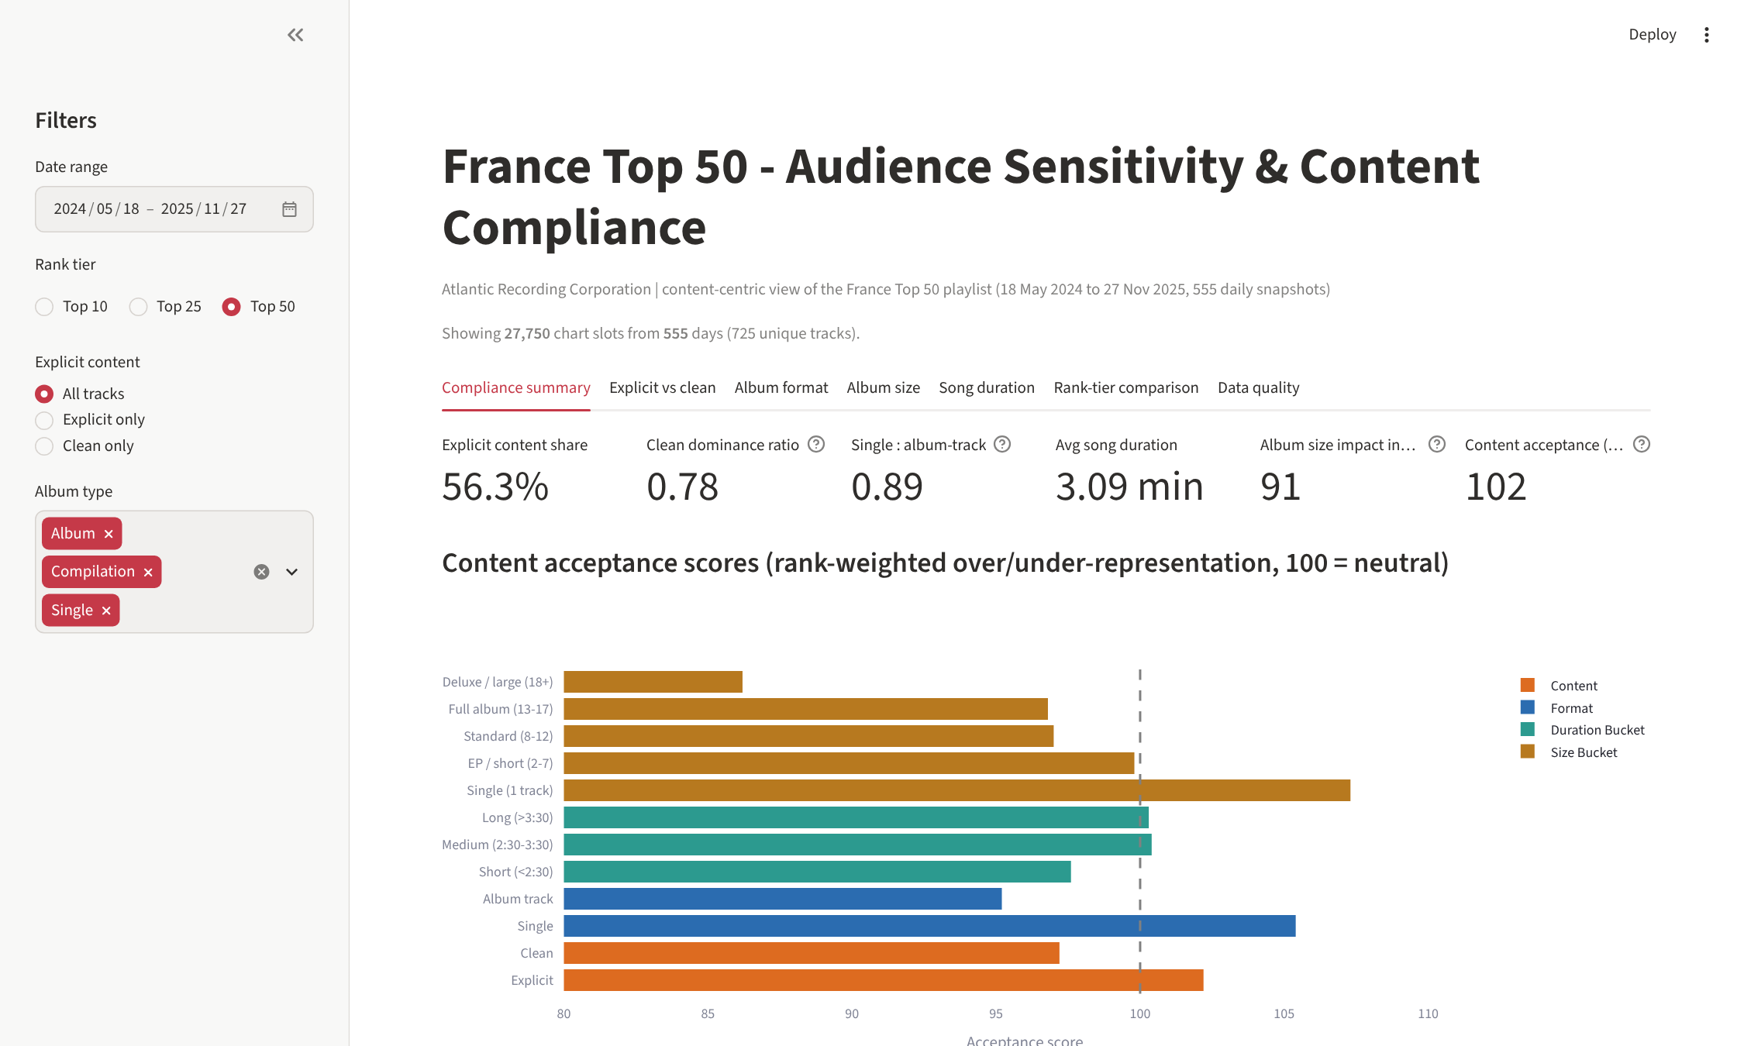
The live dashboard: four filters, five analysis modules
Date range selector
Rank tier: Top 10 / 25 / 50
Explicit toggle: all, explicit only, clean only
Album type filter
Tabs for every analysis, plus a data-quality log and CSV download
Built with Python, pandas, Plotly and Streamlit
5
Notes:
I can filter by date range, rank tier, explicit content and album type. The tabs cover compliance summary, explicit versus clean, album format, album size, song duration, rank-tier comparison and data quality. Toggle one filter live here so the viewer sees it work.

Slide 6
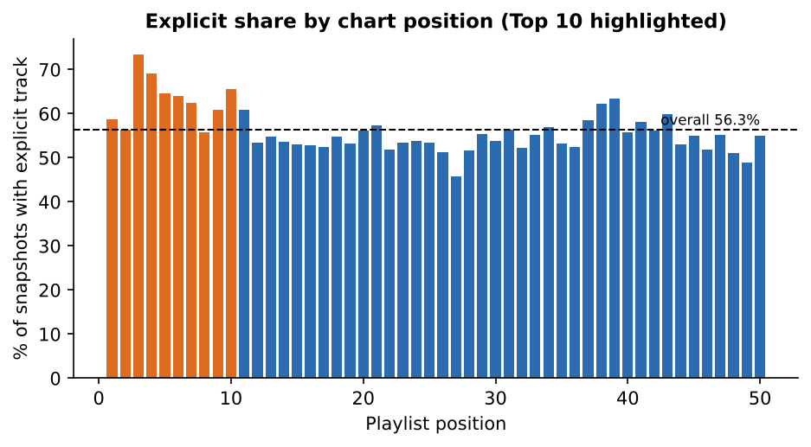
Explicit content is mainstream and strongest at the top
56.3%
of all chart slots are explicit
63.0%
of the Top 10 are explicit
Chi-square test: Top 10 vs the rest, p < 0.001
6
Notes:
Explicit tracks rise to 63 percent of the Top 10, so there is no sign of listeners avoiding them.

Slide 7
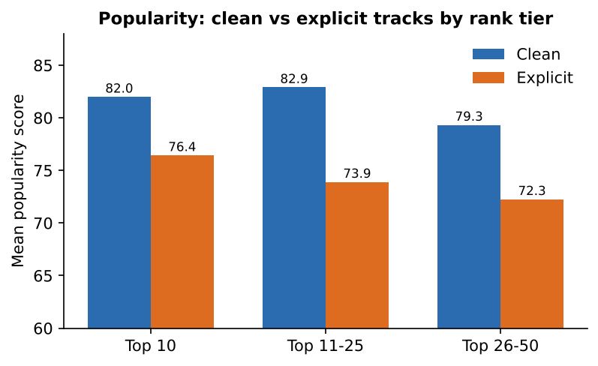
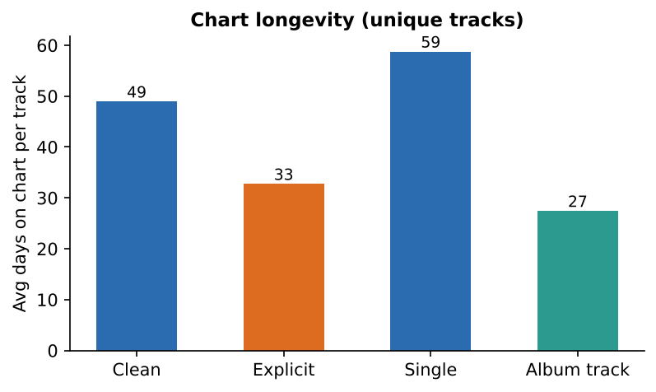
But clean tracks are more popular and last longer
Popularity: clean 80.9 vs explicit 73.7. Days on chart per track: clean 49 vs explicit 33.
7
Notes:
Clean tracks have higher popularity, 81 versus 74, in every rank tier. Clean tracks also stay on the chart longer, about 49 days against 33. Explicit tracks turn over faster.

Slide 8
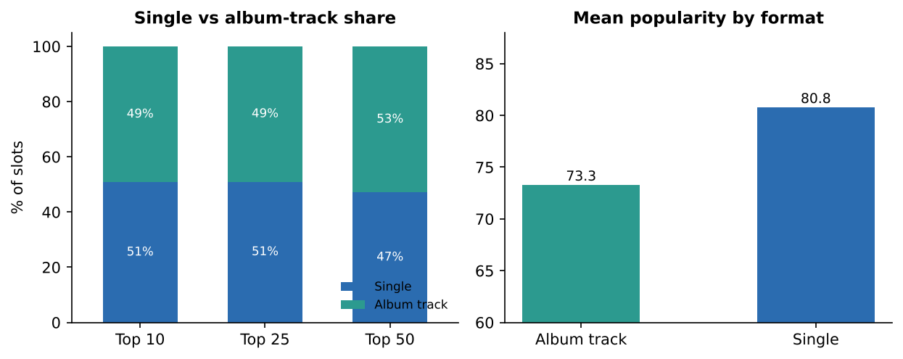
Singles beat album tracks per track
Singles: 47% of slots, 51% of the Top 10
Singles are more popular: 80.8 vs 73.3
Singles stay about 59 days on chart vs 27 for album tracks
Album releases create many short-lived entries
8
Notes:
Album tracks take slightly more slots overall, but singles lead the Top 10, score higher and last more than twice as long.

Slide 9
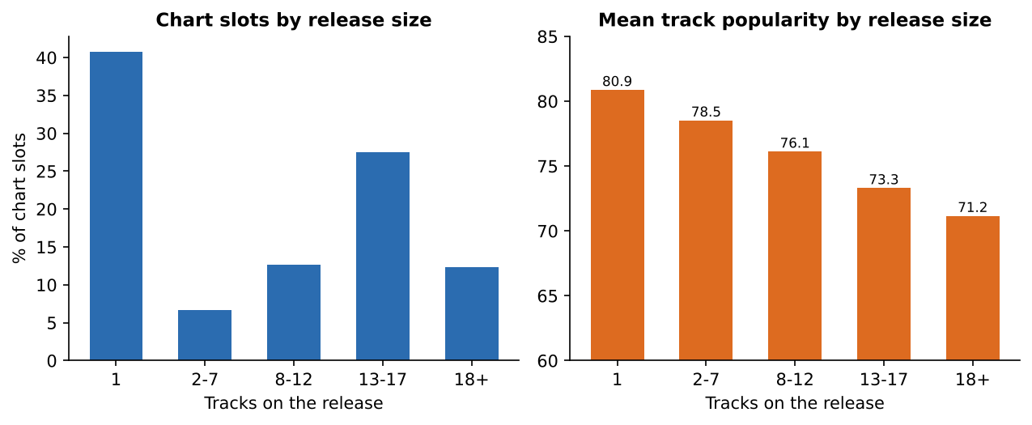
Bigger releases dilute individual tracks
91
Album size impact index
Single: 80.9
13-17 tracks: 73.3
18+ tracks: 71.2
Association, not proof of cause
9
Notes:
Popularity falls as releases get bigger, from 81 for singles to 71 for 18-plus track releases. That suggests larger releases dilute individual tracks.

Slide 10
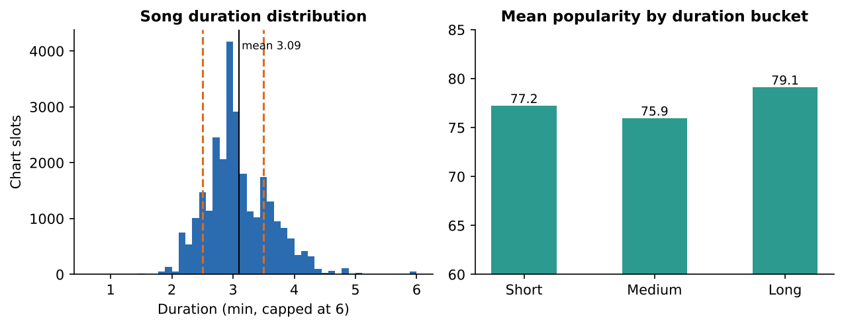
Duration is neutral: three minutes is the norm
3.09 min
average chart track
13% short, 64% medium, 24% long
Correlation with rank: 0.008 (none)
No need to edit length for France
10
Notes:
Most songs are around three minutes, and duration has no effect on rank.

Slide 11
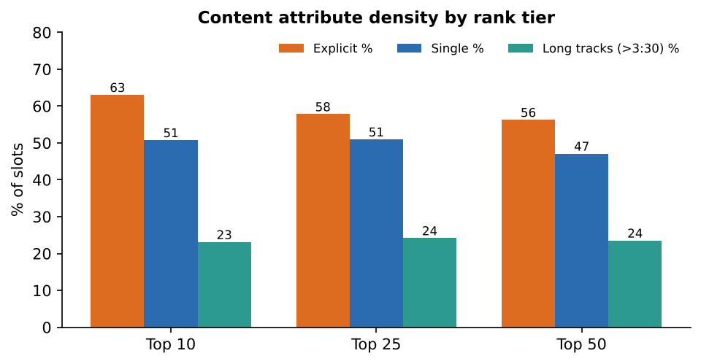
Top 10 vs Top 50: only explicit share really differs
Top 10 content profiles
Explicit | album track | medium | 29.0%
Clean | single | medium | 21.3%
Explicit | single | long | 12.0%
Explicit | single | medium | 9.0%
Share of Top 10 slots
11
Notes:
This compares Top 10, 25 and 50. Only explicit share differs noticeably between tiers; the duration mix is almost identical.

Slide 12
Recommendations for Atlantic
Single-led releases
Manage explicit risk
Lead with one or two focus singles; promote focus tracks, not whole albums.
Keep explicit content where it fits; prepare clean edits for radio and seasonal windows, and test them.
Compact albums
Monitor monthly
Keep standard albums at 8 to 17 tracks; treat 18+ track deluxe editions as catalogue extensions.
Track explicit share, format mix and acceptance score with the dashboard. No duration edit is needed.
12
Notes:
The main finding is that France doesn't avoid explicit content, since it leads the Top 10. But focus is rewarded: singles last longer, big albums dilute tracks, and clean content is steadier. For Atlantic, I recommend single-led releases, albums of 8 to 17 tracks, clean edits for radio and seasonal windows, and monitoring these KPIs monthly.

Slide 13
France rewards focus, not just clean content
Explicit content leads the Top 10. Singles last longer, big albums dilute tracks, and duration doesn't matter.
Built with Python, pandas, Plotly and Streamlit. Code on GitHub. Thank you.
Notes:
I used Python with pandas for the analysis, Plotly and Streamlit for the dashboard, deployed on Streamlit Cloud with the code on GitHub. Thank you.

