Slide 1
Real-time sport event detection on Twitter
Li Gu
Karthik
Shiting Wu

Slide 2

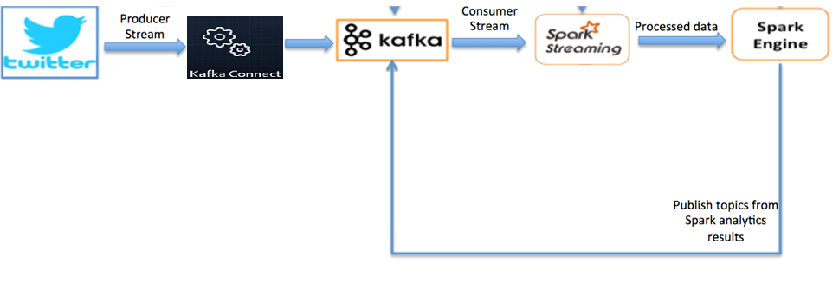
overview
Hadoop
HDFS
Flume

Slide 3
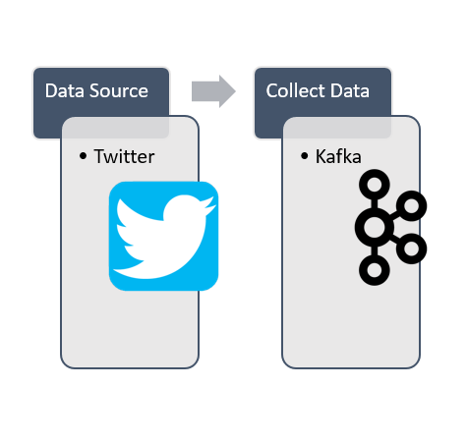
Kafka
Why Kafka
Prevent data loss
A unified, high-throughput, low- latency platform for handling real-time data

Slide 4
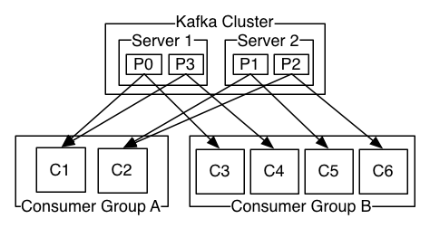
Kafka
Data will be assigned to the message topic
Both the partitions and data inside the partition will be organized chronologically

Slide 5
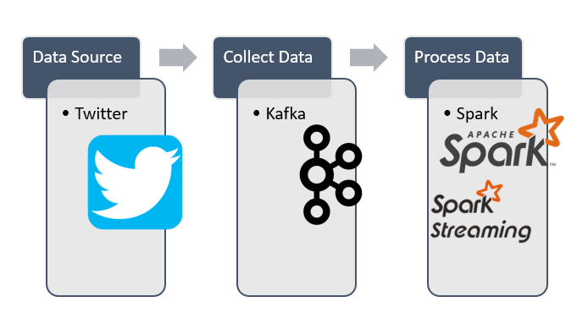
Spark

Slide 6
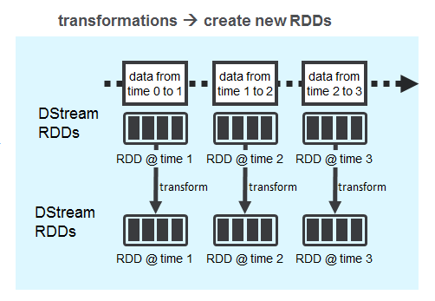
Spark Streaming
Why Spark
Provides scalable, high-throughput and fault-tolerant stream processing for real-time data streams
Able to apply complex algorithm with the data

Slide 7
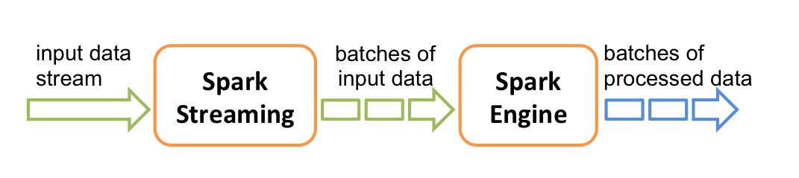
Spark

Slide 8



Part II : To tell which event is interesting and trending
In our specific case of Chicago sports events detection, we define the interestingness as the number of people discussing the event, which is the volume of the messages

Slide 9
Discovery
Detect specific events using features of tweets content (e.g., hashtag, term statistics, time references, a bag of keyword triggers of related sports and teams)
Group similar content via clustering into initial clusters
Organization
Associate real-time Tweeter streams with discovered clusters of events
Extract discriminating features of clusters
Build an event classifier

Slide 10
Hadoop
HDFS
Flume

Slide 11
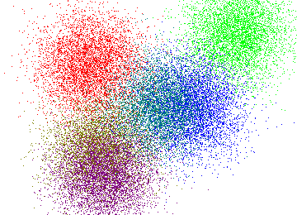
+ K-means Clustering
Input: tweets of the recent weekend uploaded to HDFS: hashtag, term, time reference, a bag of keyword triggers of related sports and teams
Output: clusters consist of sport event-based clustering of messages
K-means clustering which is guided by the term popularity(TF) which is based on a weighted combination of term similarity measures, including complete string matching, and adjacency and equality indicators scaled by the inverse document frequency(IDF)
Stop word elimination
Stemming
Enhanced weight for hashtags
Separate tweets by location and focus on Chicago

Slide 12

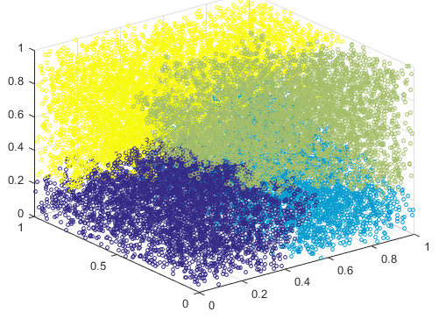
+ Single–Pass incremental Clustering
Input: Existing clusters from Mahout and real-time RDDs from the spark streaming
Output: Event clusters consist of discriminating features of clusters
Single-pass incremental clustering does not require a priori knowledge of K
This clustering method has been shown to be an effective technique for event detection in textual documents based on the element’s similarity to any existing clusters
It groups the element similar to any existing cluster using the centroid similarity approach by aggregating and average the TF.IDF

Slide 13








Tweets
Tweet Clusters
Event Clusters
Classified Tweets

Slide 14
Cluster Classification
Extract Discriminating Features from Clusters
Social Interaction Features
Topic Coherence
Trending Behavior
Increase in Volume over time-window
Build an Event Classifier
SVM for RW-event from Weka Toolkit(Witten & Frank).
Logistic Regression
O/P: At the end of each hour, we select 20 fastest growing clusters per hourly volume and publish it to Kafka topics

Slide 15

Broadcast Events to Users.
Topic-1
Topic-2
Topic-3
Mobile Push Notification
Email
New Topic
SMS
Kafka
New Topic
Amazon
SNS

Slide 16
Why Amazon Simple Notification Service?
Reliable
Simple
Secure
Scalable
Flexible
Inexpensive

Slide 17
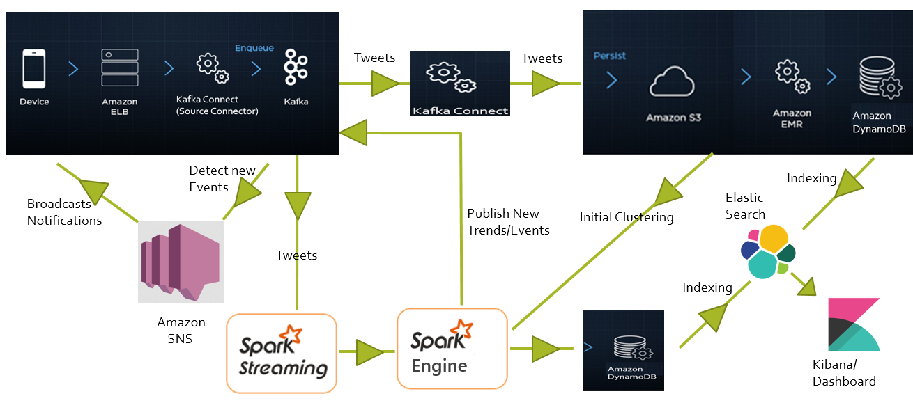
Scalable Data Pipeline
Amazon
DynamoDB

Slide 18
Thank You.

Slide 19
Extra

Slide 20
Advantage and Disadvantage
Advantages
Scalable
Reliable
Inexpensive
Disadvantages
Less Customizable
Depends on initial input of ‘K’

