Slide 1
CHAT BOT
KARTHIK H R
4JK20CS021
B.TECH AJIET MANGALURU, KARNATAKA

Slide 2
INDEX
Introduction
Overview
Need of Chatbot
How Does it Respond
Snapshots
Artifical Intelligence
Requirements
Project Proposal

Slide 3
INTRODUCTION
Chat Bot: A computer program that can talk to humans in natural language!
Uses Artificial Intelligence Markup Language (AIML) to represent knowledge.
Can replace a human for monotonous jobs of answering queries, e.g. E-help desk.

Slide 4
OVERVIEW
  A chatbot is a conversational agent that interacts with users using natural language.
  Numerous applications of chatbots such as Customer Service, call centers etc

Slide 5
NEED OF CHATBOT
Widespread use of personal machines
Better Human Computer Interaction
It is not possible to tackle a huge amount of peoples queries at a time by a human.

Slide 6
HOW DOES IT RESPOND
Looks for certain patterns of words in the user's input.
Replies with pre-determined output, if the pattern is matched.
Needs to have an idea of what the user will chat.

Slide 7
ARTIFICAL INTELLIGENCE
Artificial intelligence (AI), sometimes called machine intelligence, is intelligence demonstrated by machines. In the most basic form, AI is a program that can update itself.
Artificial intelligence was founded as an academic discipline in 1956, and in the years since has experienced several waves of optimism, followed by disappointment and the loss of funding (known as an AI Winter) , followed by new approaches.

Slide 8
TYPES OF AI
Reactive – Contains no memory hence cannot learn from experiences, does only what it is programmed for
Limited Memory – Has limited memory to store experiences and update. Deletes old experiences to add new ones
Theory of Mind – Work of fiction. Can understand emotions and thoughts that affect human behaviour
Self Aware – Work of fiction. AI would be able to form thoughts about itself.

Slide 9
RAG (RETRIEVAL-AUGMENTED GENERATION)
Problem Statement: Users struggle to quickly extract accurate answers from large documents and knowledge bases
Proposed Solution: Build an AI-powered chatbot with RAG and live web search to deliver context-aware, real-time responses
Expected Impact: Improve information accessibility, reduce manual effort, and enable 24/7 intelligent support.

Slide 10
REQUIREMENTS
Hardware
Windows 10,11
Linux
Android
Software
Python 3.7
Pip
VS code

Slide 11
TOOLS & TECHNOLOGIES USED
Streamlit – For building an interactive and user-friendly chatbot interface
LangChain – To manage prompts, chains, and integrate LLM workflows
FAISS / Vector DB – For efficient document embedding storage and similarity search.
LLMs (OpenAI/Groq/Gemini) – To generate intelligent, context-aware responses.

Slide 12
HOW TO BUILD A BOT OF YOUR OWN
Components – An AIML Object Spec, AIML interpreter, and a responder!
A Chat Bot represents and models a character.
The brain is the AIML file, that defines patterns and corresponding replies
A bot can be trained to be an Expert System about a special theme – large data!

Slide 13
PROJECT PROPOSAL
Problem Statement: Users struggle to quickly extract accurate answers from large documents and knowledge bases.
Proposed Solution: Build an AI-powered chatbot with RAG and live web search to deliver context-aware, real-time responses.
Expected Impact: Improve information accessibility, reduce manual effort, and enable 24/7 intelligent support.

Slide 14
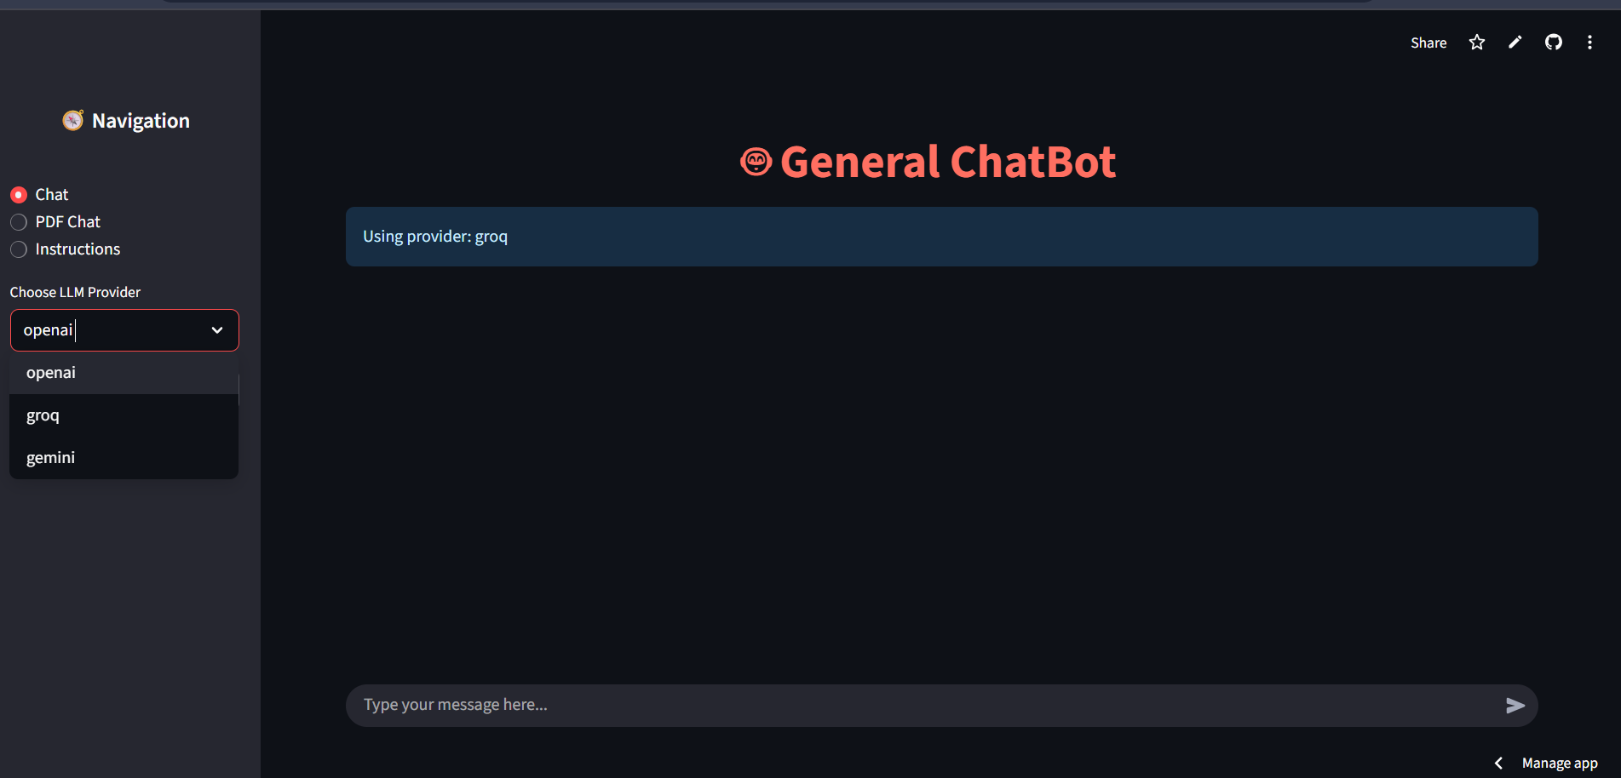
CONTINUE
Fig 1.1: User Interface Chat Bot

Slide 15
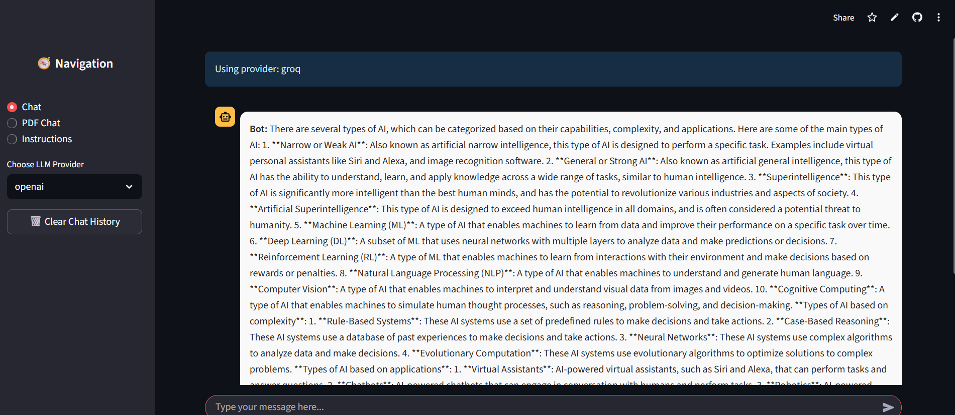
CONTINUE
Fig1.2: Chat bot response & answers

Slide 16
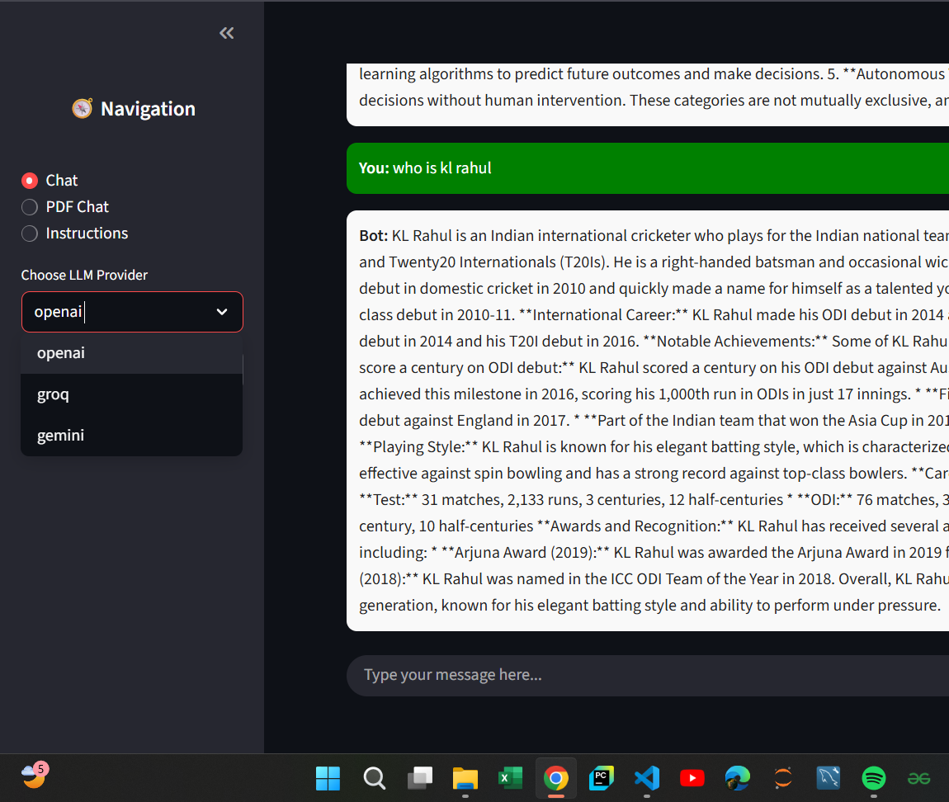
CONTINUE
Fig 1.3: We can select model

Slide 17
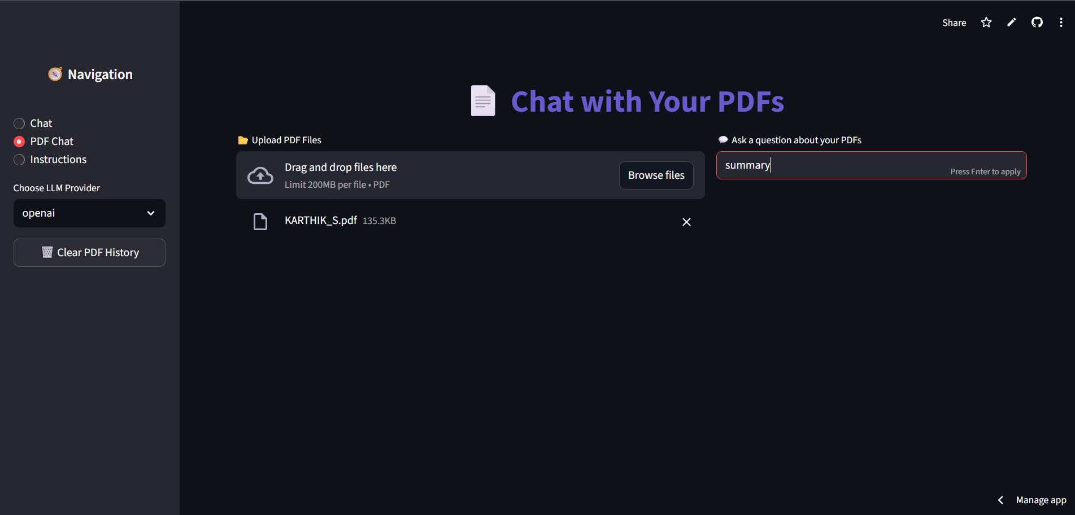
CONTINUE
Fig1.4 : Summarize pdf

Slide 18
CONCLUSION:
Intelligent Assistance: Provides accurate, real-time answers from documents and the web
Efficiency & Scalability: Reduces manual effort while handling multiple user queries simultaneously.
Future-Ready: Flexible design allows easy integration of new models, data sources, and features.

Slide 19
Thank You

