Slide 1




HWF - Hazardous Waste Tracking Management System
Karthi Kishore Jakkli Sounder
Masters Project - 3 credit hour

Slide 2
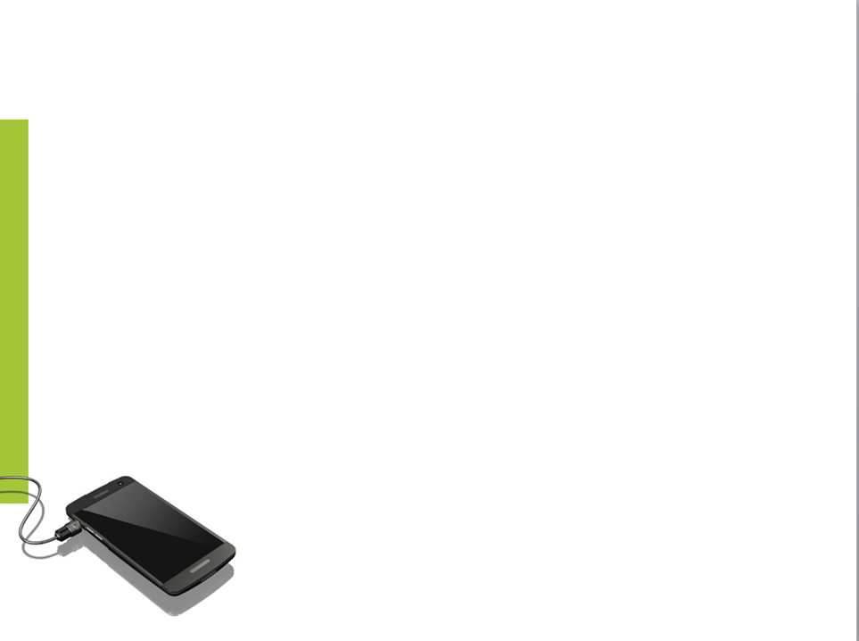
Introduction
Hazardous waste
a waste that is substantial or potential threats to public health or the environment
liquids, solids, contained gases or sludge
discarded commercial products
- by-products of manufacturing processes

Slide 3
Resource Conservation and Recovery Act
RCRA - October 21, 1976
Solid and hazardous waste program
EPA(Environmental Protection Agency)
- Create regulations to manage hazardous waste
EPA developed strict requirements for hazardous waste management
- Treatment, storage, and disposal
- State government regulations stringent than the federal

Slide 4
Hazardous Waste Classification
Listed wastes
- F-list, K-list, P-list and U-list
Characteristic wastes
- Ignitable, Corrosive, Reactive and Toxic
Solid waste
Universal waste
Mixed waste
- Radio Active

Slide 5
Hazardous Waste Management
Proper management and control to reduce the dangers of hazardous waste
Tracking a hazardous waste becomes necessary
Tracking starts right from the point where a waste is produced and ends at the site where it needs to be disposed
Eliminate the use of paper reports minimizing the time and man hours employed in the hazardous waste inspection process
Surface Impoundments
High temperature
Incineration
Hazardous
Landfills
Deep Well
Injection

Slide 6
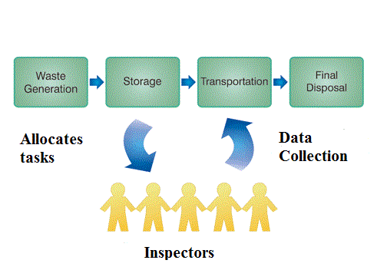
Scope
Hazardous waste finder - supports activities of an inspector, who carries the inspection process on the hazardous waste with the help of a mobile device and recommends action

Slide 7
Mobile Apps Growth
Smartphones and tablet computers will increase Mobile Web traffic by 26 times during the next four years - Cisco
Users spend 2 hours and 42 minutes per day on mobile devices as of March 2014 - Flurry
Mobile web usage has come down since last year - Flurry
80% of time on mobile is spent inside apps - SuperMonitoring
4.4 billion users estimated to use apps by 2017 - Portio Research

Slide 8
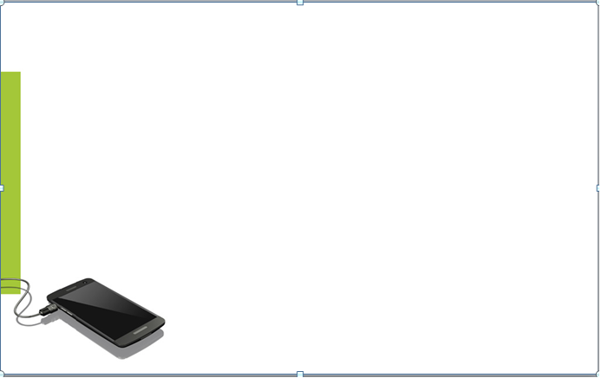
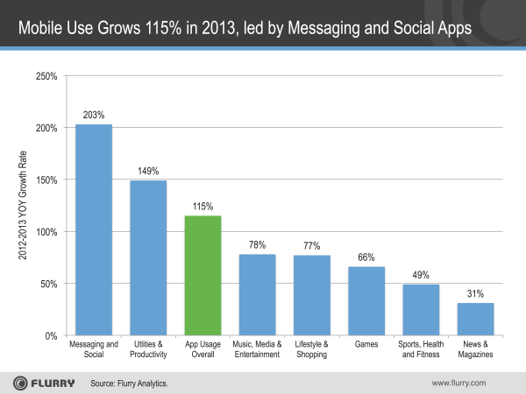
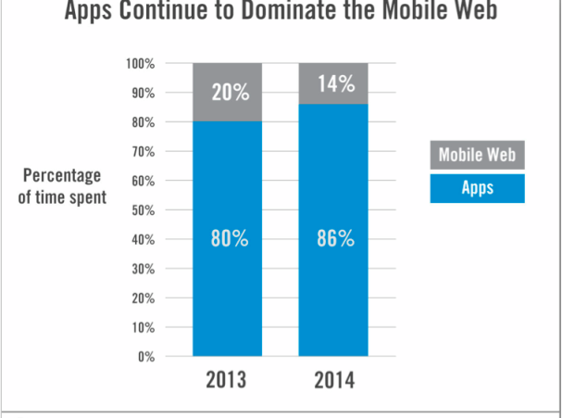
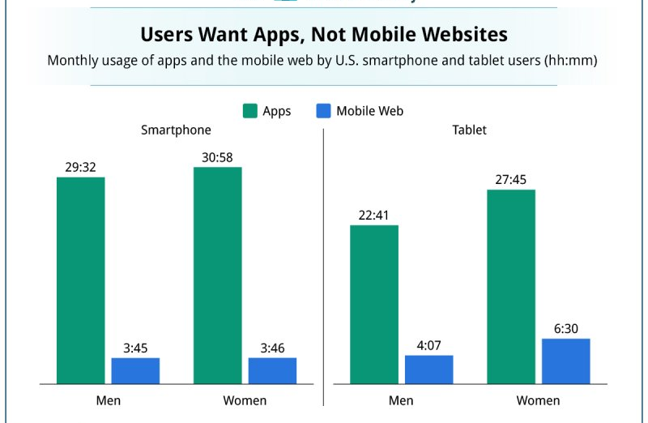

Slide 9



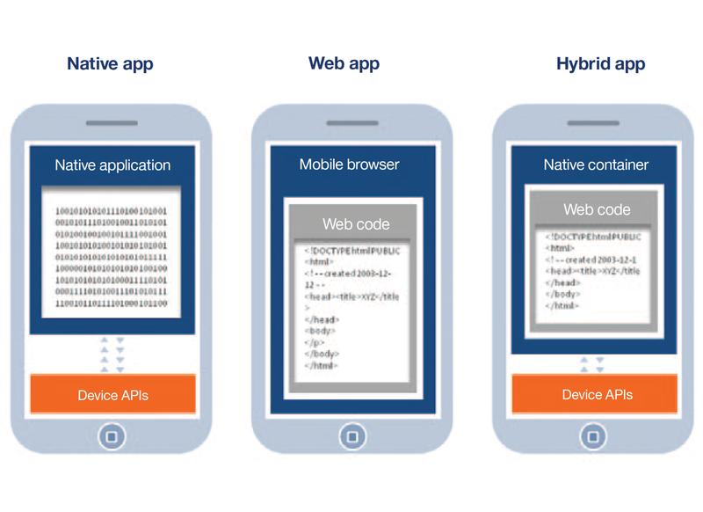
Mobile application Development
Native applications
Mobile optimized web applications
Hybrid applications - Sencha, Phonegap
Distribution in app stores

Slide 10















Native/Hybrid/Mobile Web apps examples
Native apps -
Mobile optimized web apps -
Hybrid apps -

Slide 11
PhoneGap is an open-source mobile development framework
- Developed by Nitobi Software
- Bought by Adobe
Enables building of mobile device applications using JavaScript, HTML and CSS
- Ruby can be used as well
- Instead of often less-known languages such as Objective-C
or Java

Slide 12
Means of Phonegap Development
Phonegap is just a library that you must include in your app
- Couple of JavaScript and xml files
What is Phonegap doing?
- Phonegap generates a out-of-the-browser window that executes the HTML and JavaScript
- Due to a couple of xml and jar/dll files it enables the usage of native APIs

Slide 13

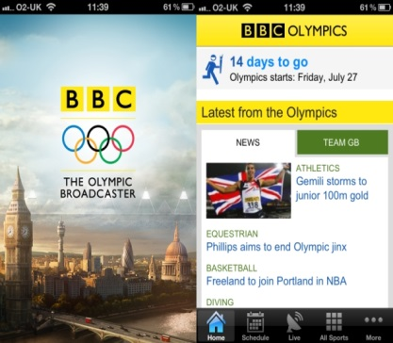

Phonegap framework supports native device features such as accelerometer, camera, compass, geo-location, contacts, media, local storage
Availability of single code base across platforms
Easier to develop and maintain native applications at low cost

Slide 14
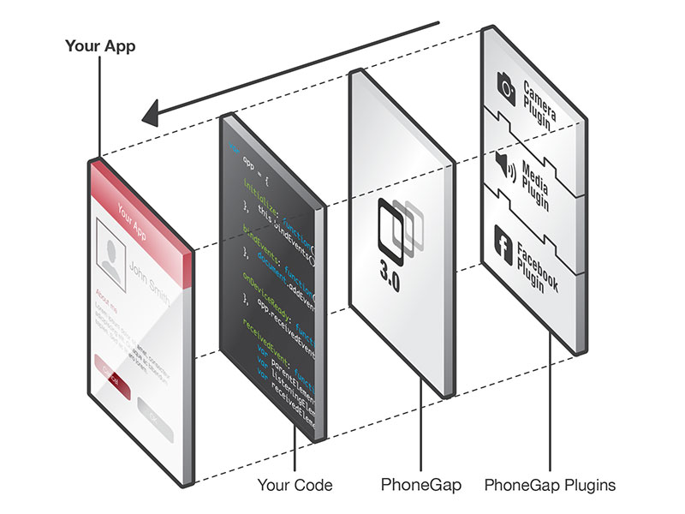

Slide 15
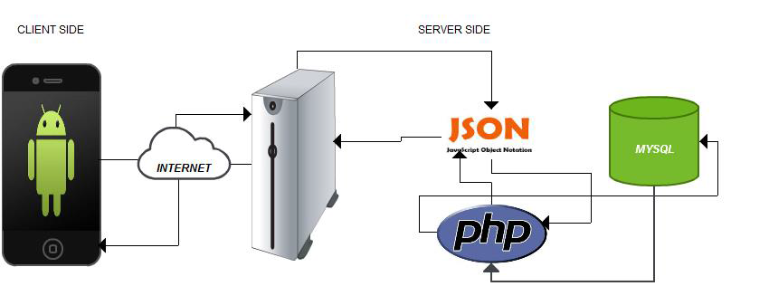
HWF Architecture

Slide 16
HWF Modules
Solid/Universal Waste Tracking - track the amount of solid or universal waste and the recycled information
Container Inspection - monitor the container that stores the hazardous waste by noting its corresponding attributes
Area Inspection - monitor the storage areas of the hazardous waste
New Inspection Request - deviations encountered
Work orders - Shipping status of hazardous waste

Slide 17
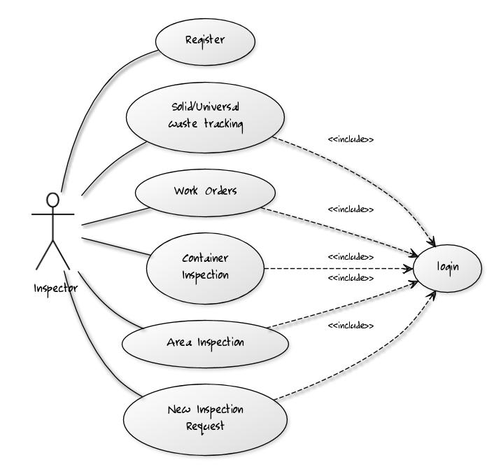
Use Case Scenario

Slide 18
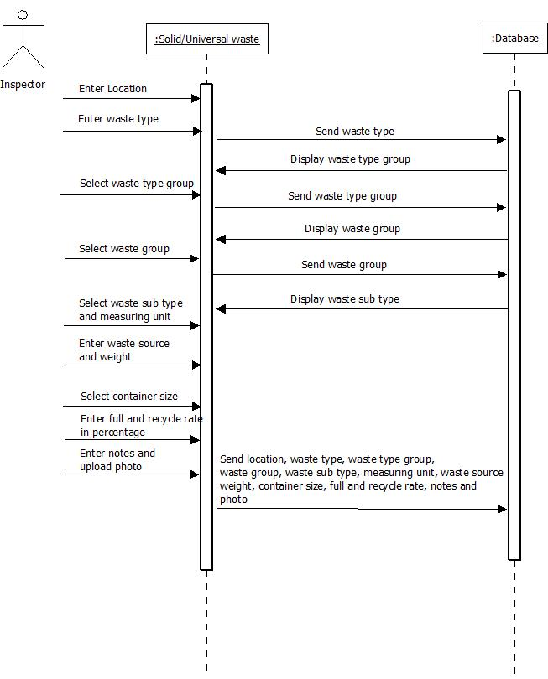
Solid/Universal Waste Tracking
Waste Assessment

Slide 19
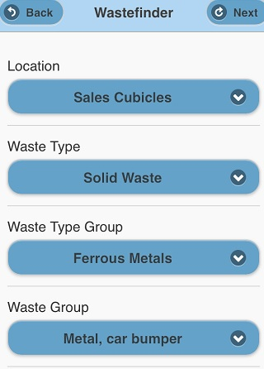
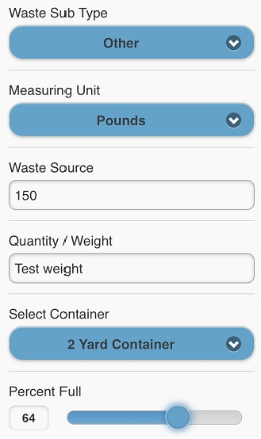
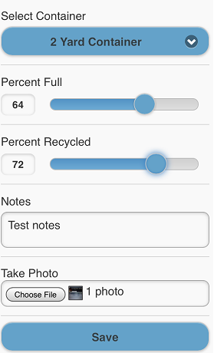
Solid/Universal Waste Tracking

Slide 20
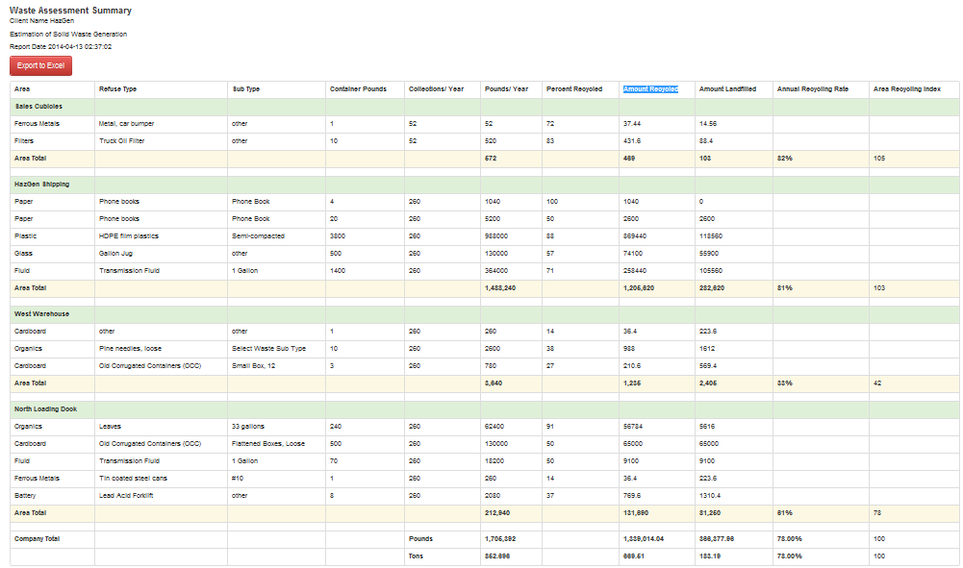
Solid/Universal Waste Report

Slide 21
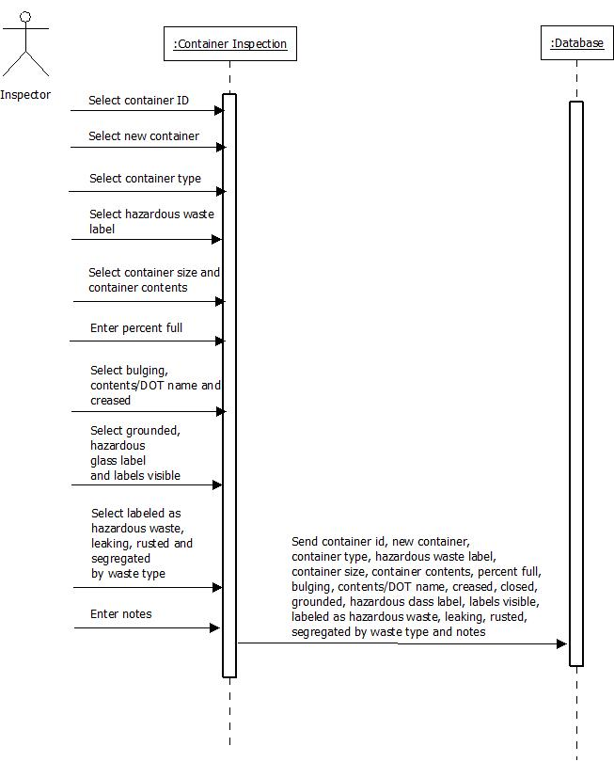
Container Inspection

Slide 22
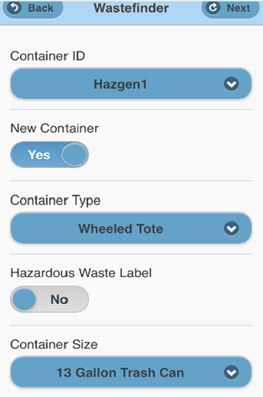
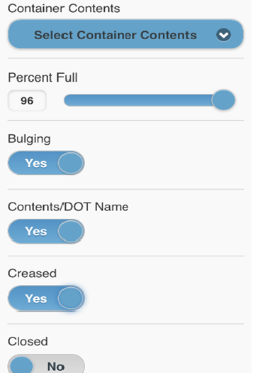
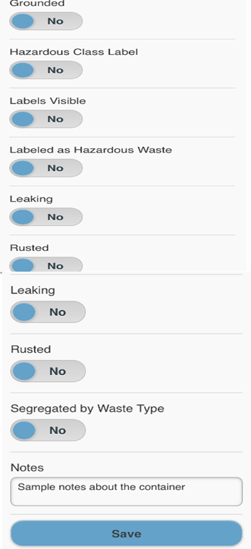
Container Inspection

Slide 23
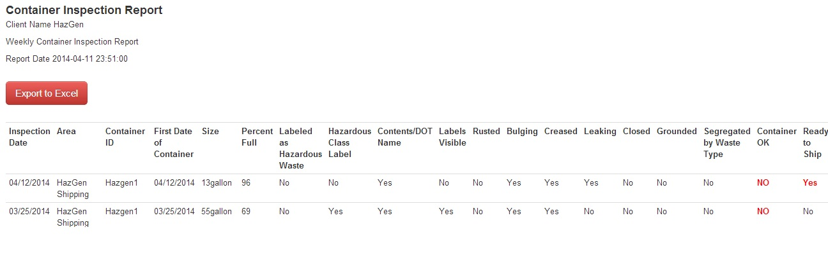
Container Inspection Report

Slide 24
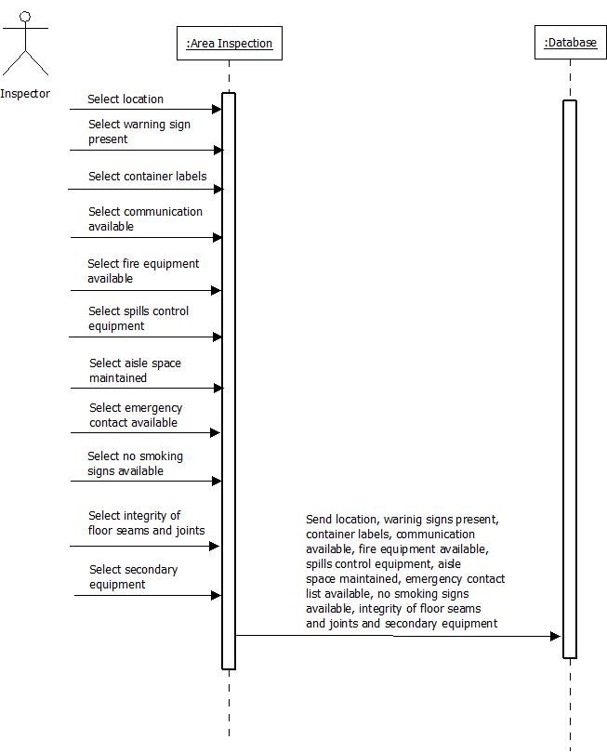
Area Inspection

Slide 25
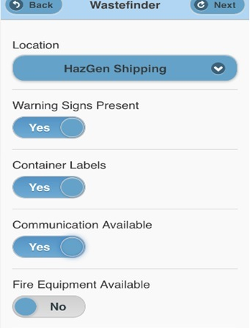
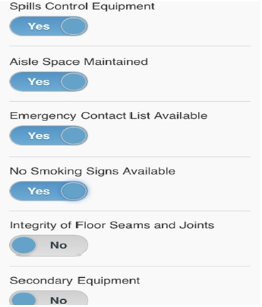
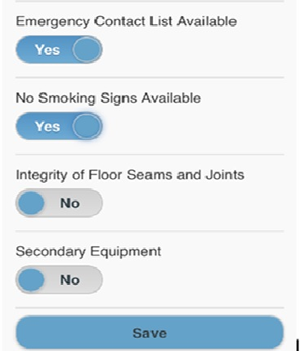
Area Inspection

Slide 26
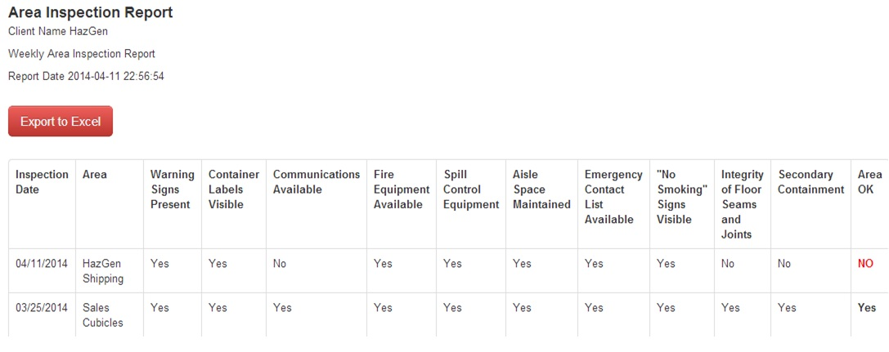
Area Inspection Report

Slide 27
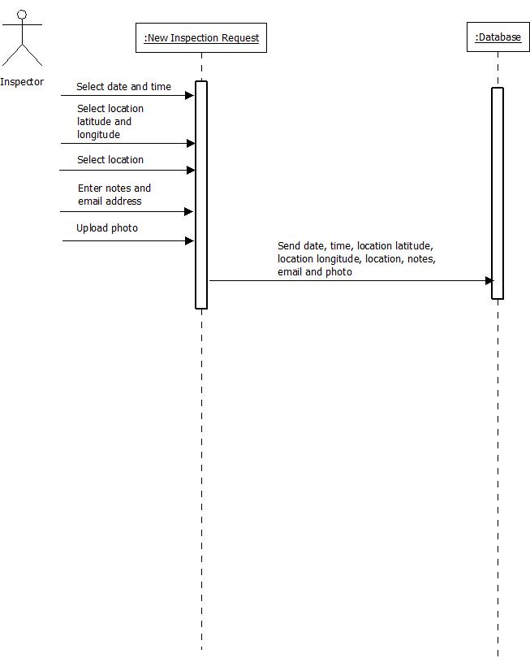
New Inspection Request

Slide 28
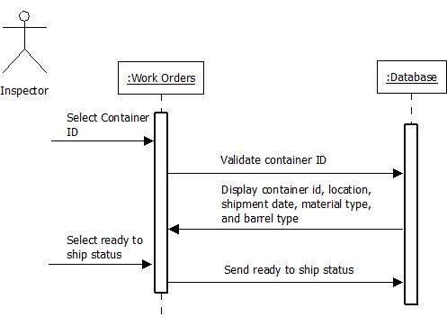
Work Orders

Slide 29
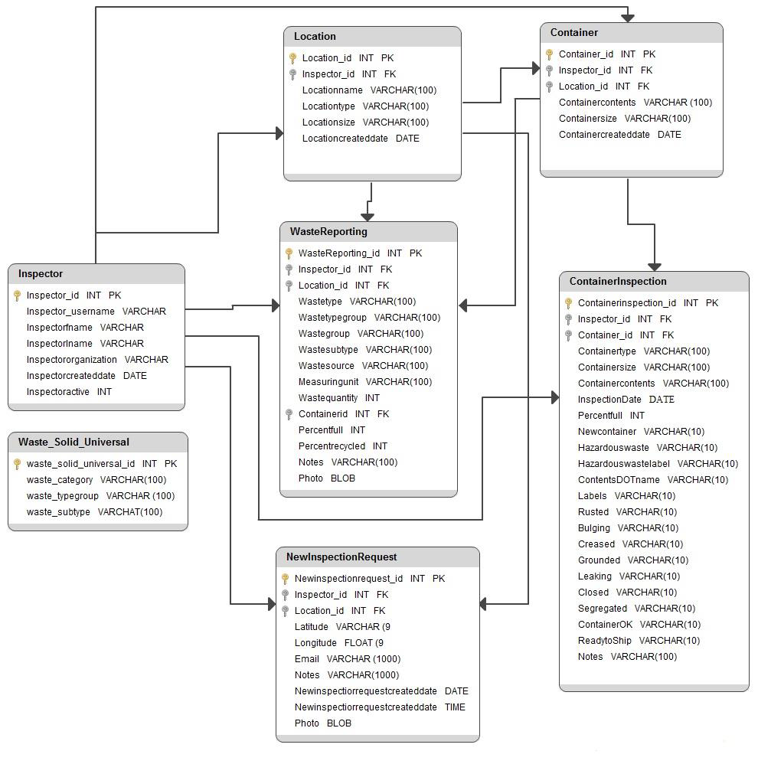
Database Schema Design

Slide 30
Conclusion and Future work
Deciding the right choice for mobile apps development
Save time and eliminate the use of paper reports
Technological skills and Project Management
Embedding a voice recognition system to collect notes about a waste can prove to be decisive in future
Extending to other operating platforms
Exploring new security aspects with new versions of operating
systems

Slide 31
References
http://www.epa.gov/wastes/hazard
http://www.epa.gov/superfund/students/clas_act/haz-ed/ff_01.htm
http://en.wikipedia.org/wiki/Hazardous_waste_in_the_United_States
http://www.epa.gov/osw/hazard/wastetypes/listed.htm
http://blog.flurry.com/?Tag=Usage%20Statistics

