Slide 1

An android app for measuring WIFI signal strength campus-wide
Karthi Kishore Sounder
Department of Computer Science and Engineering
CSCE 952 Advanced Computer Networks Class Project

Slide 2




Motivation
The Big Picture
Results
Conclusion and Future work

Slide 3
Motivation
Have you ever tried walking around the campus just to get better signal on your phone?
Mobile Programming (Objective C/ Java).

Slide 4
The Big Picture
"Network Signal Info" provides detailed information over the currently used network, whether Wi-Fi or cellular connection.
Identify the extent of Wi-Fi network coverage by taking into account the signal information campus-wide.
Existing close works.

Slide 5
The Big Picture (Ctd..)
Found locations where Wi-Fi signal strength is low, average, good.
Analyzed the Wi-Fi signal strength which is helpful in optimizing the network setup.
Implemented Network Speed Test.
Integrated the Wi-Fi signal strength information w.r.t locations with Google Maps API.

Slide 6
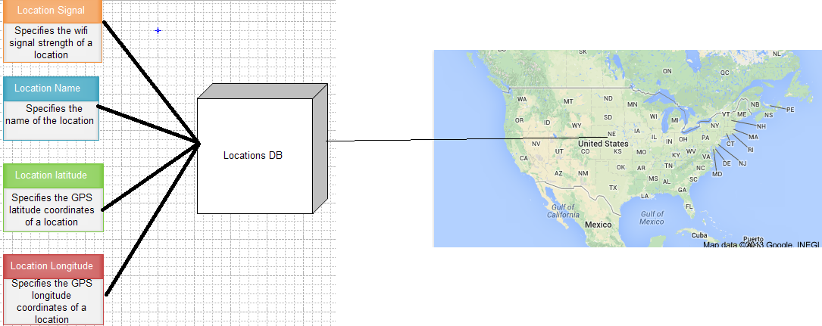

The Big Picture (Ctd..)
Android, SQLite, Google Maps Android API v2, Google Play Services.
Target Device : API level 7 or greater, SDK > 14.
WifiManager class, Location Manager class.
Wireless Access Point : UNL AIR

Slide 7
Results

Slide 8
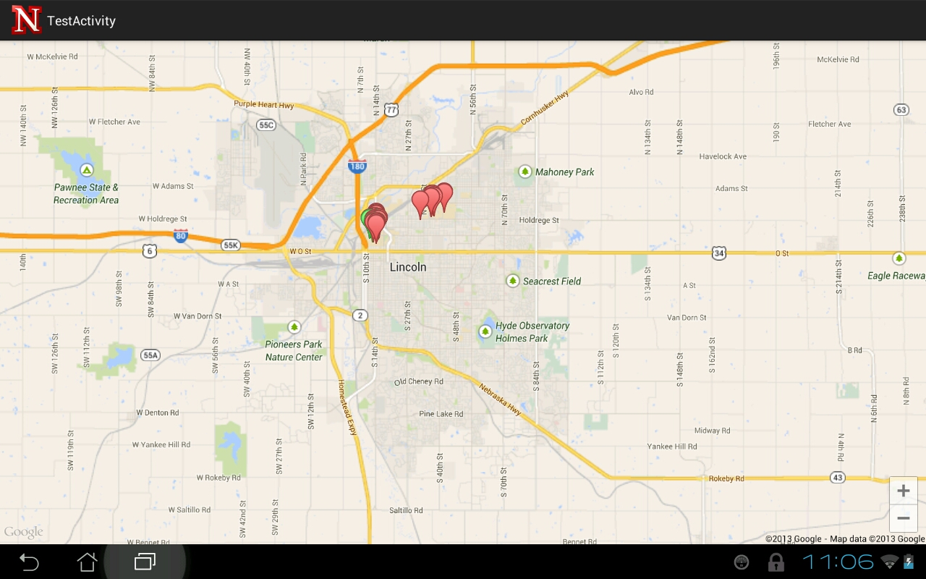
UNL Campus

Slide 9
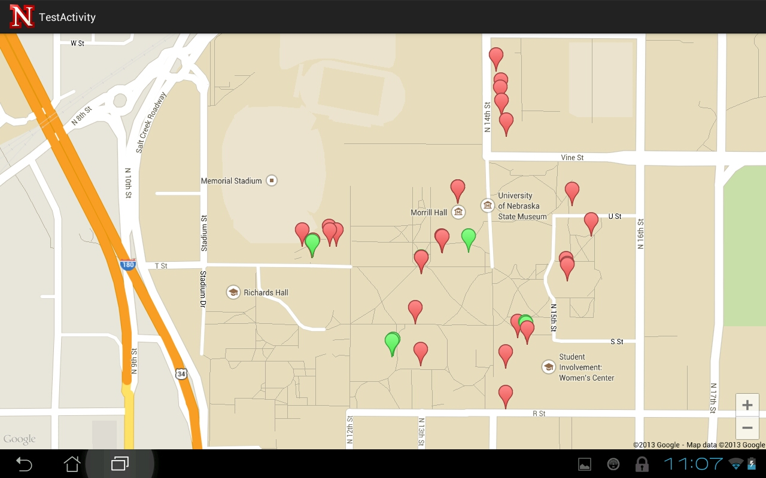
UNL City Campus

Slide 10
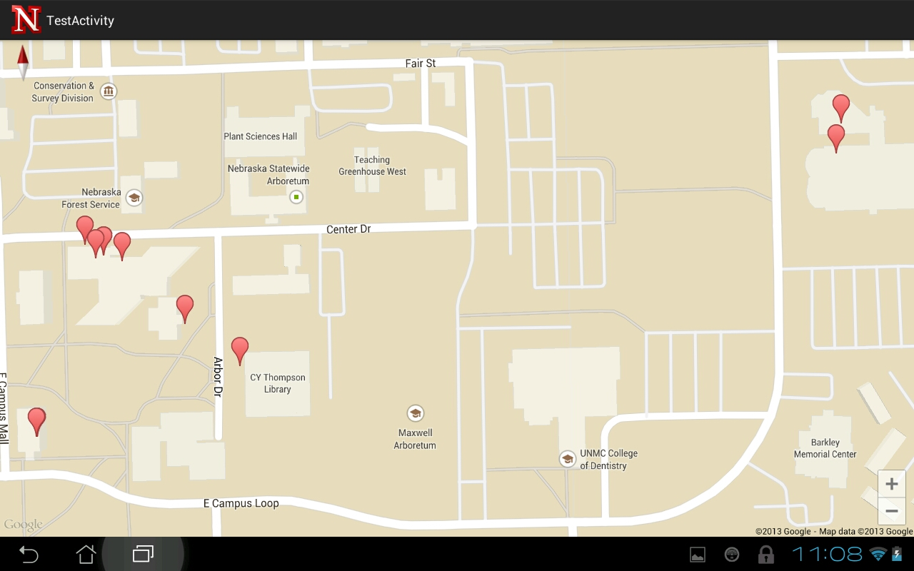
UNL East Campus

Slide 11
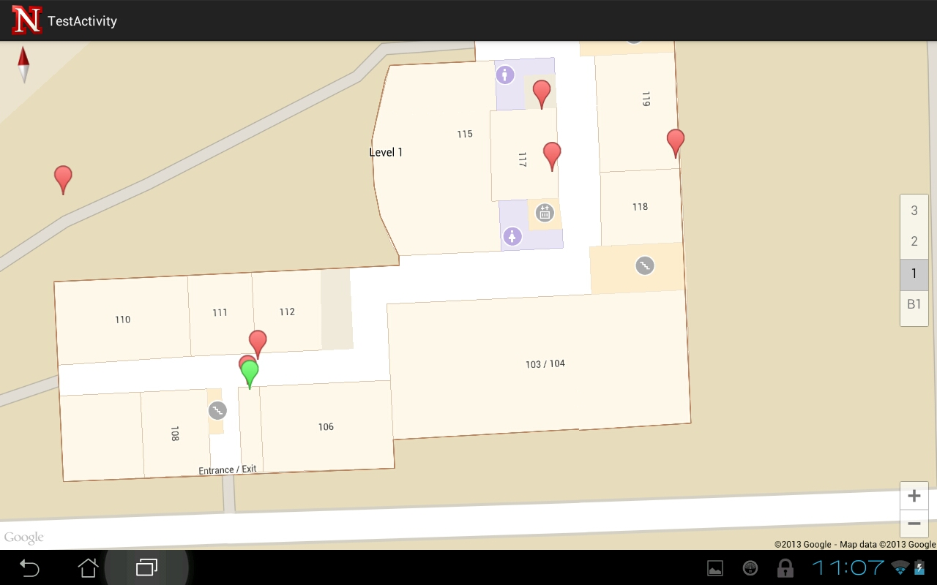
Avery Hall

Slide 13
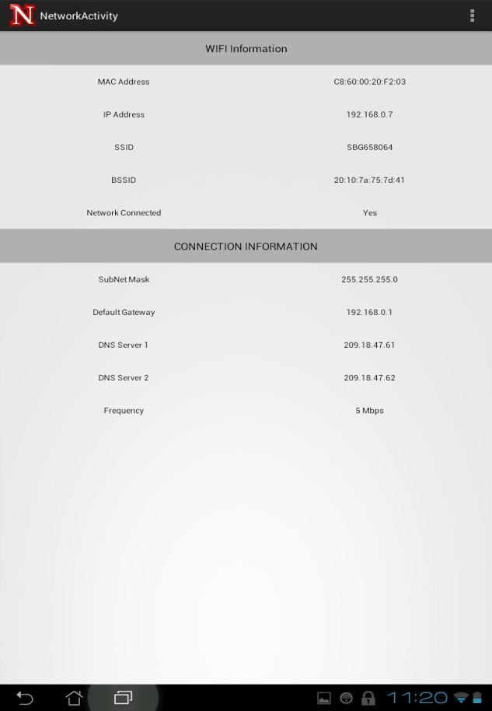
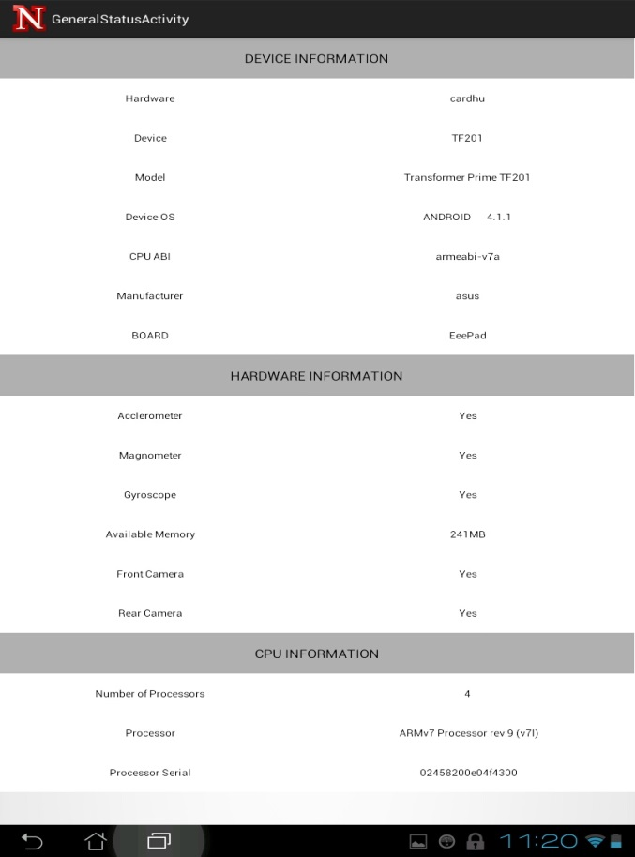
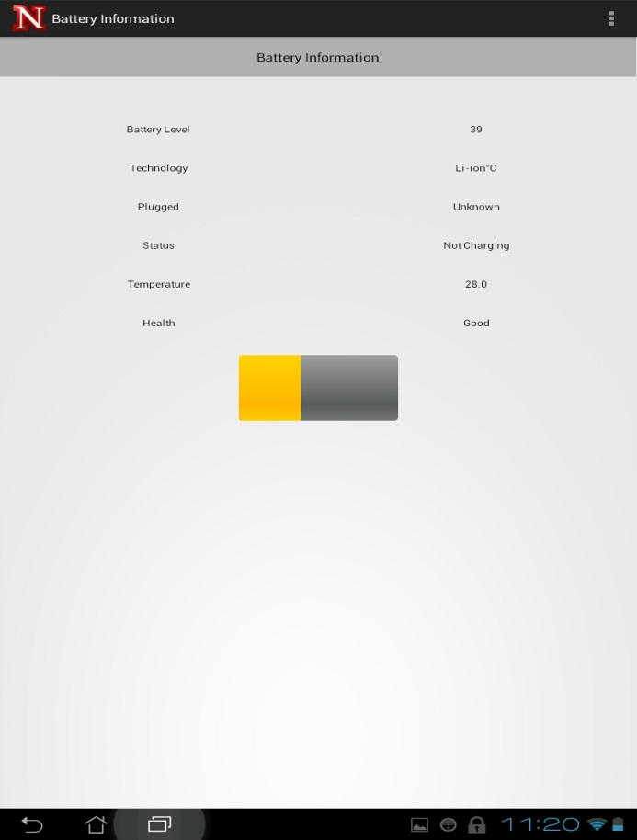

Slide 14
Conclusion & Future Work
Identified locations where there was no/minimum traces of Wi-Fi signal.
Scalability with respect to location.
Mobile Networks(4G).
Mapping information between Mobile and Wifi Network.
Advanced signal strength graphs.

Slide 15

References
https://developers.google.com
http://www.androidhive.info/2013/08/android-working-with-google-maps-v2/
http://www.androidhive.info/2011/11/android-sqlite-database-tutorial/
http://www.javabeat.net/location-tracker-in-android-using-gps-positioning-and-sqlite/
Source code : https://github.com/karthikishorejs/UNLNetworkFinder

Slide 16

Thank You !!!

