Slide 1
Yelp Dataset
EMSE 6586: Database Management for Data Analytics
Presented By : Akash Poddar
Avani Rao
Karthik Iyer
Vidit Sheth

Slide 2
Outline
Introduction
Setting Up
Reading
Data Cleaning
Connecting to SQL Database
SQL Queries
Spark SQL Queries
Sentiment Analysis
Conclusion

Slide 3

Introduction
The Yelp Dataset contains JSON data about businesses, user reviews, user interactions, and geographical information.
The dataset encompasses a wide range of businesses, including restaurants, cafes, hotels, salons, retail stores, and more.

Slide 4
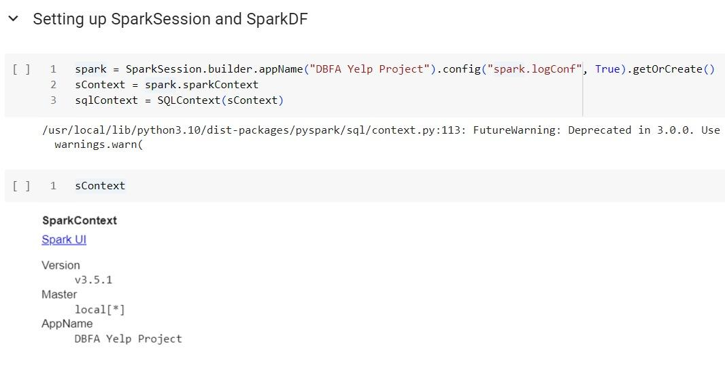
Setting Up
The Yelp dataset spans 8GB.
Spark seamlessly scales to manage vast data volumes by distributing processing across multiple nodes.
With user-friendly APIs supporting various languages like Python, Spark accommodates a wide range of users.
Its smooth integration with Python and effective big data management render Spark a prime option for our project.

Slide 5
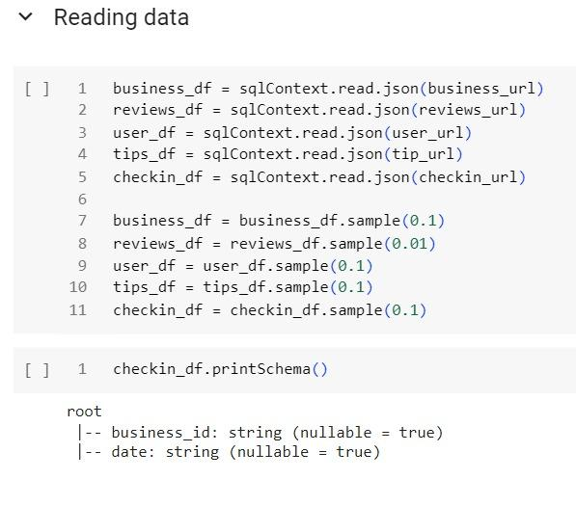
Reading Data
Reading JSON Data: It reads JSON data from various sources (specified by business_url, reviews_url, user_url, tip_url, and checkin_url) into Spark DataFrames.
Sampling Data: After reading the JSON data into DataFrames, the code samples a portion of each DataFrame using the sample( ) function.
The argument passed to the sample ( ) function indicates the fraction of data to be sampled.

Slide 6
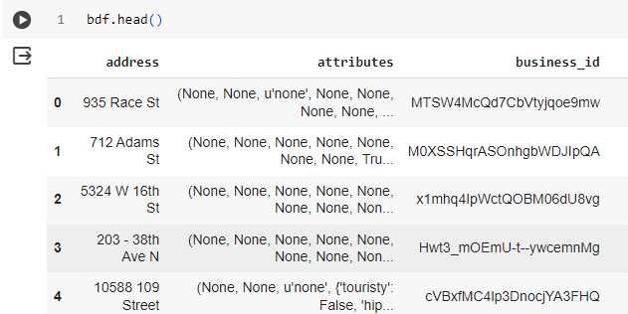
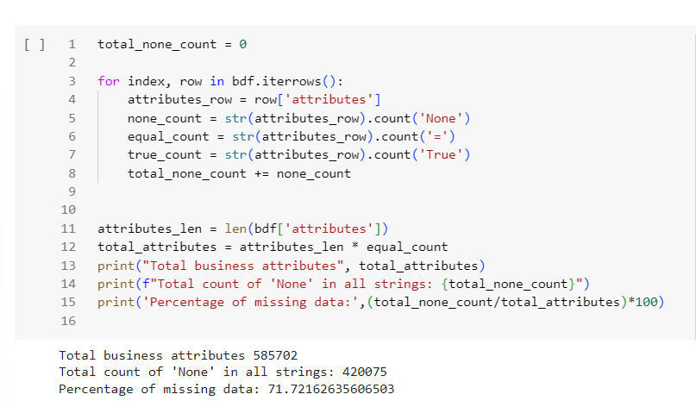
Data Cleaning - Cleaning Business Data
Dropped null values, especially in 'attributes' (71%), impacting analysis.
Analyzed 'attributes' for 'None' prevalence to gauge data completeness.

Slide 7
SQL and SPARK for Querying

Slide 8
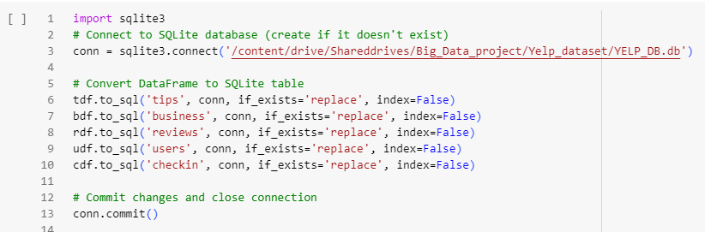
Connecting to SQL Database
Connect to SQLite database (create if it doesn't exist)
Convert DataFrame to SQLite table
Commit changes and close connection

Slide 9
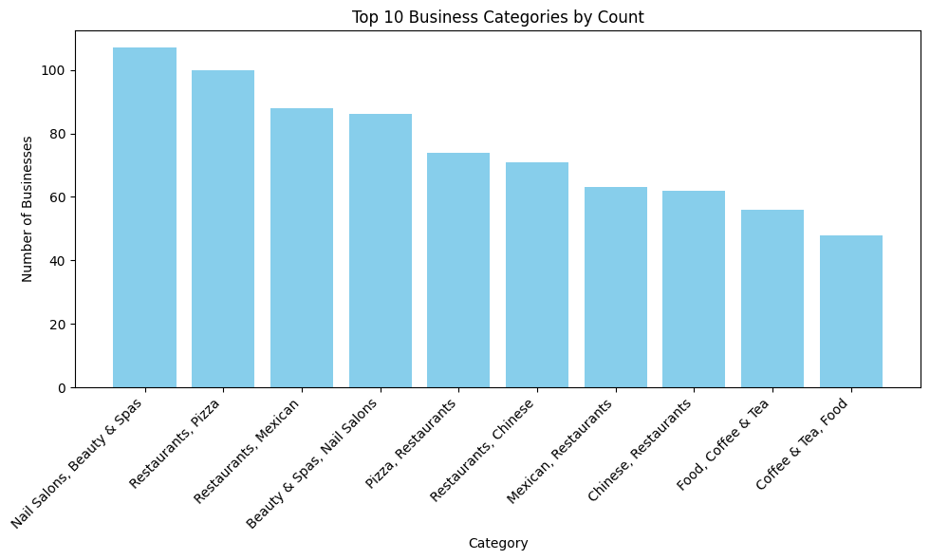
Query to find out top ten Categories of Businesses reviewed on Yelp
SQL Queries:

Slide 10
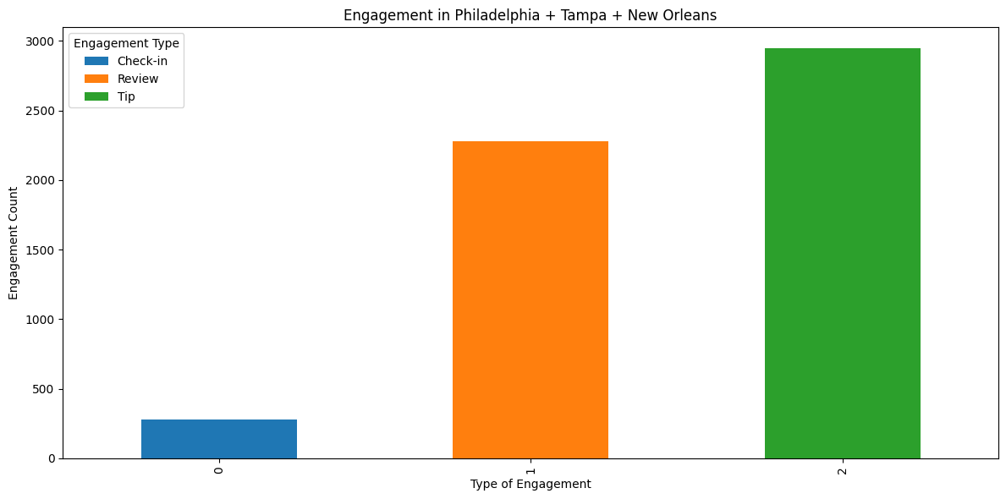
Query to
find out Engagement Count based on Type for Philadelphia, Tampa, New Orleans
SQL Queries:

Slide 11
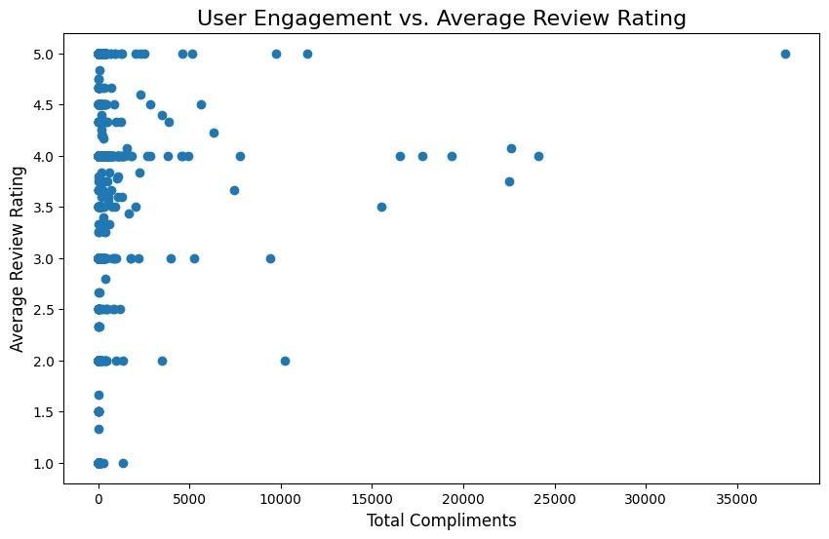
Query to Investigate if users who are more engaged on Yelp (via compliments and fans)
SQL Queries:

Slide 12
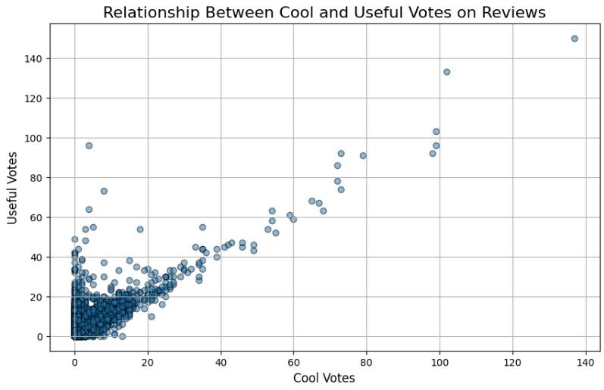
Query to Investigate Relationship between Cool and Useful Votes on Reviews
SQL Queries:

Slide 13
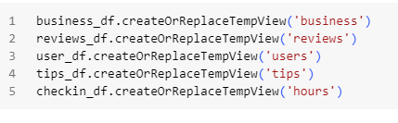
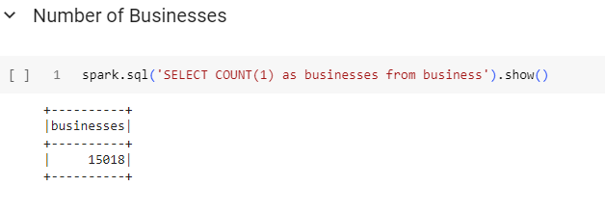
Spark Database
Create a temporary instance of a spark database
Using spark to query

Slide 14
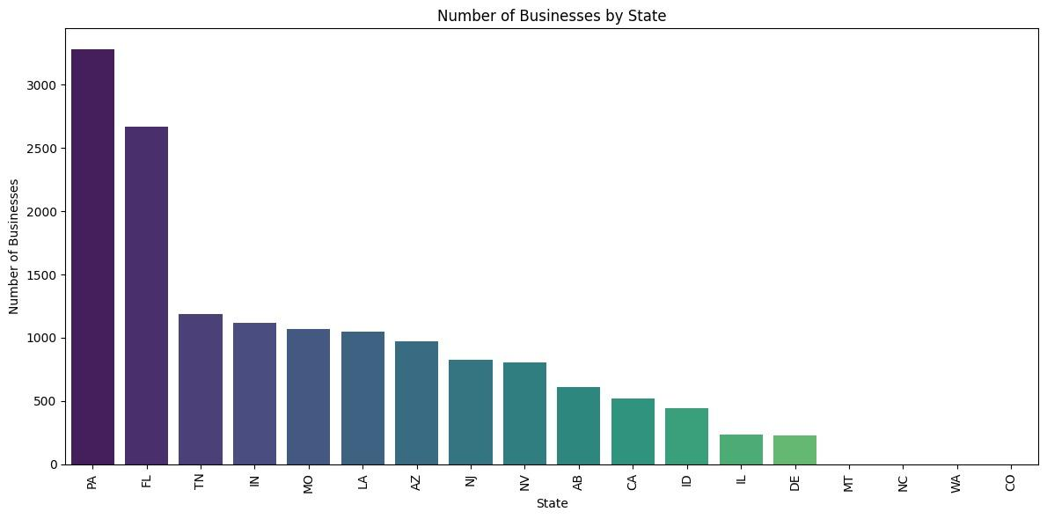
Query to find out Number of Businesses by State
Spark
SQL Queries:

Slide 15
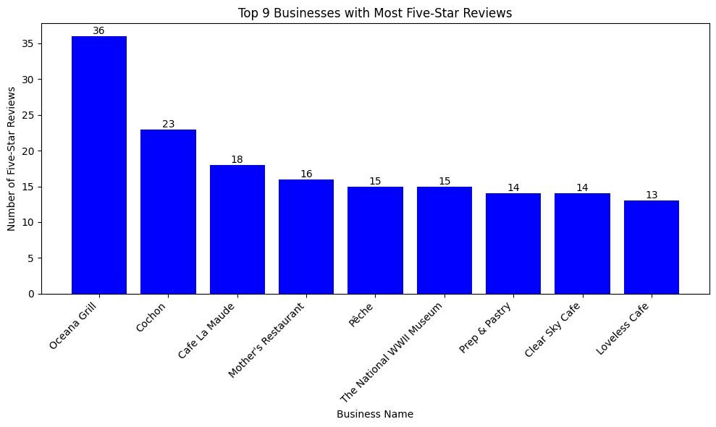
Query to find out top ten Business with 5-star Rating (Business)
Spark
SQL Queries:

Slide 16
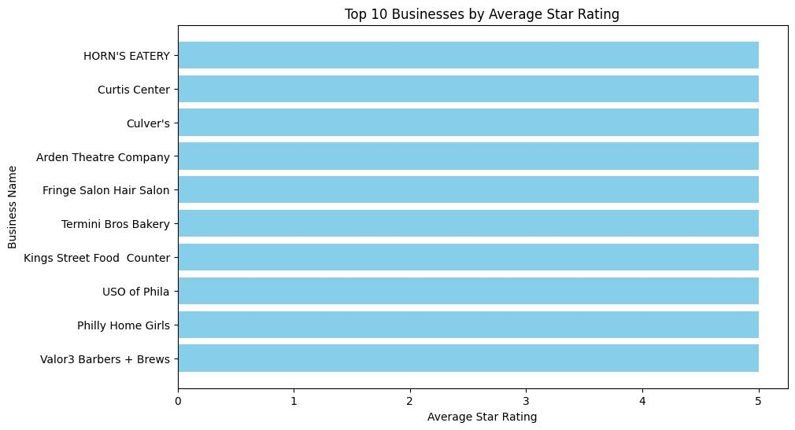
Query to find out top ten Business by Average star Rating
Spark
SQL Queries:

Slide 17
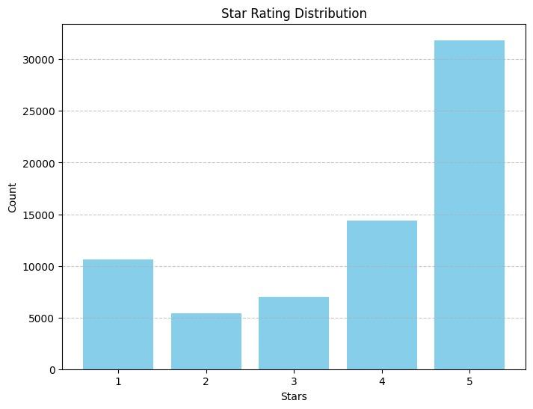
Query to find out Star Rating Distribution
Spark
SQL Queries:

Slide 18
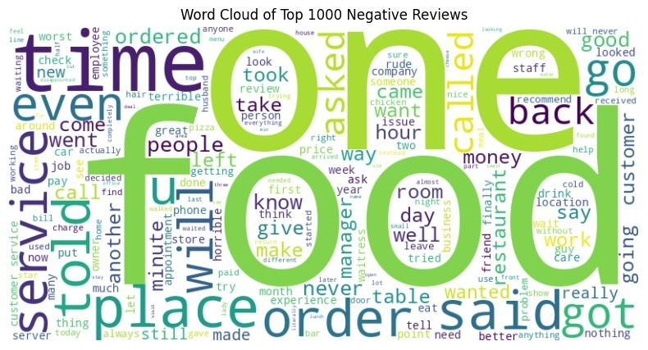
Query to find out top ten Negative Reviews
Spark
SQL Queries:

Slide 19
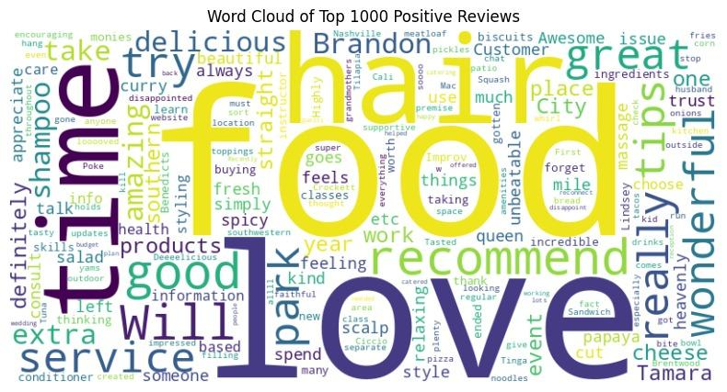
Query to find out top ten Positive Reviews
Spark
SQL Queries:

Slide 20
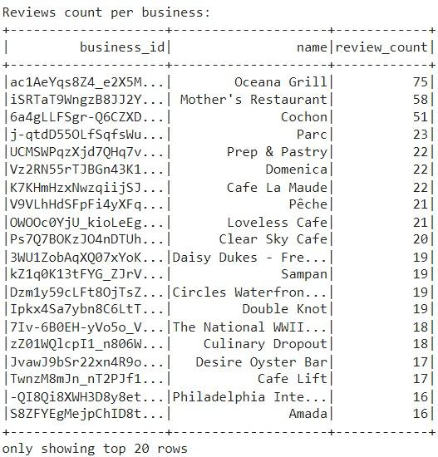
Review Counts per Business
Sentiment
Analysis:

Slide 21
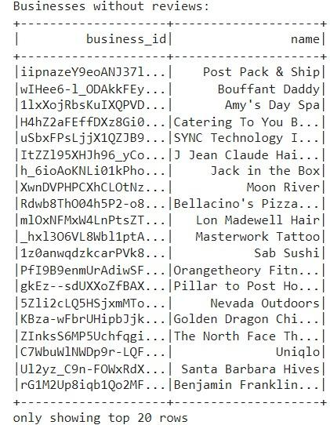
Businesses without Reviews
Sentiment
Analysis:

Slide 22
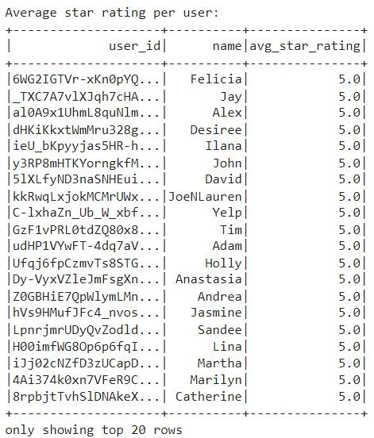
Average Star Rating Per User
Sentiment
Analysis:

Slide 23
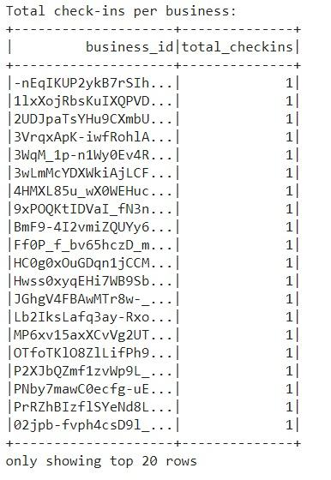
Total Check-ins Per Business
Sentiment
Analysis:

Slide 24
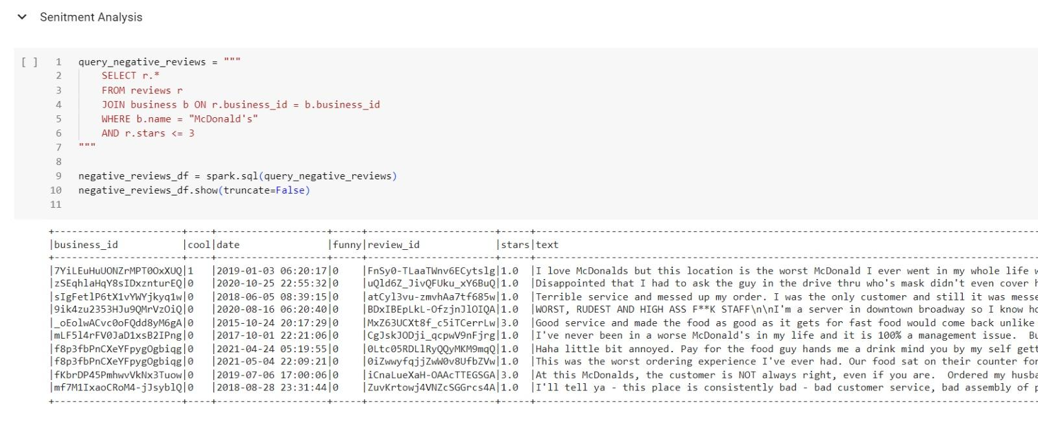
Sentiment Analysis

Slide 25
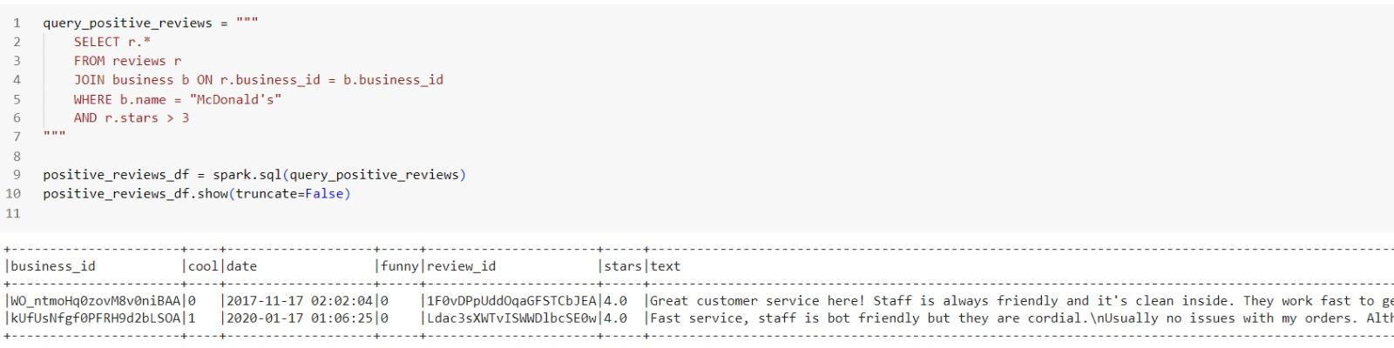
Sentiment Analysis

Slide 26
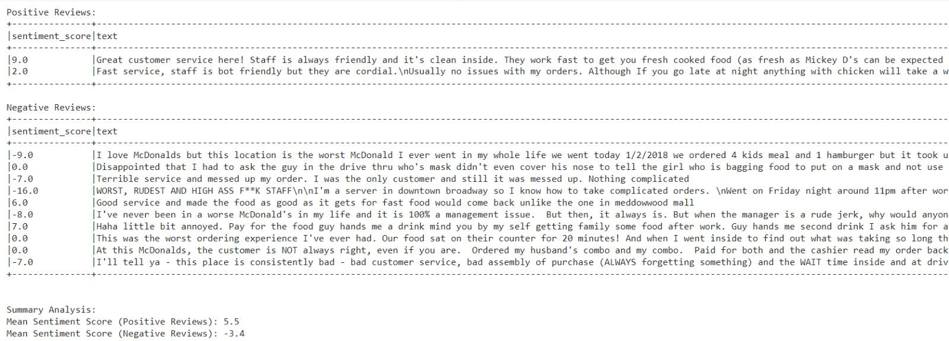
Sentiment Analysis

Slide 27
Conclusion
The code effectively uses PySpark to analyze Yelp dataset, efficiently managing large datasets with its distributed computing capabilities.
By employing SQL queries on Spark DataFrames, the code extracts key insights like business distribution across states and top business categories by count, , and correlation between user engagement metrics and review ratings.
Visualizations such as bar charts, scatter plots, and word clouds present data intuitively, aiding trend identification for deeper analysis.
Conducting sentiment analysis on reviews provides nuanced understanding of customer opinions.
Overall, the code illustrates PySpark's versatility and scalability for large-scale data analytics, showcasing its effectiveness in deriving actionable insights from extensive datasets like Yelp.

Slide 28
Thank You

