Slide 1
Finding the pattern behind the online shoppers purchasing intention
Naveen Raju Sreerama Raju Govinda Raju | A20516868
Karthik Kumar Kaiplody | A20523668
Professor - Jawahar Panchal
CSP571 Data Preparation and Analysis

Slide 2
Outline
Problem Statement
Data Sources
Data Description
Data Processing
Data Analysis
Model Training and Results
Conclusion
Bibliography

Slide 3
Problem Statement

Slide 4
Problem Statement
Analyze trends in the online shoppers purchasing intention dataset using exploratory data analysis techniques, and build machine learning models to predict the purchasing intentions of visitors to a store's website both using supervised and un-supervised techniques.

Slide 5
Project Planning

Slide 6
Team Structure
Naveen Raju Sreerama Raju Govinda Raju - Team Leader
Karthik Kumar Kaiplody

Slide 7
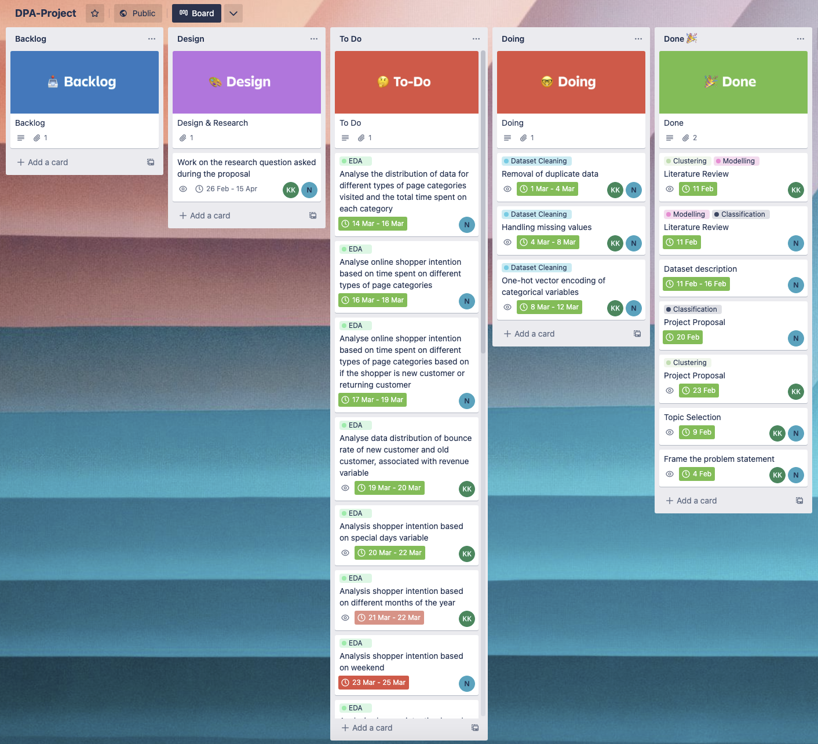
Project Planing and execution
Used trello for the planning and keeping track of the project.
Logistic Regression and GMM were not implemented and put to the backlog, will be included in the future work.
Project Repository: DPA-Project

Slide 8
Workflow overview
Data Preparation & Analysis
Results & Conclusion
Data Collection
Modelling
Online Shopper Purchase Intenstion Dataset from UCI
Data cleaning.
Data Balancing.
Univariate, Bivariate and Multivariate analysis.
Supervised Modeling
Naive Bayes
K-NN
Random Forest
SVM
XGBoost
Un-supervised
K-means Clustering
DBScan Clustering
Hierarchical clustering
Analysed conclusion.
Model reports and evaluation.
Future work.

Slide 9
Data Sources
The data that is being used in this project was obtained from the UC Irvine Machine Learning Repository.
Data set contributers:
1. C. Okan Sakar
Department of Computer Engineering, Faculty of
Engineering and Natural Sciences, Bahcesehir University,
34349 Besiktas, Istanbul, Turkey
2. Yomi Kastro
Inveon Information Technologies Consultancy and Trade,
34335 Istanbul, Turke

Slide 10
Data description
The dataset consists of feature vectors belonging to 12,330 sessions.
The dataset consists of both numerical and categorical attributes.The 'Revenue' attribute can be used as the class label.
Attributes
Administrative | Administrative Duration
Informational | Informational Duration
Product Related | Product Related Duration
Bounce rate | Exit rate
Page value | Special day
Operating system | Browser
Region | Traffic type
Visitor type | Weekend
Month of the year | Revenue

Slide 11
Data Preprocessing

Slide 12
Data processing
Check number of observations with NA values
Fixing naming convention of month names in Month column
“June” ->”Jun”
Convert Month feature data type to factor data type
Transforming categorical attributes(OperatingSystems, Browser, Region, TrafficType, VisitorType) into “factor” data type and then perform one-hot encoding
Convert Revenue attribute data type to a factor.
Transforming Boolean attributes(Weekend, Revenue ) into “int” data type
Train - Test split : 70:30 split
One hot encoding of train and test set

Slide 13
Data balancing:
There is huge imbalance in data set as Revenue=0 is the majority. Hence the algorithm tries to over fit on majority class.
Number of observations with Revenue as False = 10422
Number of observations with Revenue as True = 1908
Here we are trying to increase minority class observations using SMOTE(Synthetic Minority Over-sampling Technique) algorithm.

Slide 14
Data Analysis

Slide 15
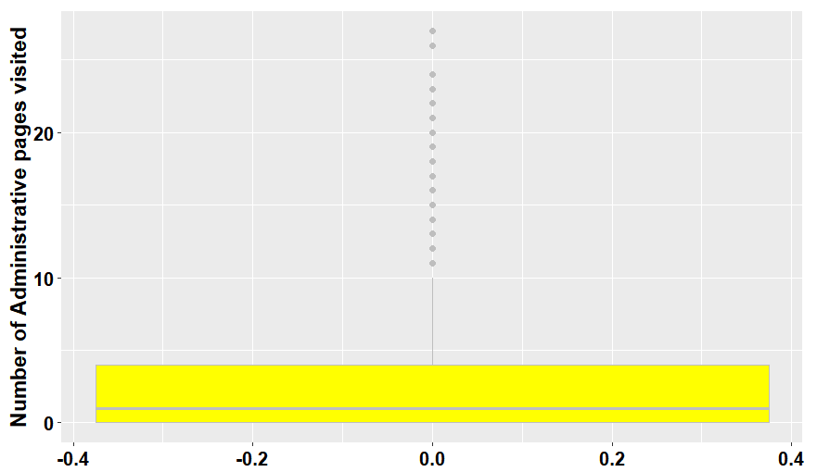
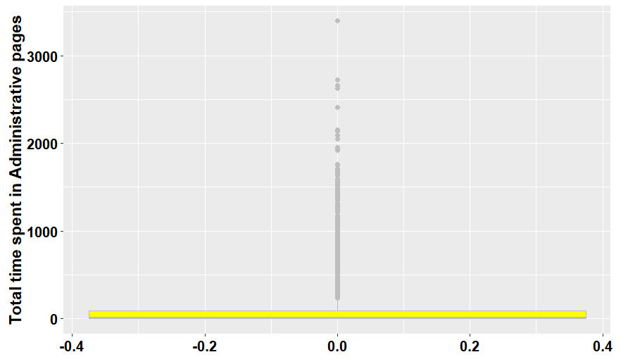
Data Analysis
1) Exploring data distribution of different page category and time spent in it.
a) Exploring data pattern of “Administrative” and “Administrative_Duration”

Slide 16
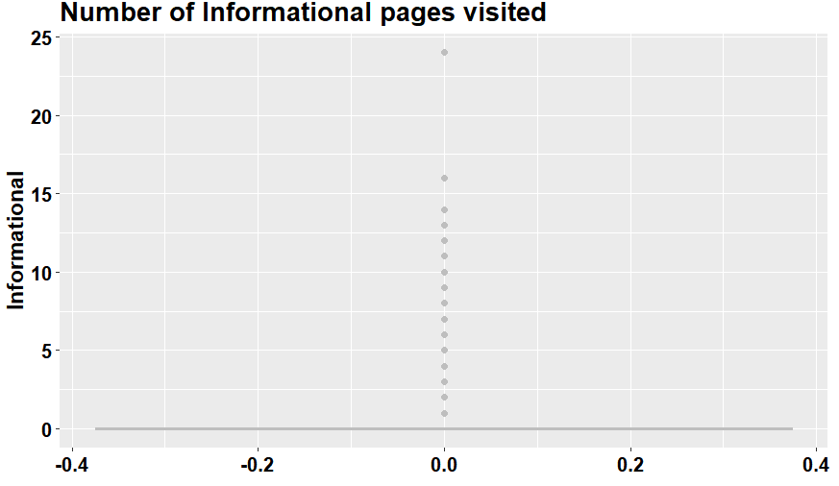
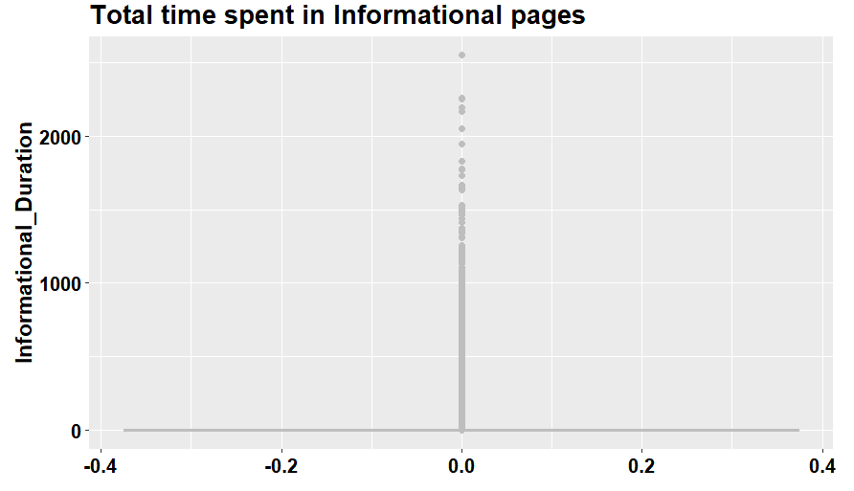
b) Exploring data pattern of “Informational” and “Informational_Duration”
●

Slide 17
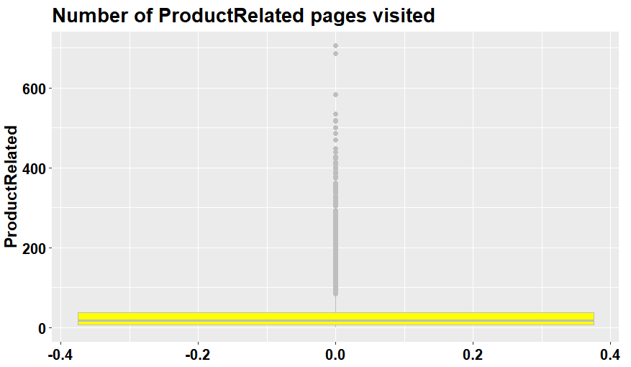
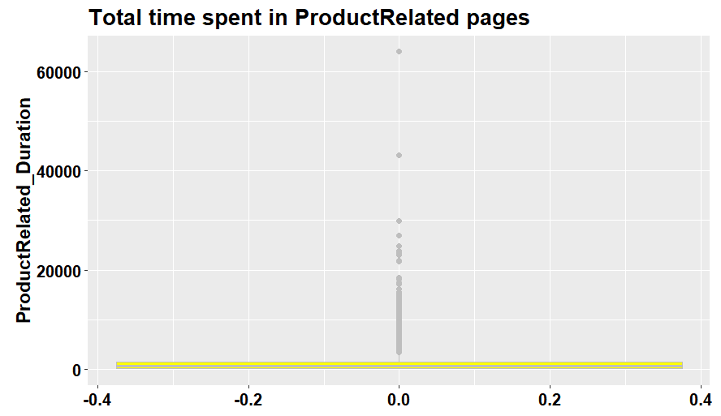
c) Exploring data pattern of “Product Related” and “Product Related Duration”

Slide 18
Summary
Analysing number of page visit of 3 different page categories it clearly says that customers are interested more in Product related pages rather than knowing information of the product in detail.
Analysing total time spent in 3 different page categories, it clearly says that customers spend most of the time in product related pages whereas they are not interested in spending time in information related pages.

Slide 19
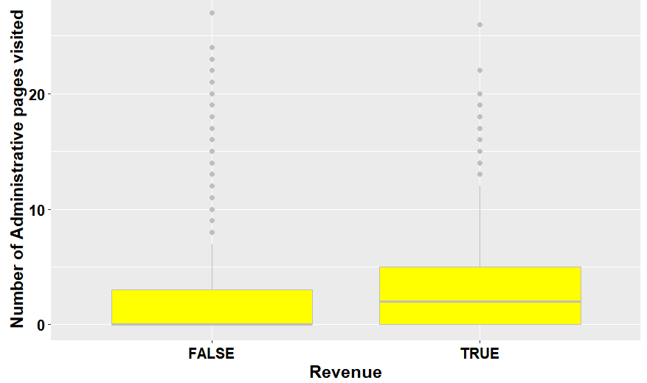
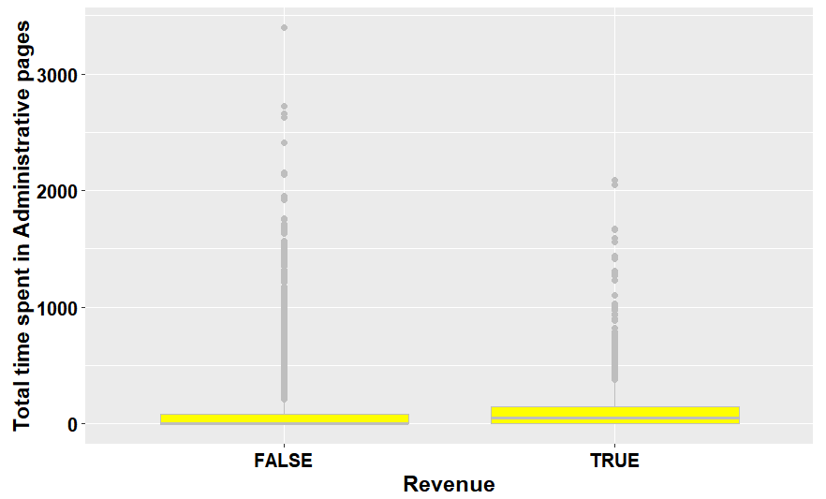
2)Exploring the data distribution of different page categories versus the target variable Revenue, as well as the time spent on each page category versus the target variable Revenue.

Slide 20
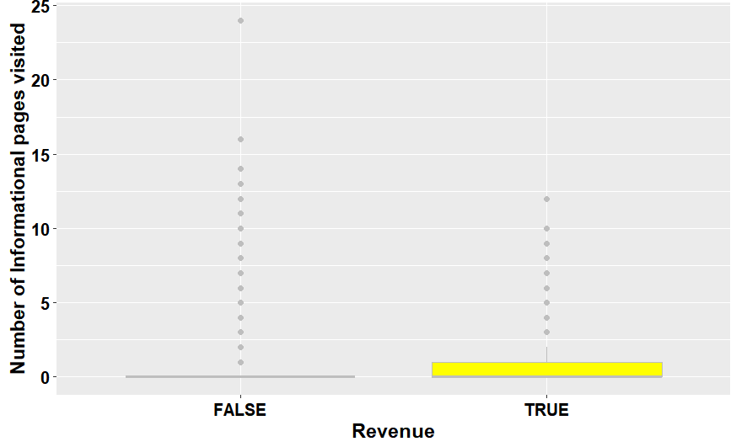
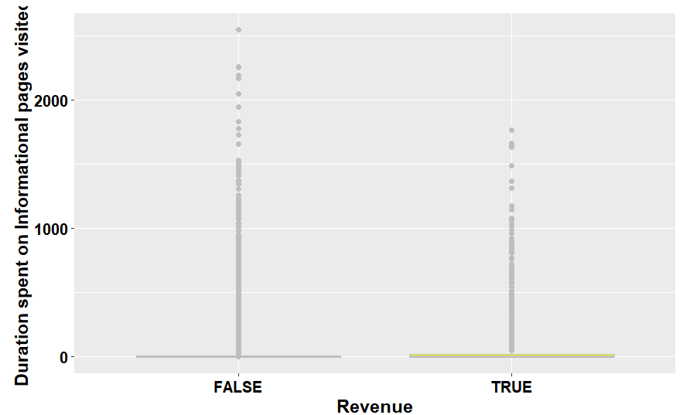

Slide 21
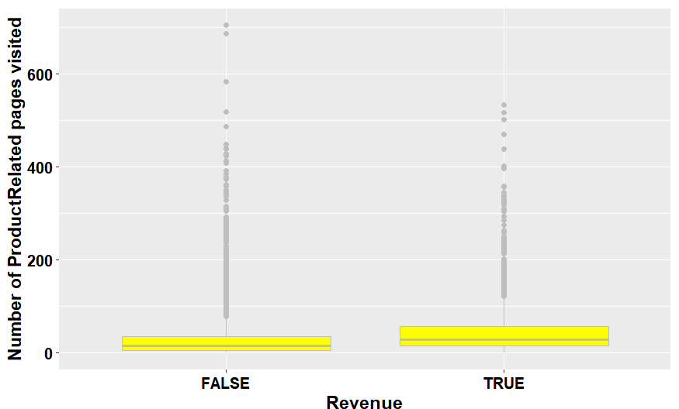
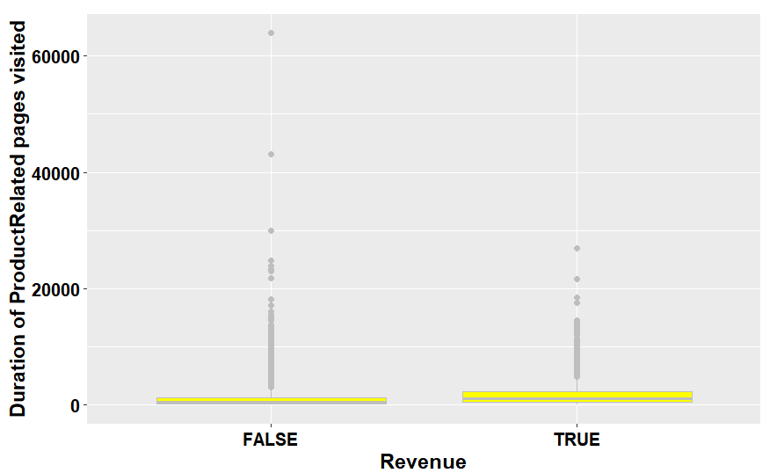

Slide 22
Summary
People who end up buying will mostly visit administrative page and spend almost 52seconds.
People who end up not buying will mostly not visit administrative page.
People are least interested in visiting informational page.
People who end up buying will mostly visit product related page and spend almost 1109 seconds.
People who will end up buying will mostly visit product related page and spend almost 510 seconds.
But people who end up buying will visit more product related than the ones who don't.

Slide 23
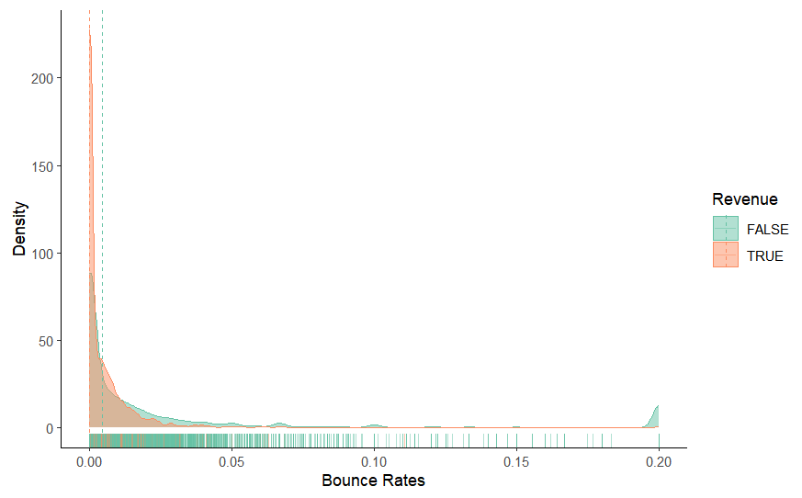
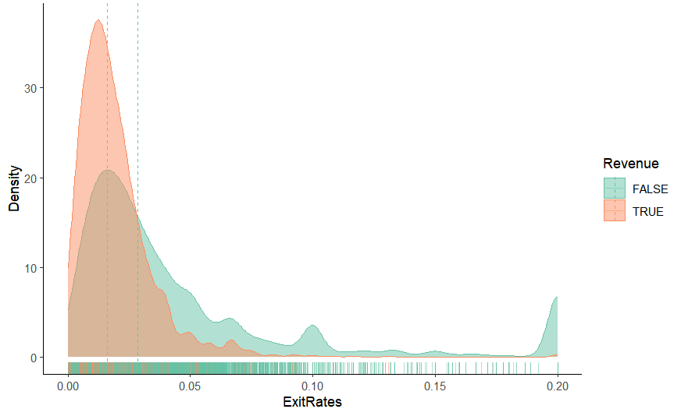
3) “Bounce Rates”, “Exit Rates” and “Page Values” features versus the target variable Revenue respectively.

Slide 24
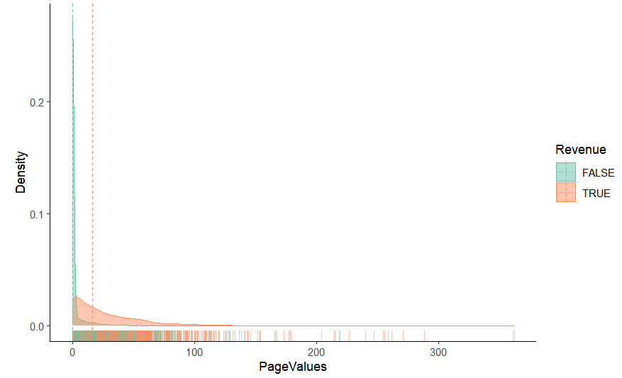
Summary
There is no noticeable disparity in Bounce Rates between customers who made a purchase and those who did not.
However, customers who ended up making a purchase had lower Exit Rates on average, indicating that they were more likely to remain on the website's pages.
Additionally, customers who did not make a purchase had significantly lower Page Values, suggesting that they spent less time on related pages.

Slide 25
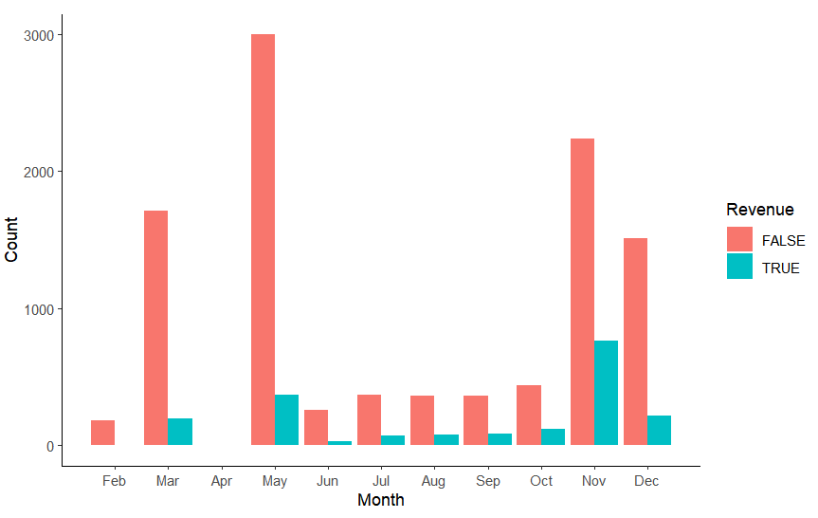
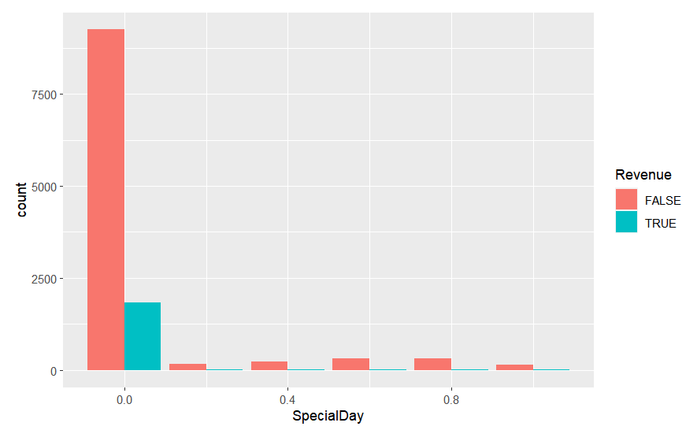
4) “Special Day” features versus the target variable Revenue
5) “Month” features versus the
target variable Revenue.

Slide 26
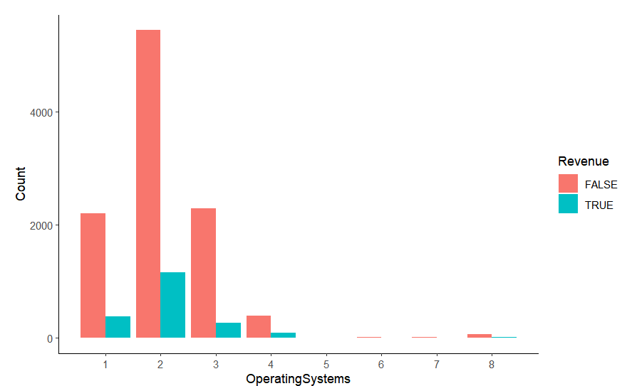
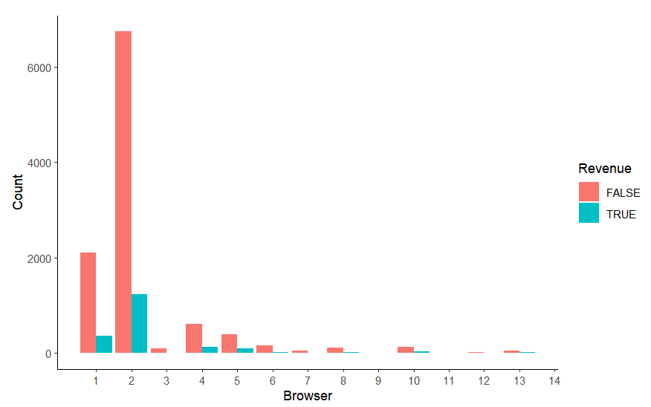
6) “Operating Systems” features versus the target variable Revenue.
7) “Browser” features versus the target variable Revenue.

Slide 27
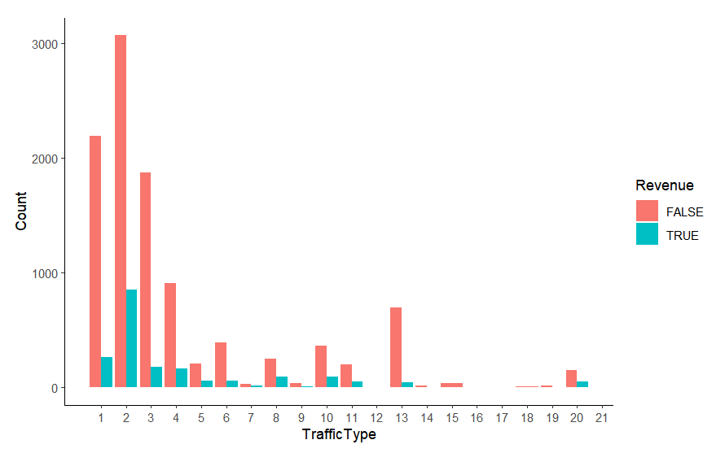
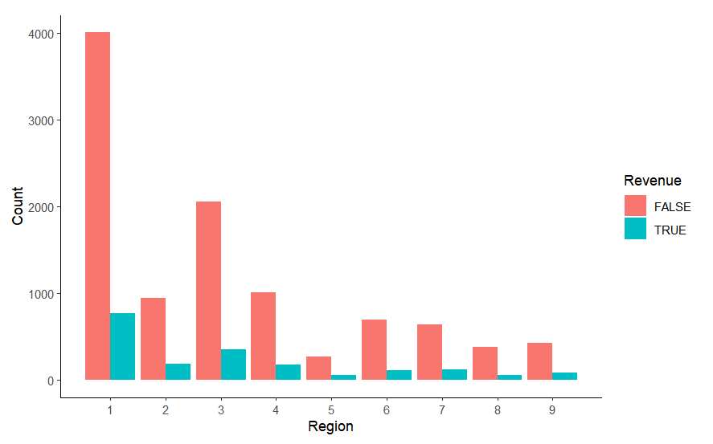
8)“Region” features versus the target variable Revenue.
9)“Traffic Type” features versus the target variable Revenue.

Slide 28
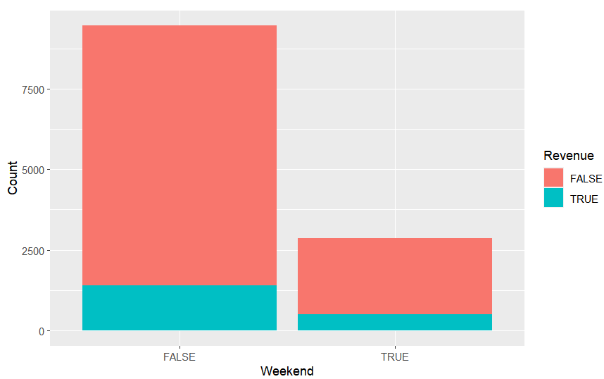
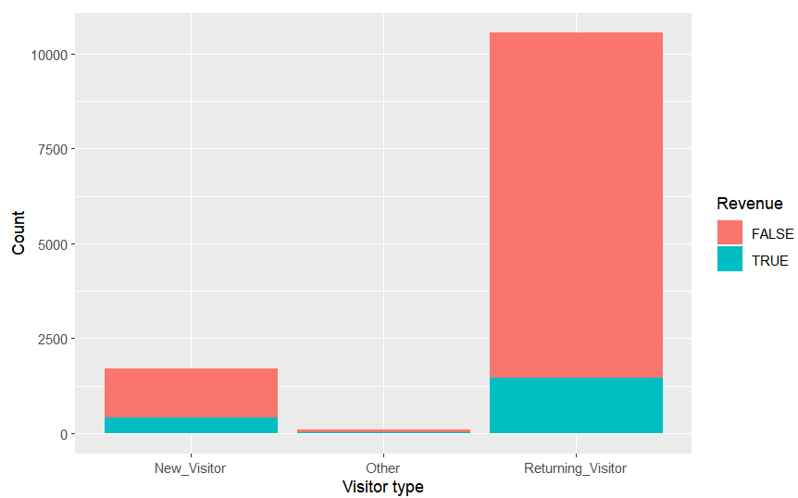
10)“Weekend” features versus the target variable Revenue.
11)“Visitor Type” features versus the target variable Revenue.

Slide 29
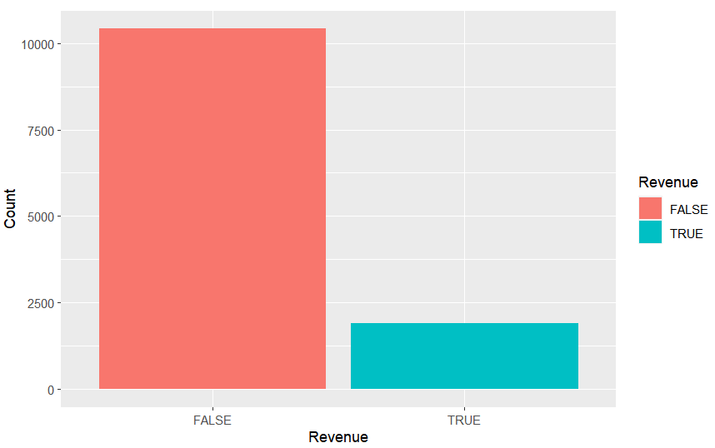
12) Data distribution of “Revenue” feature
FALSE | TRUE
10422 | 1908

Slide 30
Supervised

Slide 31
Model Training and Results
1) Naive Bayes
Results:
One hot encoding data
Average accuracy: 75.6%
Data without one-hot encoding
Average accuracy: 84.5%
Prediction | Reference
 | 0 | 1
0 | 31.6 | 6.0
0 | 18.4 | 44.0
Prediction | Reference
 | 0 | 1
0 | 84.5 | 15.5
0 | 0 | 0

Slide 32
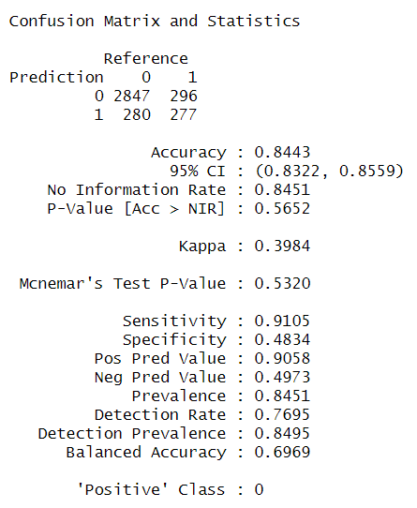
2) k-Nearest Neighbor
Trained on one-hot encoded dataset

Slide 33
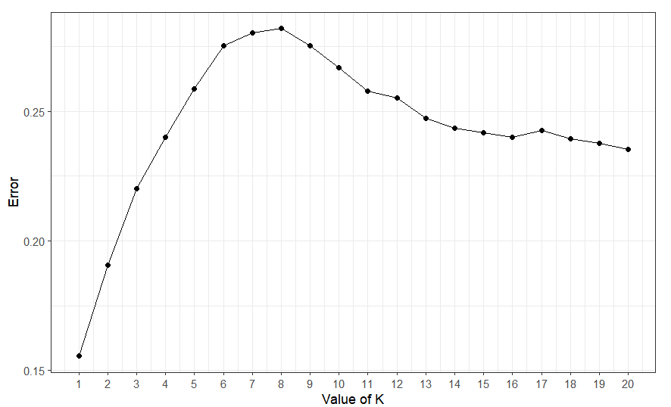
Visualizing KNN with different k values(number of nearest neighbor)
Lowest error with k=1

Slide 34
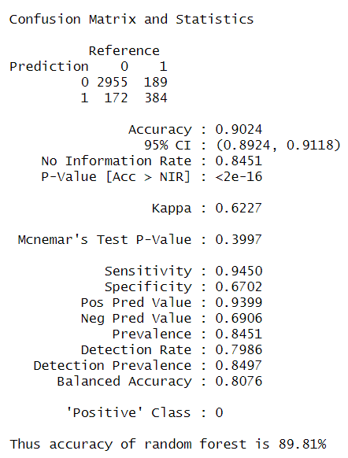
3) Random Forest
Results: Recursive Feature Elimination
 | Attribute | Accuracy
14 | Region | 0.9667576
17 | Weekend | 0.9665521
13 | Browser | 0.9664835
16 | VisitorType | 0.9664151
15 | TrafficType | 0.9660722
12 | OperatingSystems | 0.9651126
11 | Month | 0.9651125
10 | SpecialDay | 0.9644273
9 | PageValues | 0.9629195
8 | ExitRates | 0.9603834
7 | BounceRates | 0.9568190
6 | ProductRelated_Duration | 0.9446862
5 | ProductRelated | 0.9267302
4 | Informational_Duration | 0.9051401
1 | Administrative | 0.8694320
3 | Informational | 0.8509948
2 | Administrative_Duration | 0.8483216

Slide 35
Feature variable importance table
Feature variable importance table | MeanDecreaseAccuracy
Administrative | 25.740664
Administrative_Duration | 29.428259
Informational | 22.772219
Informational_Duration | 22.896964
ProductRelated | 44.383527
ProductRelated_Duration | 37.415946
BounceRates | 35.813305
ExitRates | 34.568105
PageValues | 135.122725
SpecialDay | 8.007717
Month | 68.915250
OperatingSystems | 19.990634
Browser | 45.293001
Region | 62.972472
TrafficType | 39.930089
VisitorType | 12.686405
Weekend | 25.540213

Slide 36
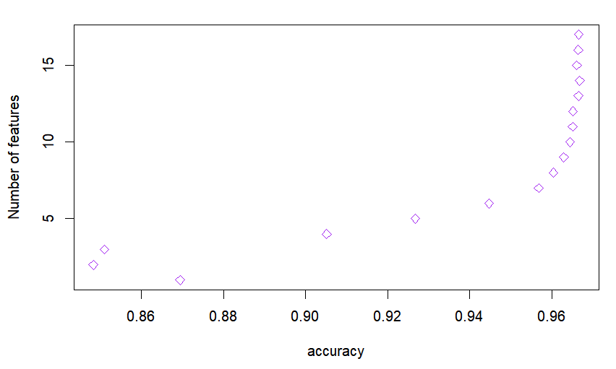
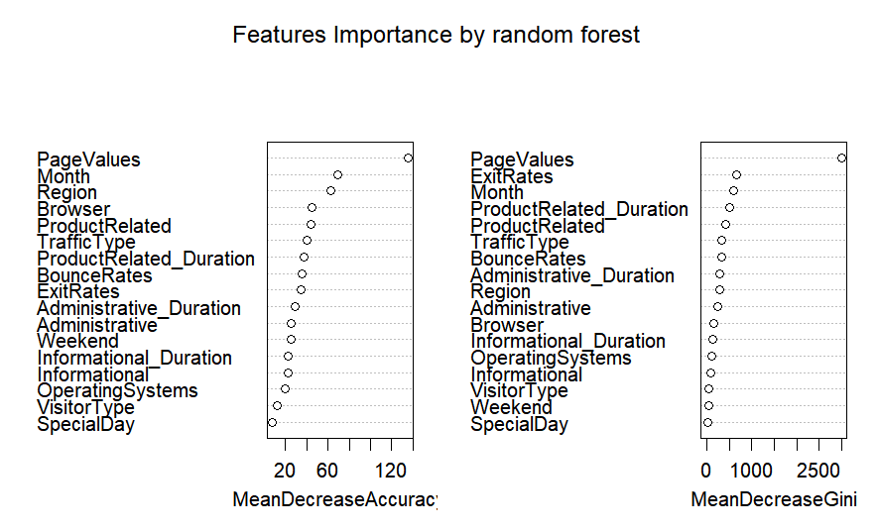
Number of features vs Accuracy plot  Variable importance plot

Slide 37
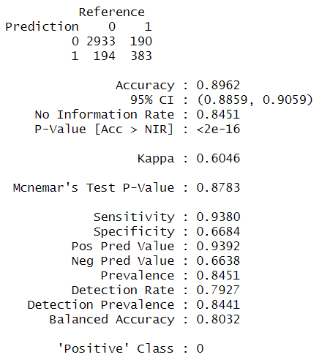
Random forest trained on top 10 features
Results
Top 10 features
PageValues
Month
Region
Browser
ProductRelated
TrafficType
ProductRelated_Duration
BounceRates
ExitRates Administrative_Duration

Slide 38
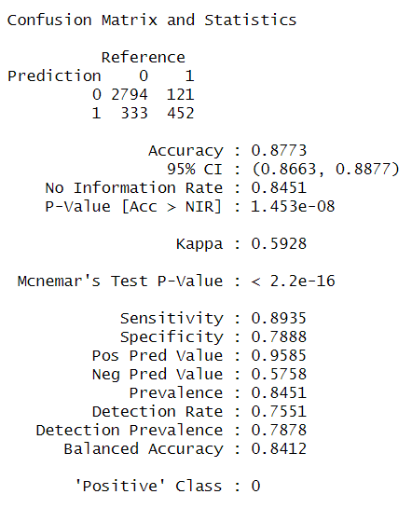
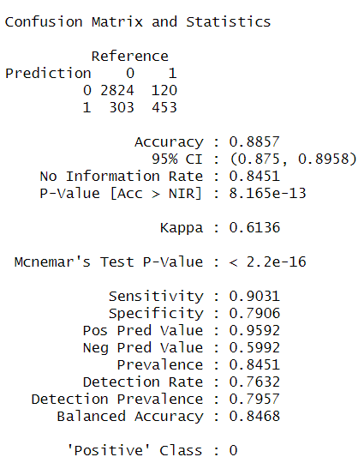
4) Support Vector Machine
Kernel : Linear Kernel : Radial
Result Result

Slide 39
5) XG Boost
[1] train | auc:0.940757 | test | auc:0.909651
[2] train | auc:0.949137 | test | auc:0.918012
[3] train | auc:0.952685 | test | auc:0.922717
[4] train | auc:0.954565 | test | auc:0.926051
[5] train | auc:0.957042 | test | auc:0.926611
[6] train | auc:0.958906 | test | auc:0.927626
[7] train | auc:0.961152 | test | auc:0.927922
[8] train | auc:0.963121 | test | auc:0.927406
[9] train | auc:0.963852 | test | auc:0.926375
[10] train | auc:0.965559 | test | auc:0.925545
[11] train | auc:0.967358 | test | auc:0.925664
[12] train | auc:0.969143 | test | auc:0.924629
[13] train | auc:0.970182 | test | auc:0.924950
[14] train | auc:0.970923 | test | auc:0.924509
[15] train | auc:0.973319 | test | auc:0.923537
[16] train | auc:0.974383 | test | auc:0.923199
[17] train | auc:0.975294 | test | auc:0.923111
Training parameters
a)objective = "binary:logistic"
b)eta = 0.3
c)max_depth = 6
d)eval_metric = "auc"
e)Nrounds = 100
f)Early stopping rounds = 10
Stopping. Best iteration:
[7] train-auc:0.961152 test-auc:0.927922

Slide 40
Un-supervised Learning

Slide 41
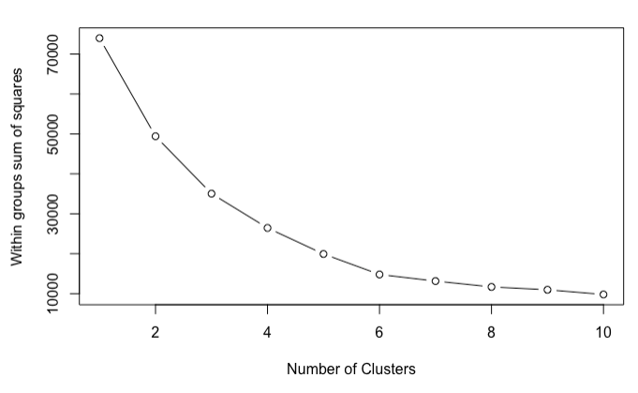
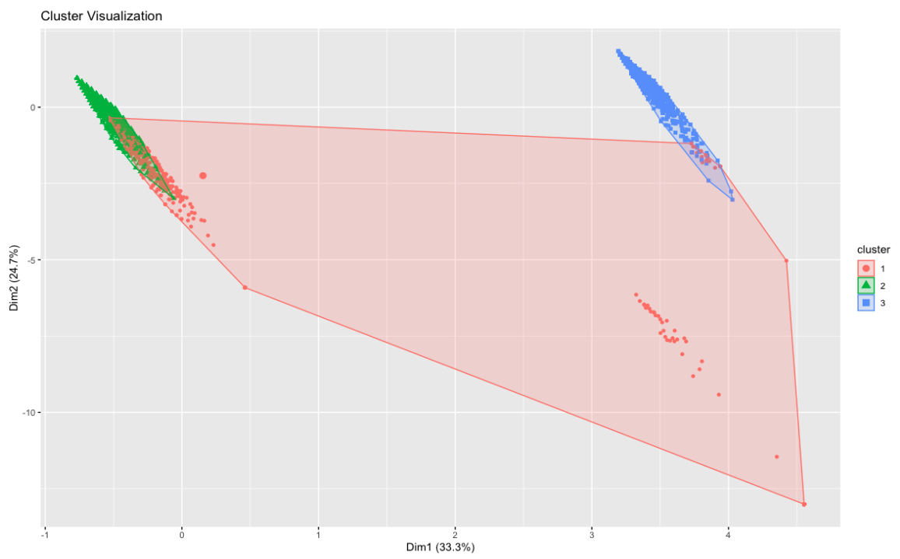
K-Means Clustering
Clusters has been identified using Elbow method, and from the clustered plot we can say that most of the data can be clustered into 3 clusters.

Slide 42
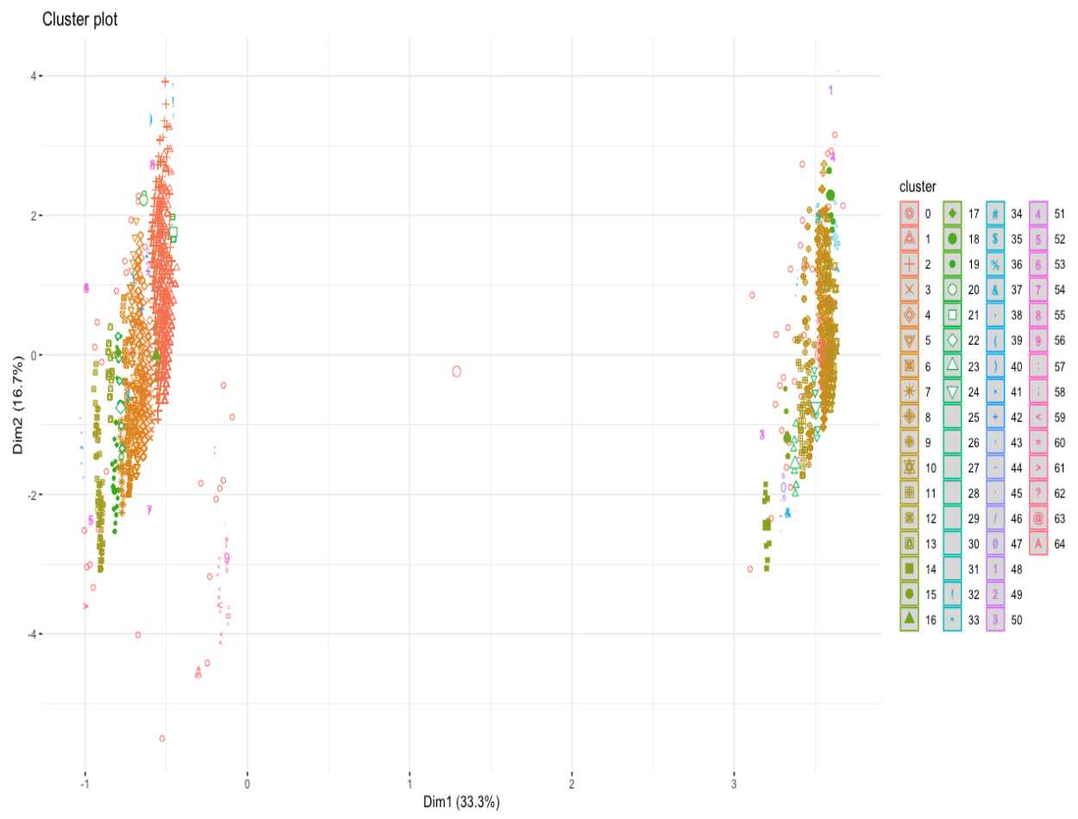
DBScan Clustering
As name says this is a density-based clustering algorithm that groups data points into clusters based on their density. DBSCAN is particularly useful for datasets with irregular shapes and noises. But our dataset was mostly without the noises and hence the results were as below

Slide 43
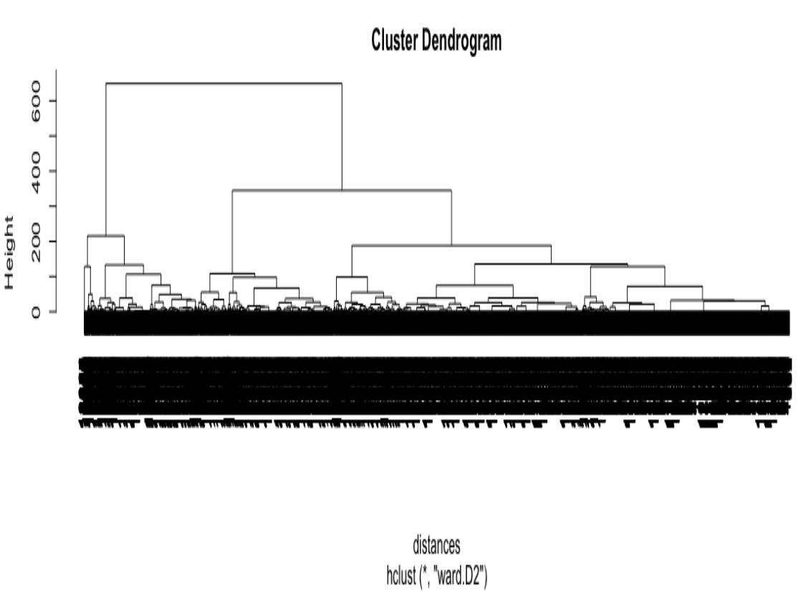
Hierarchical clustering:
This is another unsupervised learning algorithm that clusters data points into a tree-like structure based on the similarity between them. Hierarchical clustering can be either agglomerative (bottom-up) or divisive (top-down).

Slide 44
Future Work

Slide 45
Future Work
We would plan to work more on the data gathering, we did look into it but couldn’t find the similar datasets.
Work on couple more research question for example, “How does web metrics influence the revenue.”
Will explore and try to implement MLOps best practices by designing and creating a end-to-end pipelines.
Would explore Gaussian Mixture Models for the clustering and also analyse the clusters indepth.

Slide 46
Conculsion

Slide 47
Conclusion
Analysing number of page visit of 3 different page categories it clearly says that customers are interested more in Product related pages rather than knowing information of the product in detail.
Revenue is generated by the customers who visit the product page and spend more time on it, which intuitively mean whom ever spends more time on administrative and informational page will only hop around rather than end up buying.
Discounts can be given to the ones who spend more time on Product related page.
There is no noticeable disparity in Bounce Rates between customers who made a purchase and those who did not.
However, customers who ended up making a purchase had lower Exit Rates on average, indicating that they were more likely to remain on the website's pages.
Additionally, customers who did not make a purchase had significantly lower Page Values, suggesting that they spent less time on related pages.

Slide 48
Bibliography
[1]. https://jurnal-ppi.kominfo.go.id/index.php/jppi/article/view/341
[2]. Real-time prediction of online shoppers’ purchasing intention using multilayer perceptron and LSTM recurrent neural networks [ https://link.springer.com/article/10.1007/s00521-018-3523-0 ]
[3]. Data Clustering: A Review [ https://dl.acm.org/doi/pdf/10.1145/331499.331504 ]
[4]. A Comparison Study of Credit Card Fraud Detection: Supervised versus Unsupervised [ https://arxiv.org/pdf/1904.10604.pdf ]
[5].Real-Time Prediction of Online Shoppers Purchasing Intention Using Random Forest [ https://www.ncbi.nlm.nih.gov/pmc/articles/PMC7256375/ ].

Slide 49
Thank You

