Slide 1
ANALYSIS OF RESTAURANT DISTRIBUTION IN THE CITY OF CHENNAI
By S Karthik Krishnan

Slide 2
BUSINESS UNDERSTANDING
To analyse the restaurant distribution in the city of Chennai.
To cluster them into meaningful groups that provide useful insights while choosing a location to open a restaurant.
The target stakeholders are individuals that are involved in or are interested in the restaurant industry and is especially useful for stakeholders interested in opening up restaurants in different venues in the city.
The reason for choosing Chennai is because it is one of the major metropolitan cities in the country of India and considering the fact that India is a developing nation with ever-growing middle class, it makes sense that a large number of stakeholders could benefit from this analysis.

Slide 3
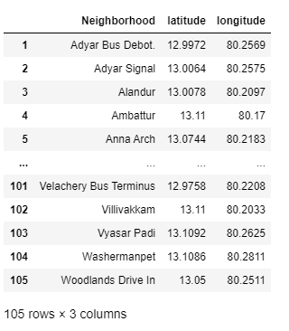
DATA PREPARATION – Location information
The latitude and longitude data of the different neighbourhoods in the city of Chennai:- https://chennaiiq.com/chennai/latitude_longitude_areas.asp
Beautiful soup module in python is used to extract the information from the website and put it into a pandas dataframe.
The latitude and longitude data is obtained in DMS system and is converted to decimals system for convenience and ease of usage.

Slide 4
DATA PREPARATION – Venue information
The venue information is obtained from the foursquare website by making API calls.
The url for the API calls involve the Client ID, client SECRET, the version date (upto date) , the latitude and longitude of the location, the radius about which the information is to be returned, the limit on number of instances to be returned and the endpoint( explore? Or categories? Or search? Etc)
The API call looks as shown below:-
This API call is sent for each neighbourhood and the venue data returned is stored into a dataframe by using a for loop to extract the required informationfrom the venues dictionary

Slide 5
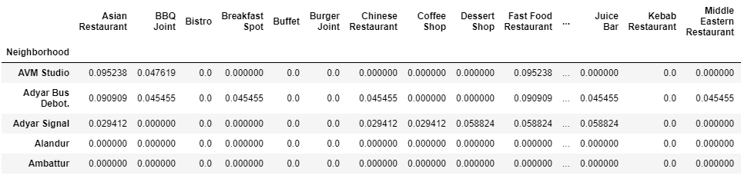
METHODOLOGY – ONE HOT ENCODING
The data is in the form of categorical information and cannot be fed into a clustering or machine learning algorithm easily. As a result, one hot encoding is performed to convert the information into n columns, where n corresponds to the number of categories and each column either has a 0 or 1.
When we find the mean of this column grouped about the neighbourhood data,we get the dataframe ready for clustering.

Slide 6
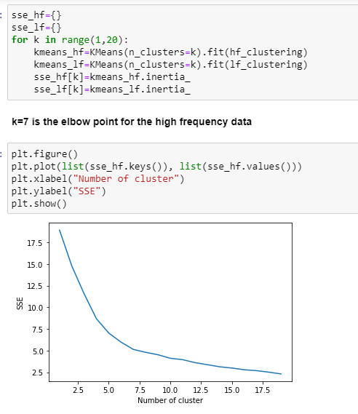
METHODOLOGY – KMEANS CLUSTERING
The data is now clustered using an
unsupervised learning algorithm called
kmeans clustering. The data splits the
information into k clusters based on the
minimum sum of squares distance within
clusters.
To find the ideal k value, we loop it for
different values of k and choose the k
at the elbow point of the graph of
K vs SSE

Slide 7
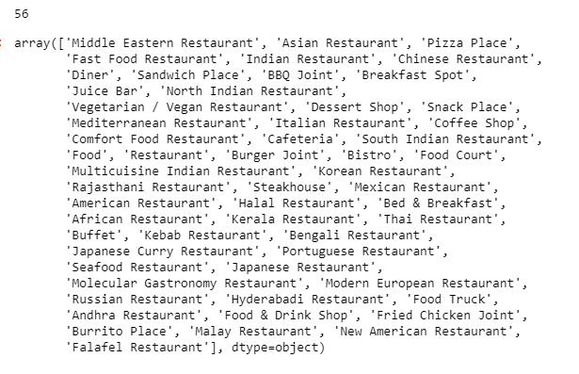
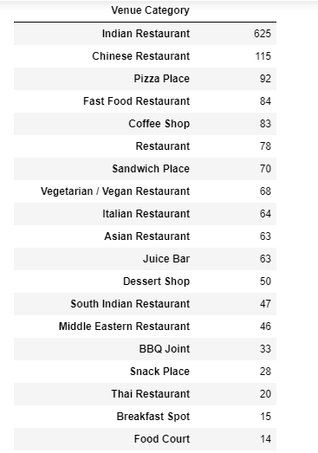
METHODOLOGY – DISTRIBUTION ANALYSIS
The restaurant distribution has been analysed and the following information is of great importance
Restaurant categories Quantitative distribution

Slide 8
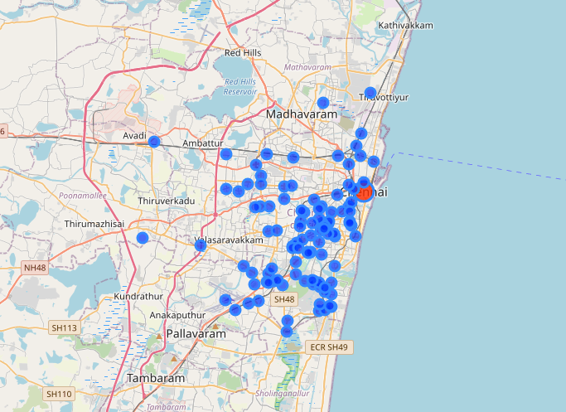
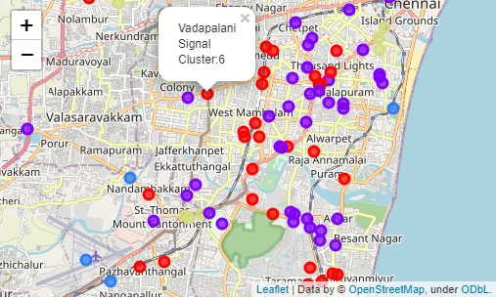
METHODOLOGY – CLUSTER REPRESENTATION
The neighbourhoods with the respective clusters are shown on a folium map
Neighbourhoods Cluster representation
(city centre in red) (cluster labels shown in popup)

Slide 9
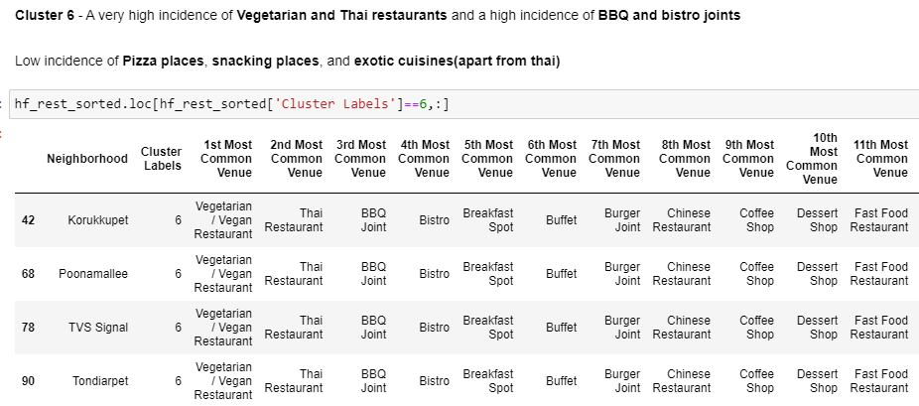
METHODOLOGY – CLUSTER ANALYSIS
For example, cluster 6 has information displayed as shown below.
The above table shows the restaurant distribution for neighbourhoods in cluster 6 and it shows a clear excess of vegan and thai restaurants and a clear lack of pizza places and snacking places. (The end columns aren’t present in the screenshot but have been taken into consideration for the analysis).

Slide 10
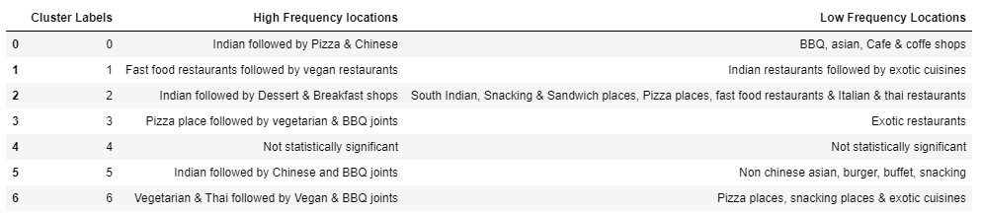
METHODOLOGY – CLUSTER ANALYSIS
Similarly, all the clusters were analysed and the information has been combined into a table as shown below.

Slide 11
RESULT, DISCUSSION AND CONCLUSION
The analysis focuses on retrieving all the venues in Chennai, accurately filtering out the restaurants and clustering them to analyse the neighbourhoods
The analysis showed an exceptionally high number of Indian restaurants and a reasonably high number of Chinese restaurants
the few major areas that had a major lack of Indian restaurants were identified which could be crucial for stakeholders interested in entering the Indian restaurant game.
For a future design, the data could be fed into an app or platform where based on the type of restaurant or choice of area, the cluster data, similar neighbourhoods, distribution of restaurants etc can be easily obtained.
Final decision on optimal restaurant location will be made by stakeholders based on specific characteristics of neighbourhoods and locations in every recommended zone, taking into consideration additional factors like attractiveness of each location.

