Slide 1
Flight Fare Prediction
Using Machine Learning
Submitted by: Karthik KS
ICFOSS Hybrid Internship Program

Slide 2
Program Background
Conducted by International Centre for Free and Open Source Software (ICFOSS).
Focuses on practical computing and open-source development.
Bridges the gap between theory and hands-on implementation.
Final objective: Develop and deploy a full machine learning model.

Slide 3
Problem Statement
Airline ticket prices are highly dynamic and fluctuate based on various factors.
Goal: Build a predictive model to estimate domestic flight prices in India.
Provides users with a clear expectation of ticket costs before booking.
Allows airlines to understand which features drive pricing the most.

Slide 4
The Dataset
Source: Kaggle (Flight Price Prediction Dataset).
Size: Over 300,153 flight booking records.
Key Features Used:
- Airline Name (Vistara, Air India, Indigo, etc.)
- Source & Destination Cities
- Days Left until Departure
- Flight Duration

Slide 5
Methodology & Preprocessing
1. Data Cleaning: Removed empty rows and invalid data.
2. Outlier Removal: Used the IQR (Interquartile Range) method to remove crazy price spikes.
3. Encoding: Used One-Hot Encoding to convert text (like Airline names) into numbers (0s and 1s).
4. Scaling: Standardized numerical data (like duration) so the model trains fairly.
5. Splitting: 80% data for training, 20% for testing.

Slide 6
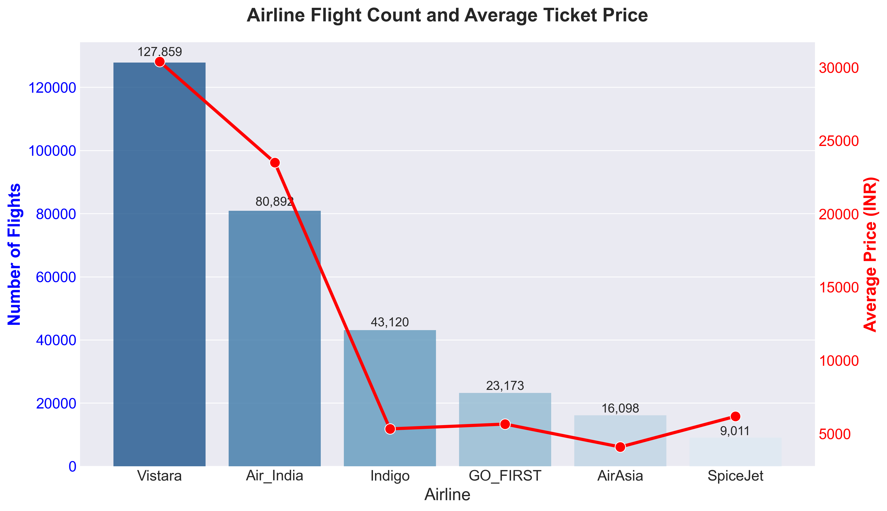
Exploratory Data Analysis

Slide 7
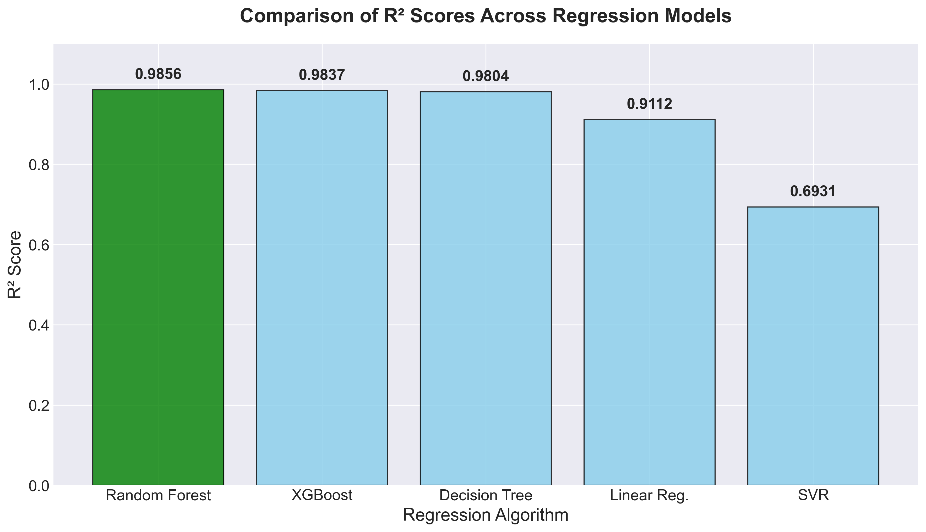
Comparing Machine Learning Models

Slide 8
Results: Why Random Forest?
Random Forest Regressor was the absolute best performer.
R² Score: 98.56% (It explains 98.5% of the variance in ticket prices).
Mean Absolute Error (MAE): Only ~1,250 INR.
Why? Random Forest is an 'ensemble' model (it combines many decision trees), making it perfect for complex, non-linear airline pricing data.

Slide 9
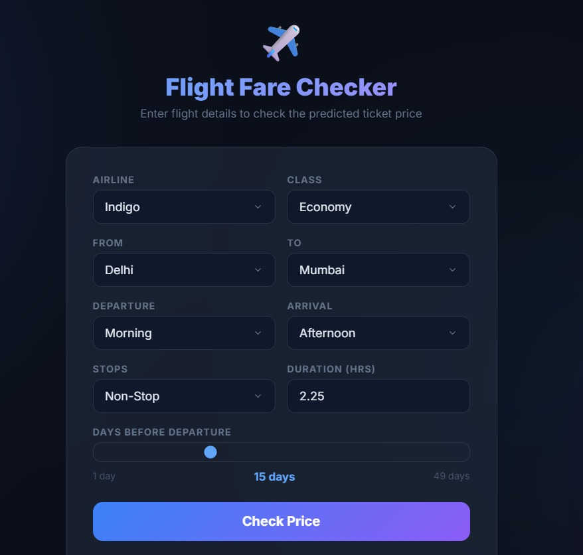
Web Application Deployment (Flask)

Slide 10
Live Demo & Q&A
Thank You!

