Slide 1
TOP INVESTMENT SECTORS IN DIFFERENT COUNTRIES
Name: Karthik K V

Slide 2
Abstract
Global Trends of investments across various sectors show that Venture type is the most sought after funding type, and USA, UK, China, India, Canada hubs for investments and most investments are happening here.
The project dives into the facts and figures for various fund types in different countries and the sectors which are most favorable for investments in these countries.

Slide 3
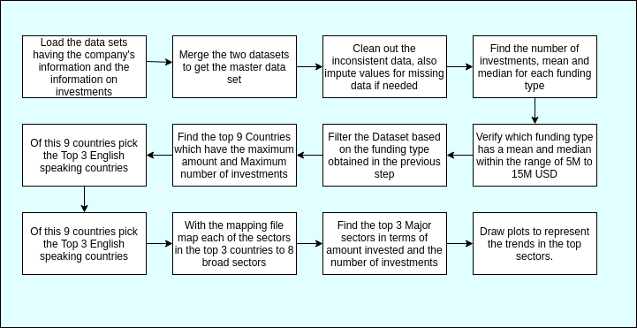
Problem solving methodology

Slide 4
Analysis
First data was imported from companies.csv and rounds.csv. All encoding errors are resolved and loaded into two dataframes.
After merging the companies.csv data with the rounds.csv data we get about 114949 entries.
We see that funding_round_code column has only 31140 entries. Most of the data is missing for this column. So dropping this column.
The raised amounts for various funding types have 0 values and the standard deviation is also very high. Hence removing these rows with NULL values since they constitute to only about 14% of data.
We then find the number of investments under each type of funds. Venture and Seed clearly have a lot more number of investments than the other types. Followed by Debt Financing, Angel, Grant and Private Equity.

Slide 5
Analysis
We then find the total amount of investments for different types of funds. Here Venture, Private equity and debt_financing have more amount invested in them. This shows that Private equity and Debt financing has an average investment which is far greater than Venture. Venture seems to have a balanced Investment amount.
Since these funds vary over a wide range of values and many values are concentrated across a certain interval for each type of funds. Hence if we look at the Median values. Only venture and post_ipo_equity have the values between 5 and 15 Million USD. From the above 3 observations its clearly evident venture is the best fund type to invest in for our requirement.
Additionally on looking at the average amount of in investments, we see that venture has an average of about 11 Million USD. Hence this is the best fund type to invest in, if we are looking to invest in the 5 Mil to 15 Mil range

Slide 6
Analysis
When we look at the countries, USA, China, UK, India Canada and France have the highest investments made both in terms of amount and number of investments.
Picking the top 3 English speaking nation among them, we get USA, UK and India.
Then we categorize the sectors into 8 main sectors and on filtering out by the top 3 countries we find the top 3 sectors in each of those countries. Results provided in the subsequent graphs.

Slide 7
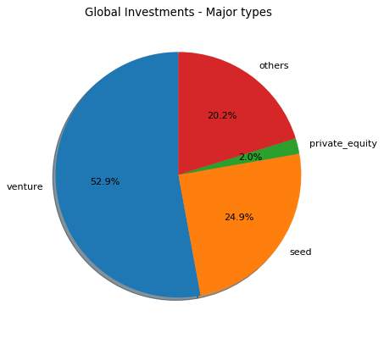
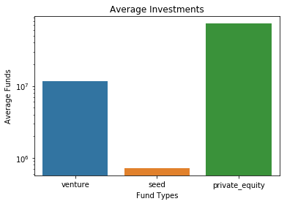
Results

Slide 8
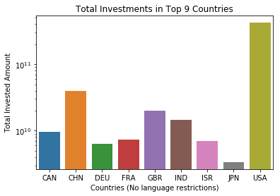
Results
The top 5 countries as evident from the graph are USA, China, UK, India, Canada and France
Of these the top 3 English speaking countries are USA, UK and India.

Slide 9
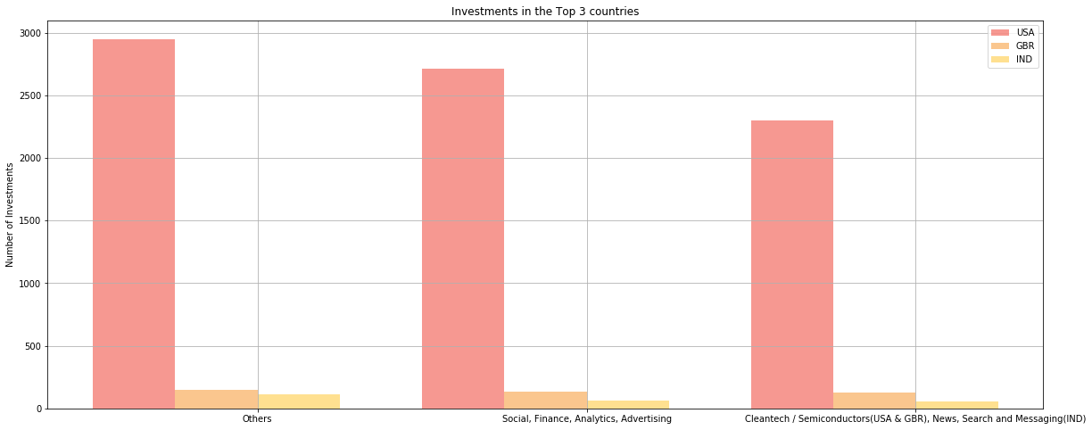
Results: Sector Wise Analysis for the top 3 countries

Slide 10
Conclusions
Globally, Venture funds are the most sought after funding type.
Most of the Investments occur around 5 Million USD for Venture type funds and the average Investment amount is 11.7 Million USD. Hence its the best investment in the Range 5-15 Million USD.
The Top 3 English Speaking Countries are USA, UK and INDIA. This is where most of the investments happen among the English speaking countries.
‘Others’, ‘Social, Finance, Analytics, Advertising’, ‘Cleantech / Semiconductors’ are the top sectors for Venture type investment in the US and UK.
‘Others’, ‘Social, Finance, Analytics, Advertising’, ‘News, Search and Messaging’ are the top sectors for Venture type investment in India.

