Slide 1
Operating Systems (An Introduction)
Notes:
Motivation…
Operating systems most interesting piece of software in the system
Interface with both hardware and software
Need to have a good knowledge of computer organization
Unlike normal programs, time plays a crucial role
A program may behave differently when run multiple times.
Strange behavior of functions.
A function call may not ever return
Or may return to some other location
Need to understand from the middle of the function
All these reasons make the OS code not very intuitive
What to expect from this course.
Good computer architecture background
A lot of playing around with pointers in C
‹#›

Slide 2
The Layers in Systems
Applications
Operating Systems
Computer Organization
VLSI
Transistors
‹#›
Notes:
Eg. Take a mobile phone.
‹#›

Slide 3
OS usage
Hardware Abstraction
turns hardware into something that applications can use
Resource Management
manage system’s resources
‹#›

Slide 4
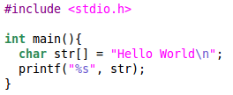
A Simple Program
What is the output of the following program?
How is the string displayed on the screen?
‹#›

Slide 5
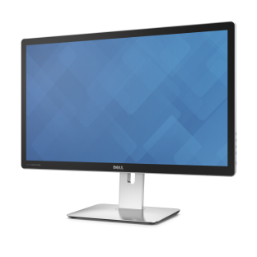
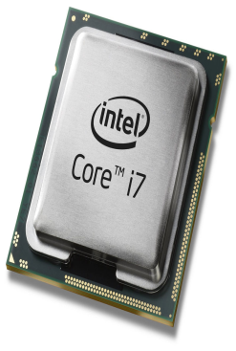
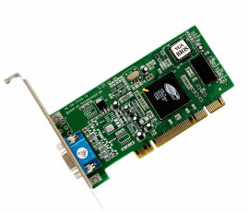
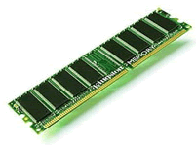
Displaying on the Screen
“Hello World” +
coordinates, color,
depth, etc
Monitor
“Hello World”
Processor
Main Memory
(RAM)
Graphics Card
Can be complex and tedious
Hardware dependent
Without an OS, all programs need to take care of every nitty gritty detail
‹#›
Notes:
‹#›
The programmer must
Determine coordinates for display
transfer the string “Hello World” to video card memory along with specifics such as color, depth for every pixel, etc
Each video card needs to be programmed for modes, depth, refresh rates, etc.
The programmer must keep therefore know which display and video card is being used.
Difficult and very tedious as it needs to be repeated for every program written
The programmer must
Determine coordinates for display
Transfer the string Hello World to Graphics card along with coordinates and attributes such as color, depth of every pixel etc.
Each video card needs to be programmed differently.

Slide 6
Operating Systems provide Abstraction
App
system call
(write to STDOUT)
Operating System
device
driver
Easy to program apps
No more nitty gritty details for programmers
Reusable functionality
Apps can reuse the OS functionality
Portable
OS interfaces are consistent. The app does not change when hardware changes
‹#›

Slide 7
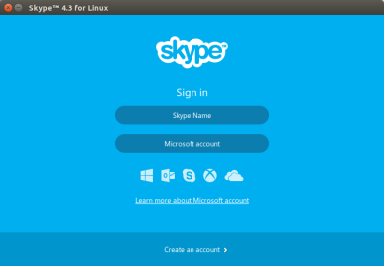
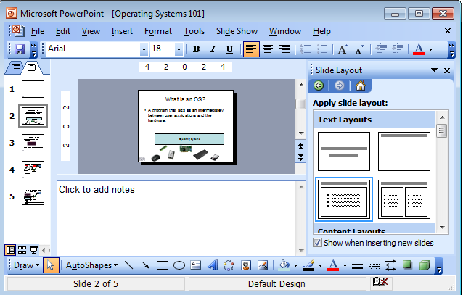
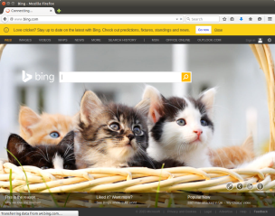
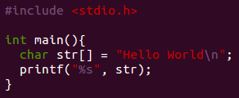

OS as a Resource Manager
Multiple apps but limited hardware
Apps
Operating Systems
Allows sharing of hardware!!
‹#›

Slide 8
OS as Resource Manager
OS must manage CPU, memory, network, secondary storage (hard disk), etc…
Resource management
allows multiple apps to share resources
protects apps from each other
Improves performance by efficient utilization of resources
‹#›

Slide 9
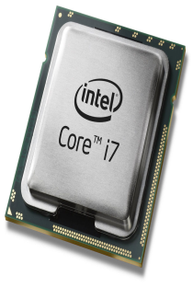
Sharing the CPU
App1
App2
App3
App4
Who uses the CPU?
App1
App2
App3
App4
time
pre‹#›

Slide 10
Sharing Memory
App1
App2
App3
App4
Main Memory
Which App uses which memory?
‹#›

Slide 11
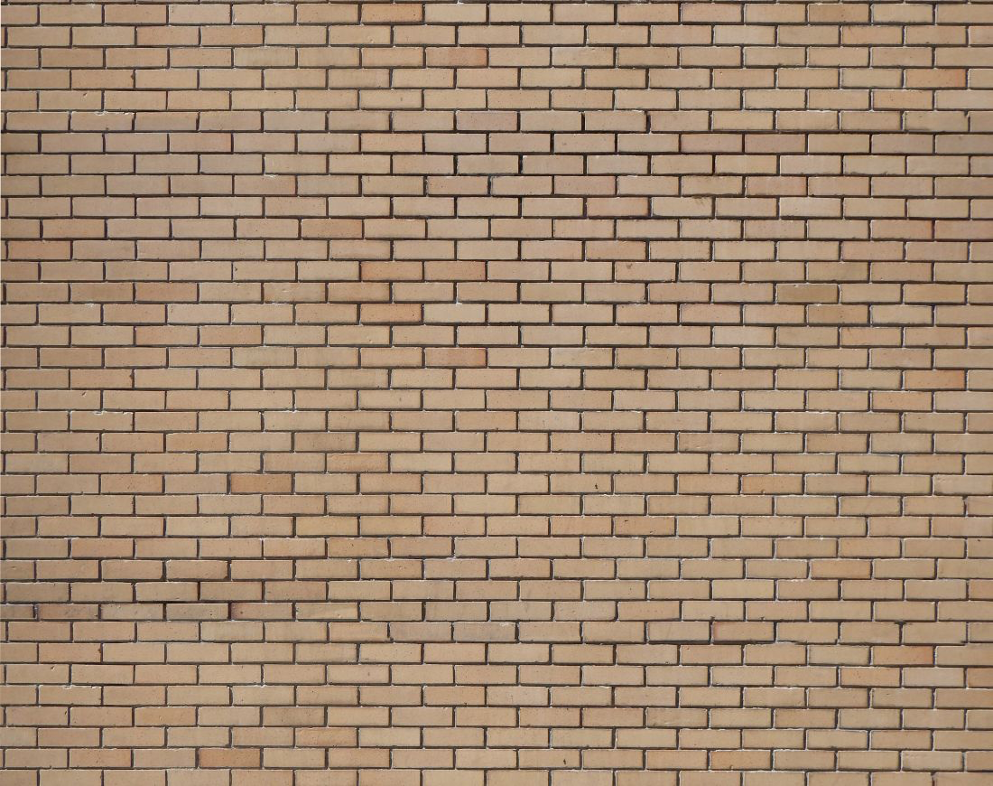
Share but Isolate
App1
App2
App3
App4
Share resources but keep applications isolated from each other
‹#›

Slide 12
Operating Systems Types
Application Specific
Embedded OS
eg. Contiki OS, for extremely memory constraint environments
Mobile OS
Android, iOS, Ubuntu Touch, Windows Touch
RTOS
QNX, VxWorks, RTLinux
Secure Environments
SeLinux, SeL4
For Servers
Redhat, Ubuntu, Windows Server
Desktops
Mac OS, Windows, Ubuntu
‹#›

Slide 13
xv6
Designed for pedagogical reasons
Unix like (version 6)
Looks very similar to modern Linux operating systems
Theory classes : xv6
Well documented, easy to understand
https://pdos.csail.mit.edu/6.828/2012/xv6.html
‹#›
Notes:
Version 6. Unix standard developed in the 70s
Smaller code, well documented, easier to understand
‹#›

