Slide 1


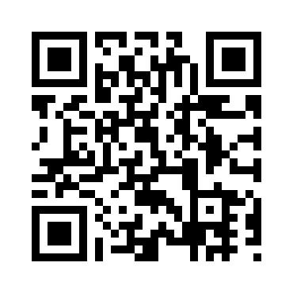
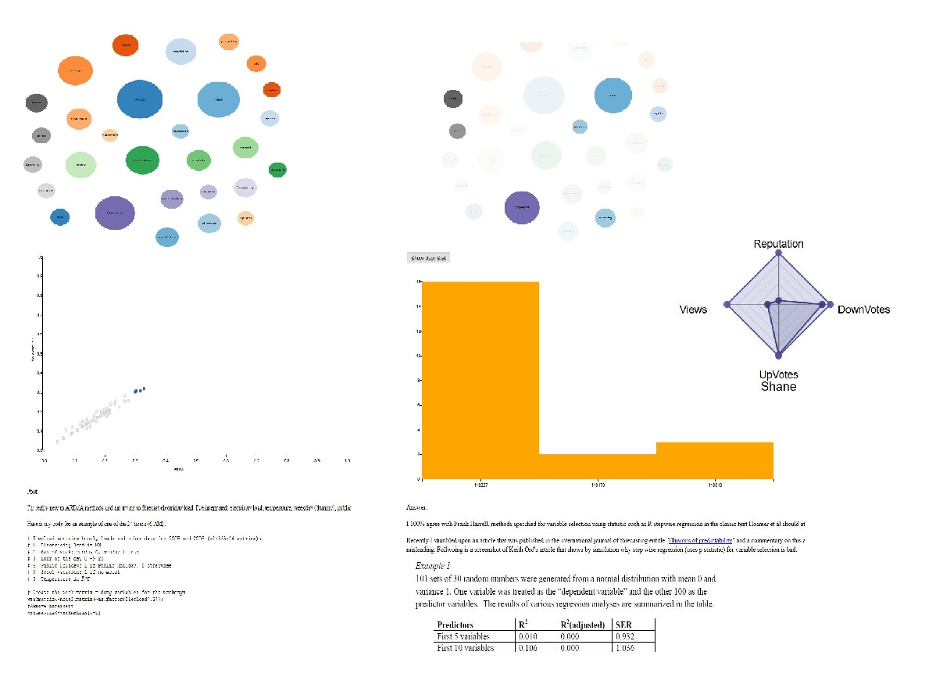
Analysis of topics and relations in Cross Validated
Karthik Lakshmi Narayana Sarma, Arizona State University, klakshm6@asu.edu
Venkata Guru Sai Srikanth vemulakonda, Arizona State University, vvemulak@asu.edu
Sagar Burra ,Arizona State University ,sburra@asu.edu
Jaswitha Vankineni , Arizona State University ,jvankine@asu.edu
Motivation & Relevant Work:
Analyzing the Cross Validated website content and discovering the most frequently used topics and their relations helps engineering community to know the needs of developers better.
What Developers are talking about ? An Analysis of Stack Overflow data (Anton Barua, Stephen W. Thomas, and Ahmed E. Hassan ,2012).
Why, When, and What: Analyzing Stack Overflow Questions by Topic, Type, and Code (Miltiadis Allamanis, Charles Sutton School of Informatics ,Edinburgh EH8 9AB, UK)
Research Questions:
How do communities /developers know about new trends in particular language that helps to study about the needs of the developers?
How do we identify closely related topics and determine post – topic similarity based on latent semantic structures ?
Can we provide accurate post that deals with specific topic in which, user is interested?
How do we identify significant posts through topic similarity and how to display using Euclidean measure ?
Methodology:
Text Analysis :{Term Frequency is used to find most frequently used topics and topics that are tightly coupled to each topic}
Pre-processing done through lemmatization, removing stop-words and common English words.
Used term frequency as a metric in determining the most frequently used topics.
Topic Modeling : {Identifying to which topic the post belongs and portraying the most relevant posts for given two topics}
Constructed the common words vector for the selected two topics and calculated binary vectors for each topic using the word vector.
Each post is considered as a document and cosine similarity is determined based on topic and post vectors. Based on the similarity values, the 2D graph is plotted. The post that lie in between and farther away is the most appropriate post that talks about both the user selected topics.
Data Collection:
Cross Validated (http://stats.stackexchange.com/)
(Sampled year from 2010 till 2016) of forum posts in topic R from cross validated {14,109 questions, 13,781 answers}
Findings:
Identified significant posts through plots drawn based on cosine similarity between post – topic content.
Probability values (p>0.5) for post-topic similarity shows valuable post.
Identified constructive answers based on user-user comparison for a given post.
Web plot shows which user contributions are important.

