Slide 1
AAI-500 Group 4 Project
Prediction of Carbon Monoxide (CO) Levels Using Machine Learning
Kalyan Brata Majumder Karthik Mekala
MS in Applied Artificial Intelligence University of San Diego
Supervisor: Prof. Anuj Kumar Sirohi
February 23, 2026

Slide 2
Background & Motivation
Air pollution is a major global health risk.
Pollutants such as CO, NOx, Benzene and Ozone impact human health and environment.
Real-time prediction helps in:
Early warning systems
Pollution control strategies
Smart city monitoring
This study uses the UCI Air Quality dataset to model and predict pollutant concentration.

Slide 3
Problem Statement
Objective:
Predict Carbon Monoxide (CO) concentration using environmental and sensor variables.
Build a statistical / machine learning model
Evaluate prediction accuracy and interpret pollutant relationships.

Slide 4
Scientific Justification for Selecting Carbon Monoxide as Target Variable
Public Health Significance - According to WHO and US EPA, both acute and chronic CO exposure significantly increase respiratory and cardiovascular risk, even at relatively low concentrations.
CO is a primary pollutant, emitted directly from incomplete combustion and provides real-time information about emission-driven pollution.
Correlation analysis shows CO has strong positive association with combustion-related pollutants:
CO–C6H6 ≈ High correlation
CO–NOx ≈ Strong correlation
CO–NO₂ ≈ Significant correlation
CO therefore acts as a proxy indicator of overall urban air pollution.

Slide 5
Dataset Description
Source: UCI Machine Learning Repository.
Dataset: Air Quality Dataset.
Time period: March 2004 – April 2005.
Measurements taken hourly.
Contains sensor readings + environmental variables.

Slide 6
Data Cleaning/Preparation
Missing Values
Removed empty columns and NMHC(GT)
Imputed missing values using Iterative Imputer
Time-Series Preparation
Combined Date + Time → Datetime
Sorted chronologically
Set Datetime as index
Data Cleaning
Removed duplicates
Ensured consistent and valid dataset
Result
Clean, complete, and model-ready dataset

Slide 7
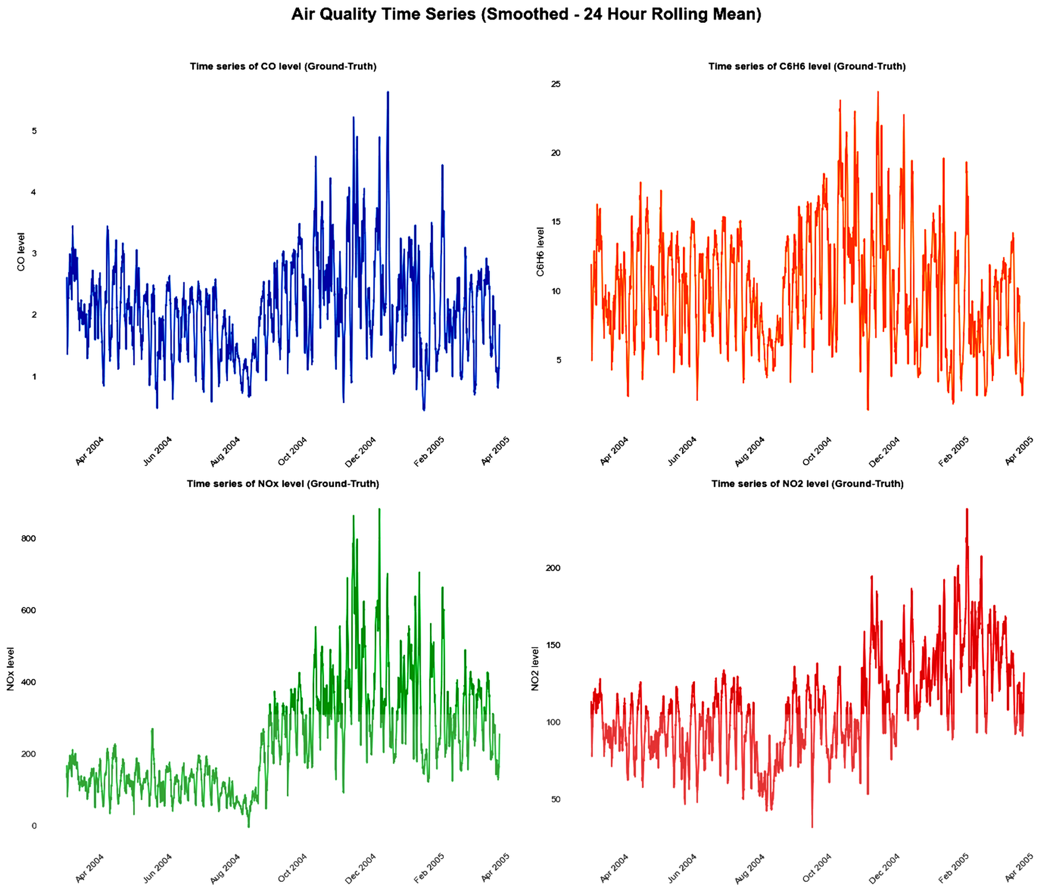
Exploratory Data Analysis (EDA)

Slide 8
Exploratory Data Analysis (EDA)
Interpretation of the time-series plot
Seasonal Increase in Pollution (Oct–Feb, Italy)
Observation
Pollutant levels (CO, NOx, NO₂, C₆H₆) are highest from October to February.
Main Reasons
Temperature Inversion: Cold air traps pollutants near the ground.
Winter Heating: More emissions from wood, gas, and oil heating.
Cold Vehicle Starts: Higher CO and NOx emissions.
Po Valley Geography: Mountains restrict airflow and trap pollution.
Conclusion
Winter weather + increased emissions + geographic trapping cause high pollution during Oct–Feb, consistent with patterns seen in EDA.

Slide 9
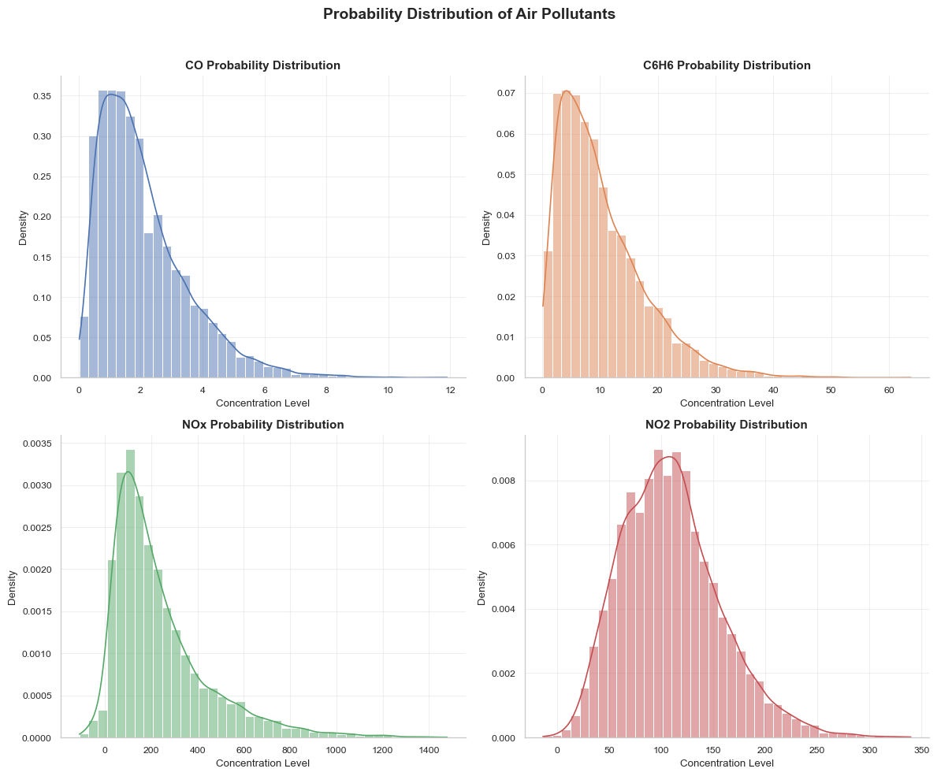
Exploratory Data Analysis (EDA)
Distribution of Pollutants

Slide 10
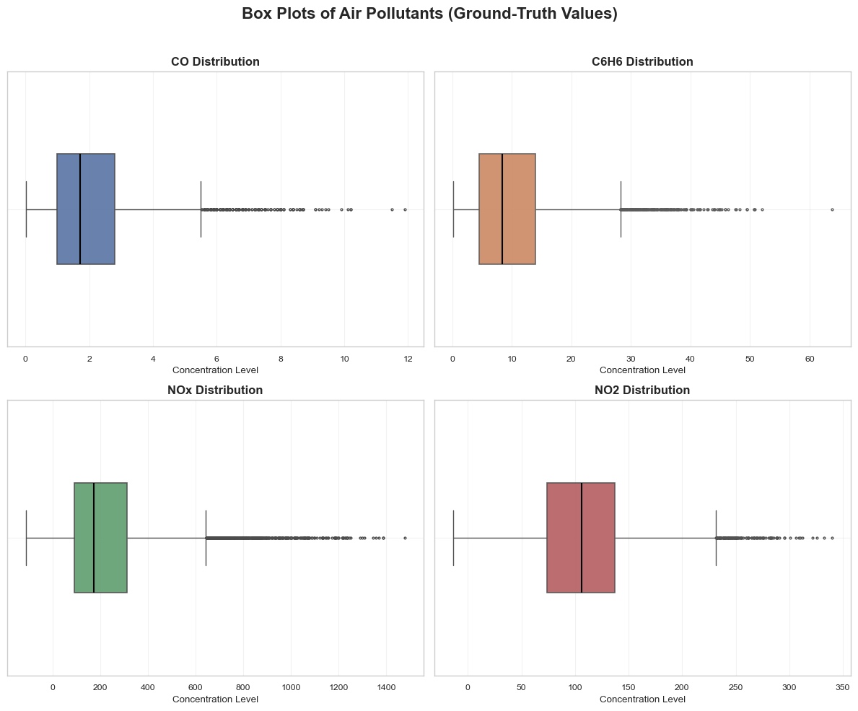
Exploratory Data Analysis (EDA)
Distribution of Pollutants

Slide 11
Exploratory Data Analysis (EDA)
Interpretation of Pollutants Distribution
Observation
All pollutants show right-skewed distributions
Boxplots reveal significant variability and presence of outliers.
Interpretation
Most of the time , pollution levels are low or moderate.
Outliers represent real , high-pollution episodes, not data errors.
High variability confirms pollutants are dynamic and time-dependent, supporting predictive modeling.

Slide 12
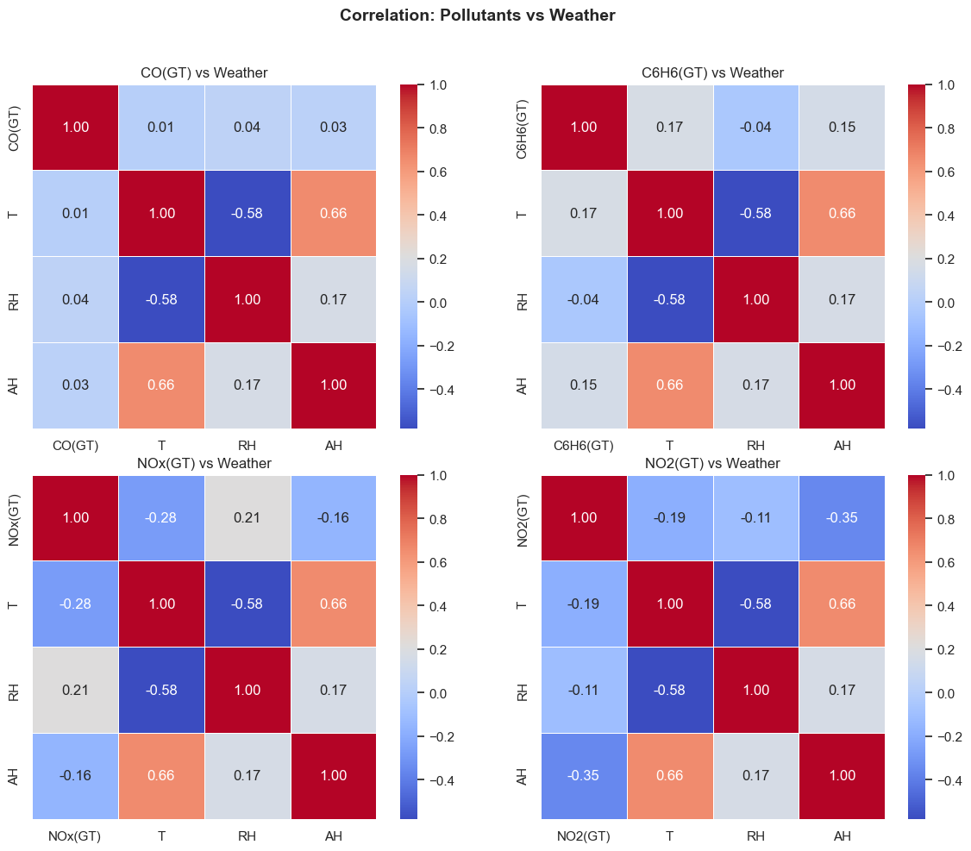
Exploratory Data Analysis (EDA)
Influence of Meteorological Factors on Air Pollutants

Slide 13
Exploratory Data Analysis (EDA)
Influence of Meteorological Factors on Air Pollutants
Observations
Temperature and humidity shows moderate negative correlation with NOx and NO₂
CO has very weak correlation with meteorological parameters.
Interpretation
NOx: Decreases with rising temperature. This is related to better atmospheric dispersion.
NO₂: Decreases with higher moisture levels. Moisture converts NO₂ to nitric acid (HNO₃) on wet surfaces/droplets and this removes NO₂ from air.
Weather impact on NO₂ is stronger than on CO, C₆H₆, and NOx, as supported by the data.

Slide 14
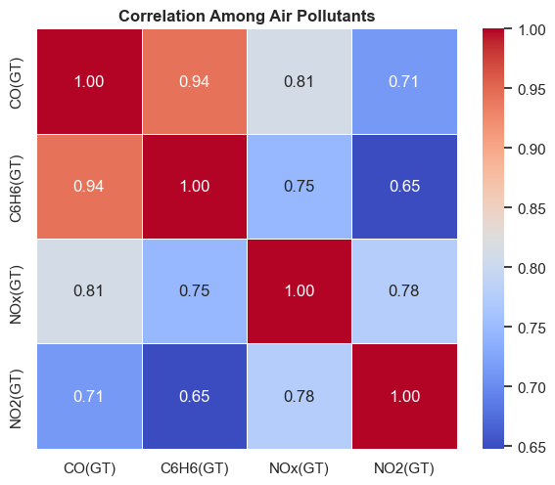
Exploratory Data Analysis (EDA)
Correlation Structure Among Major Air Pollutants

Slide 15
Exploratory Data Analysis (EDA)
Correlation Structure Among Major Air Pollutants
Observations
Strong positive correlation between CO and C6H6 (≈ 0.94).
CO also shows high correlation with NOx (≈ 0.81) and NO₂ (≈ 0.71).
C6H6 is strongly correlated with NOx (≈ 0.74) and moderately with NO₂ (≈ 0.64).
All pollutants exhibit positive association, indicating linked behavior.
Interpretation
Strong correlations indicate common emission sources, primarily vehicular and combustion-related pollution.
CO behaves as a representative proxy pollutant for overall combustion-driven air pollution.
High pollutant interdependence supports multivariate modeling approach.
Correlation structure explains why CO can be predicted effectively using other pollutants.
Results confirm pollution is system-driven rather than independent random behavior.

Slide 16
Predictive Model for Carbon Monoxide (CO) Concentration
Model Description
A Generalized Linear Model (GLM) with Gaussian family was developed to estimate CO(GT) concentration.
Input predictors included:
Combustion related pollutants : C6H6(GT), NOx(GT), NO₂(GT)
Meteorological variables : Temperature (T), Relative Humidity (RH), Absolute Humidity (AH)
Date and time
CO sensor readings excluded to avoid data leakage
Dataset was divided into training and testing subsets (70-30 ratio) to evaluate model performance.

Slide 17
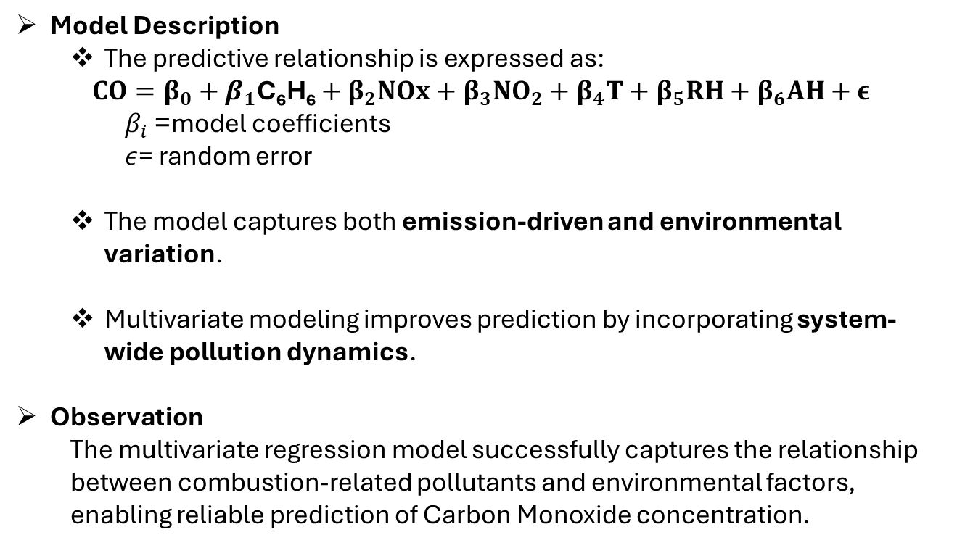
Predictive Model for Carbon Monoxide (CO) Concentration
Model Description
The predictive relationship is expressed as:
$$CO=β_{0}+β_{1}\text{C}\text{₆}\text{H}\text{₆}+β_{2}NOx+β_{3}NO_{2}+β_{4}T+β_{5}RH+β_{6}AH+ε$$
$β_{i}$= model coefficients
$ε$= random error
The model captures both emission-driven and environmental variation.
Multivariate modeling improves prediction by incorporating system-wide pollution dynamics.
Observation
The multivariate regression model successfully captures the relationship between combustion-related pollutants and environmental factors, enabling reliable prediction of Carbon Monoxide concentration.

Slide 18
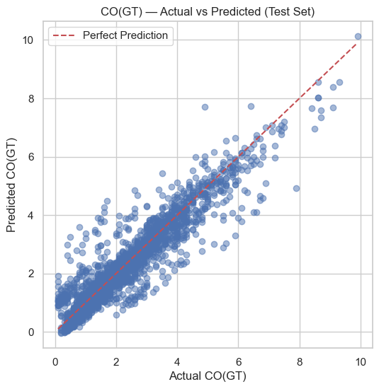
Predictive Model for Carbon Monoxide (CO) Concentration
Model performance

Slide 19
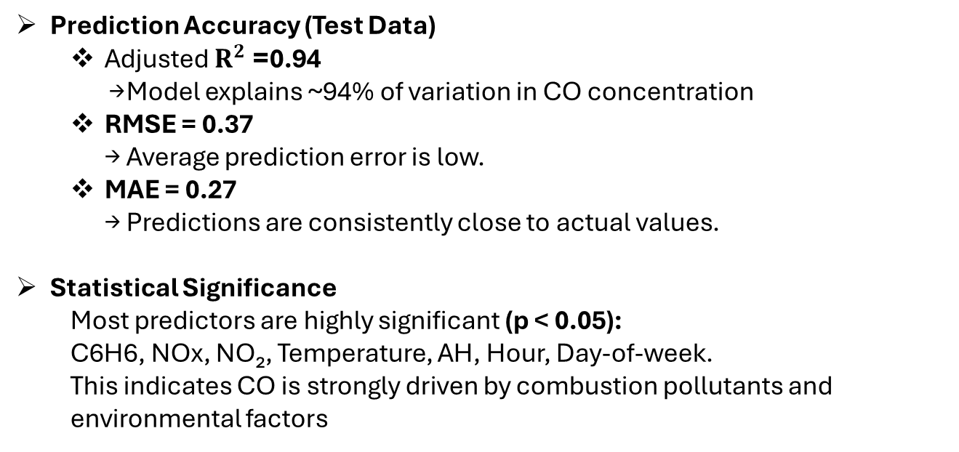
Performance Evaluation of CO Prediction Model
Prediction Accuracy (Test Data)
Adjusted $R^{2}$= 0.94 → Model explains ~94% of variation in CO concentration
RMSE = 0.37 → Average prediction error is low.
MAE = 0.27 → Predictions are consistently close to actual values.
Statistical Significance
Most predictors are highly significant (p < 0.05):
C6H6, NOx, NO₂, Temperature, AH, Hour, Day-of-week.
This indicates CO is strongly driven by combustion pollutants and environmental factors

Slide 20
Limitations of the CO Prediction Model
Key Limitations
Limited Geographic Scope - Model may not generalize directly to other cities with different emission patterns and meteorological conditions.
Missing External Influencing Factors – Important real-world variables not included:
Wind speed and direction
Traffic intensity
Industrial activity
Rare high-pollution spikes are harder to model accurately.
Model Constraints
While the model demonstrates strong predictive capability, its performance is constrained by data limitations, unobserved environmental factors, and challenges in modeling extreme pollution events.

Slide 21
Future Work
Model Enhancement - Extend current framework to deep learning–based time-series models (LSTM / RNN) to capture non-linear and long-term temporal dependencies.
Improve modeling of extreme pollution events and complex atmospheric dynamics.
Improve prediction by modeling pollution dispersion and emission variability.
Include important external drivers:
Wind speed and direction
Traffic intensity / vehicular load
Industrial emission indicators

Slide 22
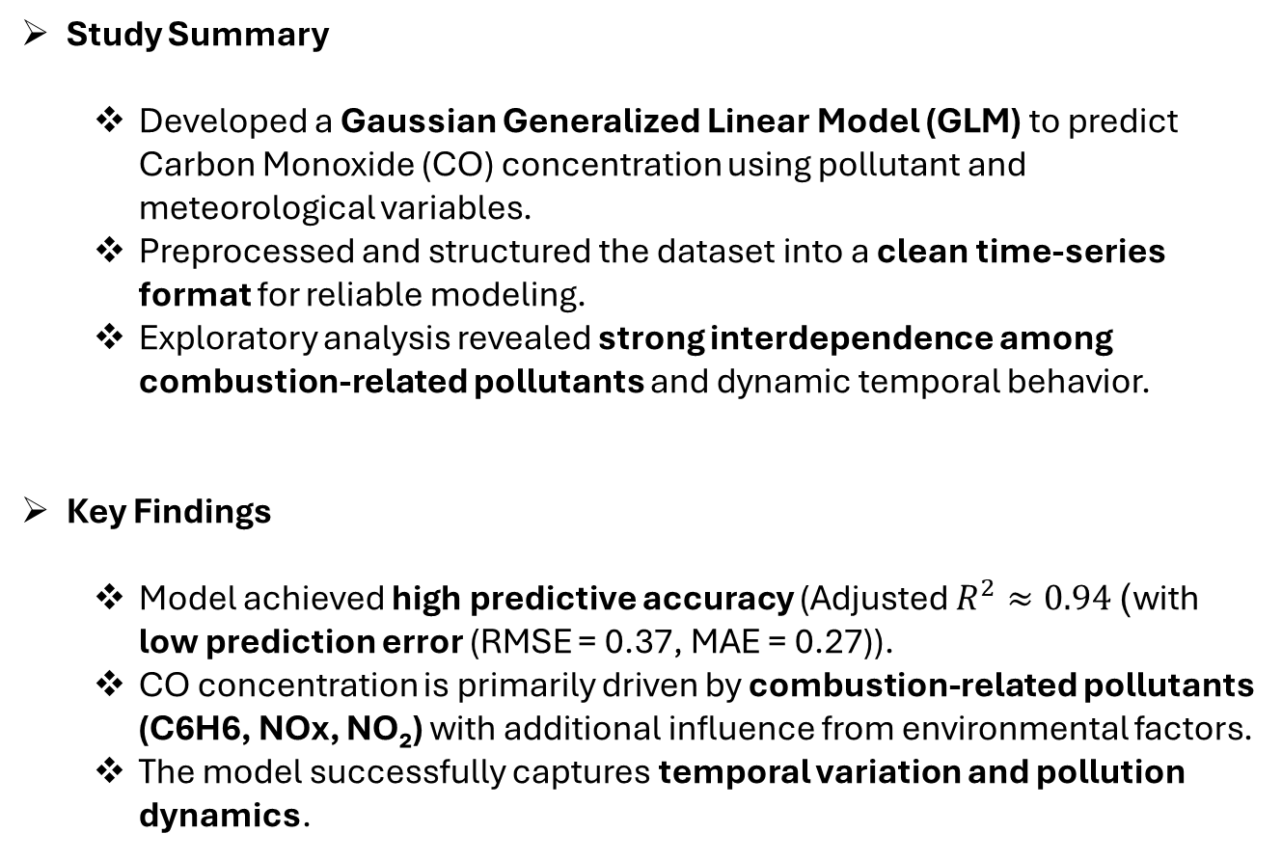
Conclusion
Study Summary
Developed a Gaussian Generalized Linear Model (GLM) to predict Carbon Monoxide (CO) concentration using pollutant and meteorological variables.
Preprocessed and structured the dataset into a clean time-series format for reliable modeling.
Exploratory analysis revealed strong interdependence among combustion-related pollutants and dynamic temporal behavior.
Key Findings
Model achieved high predictive accuracy (Adjusted $R^{2}≈0.94$) with low prediction error (RMSE = 0.37, MAE = 0.27)).
CO concentration is primarily driven by combustion-related pollutants (C6H6, NOx, NO₂) with additional influence from environmental factors.
The model successfully captures temporal variation and pollution dynamics.

Slide 23
Individual Contributions
Kalyan Brata Majumder
Performed data cleaning and handled missing value imputation.
Developed correlation heatmaps between pollutants and meteorological variables
Analyzed correlation structure among major air pollutants
Built the Carbon Monoxide (CO) predictive model using Generalized Linear Model
Prepared and finalized the presentation content
Conducted a comparative analysis with prior research, by Wang (2025), to assess relative predictive performance, interpretability, and methodological differences.
Karthik Mekala
Conducted exploratory data analysis (EDA)
Developed time-series visualization and probability distribution analysis of pollutants
Created boxplot visualizations for pollutant distribution
Prepared and finalized the technical report
Designed and structured the complete GitHub repository, including project setup and documentation
Radhakrishna Lambu
Due to academic withdrawal during the project period, all research, analysis, and implementation were carried out by the remaining two team members.

