Slide 1
INVESTMENT ASSIGNMENT SUBMISSION
Name: Karthik M N

Slide 2
Investment Analysis
OBJECTIVE
Investment constraints
STRATEGY
To help Spark Funds analyze global trends of investments and help the CEO take investment decisions effectively.
Investments between 5 Million and 15 Million USD
English speaking countries
Spark wants to invest where most other investors are investing
Region :
Our goal is to find the best English speaking countries to invest in ,this can be achieved by identify the countries with most investments in past.
Investment type:
Spark is looking to invest in the best investment type among Angel, Seed, Venture Capital and Private Equity . We have to identify the one that will fit Sparks bill.
Sectors :
The investments have been categorized into 8 different sectors , we have to identify the sectors that is attracting most investments.
GOAL
S

Slide 3
Problem solving methodology
Business Understanding
Data Import
Understanding data
& Data Modelling
Understand the objectives and goals
Import all the required files
1.Understand data
2.Merge data
3.Treat missing values
4.Retain required features
DATA ANALYSIS
Data Plotting
Sector Analysis
1.Map primary sector to Main sector
2.Identify top 3 sectors of top 3 English speaking countries
Country Analysis
1.Identify top 9 countries with highest investments
2.Select top 3 English speaking countries
Investment Type Analysis
1.Identify Best Funding Type
2.Average Investment between 5 and 15 million USD
Plot graphs to visualize and make better inferences

Slide 4
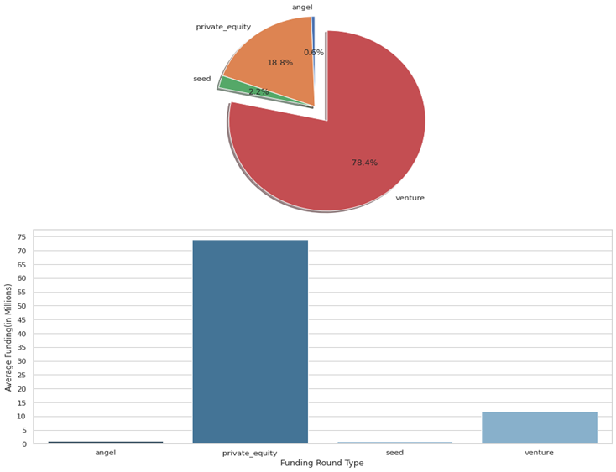
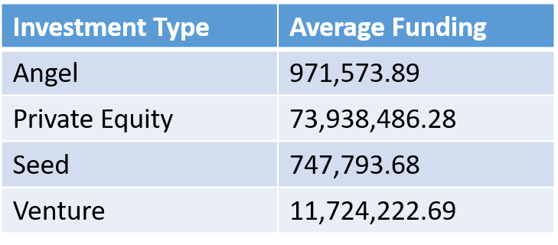
Investment Type analysis
Analyzing the average investments in the 4 investment types that spark wants to invest in.
Venture Investment seems to draw the majority portion of all the 4 investments .(1st chart)
Venture investment has an average investment between 5 and 15 million USD(2nd Chart),and others don’t.
Venture Investment is the most appropriate investment type for spark.

Slide 5
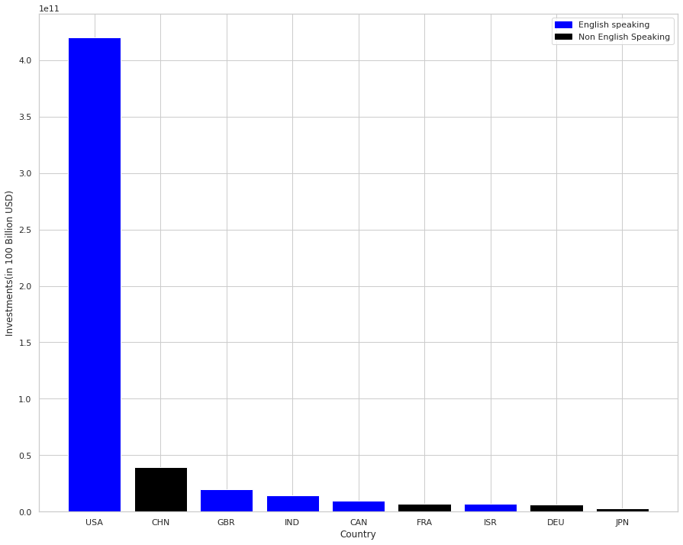
Country Analysis
Spark wants to invest in countries that have highest prior investments.
It’s focus is on English speaking nations ,as it would help in easing communications
The top 9 countries with highest prior investments are USA,CHN,GBR,IND,CAN, FRA,ISR,DEU,JPN
Amoung these,the top 3 English speaking nations are :USA , Britain and India (Highlighted in Blue)
Country | Total Investments
USA | 420,068,029,342.00
CHN | 39,338,918,773.00
GBR | 20,072,813,004.00
IND | 14,261,508,718.00
CAN | 9,482,217,668.00
FRA | 7,226,851,352.00
ISR | 6,854,350,477.00
DEU | 6,306,921,981.00
JPN | 3,167,647,127.00

Slide 6
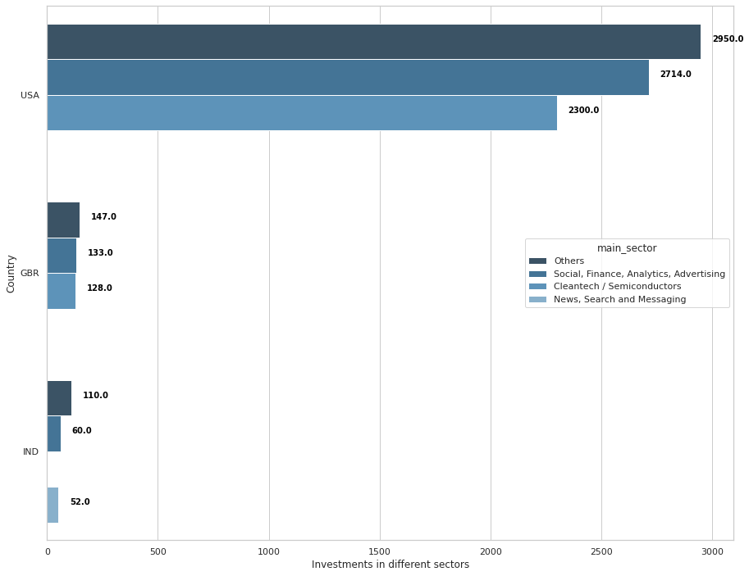
Sector Analysis
We have categorized primary sectors into 8 main sectors
Analyzing the data to Identify the top 3 main sectors across India , USA and Britain.
The main sectors that have attracted most investments in USA and Britain are “others” , “Social, Finance, Analytics, Advertising” and “Cleantech / Semiconductors” in the same order.
The main sectors that have attracted most investments in India are “others” , “Social, Finance, Analytics, Advertising” and “News, Search and Messaging” in that order.

Slide 7
Conclusions
Venture
USA
Others
Social, Finance, Analytics, Advertising
BRITAIN
Others
Investment Type
Best Countries to invest in
Best Sectors to invest in
INDIA
Cleantech / Semiconductors
Cleantech / Semiconductors
Others
Social, Finance, Analytics, Advertising
News, Search and Messaging
Social, Finance, Analytics, Advertising
As per our Analysis ,We can conclude that Spark can follow the below mentioned investment strategy :
The best investment that Spark should consider making is in the USA in others sector , the investment that would suit spark is Venture type. This ensures that Spark is investing with the trend .i.e. where most other companies are investing.
For more diverse investment strategy, spark can follow the below mentioned investment strategy ( IT SHOWS THE BEST INVESTMENT TYPE ,COUNTRIES AND SECTORS TO INVEST IN ):
To put it in words- the best investment type is venture type.
The top 3 suitable countries to invest in are – USA ,GBR and India.
Suitable sectors for investments in UK and USA are – Others, Social/Finance/Analytics/Advertising & Cleantech/Semiconductors
Suitable sectors for investments in India are – Others, Social/Finance/Analytics/Advertising & News, Search and Messaging.

