Slide 1


Slide 2
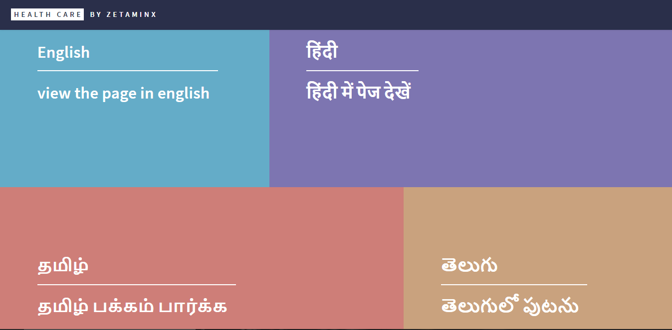

Slide 3
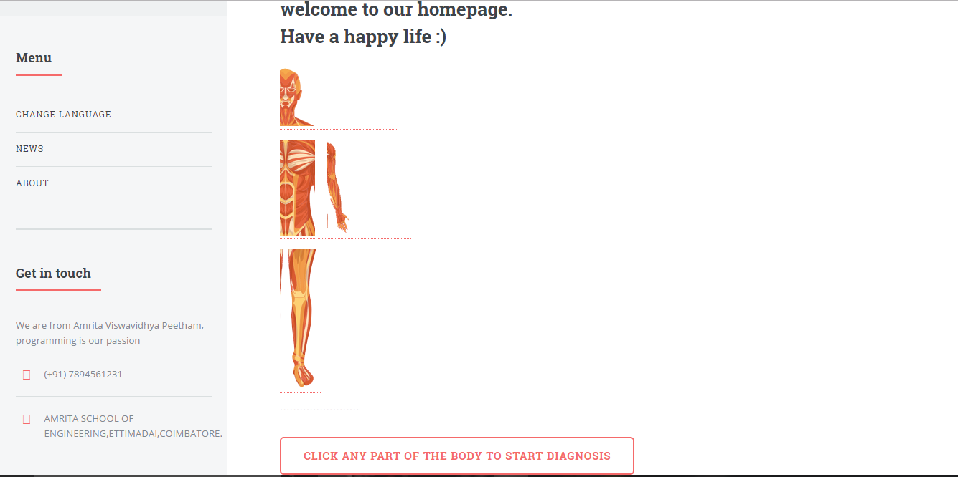

Slide 4
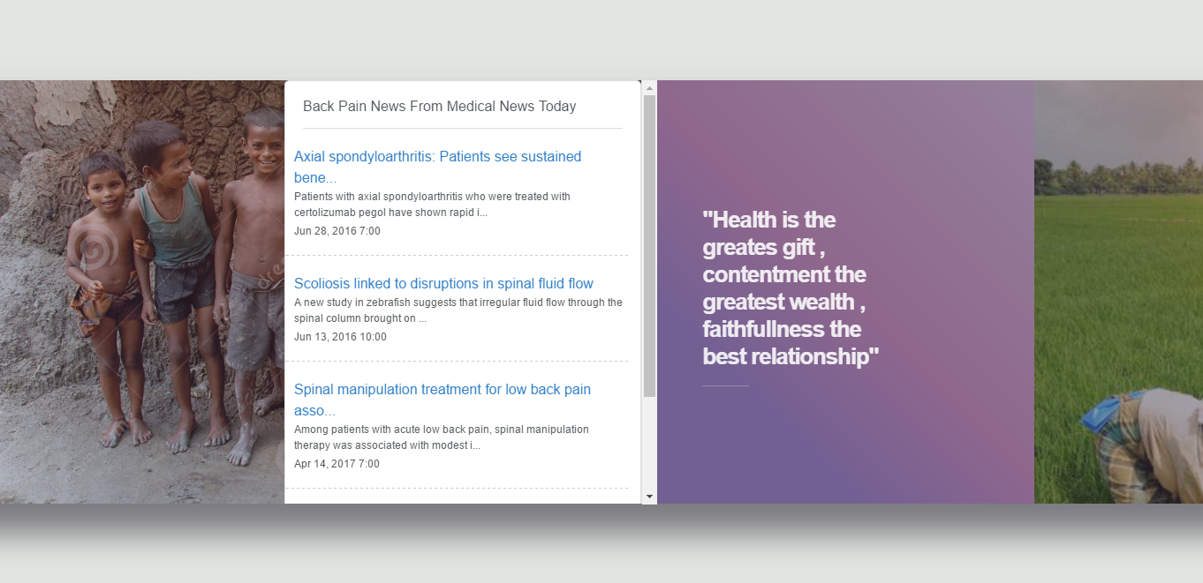

Slide 5


Slide 6


Slide 7


Slide 8


Slide 9
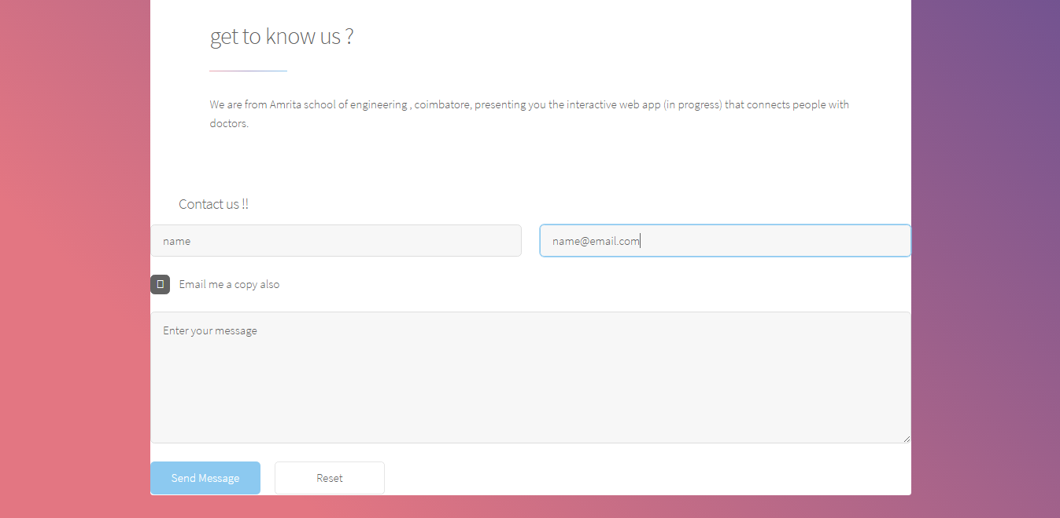

Slide 10
Why Diary Entry is important?

Slide 11
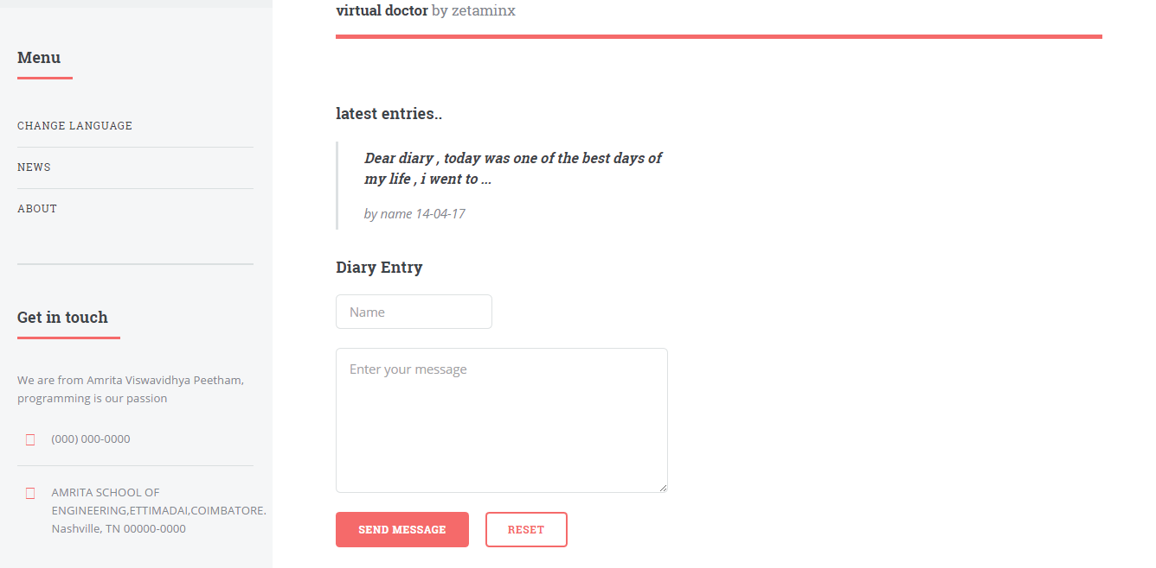

Slide 12
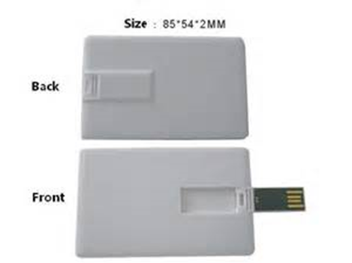
Future Scope:

Slide 13
Thank You

